Slide 1
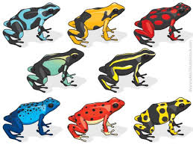
7Da Variation
Write the title, date and classwork and copy and match the key terms to the definitions below.
Where do you think there is greater variation: amongst members of a species or between different species?
Habitat
Species
Variation
A type of organism
The differences between organisms within a species
Where an organism lives

Slide 2
Learning outcomes
To know what a species is
To understand the term hybrid
To understand that variation can be continuous or discontinuous
To catagorise variation as continuous or discontinuous

Slide 3
Stick in your sheets and match the habitat to the picture Extension: Name an organism that is adapted to live in each habitat
A: Polar
B: Rainforest
C: Desert
D: Coral
E: Farmland
F: Wetland

Slide 4
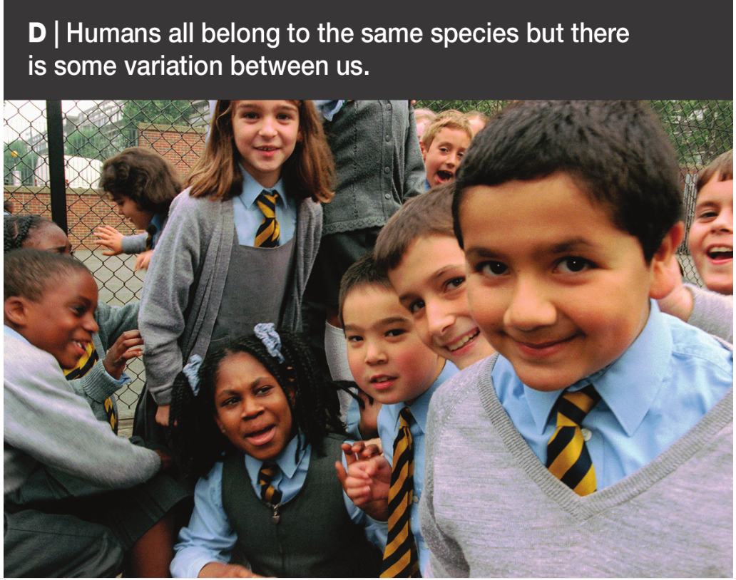
What causes variation?

Slide 5
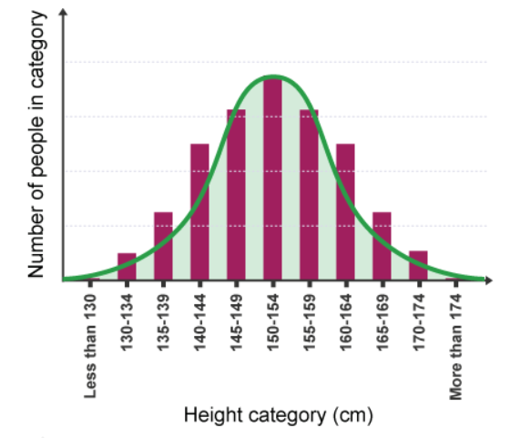
Continuous variation
For any species a characteristic that changes gradually over a range of values shows continuous variation. An example of such characteristics is height
If you record the heights of a group of people and draw a graph of your results, it usually looks something like this:

Slide 6
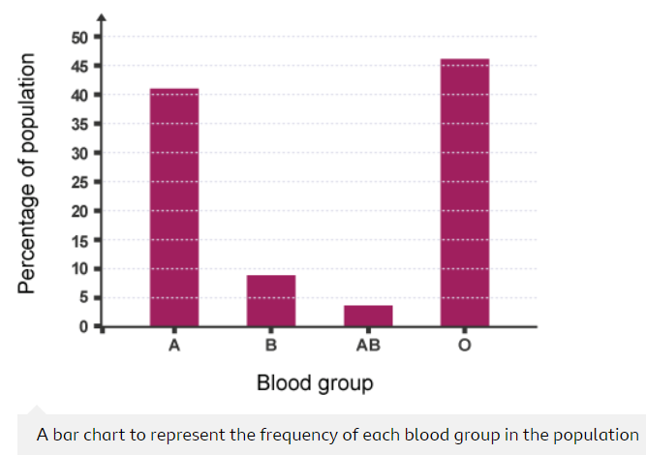
Discontinuous variation
A characteristic of any species with only a limited number of possible values shows discontinuous variation e.g. human blood group. Only four blood groups are possible (A, B, AB or O). There are no values in between.

Slide 7
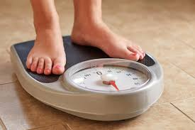
Copy and complete the wordfill beloe
Inherited
Variation can be caused by either ___________ or environmental factors.
A characteristic that change gradually over a range of values shows __________ variation.
A characteristic with only a __________ number of values shows discontinuous _________.
continuous
limited
variation
limited
Inherited
variation
continuous

Slide 8
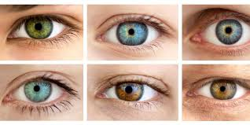
Write 2 headings: continuous variation and discontinuous variation then put the following characteristic into under the correct heading
C
Body mass index
Number of fingers
Shoe size
Handspan
Gender
Eye colour
Head circumference
Ability to roll tongue
D
D
C
D
D
C
D

Slide 9
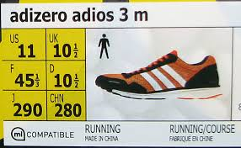

Slide 10
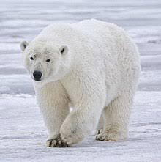
Copy the text below and on the following slides describe the variation that makes them easy to identify as a species
Every species adapts to its environment through variation
e.g. polar bears white fur helps it to remain camouflaged in the snow

Slide 11
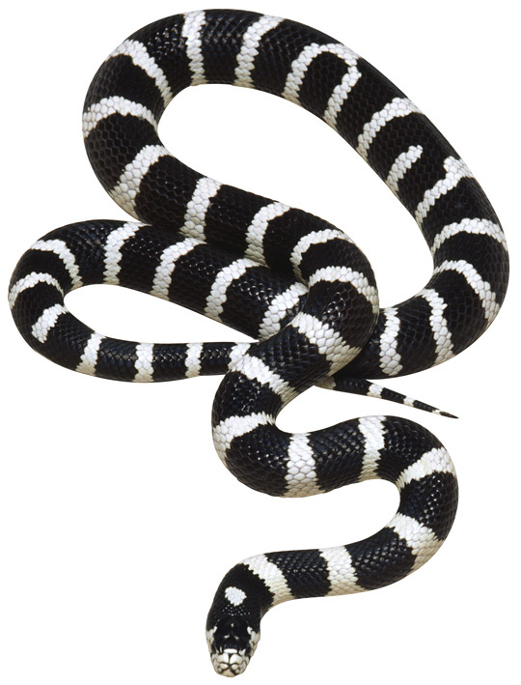
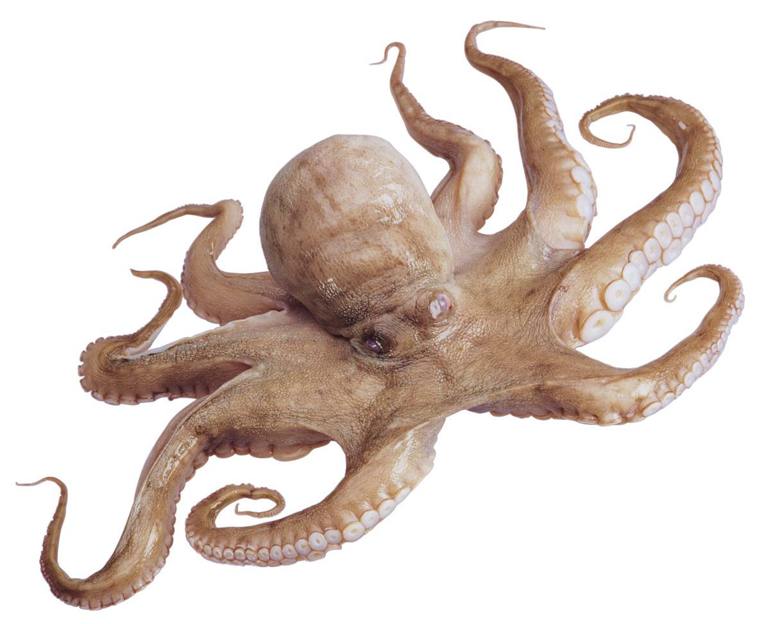
Variation:
Variation:
Black and white bands for camouflage.
Eight arms for movement and hunting.
© Pearson Education Ltd 2014. Copying permitted for purchasing institution only. This material is not copyright free.
Notes:
11

Slide 12
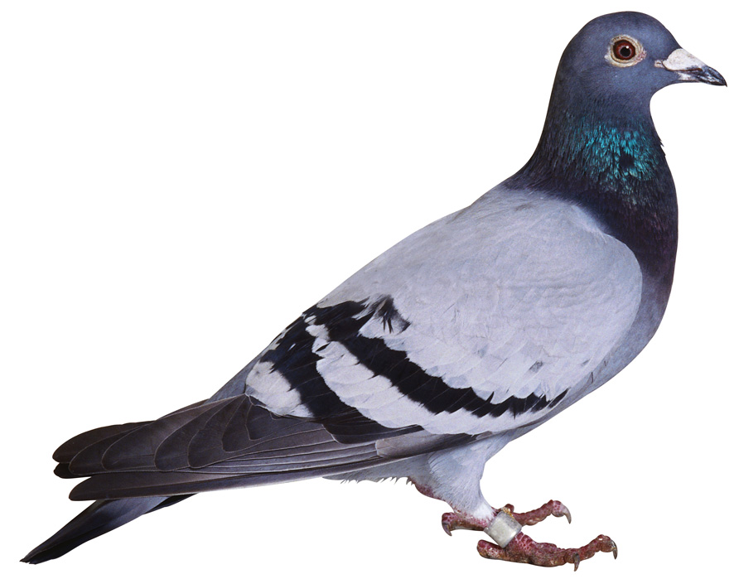
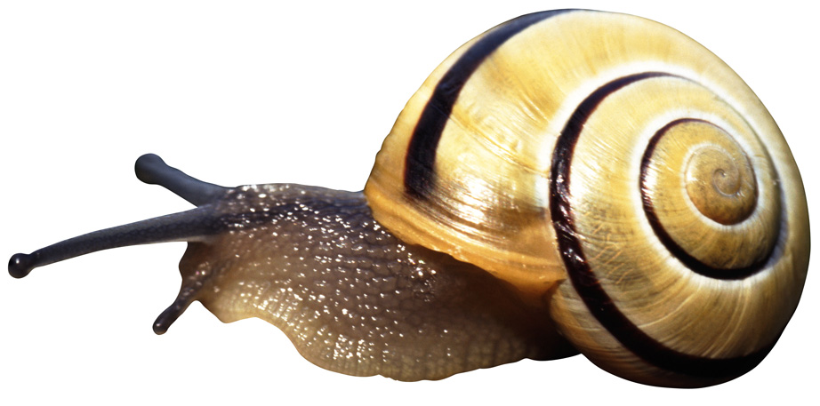
Variation:
Variation:
Shell for protection.
Feathers for flying, colouring for identification.
© Pearson Education Ltd 2014. Copying permitted for purchasing institution only. This material is not copyright free.
Notes:
12

Slide 13
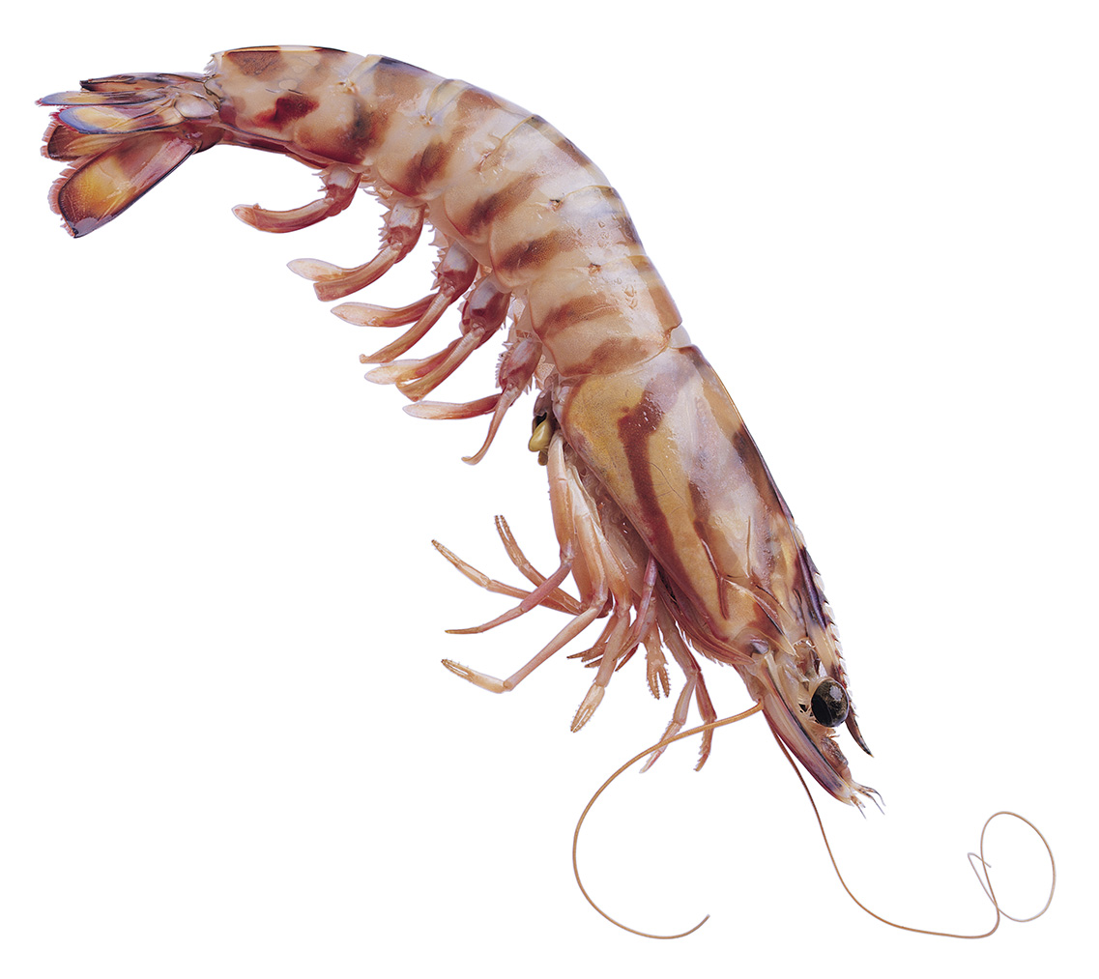
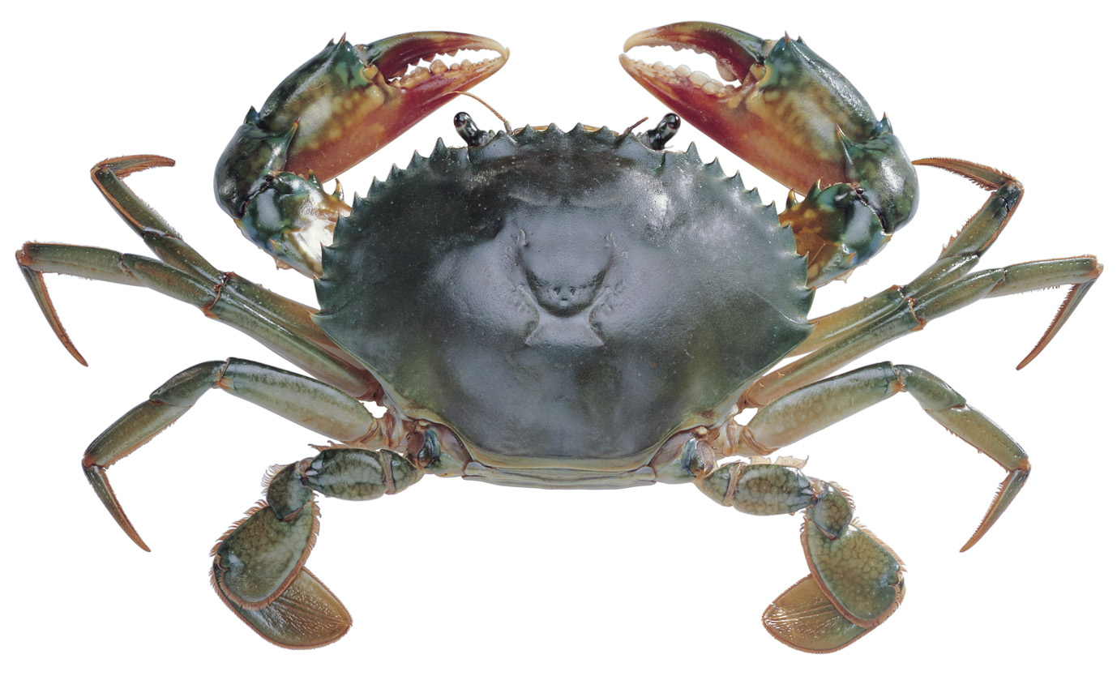
Variation:
Variation:
Claws for hunting and defence, shell for protection.
Legs for propulsion, shell for protection.
© Pearson Education Ltd 2014. Copying permitted for purchasing institution only. This material is not copyright free.
Notes:
13

Slide 14
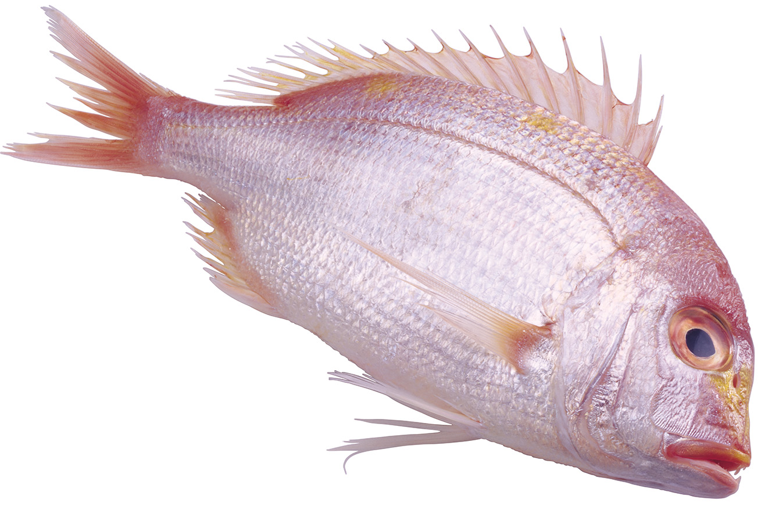
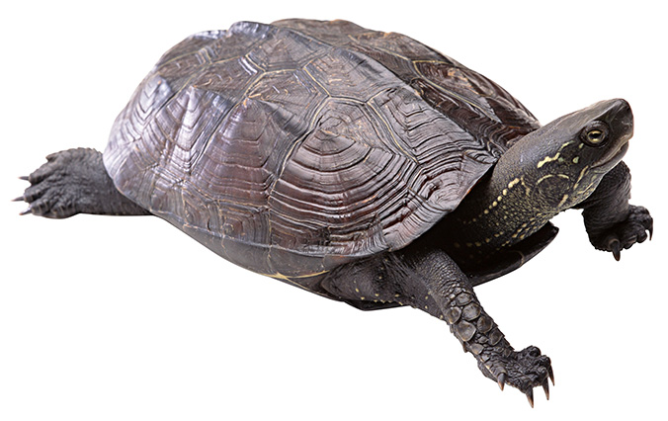
Variation:
Variation:
Gills for breathing, fins for propulsion.
Shell for protection.
© Pearson Education Ltd 2014. Copying permitted for purchasing institution only. This material is not copyright free.
Notes:
14

Slide 15
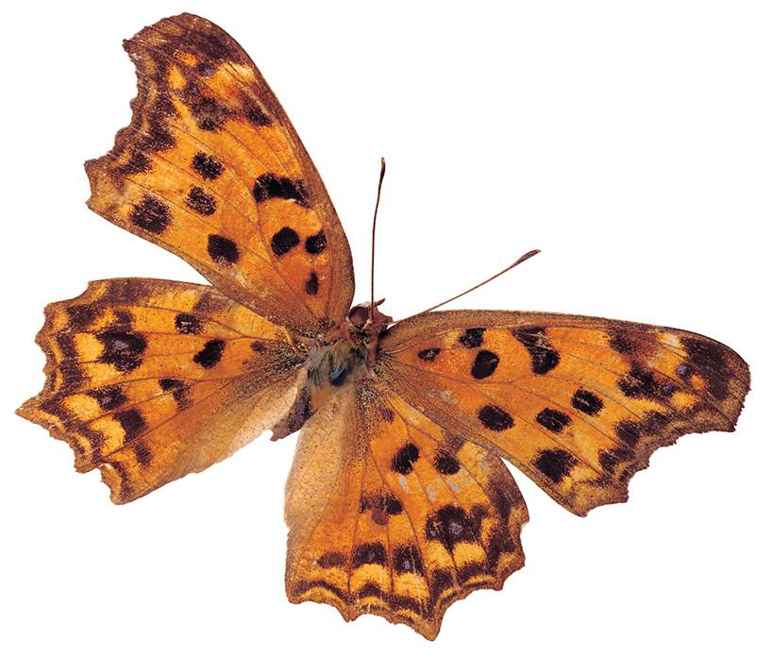
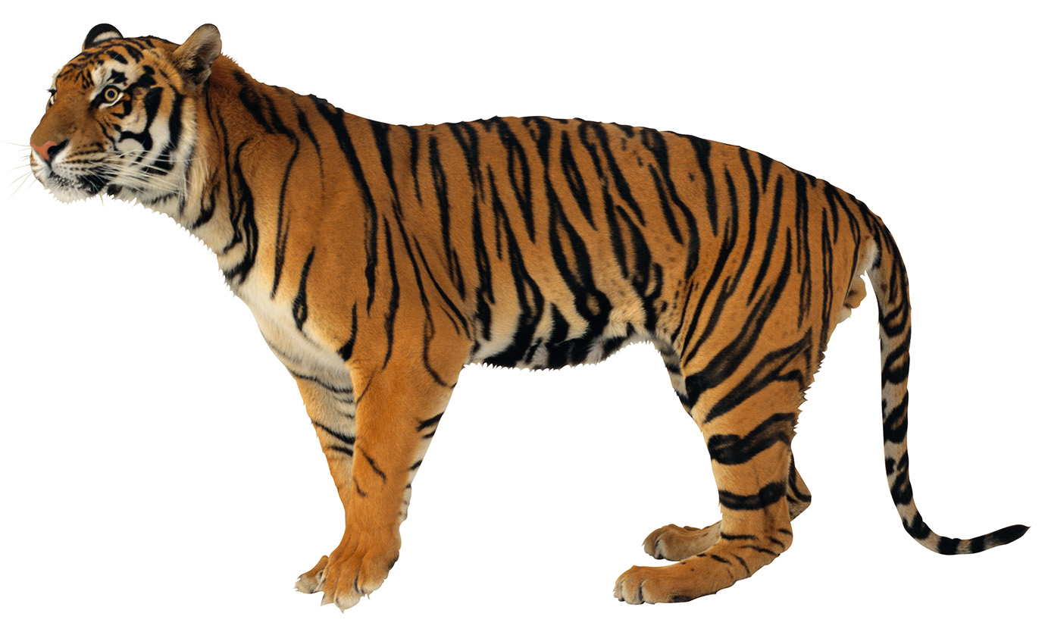
Can you think of another example that came up in your end of year exam?
Variation:
Variation:
Stripes for hunting camouflage.
Colouring for camouflage, identification and warning.
© Pearson Education Ltd 2014. Copying permitted for purchasing institution only. This material is not copyright free.
Notes:
15

Slide 16
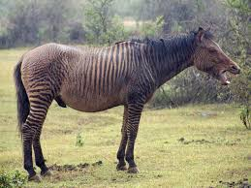
Copy the text below
A species is a group of organisms that can reproduce with on another to produce offspring that can also reproduce.
A Zebroid!
What is this animal? Is it a species?

Slide 17
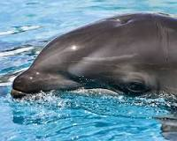
Watch the clip the answer the questions below in full sentences https://www.activeteachonline.com/product/view/id/295/page/56/mode/dps?modal=/player/video/id/286841
What is a hybrid?
Give an example of a hybrid
What is the difference between a species and a hybrid?
The offspring produced when two different species breed
Wholphin (killer whale and bottlenose dolphin)
A species can reproduce. A hybrid cannot

Slide 18
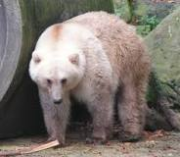
Copy the sentence below then decide for each of the following slides: what were the parents? Explain your reasoning.
Hybrid animals usually have some features from one parent and some from the other.

Slide 19
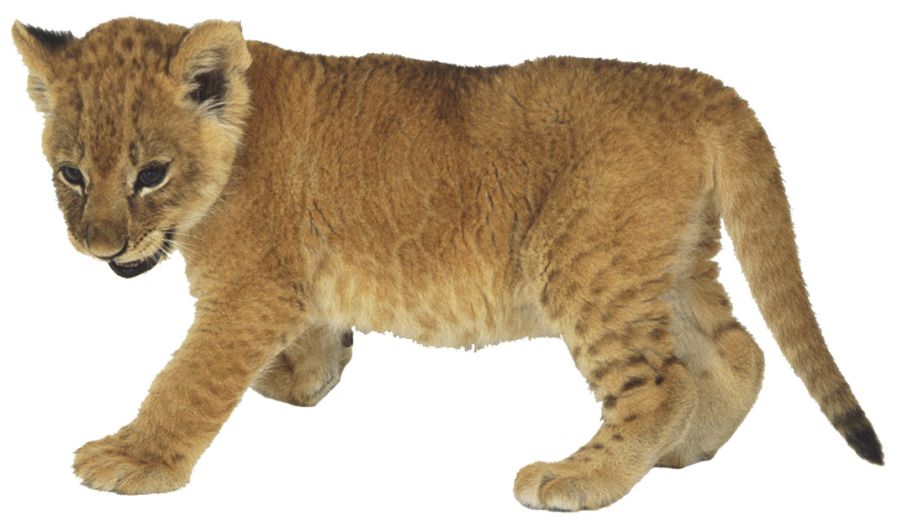
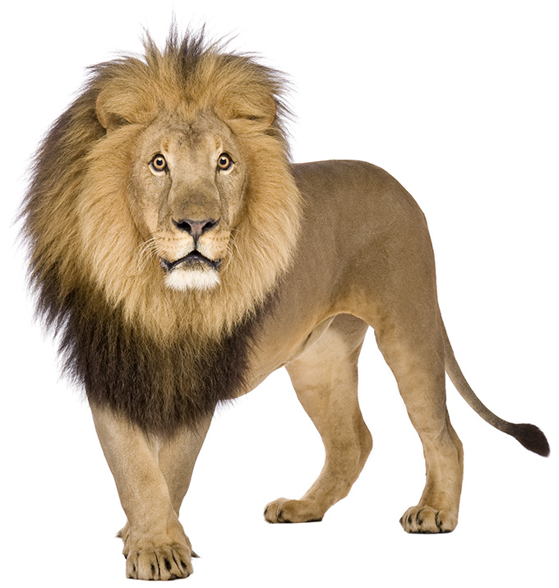
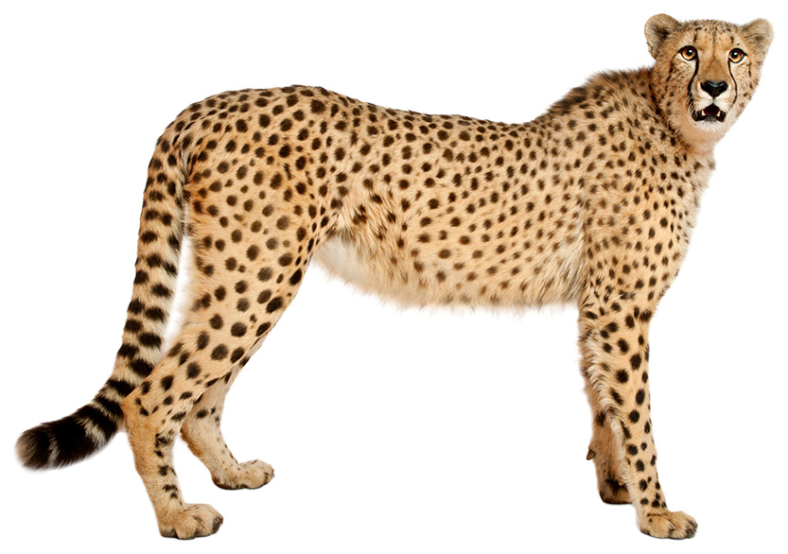
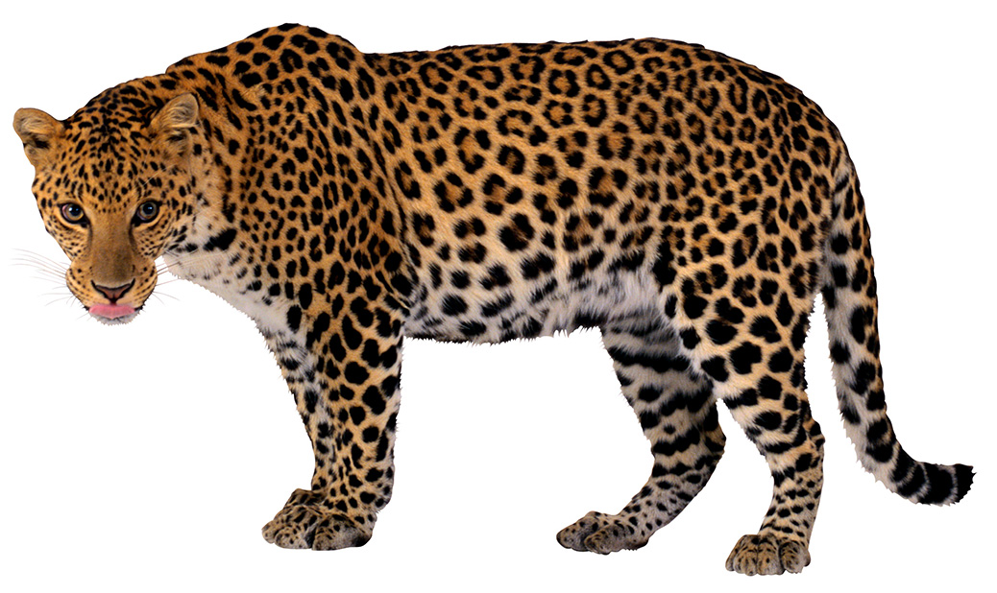
This cub is a hybrid.
Which of these species were the cub’s parents?
Explain your choices.
tiger
lion
cheetah
leopard
The cub’s parents were a lion and a leopard. The cub has a lion’s shape and pale leopard markings in its coat.

Slide 20
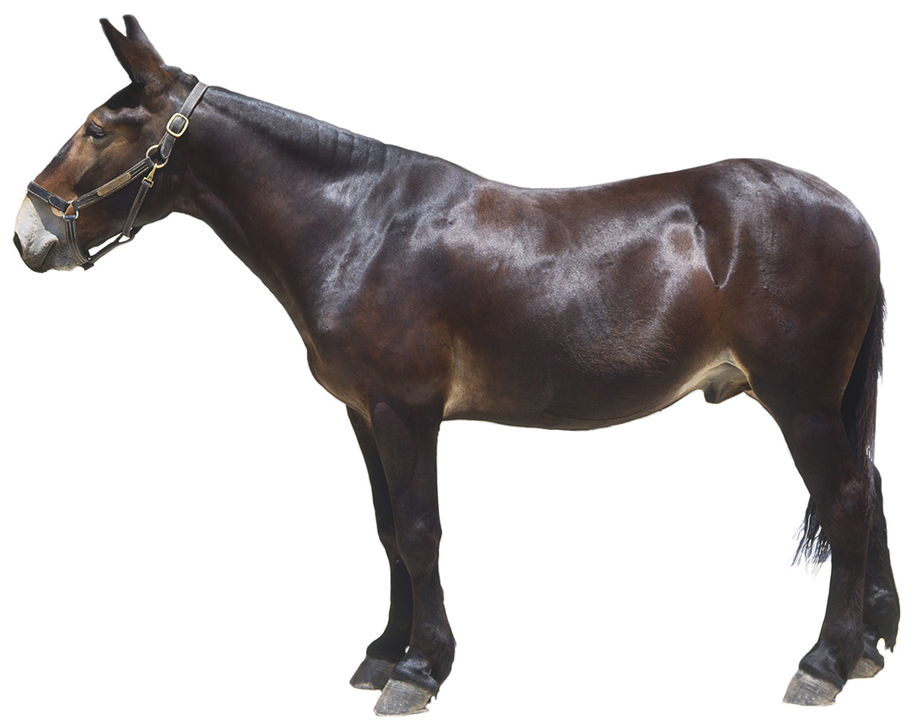
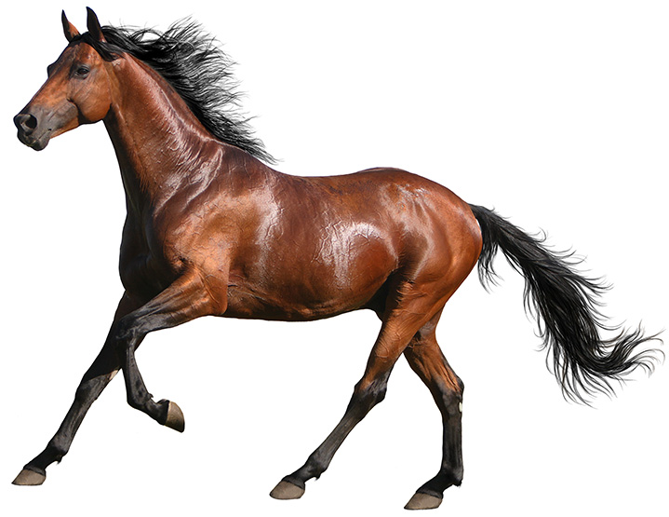
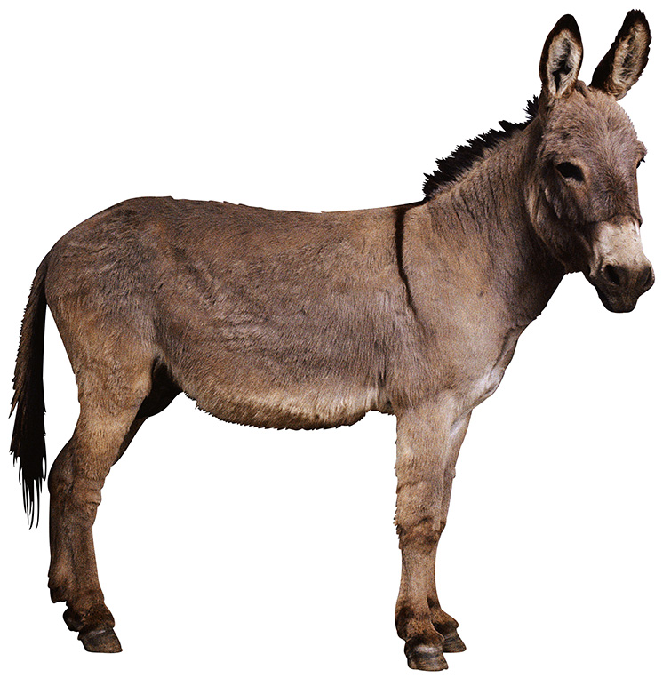
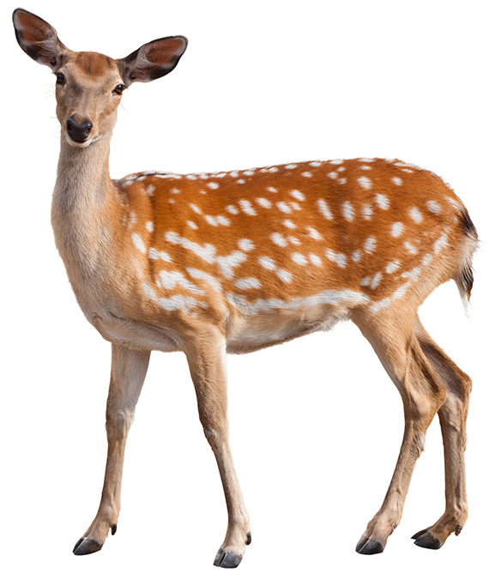
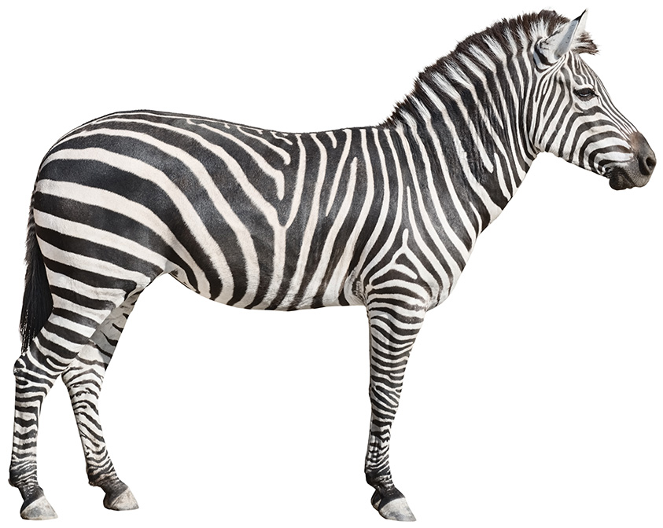
This mule is a hybrid.
Which of these species were the hybrid’s parents?
Explain your choices.
donkey
deer
zebra
horse
The parents of this mule were a horse and a donkey. The mule has the horse’s smooth shiny coat and donkey’s pale muzzle and long ears.
© Pearson Education Ltd 2014. Copying permitted for purchasing institution only. This material is not copyright free.
Notes:
20

Slide 21
Quick Quiz: Write the answers in the back of your books. You do not need to answer in full sentences
What is variation?
In which habitat would you expect to find meerkats?
How are African elephants adapted for their environment?
Is the length if someone's hair continuous or discontinuous variation?
What is the difference between a species and a hybrid?
The differences between individuals within a species
Desert
Large surface area of ears to facilitate heat loss
Continuous
Ability to produce offspring

