Slide 1
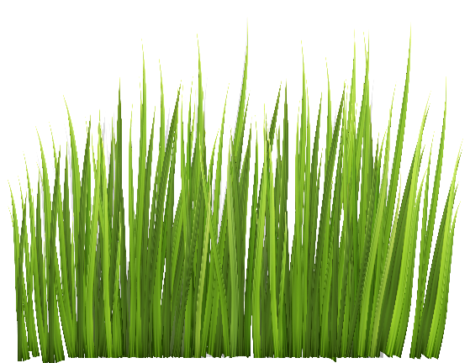
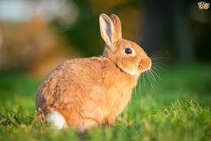
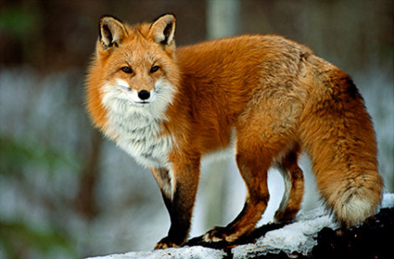
7De Transfers in food chains
Write the title, date and class work then copy this food chain and consider the following question: What do the arrows mean in food chains?
Organisms contain energy stored in substances that make up their body. The arrows in food chains and webs show how the energy passed from organism to organism

Slide 2
Learning objectives
Define feeding relationships in terms of energy flow.
Describe the sources and effects of some pesticides.
Explain the gains and losses of energy from living organisms.
Sketch pyramids of numbers.
Explain the effects of some persistent pesticides on ecosystems.
Interpret models of energy transfer (pyramids of numbers).
Compare models of energy transfer in food chains (pyramids of number, biomass)

Slide 3
Add in the energy values.
Where do you think the energy goes if it is not transferred?
1000 J of energy
100 J
10 J
Copy:
Energy stored in food is released by respiration to let animals move and keep warm
Energy can be stored in undigested foods which pass out of animals

Slide 4
Watch the clip then copy the text and draw a pyramid of numbers for the food chain in your book
https://www.activeteachonline.com/product/view/id/295/page/68/mode/dps?modal=/player/animation/id/312563
There are usually fewer organisms as you go up a food chain as energy is transferred out at each stage. This can be shown with a pyramid of numbers
Foxes
Rabbits
Grass

Slide 5
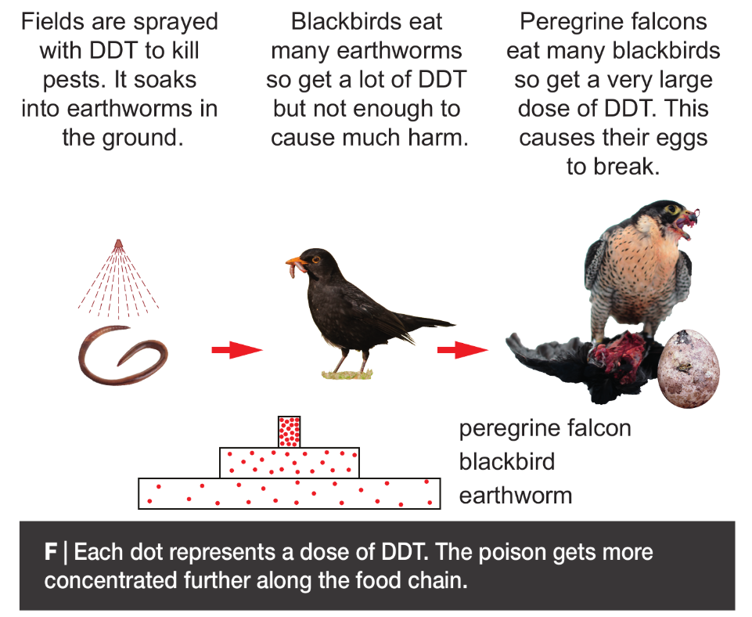
Watch the clip then copy and complete the wordfill below https://www.activeteachonline.com/product/view/id/295/page/68/mode/dps?modal=/player/video/id/286845
Poisons
Pesticides are __________ that kill pests (organisms that problems) However, these poisons can kills other ______________ as well.
Some poisons kill organisms they ate not intended for because they are not broken down in nature (they are persistent). They are passed along _______ __________.
organisms
DTT was banned in 1984
food
chains
Food chains
Poisons
Organisms
Stick in your image

Slide 6
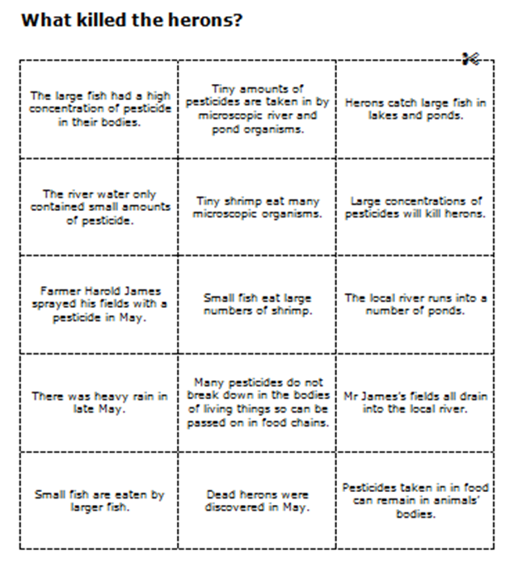
Cut and stick the statements in order to find out what killed the herons
The issue begins with the famer spraying pesticide

Slide 7
Assess and correct your work
Farmer Harold James sprayed his field with a pesticide in May
There was heavy rain in late May
Mr James’ fields all drain into the local river
The river water only contained small amounts of pesticides
The local river runs into a number of ponds
Tiny amounts of pesticides are taken in by microscopic river and pond organisms
Many pesticides do not break down in the bodies of living things so can be passed on in food chains
Tiny shrimp eat many microscopic
organisms
9. Tiny shrimp eat many microscopic
organisms
10. Small fish eat large numbers of
shrimp
11. Small fish are eaten by larger fish
12. Pesticides taken in in food can
remain in animals bodies
13. The large fish had high
concentrations of pesticides in their
bodies
14. Herons catch large fish in lakes and
ponds
15 Large concentrations of pesticides will
kill herons
16. Dead herons were discovered in May

Slide 8
Write the numbers 1-10 in the back of your books and answer the quick quiz questions. You do not need to use full sentences
What is the name given to an animal that eats other animals?
What do the arrows represent on a food chain?
What are pesticides?
What happens to the energy transferred as you go up a food chain?
What do you call the way organisms depend on one another to survive?
Name one resource plants compete for
What happens to the population of prey if the population of predators increases?
Name one type of variation that could be caused by the environment and not genetics
State one way animals are adapted to cold weather
What is a producer?

Slide 9
Assess your work and give yourself a mark out of ten
A carnivore
The direction of energy transfer
Poisons that kill problematic organisms
It decreases
Interdependence
Light/ space/ water/ minerals
It decreases
Growth, yield, intelligence, weight……..
Thicker fur, migration, hibernation…….
An organism that makes its own food

