Slide 1
Year 7 Module one Revision
Quelle est la date aujourd’hui?

Slide 2
Objectives
I MUST be able to recognise vocabulary and structures from the first unit
I SHOULD be able to recognise and produce vocabulary and structures from the first unit
I COULD be able to recognise and produce vocabulary and structures from the first unit and add extra details

Slide 3
AVOIR to have
1. I have
2. You have
3. He/she has (we have)
4. We have
5. You have
6. They have
1. J’ai
2. Tu as
3. Il/elle/on a
(On a)
4. Nous avons
5. Vous avez
6. Ils/elles ont

Slide 4
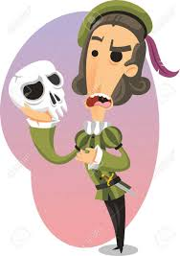
Etre- To be
I am
You are
He is / She is / (we are)
We are
You are
They are
Je suis
Tu es
Il est/ elle est (on est)
Nous sommes
Vous êtes
Ils sont / elles sont

Slide 5
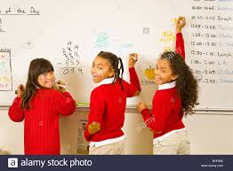
DEFI!
2 teams, choose 1 person from each team to conjugate the verb AVOIR or ETRE as quickly as possible on the whiteboard- head to head!

Slide 6
ai
suis
you
are
has
est

Slide 7
P.24 exercise 1

Slide 20
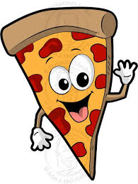
Just a minute
I like
I don’t like
Sport
Football
Cycling
School
Fish
Dance
Music
Pizza
Snakes
Ice creams
Video games
Holidays
Comics
spiders
1. J’aime
2. Je n’aime pas
3. le sport
4. le foot
5. le vélo
6. le collège
7. le poisoon
8. la danse
9. la musique
10. les pizzas
11. les serpents
12. les glaces
13. les jeux vidéo
14. les vacances
15. les BD
16. les araignées

