Slide 1
The Firefly Virtual Roadshow 2022
Day 1
Taking the Digital Leaders program to the next level
Jon Barker
Head of Digital Learning
Highams Park School
@HPdigitalLearn #DigitalLeaders #FireflyRoadshow2022

Slide 2
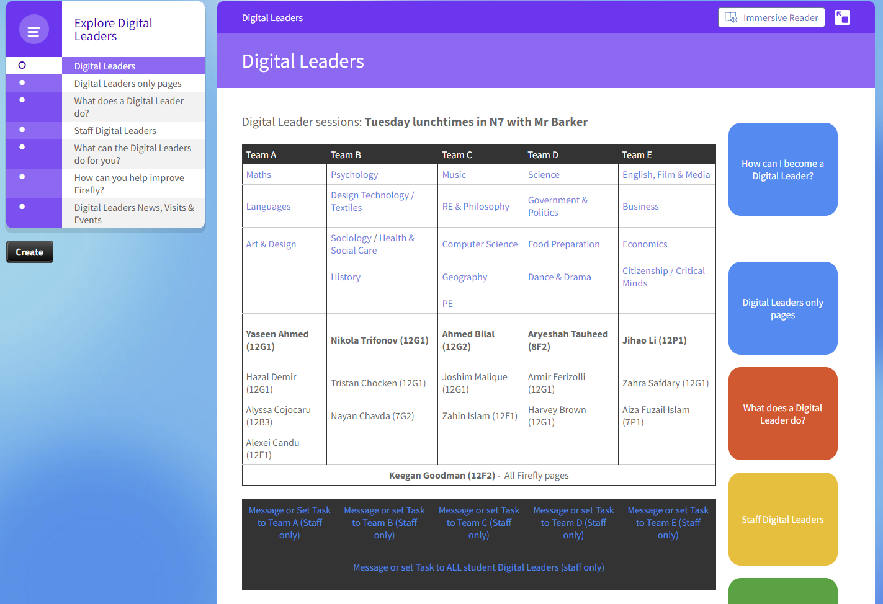
Why so many Year 12s?

Slide 3
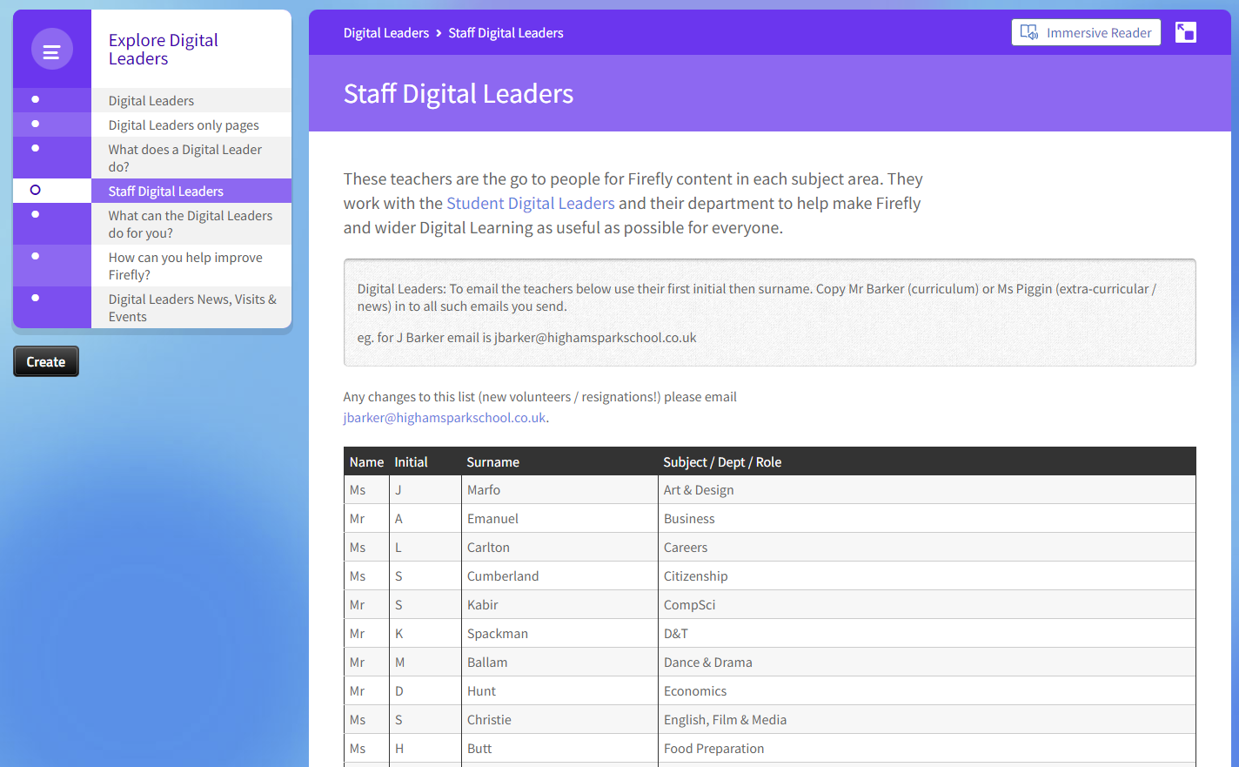

Slide 4
20 hits per user per school day
Post remote learning wave.
How do we capitalise on this?
Is this good?!
Lockdown stats meaningless!
@HPdigitalLearn #DigitalLeaders #FireflyRoadshow2022

Slide 5
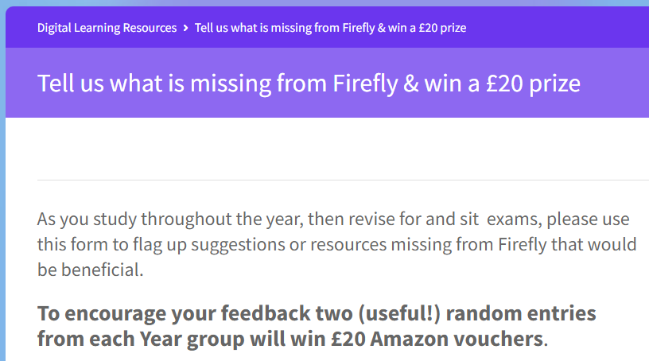
2x £20 staff prizes & 5x £10 DL prizes termly
2x £20 student prizes per year group annually

Slide 6
Spend your time adding content to …
Pages
NOT
TASKS

Slide 7
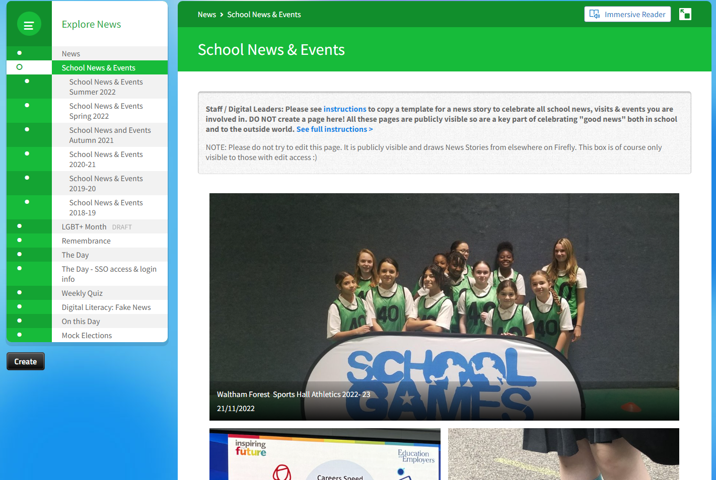

Slide 9
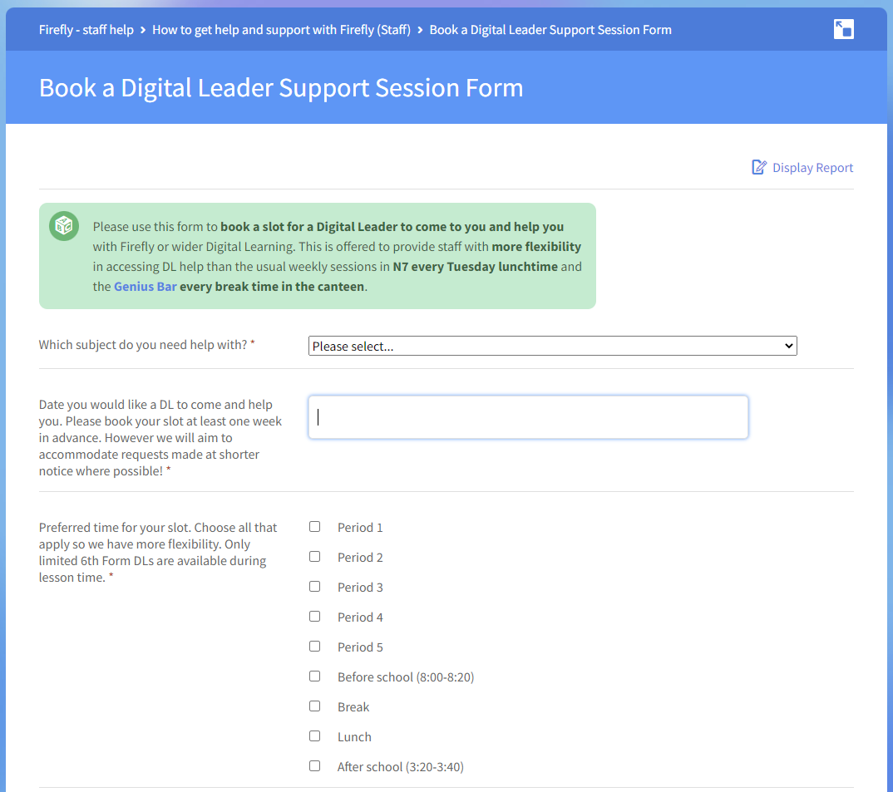
@HPdigitalLearn #DigitalLeaders #FireflyRoadshow2022

Slide 10
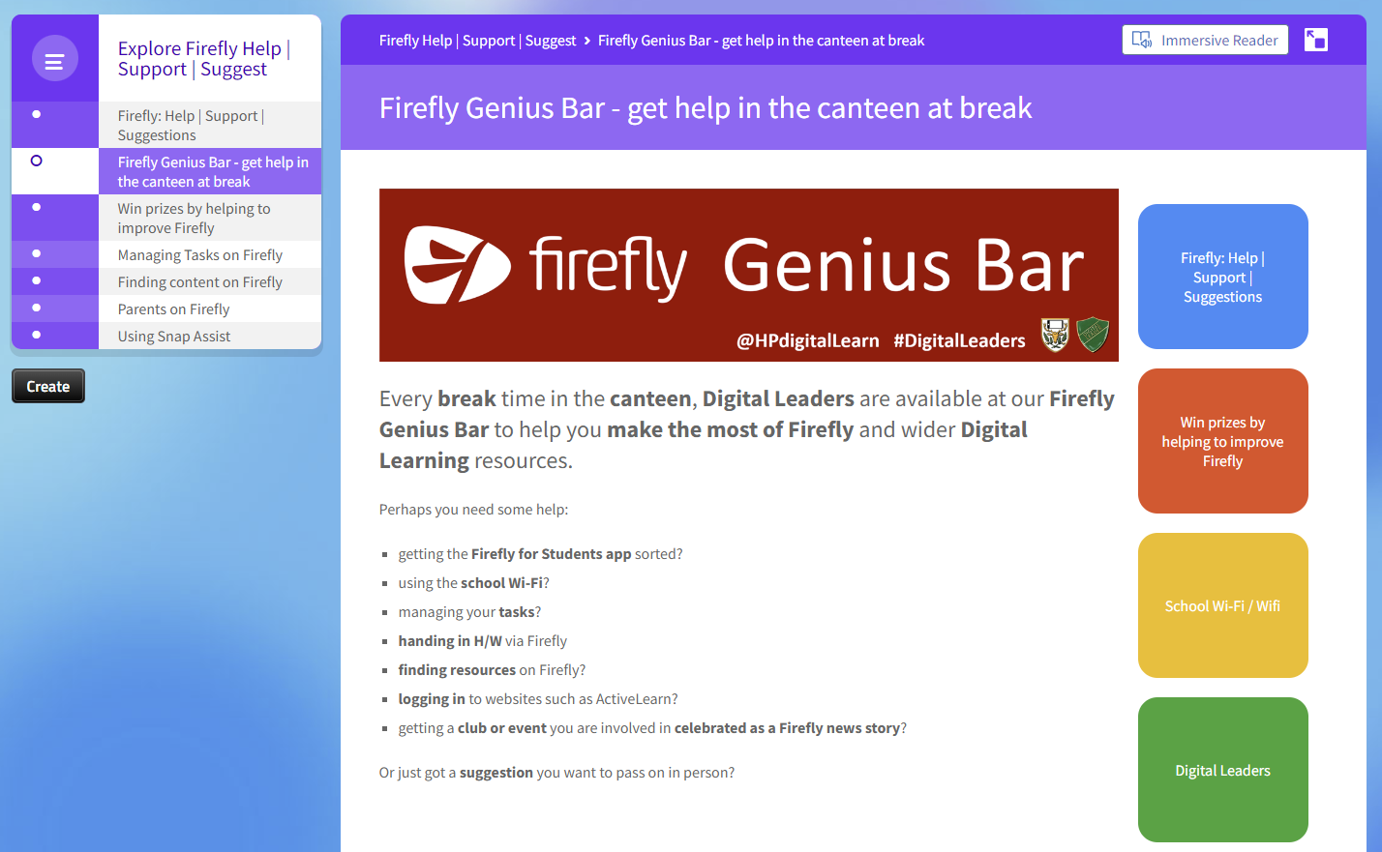

Slide 11
Ask me for help with
As a Digital Leader please allow this student and any student they are helping to have their phone out in a Genius Bar area to help staff and students use Firefly and other Digital Learning resources.
Any questions, or to report abuse of this privilege please send an email to Mr Barker (jbarker@highamsparkschool.co.uk).
& Digital Learning
@HPdigitalLearn #DigitalLeaders
wifi.highamsparkschool.co.uk
Notes:
Student DLs – only in canteen

Slide 12
Ask me for help with
& Digital Learning
wifi.highamsparkschool.co.uk
@HPdigitalLearn #DigitalLeaders
Notes:
Staff DLs

Slide 13
What do the Digital Leaders themselves think?
What do you enjoy about being a Digital Leader?
What are some examples of work you have done recently?
What do we need to do better?
@HPdigitalLearn #DigitalLeaders #FireflyRoadshow2022

Slide 14
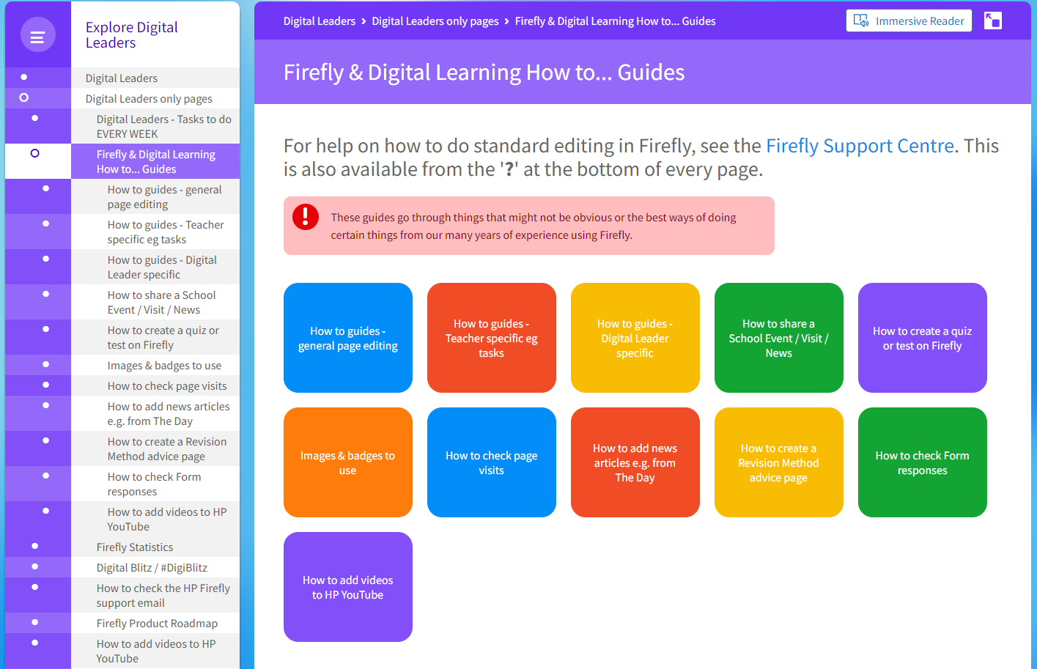

Slide 15
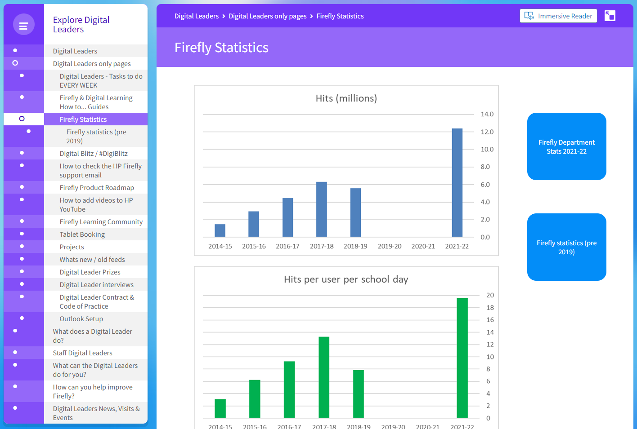

Slide 16
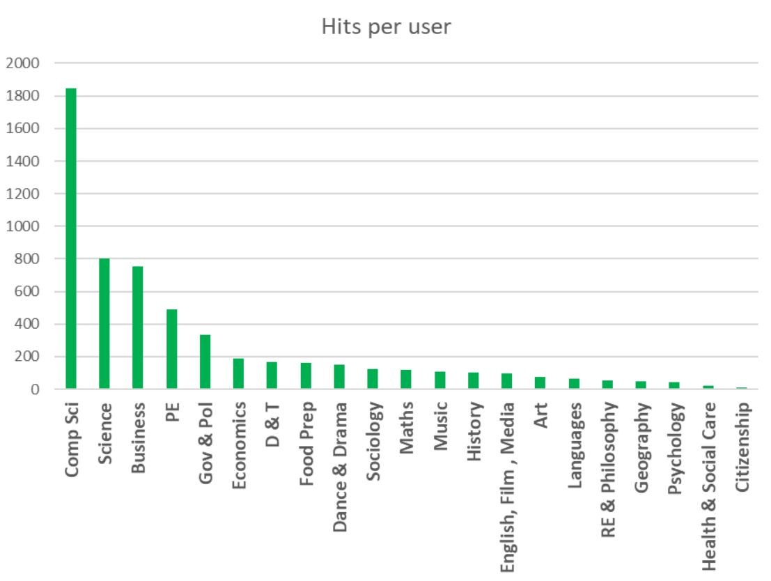
Department stats used to target extra support from Digital Leaders eg #DigiBlitz

Slide 17
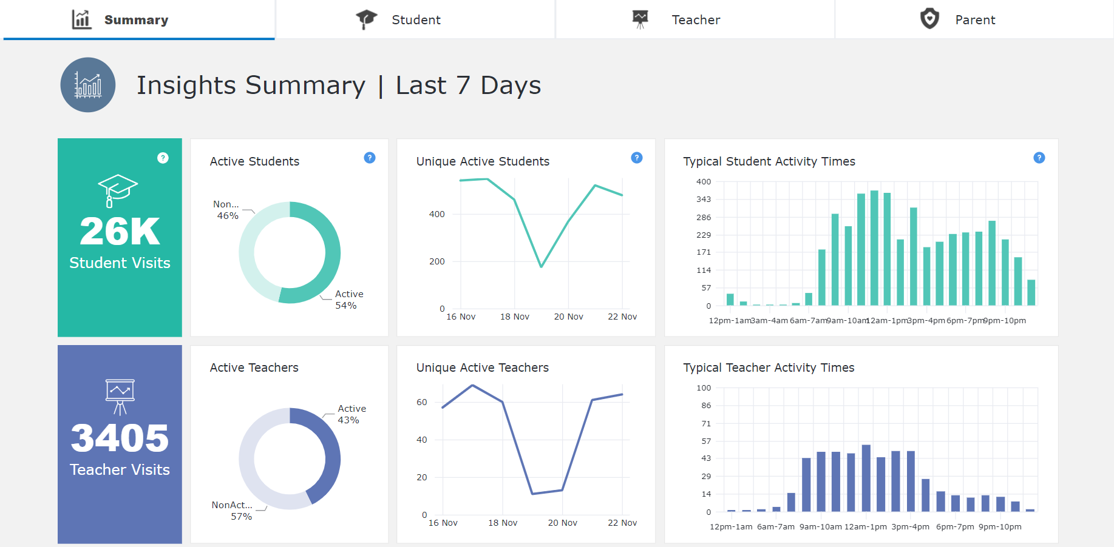

Slide 18
if you would like me to send you an export of our Digital Leaders Firefly pages. You can then import them to your site and edit as appropriate.
Email jbarker@highamsparkschool.co.uk
Anyone ever exported or imported Firefly pages?
Anyone want to save the world?!
@HPdigitalLearn #DigitalLeaders #FireflyRoadshow2022

Slide 19
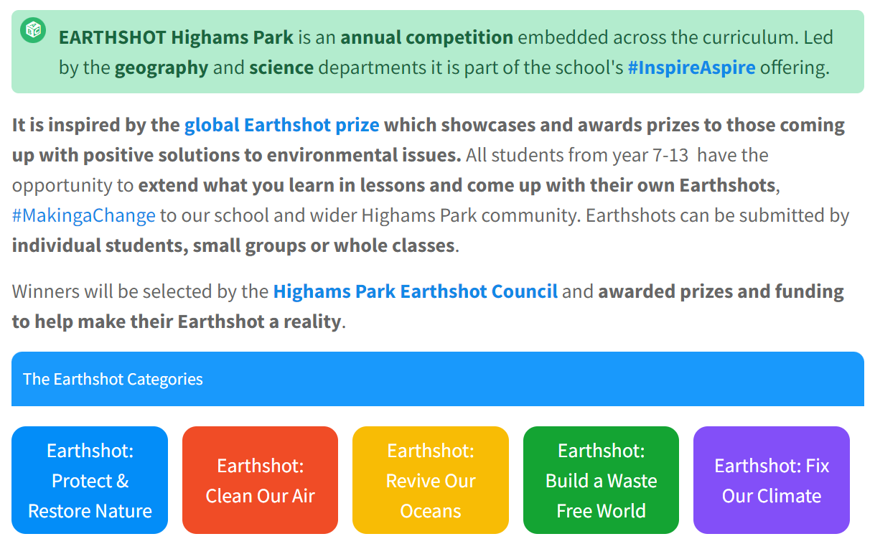
Again email jbarker@ highamsparkschool.co.uk if you would like an export of these pages to import to your site.

Slide 20
The Firefly Virtual Roadshow 2022
Any questions?
Day 1
Taking the Digital Leaders program to the next level
Jon Barker
Head of Digital Learning
Highams Park School
@HPdigitalLearn #DigitalLeaders #FireflyRoadshow2022

