Slide 1
The Portuguese language
This Photo by Unknown Author is licensed under CC BY-SA

Slide 2
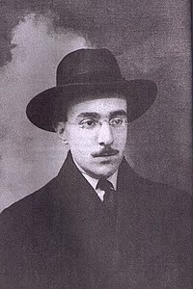
A poem by Fernando Pessoa
“Ó mar salgado, quanto do teu sal São lágrimas de Portugal! Por te cruzarmos, quantas mães choraram, Quantos filhos em vão rezaram! Quantas noivas ficaram por casar Para que fosses nosso, ó mar!
Valeu a pena? Tudo vale a pena Se a alma não é pequena. Quem quer passar além do Bojador Tem que passar além da dor. Deus ao mar o perigo e o abismo deu, Mas nele é que espelhou o céu.”
“Oh salty sea, how much of your salt
Are Portugal's tears!
For crossing you, how many mothers have wept
How many sons have prayed in vain!
How many brides remained unmarried
For you to be ours, oh sea!
Was it worth it? Everything is worthwhile
If the soul is not small.
Who wants to go beyond the Bojador
Must pass beyond the pain.
God gave the sea the danger and the abyss,
But it was in Him that He mirrored heaven.”
This Photo by Unknown Author is licensed under CC BY-SA

Slide 3
I chose the Portuguese language because the language runs in my family.
Portuguese was my first language, although I do not speak that much anymore but I can understand a lot.
My parents speak Portuguese at home.
It is important to speak other languages because, I can understand what they say all the time and for my own knowledge also for my professional future to find different type of jobs
BY Brian 7P1

