Slide 1
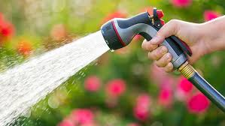
31/10/18 Models for circuits 7Jb c.w

Slide 2
Draw the table with symbols in your book then unjumble the right column to show what each symbol represents
Symbol
What is represents
SymbolS
 | Battery
 | Switch
 | Cell
 | Bulb
 | Ammeter

Slide 3
C.W Learning objectives 31.10.11
Identify common circuit components and their symbols.
Model circuits using simple circuit diagrams
Use a model to describe how an electrical circuit works
Evaluate a physical model for electric circuits on how well it explains data or observations.

Slide 4
Models
The next set of slides show different types of models.
For each slide give suggestions for the following:
What type of model is shown?
What role does each type of model have?

Slide 5
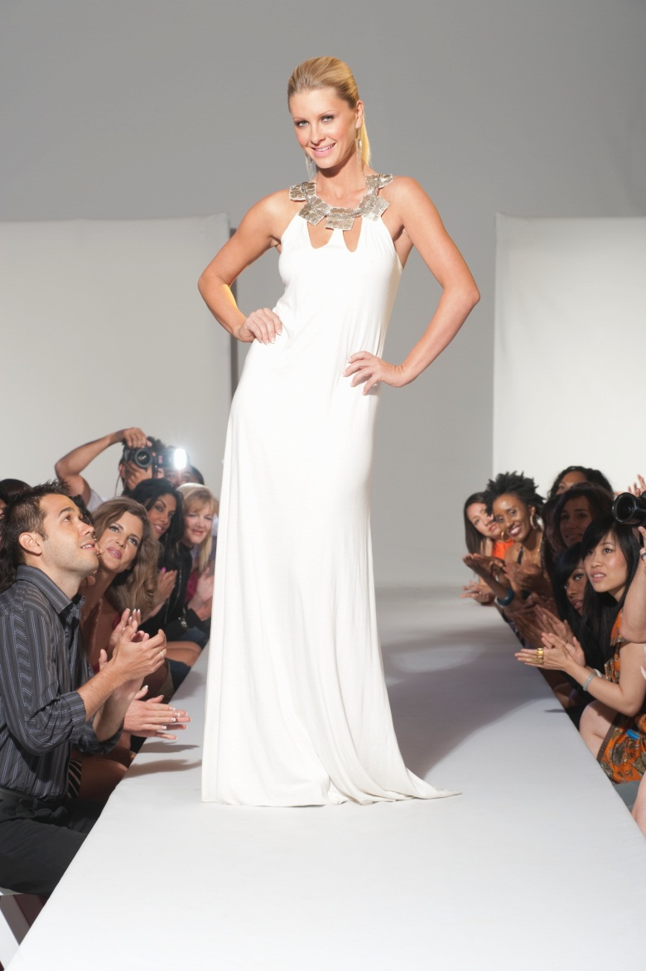
Type:
Purpose:
This person is a fashion
model.
To show how clothes look when they are being worn by a person.

Slide 6
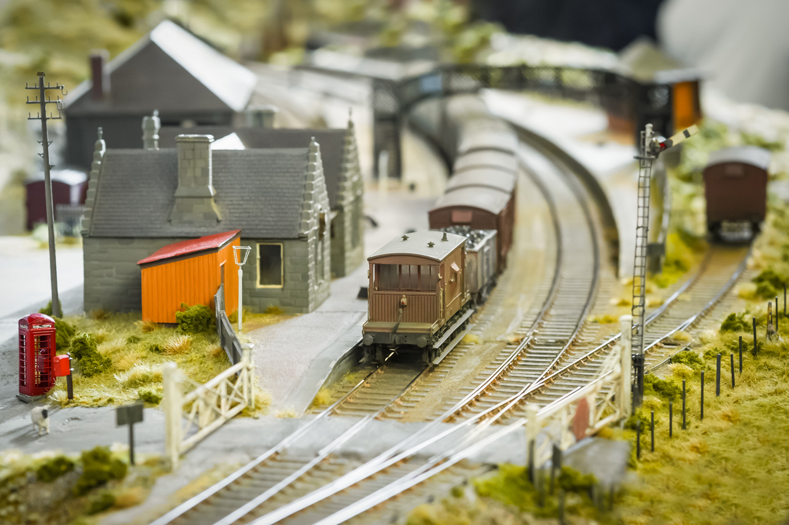
Type:
Purpose:
This is a model railway.
It is a toy to be played with, but it also simplifies how railways work.

Slide 7
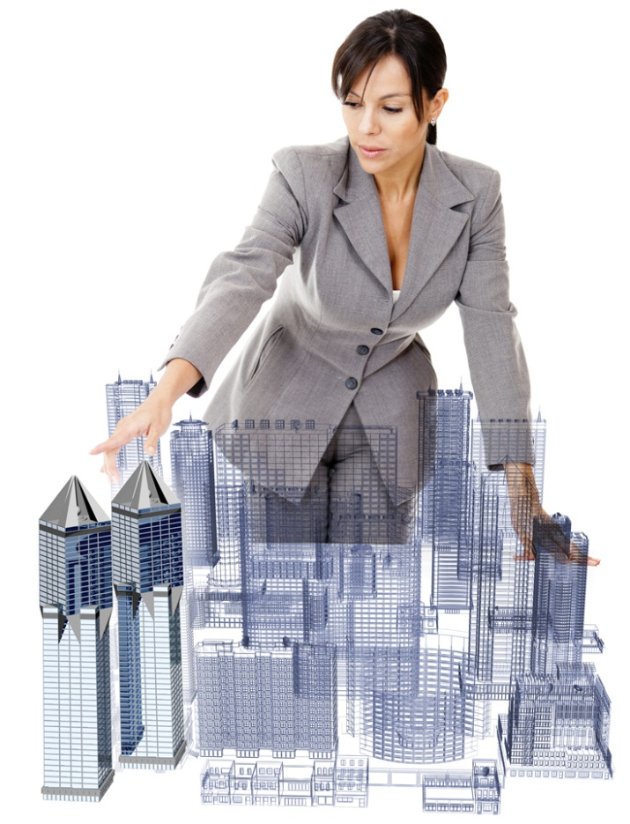
Type:
Purpose:
This is a scale model, or prototype.
To check a design and test performance before making it on a full scale.

Slide 8
Models in science
We also use models in a science lab to explain real life situations or represent something that is complicated
. For each model, answer the following questions:
Why would a teacher use the model during a lesson?
What advantage does the model offer?

Slide 9
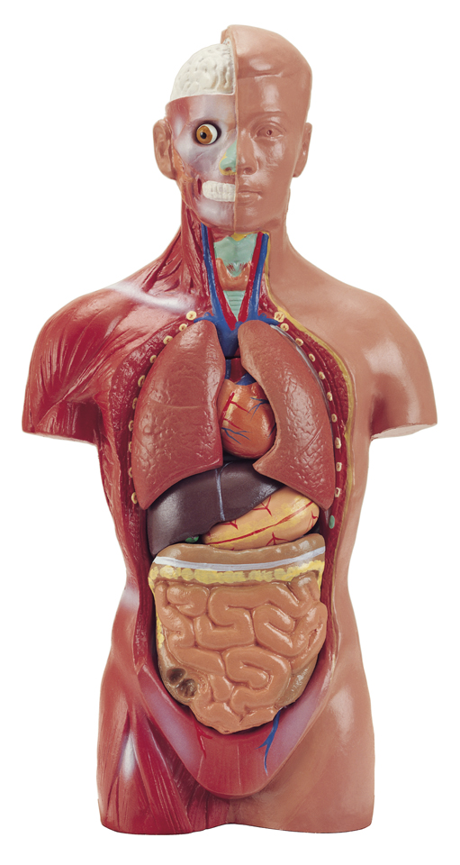
Purpose:
Advantage:
To explain the internal organs in a human body.
Don’t need to dissect a real human body!

Slide 10
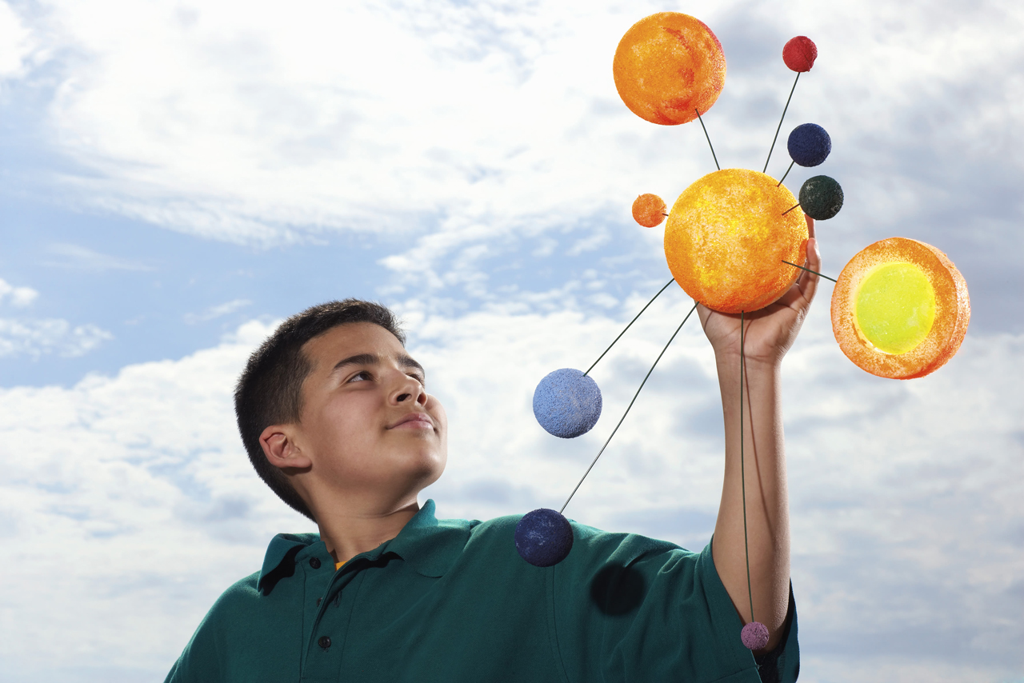
Purpose:
Advantage:
To demonstrate the solar system.
The solar system is too large and most of it is too far away to see in real life.

Slide 11
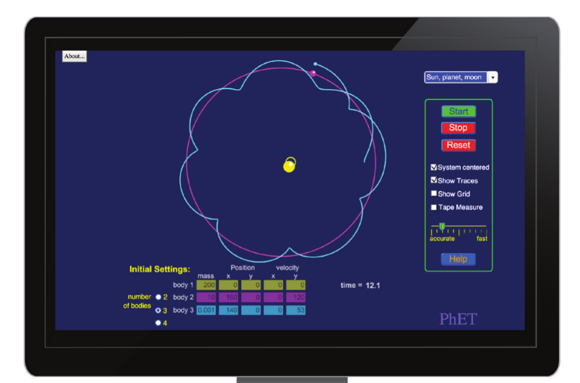
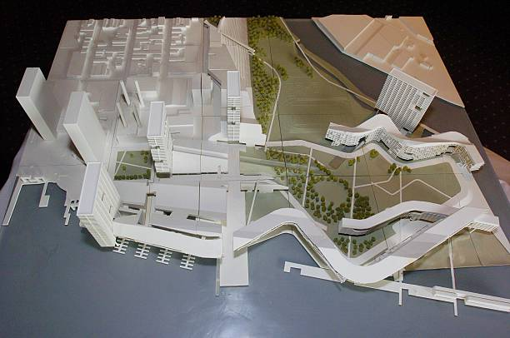
Q What do you think is meant by ‘physical’ and ‘abstract’ models? Q Can you think or an example of each?
A physical model is one that you can build or touch
An abstract model is one that you can cannot touch or build but is a representation of reality

Slide 12
The counter model
Get into allocated groups of 6.
Person A stands with a container and hands out a coin to each person that passes.
Person B, C, D and E move in a circle, collect a coin; hand it to person F and return by way of the circle to person A to collect another.
Repeat until each person has collected and handed over 3 coins.
What do the coins represent?
What does the person handing out counters represent (A)?
What do the people moving in a circle represent (B,C,D and E)?
What does the person collecting the coins represent (F)?

Slide 13
Stick the work sheet into your books, read the text and answer the questions.

Slide 14
On your worksheet, tick the ideas/ statements that you think are correct

