Slide 1
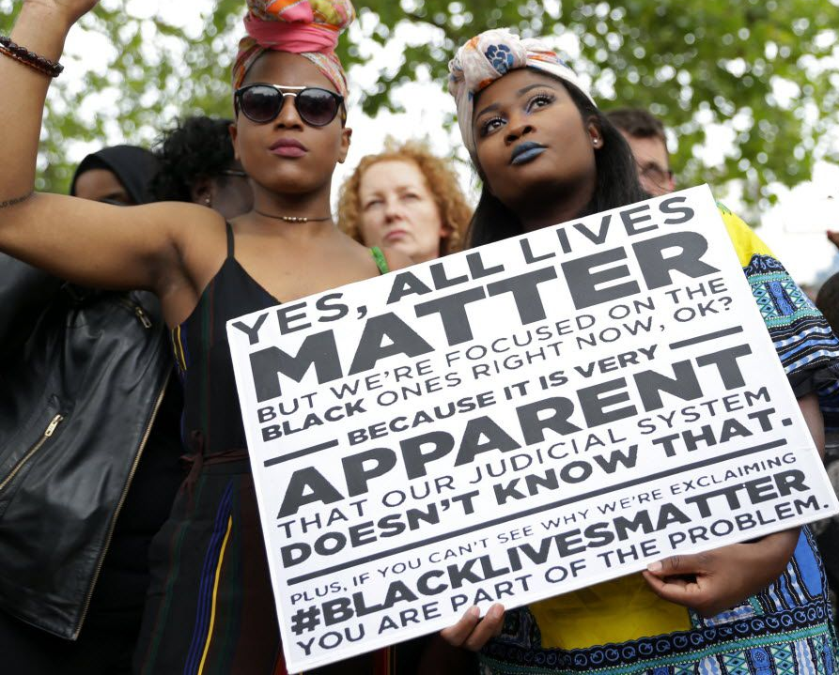
Institutional racism within the Government : The Windrush Scandal

Slide 2
Stephen Lawrence
Stephen Lawrence, aged 18 on 22 April 1993, was brutally murdered in a South East London street by a racist gang. Six years later, a report by Sir William Macpherson into Stephen’s murder and the subsequent police investigation, concluded that there was widespread ‘institutional racism’ within the Metropolitan police which resulted in a flawed police investigation. As a result, Stephen’s family were denied justice.
Importantly, the Macpherson Inquiry into Stephen’s murder acknowledged that ‘institutional racism’ existed in this country.

Slide 3
In 1999 the Macpherson report on the police response to the murder of Stephen Lawrence defined institutional racism as:
“...the collective failure of an organisation to provide an appropriate and professional service to people because of their colour, culture or ethnic origin. It can be seen or detected in processes, attitudes and behaviour which amount to discrimination through unwitting prejudice, ignorance thoughtlessness and racist stereotyping which disadvantage minority ethnic people.”
This was a watershed moment: it was the first time in the UK that institutional racism was acknowledged and defined.

Slide 4
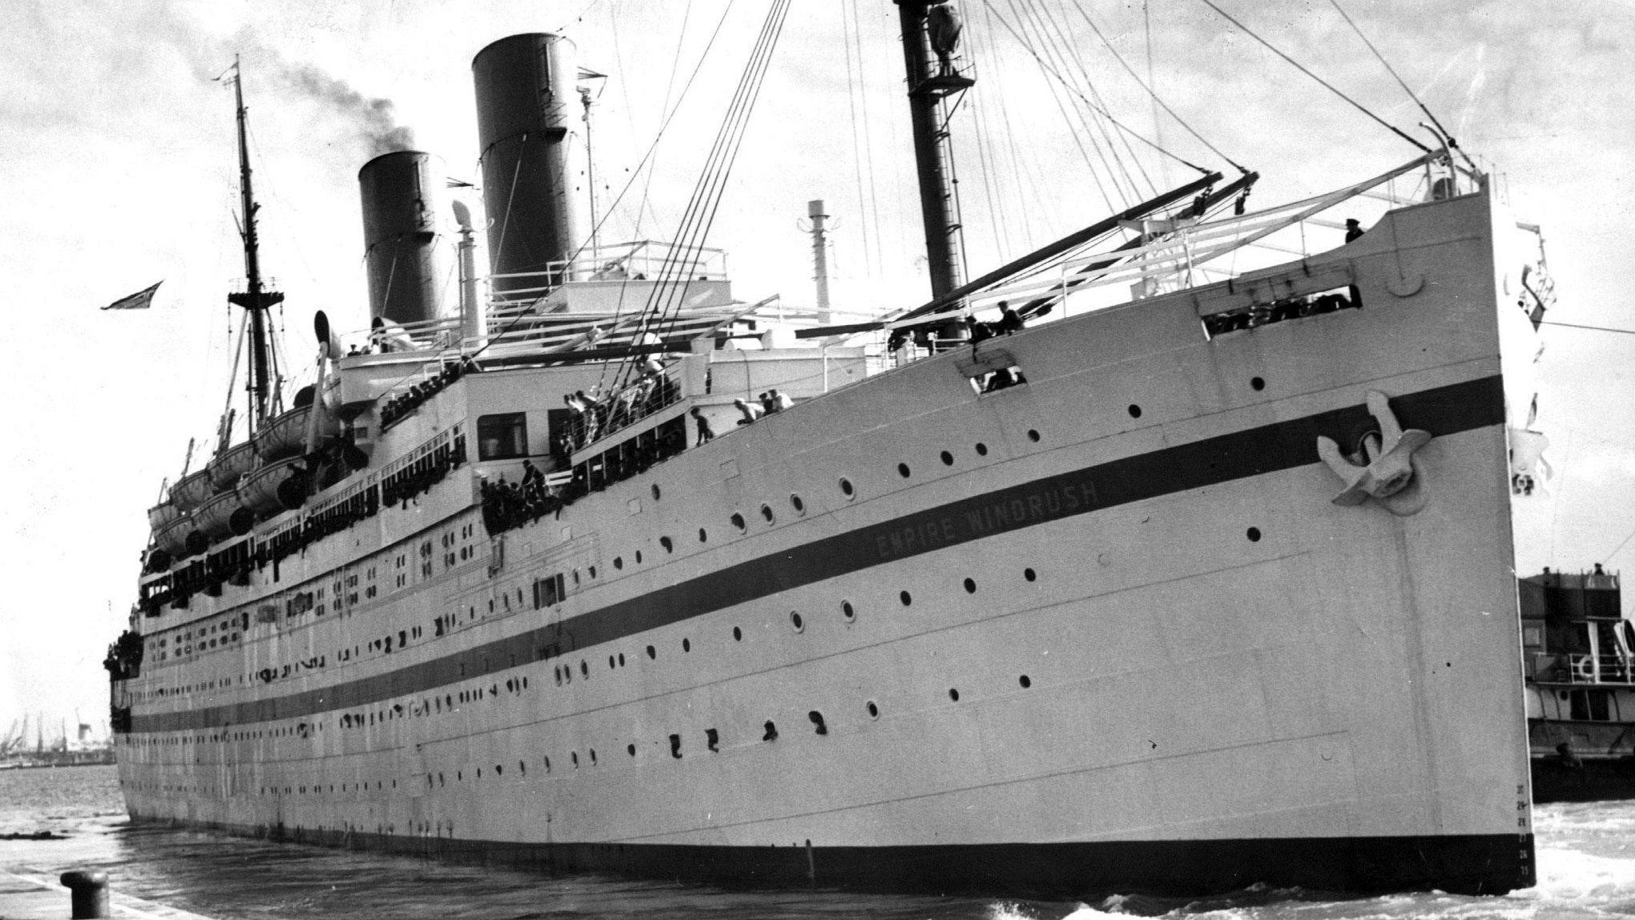
The Windrush Scandal

Slide 5
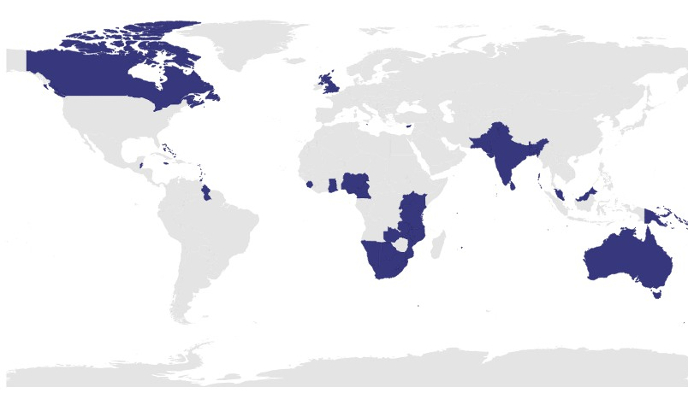
What was the Windrush
1945
World War 2 ended, it was noted by politicians that many commonwealth countries had fought for Britain and lost their lives.
1948
Politicians passed the British Nationality Act (due to Britain needing new workers due to many dying in the war). This gave over 800 million people in the commonwealth the right to claim British citizenship.

Slide 6
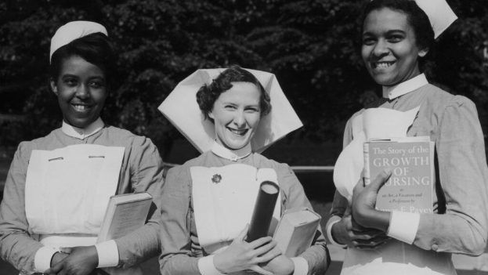
What was the Windrush?
May 1948
The NHS was launched and a huge need for skilled workers was needed. This caused the NHS to advertise in Commonwealth countries.
June 1948
Empire Windrush (an old German ship captured in the war) made a voyage from Australia via the Caribbean to Tilbury (UK), it carried around 500 experienced workers, including cleaners, labourers, nurses, builders ect.

Slide 7
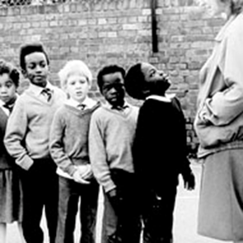
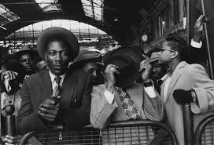
More Migration
Many other migrants arrived via other transport from many different countries, This happened all the way until 1962.
It was not just the Windrush that bought migrants to Britain.
By 1955 it was thought that over 18,000 migrants had made their way to Britain.

Slide 8
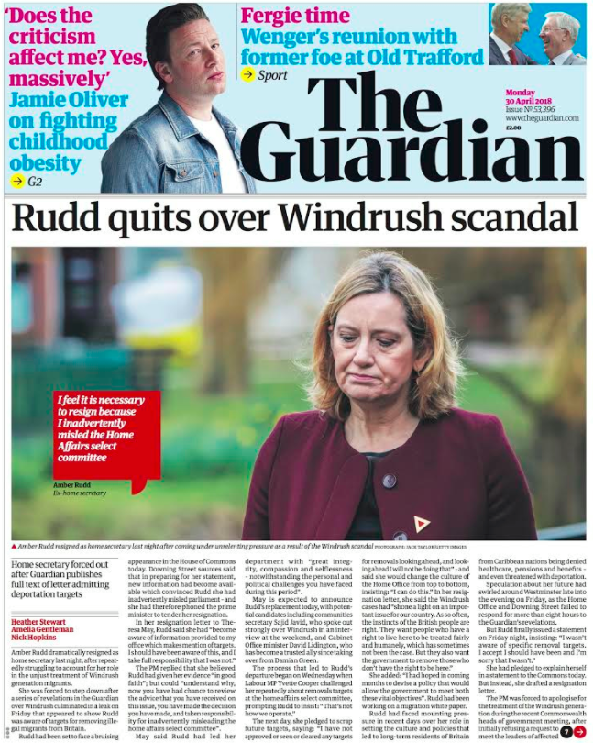
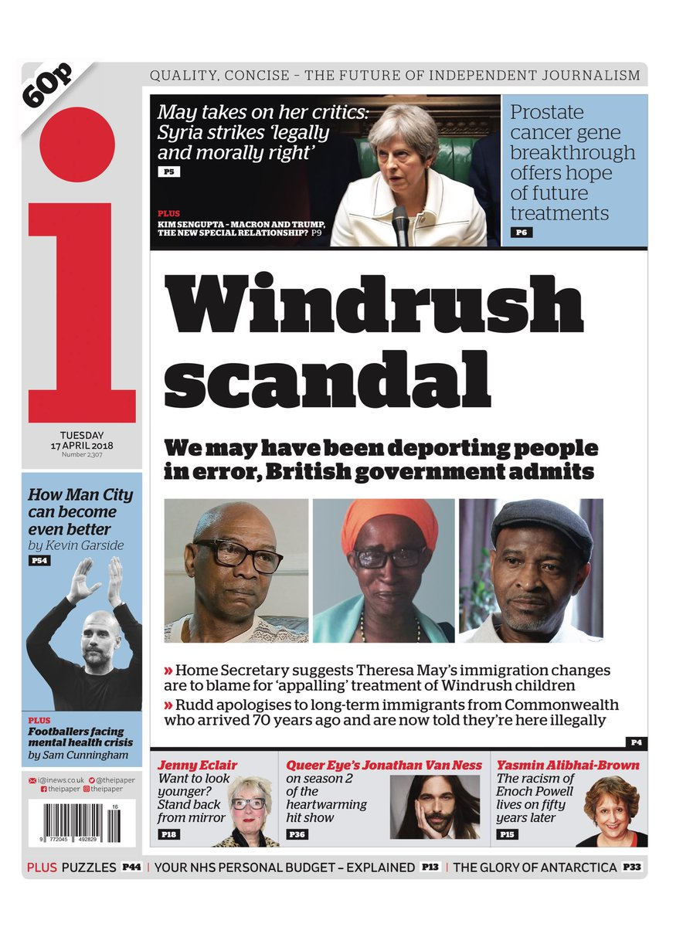
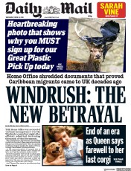
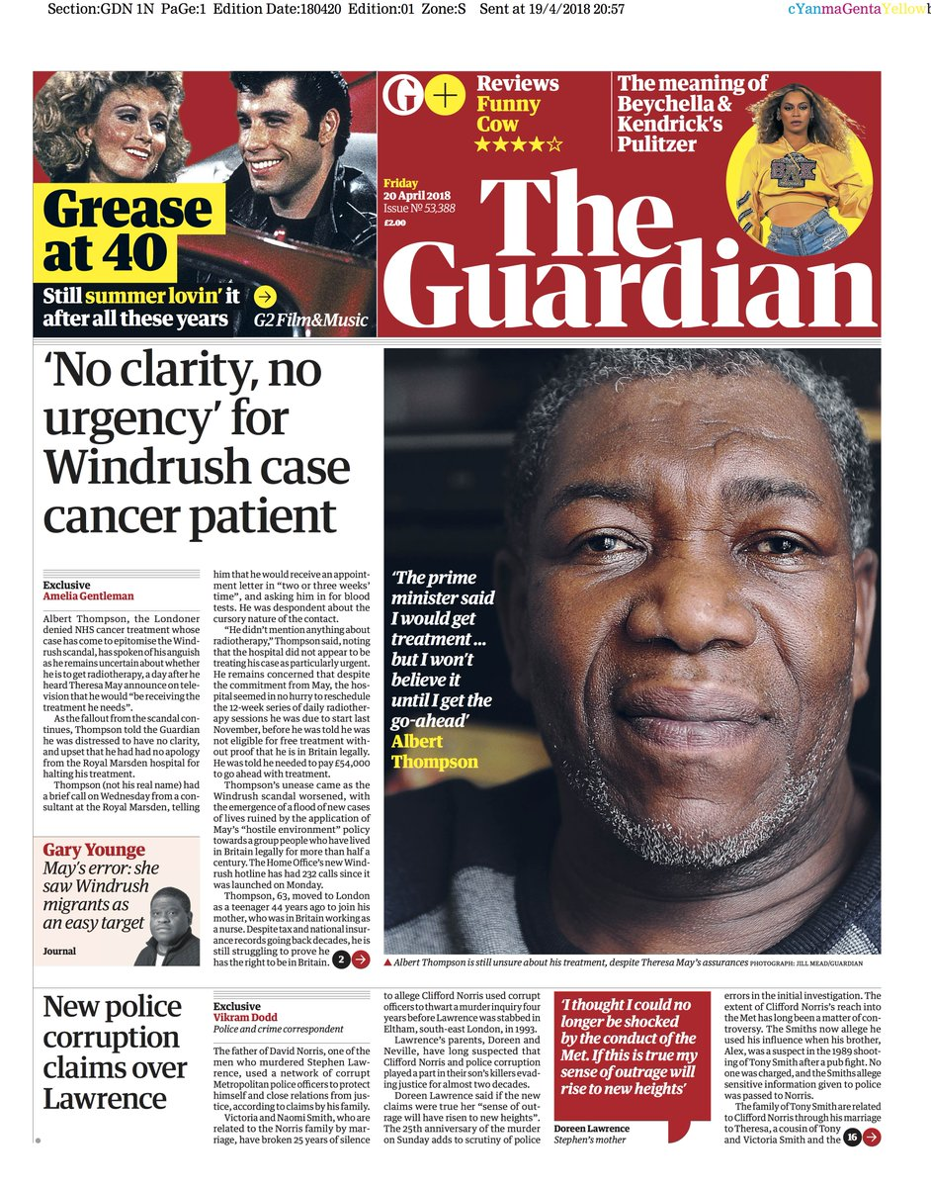
The Windrush Scandal

Slide 9
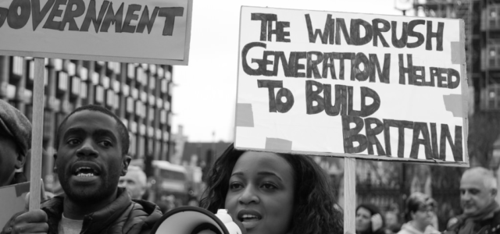
The Windrush Scandal
In 2017 a major scandal involving migrants from the Windrush generation unfolded.
Hundreds of Commonwealth citizens had been wrongly detained, deported and denied legal rights.
There was widespread shock and outrage at the fact that so many Black Britons had had their lives devastated by Britain’s deeply flawed and discriminatory immigration system.
Commonwealth citizens were affected by the government’s ‘Hostile Environment’ legislation - a policy announced in 2012 which tasked the NHS, landlords, banks, employers and many others with enforcing immigration controls. It aimed to make the UK unlivable for undocumented migrants and ultimately push them to leave.

Slide 10
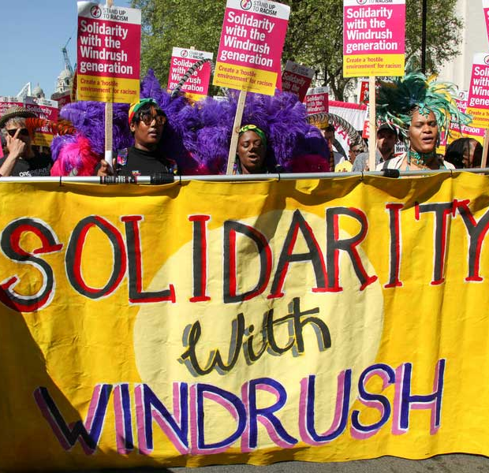
The Windrush Scandal
Because many of the Windrush generation arrived as children on their parents’ passports, and the Home Office destroyed thousands of landing cards and other records, many lacked the documentation to prove their right to remain in the UK.
This means that many of the migrants were deemed as illegal immigrants and were denied NHS healthcare, places to live, bank accounts and driving licenses, many also lost their jobs and some even forced back their commonwealth countries.

Slide 11
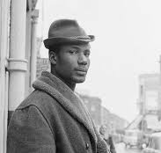
How would you feel In this situation?
This means that you are no longer able to rent your home, your driving license is invalid and your bank account is being closed. You have also received notice that you are to be deported back to Jamaca. A country you have not seen since you were a small child.
Imagine you are one of the Windrush migrants.
You arrived here in 1958 with your Dad.
In your adult life you have held a job as a labourer for a big firm for many years. Paying taxes as you earn.
In 2012, the 'hostile environment legistation' bought in meant you had to prove your citizenship to Britain, however, you have not received any paperwork from the government to prove this.

Slide 12
Notes:
https://www.youtube.com/watch?v=Q4SIP7EZze4

Slide 13
Is the Windrush Scandal All sorted now?
The short answer is NO.
There are still many people out there waiting for documents to arrive and still facing deportation.

Slide 14
What can I do?
As with other recent topics in the news you can educate yourself about this topic.
Have a look at these websites for more information...
https://windrushfoundation.com/
https://www.jcwi.org.uk/News/wjf-round2
Windrush generation: Who are they and why are they facing problems? - BBC News
Systemic racism exists in the UK at every level of government and society | Varsity
https://www.freemovement.org.uk/home-office-help-windrush-children-commonwealth-citizens/

