Slide 1
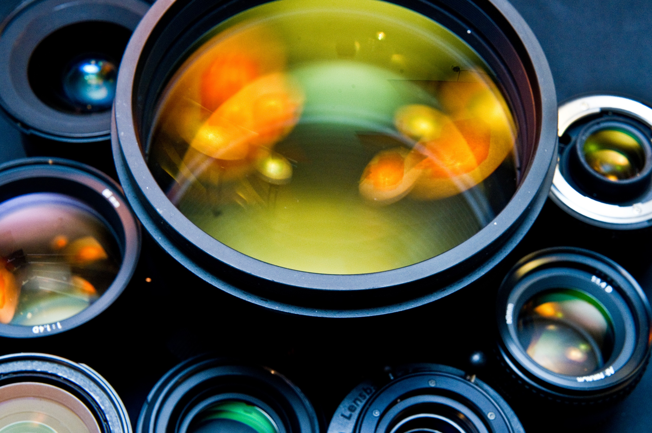
8Jc2 Lenses
CW
Do Now:
List as many uses as you can for lenses.

Slide 2
Requisitions
Equipment | Worksheets
 | Convex Lens Diagram

Slide 3
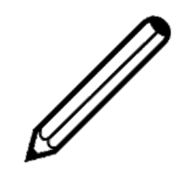
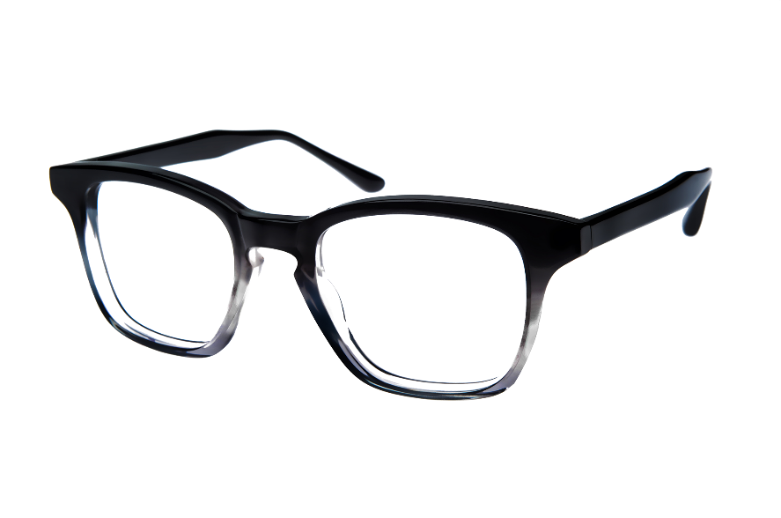
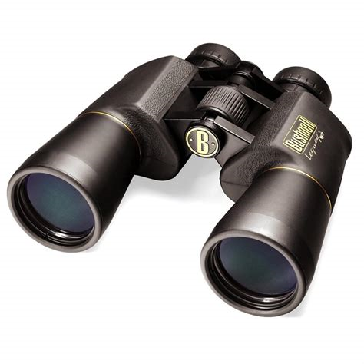
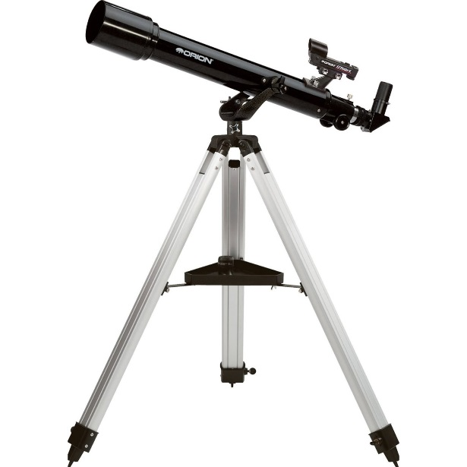
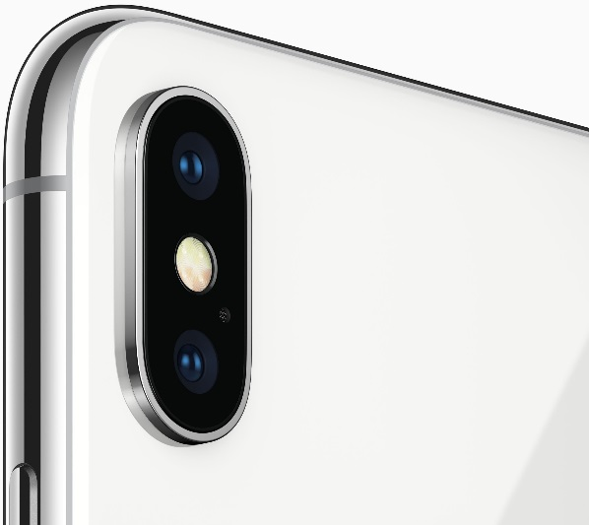
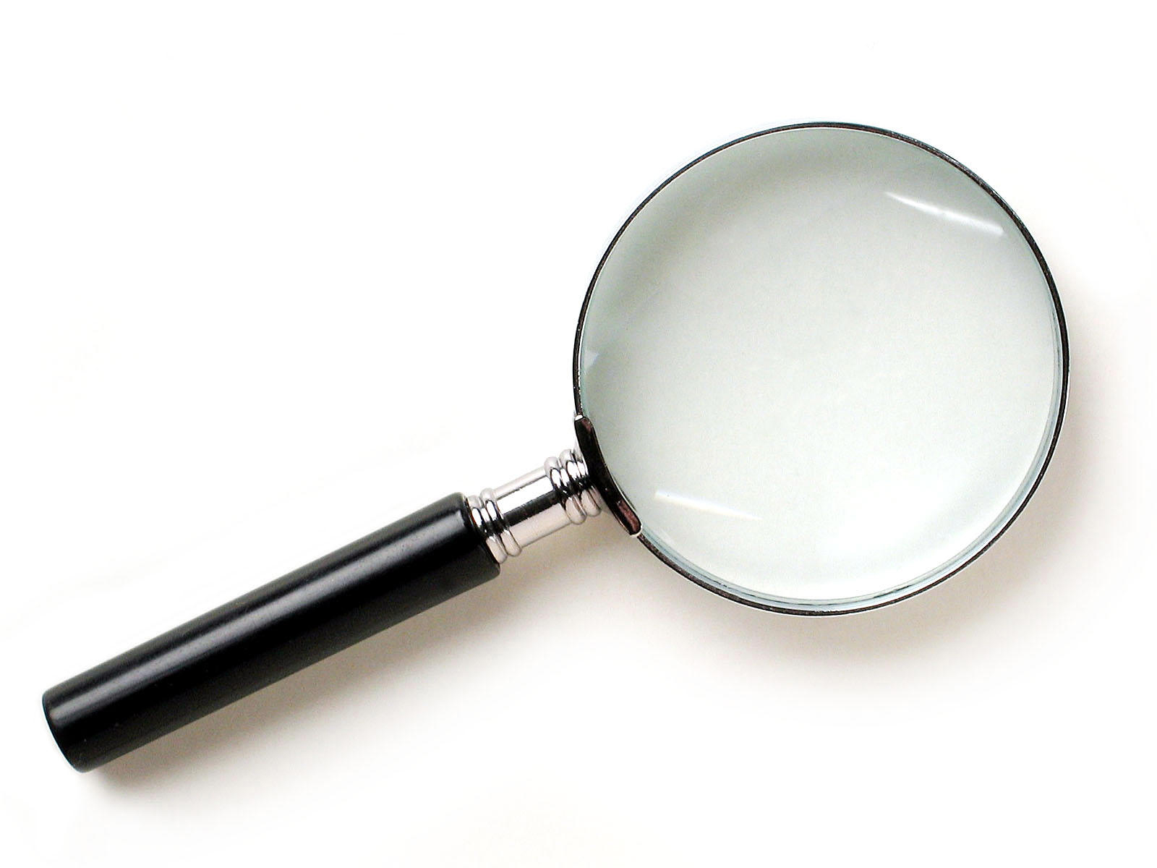
Lenses are used in…
Copy & Complete
glasses
binoculars
cameras
telescopes
magnifying glasses

Slide 4
Objectives
Describe some uses of lenses.
State the meaning of: convex lens, converging lens.
Describe the effects of convex lenses on parallel beams of light.
State the meaning of: focal length, focus, and principle axis.
Relate the power of a lens to its shape.
Describe the effects of concave lenses on parallel beams of light

Slide 5
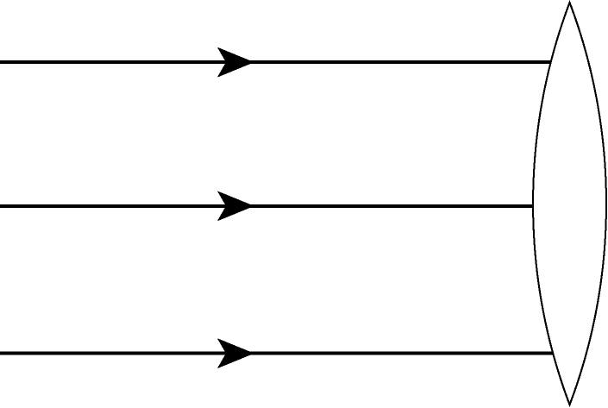
Convex (converging) lens
Place your convex lens shape in the position shown.
Shine a ray along the top line towards it.
Mark in the position of the ray to the right of the lens with a few dots.
Remove the lens shape and complete the ray outside AND INSIDE the lens.
Repeat for the other 2 rays.
Repeat for the concave lens.
What happens to the 3 rays?
Notes:
Worksheet needs doing with lens shape correct size for our lens shapes/prisms

Slide 6
Run from freezeray.com

Slide 7
Convex Lens
Focus
principle axis
Does the concave lens have a focus?
focal length
Label your concave lens diagram in the same way.

Slide 8
Concave Lens
Stick In & Add Labels
principle axis
Does the concave lens have a focus?
Focus
focal length

Slide 9
Concave Lens
Stick In & Add Labels
Does the concave lens have a focus?

Slide 10
Concave Lens
How could you make a more powerful convex or concave lens?

Slide 11
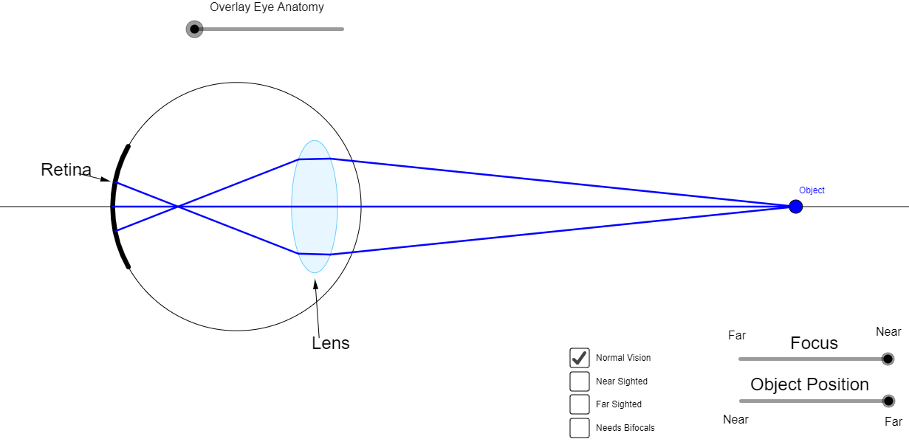
Notes:
https://ophysics.com/l16.html

Slide 12
Flash not working? Run from Firefly

Slide 13
Focal length
Draw & label a powerful and a weak lens.
Describe the shape of each.
Notes:
Teacher notes
Test all of the lenses in the first part of the experiment to move on to a summary screen with a table of results and two questions to answer.
Students should notice that a fatter lens is likely to produce much greater incidence angles, due to its pronounced curve. This will result in a greater level of refraction, and thus a more powerful lens.
Students should also see that for a given focal length, a lens made from a material with a greater refractive index will be thinner than a lens made from a material with a lower refractive index. This means that new materials being developed with greater refractive indexes will allow lenses to be manufactured thinner.
The knowledge that a lens with a given focal length can be manufactured thinner if the medium has a higher refractive index is higher tier for AQA Separate Sciences.
13

Slide 14
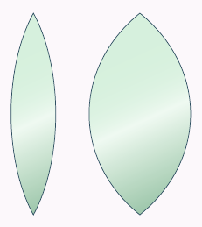
Write Down
Powerful lens
Thicker in the middle, more curved.
Shorter focal length
Weak lens
Thinner in the middle, more curved.
Longer focal length

Slide 15
How do convex lenses work?
Notes:
Teacher notes
This animation explains the function of a convex lens in terms of refraction. Between each stage, students could be asked to predict what will happen next, using their knowledge of refraction. Can they predict the relative position of the focal point in a fat or thin lens?
Light rays are parallel when the light source is very distant, as is the case with light from astronomical objects such as the Sun.
15

Slide 16
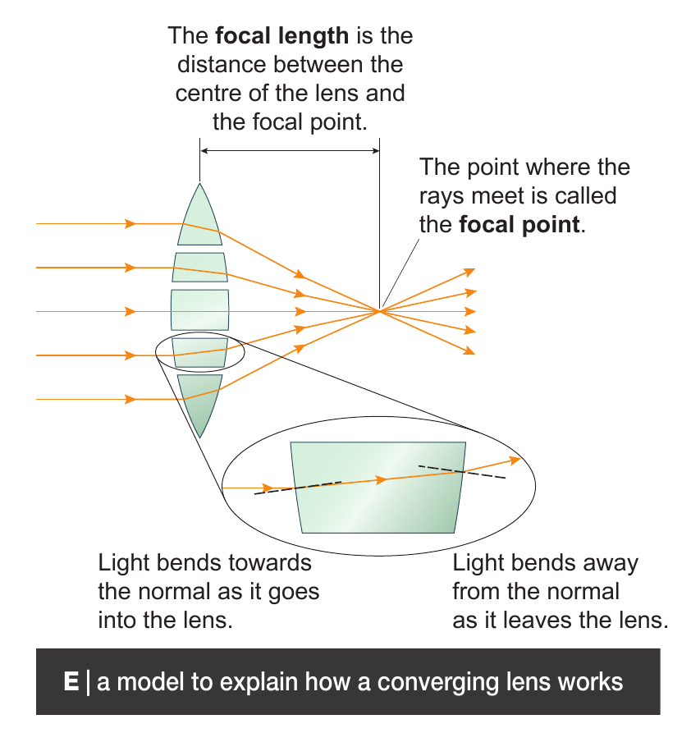

Slide 17
 Give a clue or definition for these keywords.
Hot seat
convex lens

Slide 18
 Give a clue or definition for these keywords.
Hot seat
focus

Slide 19
 Give a clue or definition for these keywords.
Hot seat
concave lens

Slide 20
 Give a clue or definition for these keywords.
Hot seat
focal point

Slide 21
 Give a clue or definition for these keywords.
Hot seat
principal axis

Slide 22
 Give a clue or definition for these keywords.
Hot seat
power

