Slide 1
Citizenship / Personal, Social, Health and Emotional Education.
Coping with the Unexpected Changes

Slide 2
Key vocabulary: match the words to the definition
Coronavirus
Quarantine
Social distancing
Isolation
Outbreak
A. Protecting the public health by separating communities so that people who are ill with a contagious illness cannot pass it on to others who are not.
B. A sudden occurrence of something unwelcome.
D. Restricting movements of well people who may have been exposed to the virus to see if they become ill.
C. A virus that effects the respiratory system.
E. The separation of ill people from others.

Slide 3
Answers
Coronavirus: C. A virus that effects the respiratory system.
Quarantine: D. Restricting movements of well people who may have been exposed to the virus to see if they become ill.
Social distancing: A. Protecting the public health by separating communities so that people who are ill with a contagious illness cannot pass it on to others who are not.
Isolation: E. The separation of ill people from others.
Outbreak: B. A sudden occurrence of something unwelcome.

Slide 4
Everyone reacts differently to stressful situations.
Reactions during an infectious disease outbreak can include:
Fear and worry about your own health status and that of your loved ones who may have been exposed to COVID-19
Changes in sleep or eating patterns
Difficulty sleeping or concentrating
Changing emotions
Anxiety caused by a continuously changing and unknown situation
Notes:
https://www.cdc.gov/coronavirus/2019-ncov/about/coping.html

Slide 5
Discuss with another person (on or offline) or write down your answers…
How did you react to the outbreak?
What has changed for you since the outbreak?
Were your holiday plans affected by the outbreak?
What are the 3 worst things about staying inside?
What are the 3 best things about staying inside?
What are the 3 worst things about online lessons?
What are the 3 best things about online lessons?
What might you do in this situation which you wouldn’t normally do? Like read a book, learn a new skill, talk to your brother…

Slide 6
What can you do to cope with unexpected change?
Accept the change. Believing that change is often good is a great starting point.
Acknowledge how you are feeling about the change. Try to recognise your emotions and when you need support.
Assess your options. Ask yourself: “What’s good about this change?” or “What new opportunities can this change bring?”
Act appropriately. Everyone is in a new situation so you will need to adapt.
Ask for help or guidance. Don’t suffer in silence.

Slide 7
Things you can do to support yourself:
Avoid excessive exposure to media coverage of COVID-19.
Take care of your body. Take deep breaths, stretch or meditate. Try to eat healthy, well-balanced meals, exercise regularly and get plenty of sleep.
Make time to relax. Try to do some activities you enjoyed in your normal life. Take breaks from studying and working. Take breaks from looking at a screen!
Connect with others. Share your concerns and how you are feeling with a friend or family member. Maintain healthy relationships.
Maintain positive thinking.

Slide 8
Connect with others: remember to ask others how they are and tell them how you are feeling too.
Can you think of some vocabulary to describe your emotions?

Slide 9
Maintain positive thinking: motivate and encourage yourself and others.
Discussion:
What can you do to keep yourself motivated and happy?
What can you do to help keep your family positive during this time?
What can you do to help keep your friends positive during this time?
What can you do to help keep your teachers positive during this time?

Slide 10
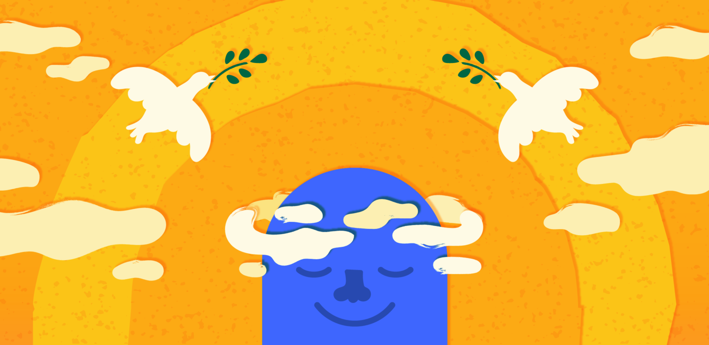
Task: make list / timetable or draw the activities you can do at home during this quiet time.
Notes:
Out of the ideas discussed to keep people happy – what will the students try and why?

Slide 11
What are people around the world doing while they're in lockdown?
LINK 1:
www.bbc.co.uk/newsround/51904789
LINK 2:
https://eu.courier-journal.com/story/life/wellness/health/2020/03/18/louisville-families-make-rainbows-combat-coronavirus-isolation/2865334001/

Slide 12
What will you do to help yourself and your community?
Send pictures and videos of what you have been doing to Ms. Herbert and she can share on this Firefly area.
oherbert@highamsparkschoool.co.uk

