Slide 1
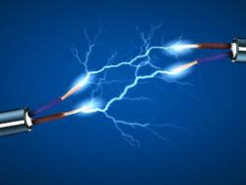
28/10/2018 7Ja Switches and Current C.W

Slide 2
17.10.18 7Ja Switches and current C.W
Recall materials that are conductors and insulators.
State the meaning of: conductor, insulator, complete circuit, ammeter, current.
Describe why a cell is needed in a circuit and recall how electrical cells work.
Explain how switches work to turn a circuit on or off.
Identify common circuit components and their symbols.
Model circuits using simple circuit diagrams.
Measure current and state its unit.
Describe and explain how adding more bulbs affects the brightness of bulbs in a circuit.
Describe the effects of breaking or removing bulbs in a circuit.
Use the idea of a complete circuit to test whether different materials conduct electricity.
Recall the link between current and bulb brightness.
Describe how changing the number or type of components in a circuit affects the current.
Describe what the current is like at different points in a series circuit.

Slide 3
Take 3 minutes to discuss in pairs how you might get a bulb to light up and what materials the wires should be made of. Jot down your ideas in the back of your books
Linked in a circuit to a battery or cell.
Wires need to be made of a metal to conduct electricity
Q: Why does the bulb light up?
Q: What is the energy transfer taking place?
A: The bulb lights up because the electricity running through it makes the filament glow.
A: Chemical energy stored in the battery is transferred by electrical energy through the wires into light and heat in the bulb

Slide 4
Write the following sentences in your book. Give an example of a conductor and an insulator, then think of an answer to the questions below.
Electric current can flow freely in a conductor but cannot flow through an insulator
An example of a conductor is……………………
An example of an insulator is……………………
Q: Why are electrical wires covered in a rubber or plastic coating?
Q: How could you test if a material was a conductor or insulator?

Slide 5
Watch the clip and then complete the gap filler. Swap books and mark using a green pen. Give your partner a mark out of 6.
https://www.youtube.com/watch?v=EJeAuQ7pkpc
The battery or cell provides a force to move electrons. This force is called voltage and is measured in _______. The flow of electrons is called __________ and is measured in ______ (A). When the switch is closed the circuit is___________ and the current can flow. The path the current follows is called a ________. Adding a bulb to the circuit _______ the current flowing.
volts
current
Amps
complete
circuit
reduces
complete Volts Amps circuit reduces current

Slide 6
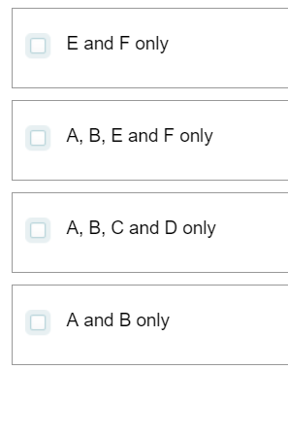
Which of the bulbs will light up if switch one is closed and switch 2 is open? Write the correct answer in the back of your books.

Slide 7
Use you key stage 2 skills and the example given to have a go at worksheet 7JA4 for ten minutes. Use a ruler and pencil to draw circuit diagrams

Slide 8
Discuss with your partner for 2 minutes and decide in which circuit the reading on the ammeter would be higher.
Current is not used up in a circuit. Therefore the current is the same, wherever the ammeter is positioned.

Slide 9
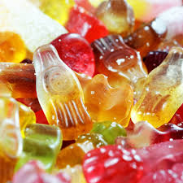
Discuss the following questions in pairs for 3 minutes.
Q: If two people were sharing 12 sweets and a third person joined them – would each person get more sweets or fewer?
Use your answer and think about what might happen to the brightness of a bulb if another bulb is added to a series circuit.
What is the sweets in this scenario?
If you add more bulbs to a circuit, all the bulbs in the circuit will be dimmer
Extension: How would you get the bulbs to shine more brightly again?

Slide 10
Spot the mistake in each diagram. Hands up.

