Slide 1
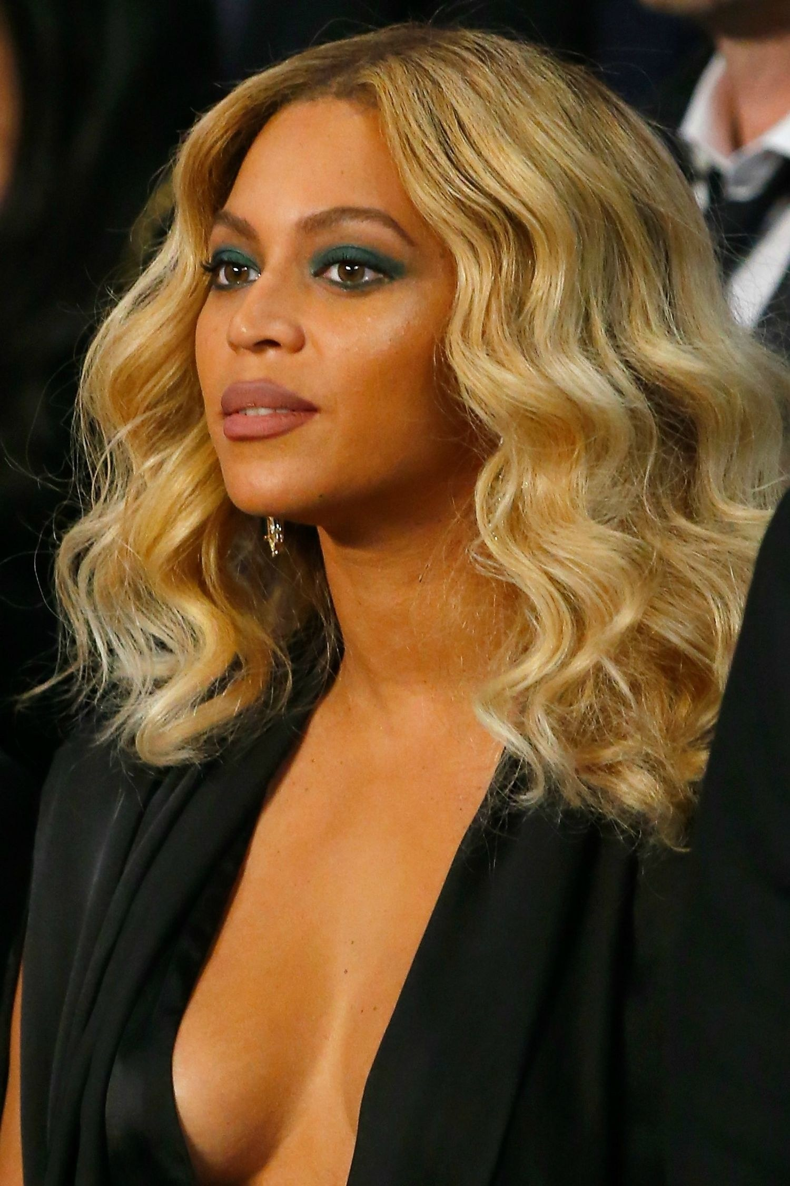
Effects of the environment
Write the title, date and classwork and consider the following question:
What are the possible environmental and hereditary reasons why someone might have blond hair?
Hair dye
Inherited genes for blond hair
Sun-bleached

Slide 2
Learning outcomes
Describe how physical environmental factors vary in a habitat, both on a daily basis and seasonally and give examples
Describe physical and behavioural adaptations of organisms to daily and seasonal changes, including deciduous and evergreen trees, nocturnal organisms, hibernation and migration
Explain how changes in a physical environmental factor in a habitat affect populations and communities.
Explain how environmental variation is caused
explain how particular adaptations increase the chances of survival.
Recall the differences between innate and learned behaviours and explain how these can be beneficial to organisms.

Slide 3
Copy the following table and for each example think of an inherited and environmental cause of variation
Variation | Genetic reason | Environmental reason
Brown skin | One of both of parents have brown skin | Fake tan/ sun-tan
Curly hair | One of both of parents have curly hair | Hair permed, weave/ extensions, wig, curling tongs used
Two apples look different | Different species | One diseased, more light/ fertiliser/water
One boy is taller than his friend | His parents may be taller than his friends parents | He may have had better nutrition growing up

Slide 4
Copy the text below and on the following few slides: identify what each variation is caused by
Some variations are caused by inherited factors.
Some variations are caused by environmental factors.
Others are affected by both factors.

Slide 5
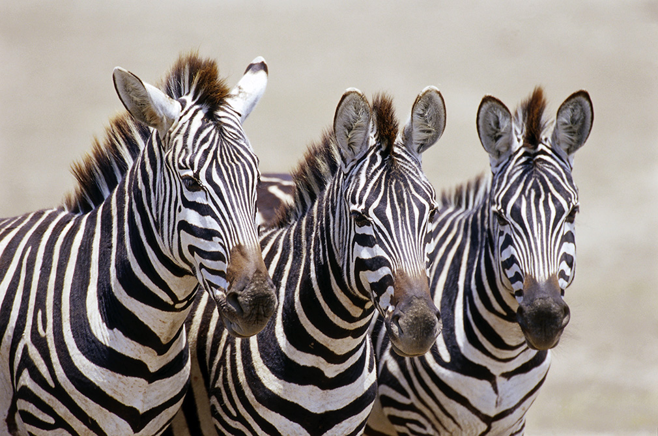
Which kind of variation are a zebra’s stripes? Choose from inherited, environmental or both.
Inherited factor – zebras are born with their stripes.

Slide 6
Which kind of variation is this woman’s blue hair? Choose from inherited, environmental or both.
Environmental factor – her hair has been coloured with hair dye.

Slide 7
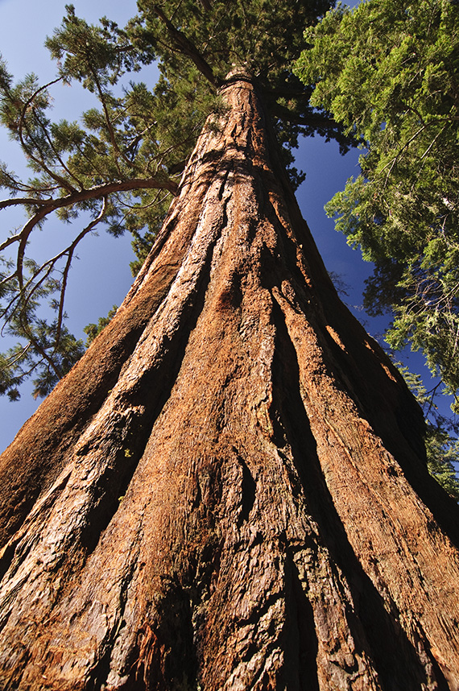
Redwood trees are some of the tallest trees on Earth, but what causes their height?
Choose from inherited factors, environmental factors or both.
Both factors:
inherited – seeds from tall trees usually grow into tall trees
environmental – growing to compete for light and water.

Slide 8
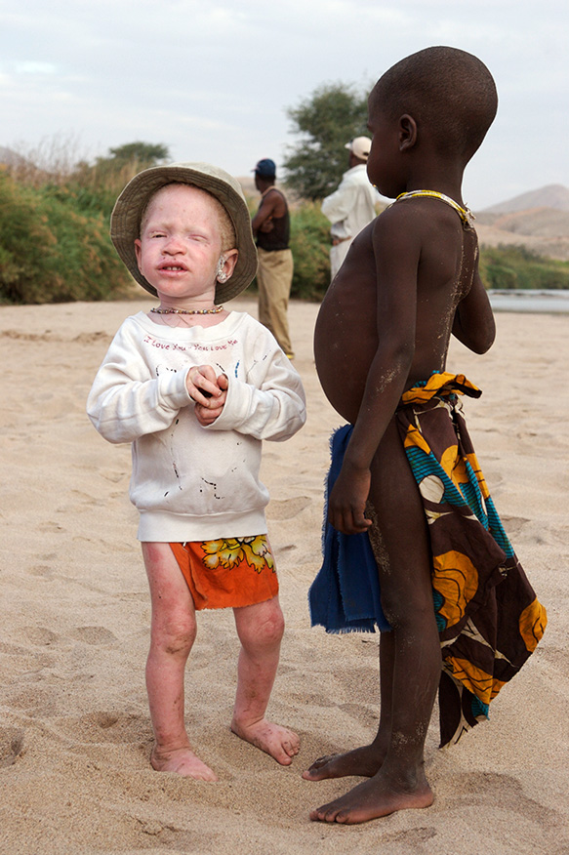
These two boys are brothers who live in Angola. The boy on the left has albinism.
Do you think albinism is caused by inherited factors, environmental factors or both?
Inherited factor – caused by a lack of the pigment that colours the skin.

Slide 9
The boy on the right has a swollen belly.
Do you think the swollen belly is caused by inherited factors, environmental factors or both?
Environmental factor – a poor diet (malnutrition) has resulted in the disease.
© Pearson Education Ltd 2014. Copying permitted for purchasing institution only. This material is not copyright free.
Notes:
9

Slide 10
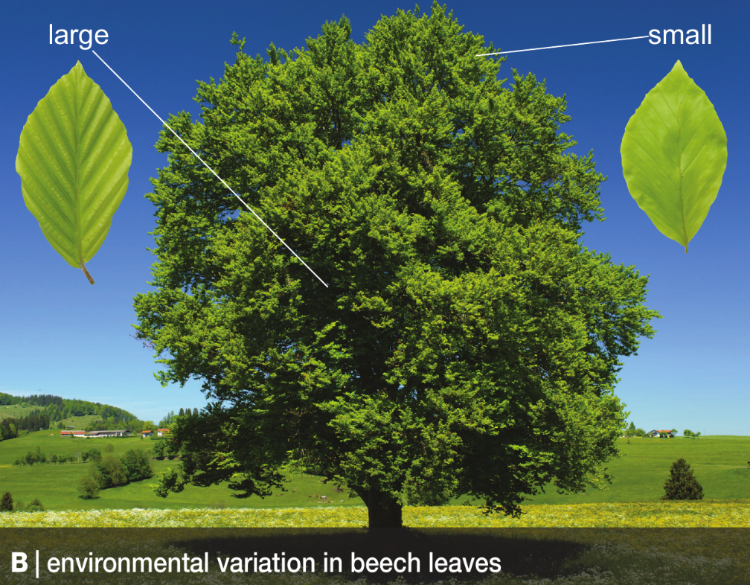
Copy the text and write down (in full sentences) which one of leaf size and shape is caused by the environment and which one is a result of inheritance
All organisms show inherited variation and environmental variation
Leaf shape is inherited
Leaf size is due to the environment (levels of sunlight)

Slide 11
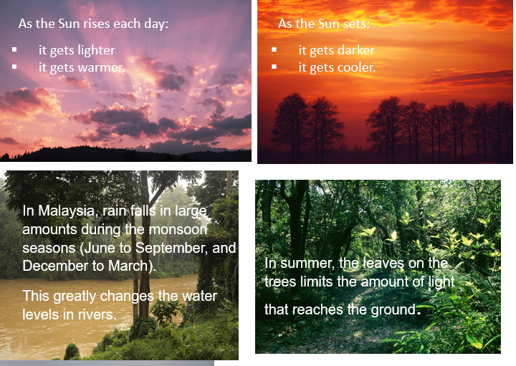
Copy the text below then cut and stick to match the regular environmental change with the adaptation
The environment is changing all the time. Some of these changes are regular, such as the daily changes that happen every 24 hours. Others are seasonal changes such as light, temperature and rainfall
Organisms have inherited features that allow them to adapt to their changing environment.

Slide 12
Assess and correct your work
light and warm in the day | Dark and cool at night | Daily tides | Monsoon rivers | Low light levels on the ground in summer | Low temperatures in winter | Low light levels in winter
Animals look for food | Hedgehogs come out at night when prey out | Sea-snails go into shells | Mangroves have wide roots | Flowers die back when leaves on trees open | Animals grow thicker coats | Trees lose leaves
 |  |  |  |  | hibernation
 |  |  |  |  | Migration to warmer climates

Slide 13
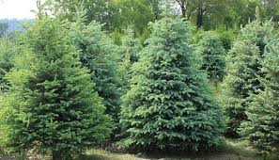
Copy the text below
In winter, deciduous trees lose their leaves because there is not much light for photosynthesis and their leaves lose water (which cannot be replaced when the ground is frozen)
Evergreen trees have tougher leaves that don’t lose much water so they keep their leaves all year round

Slide 14
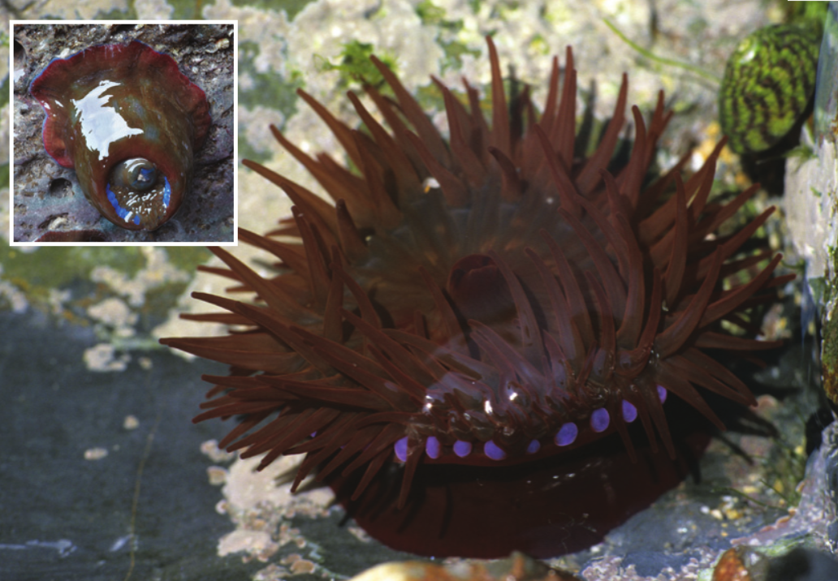
Watch the clip and write down any adaptations to tides that you hear https://www.activeteachonline.com/product/view/id/295/page/62/mode/dps?modal=/player/animation/id/312560

Slide 15
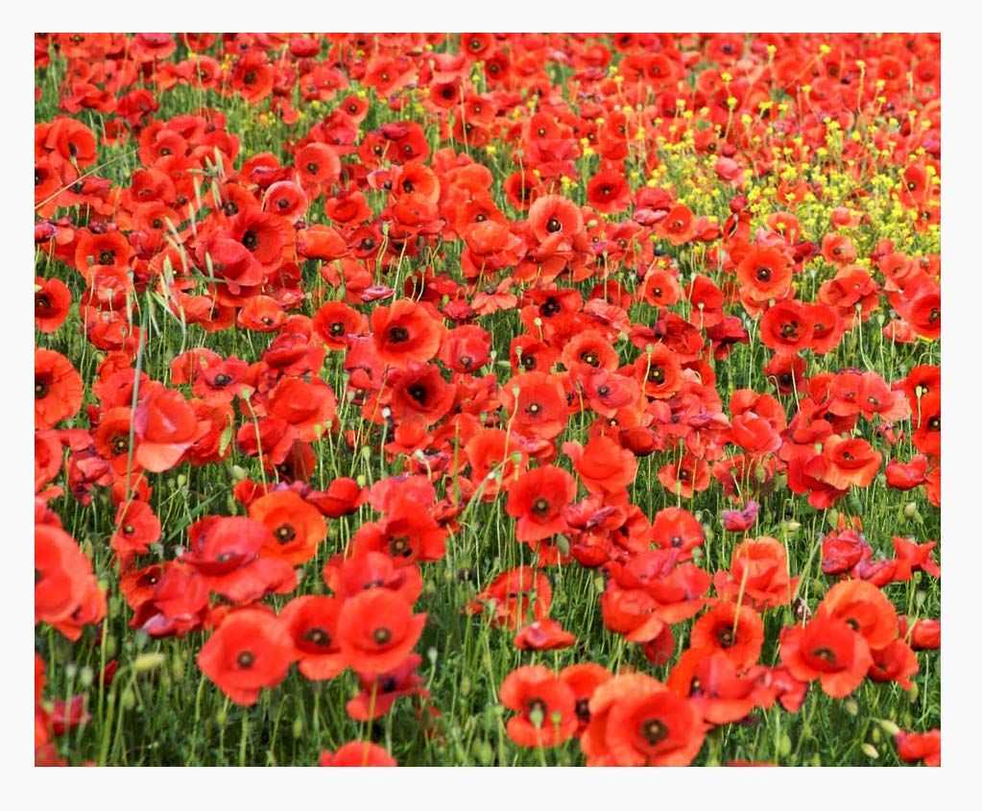
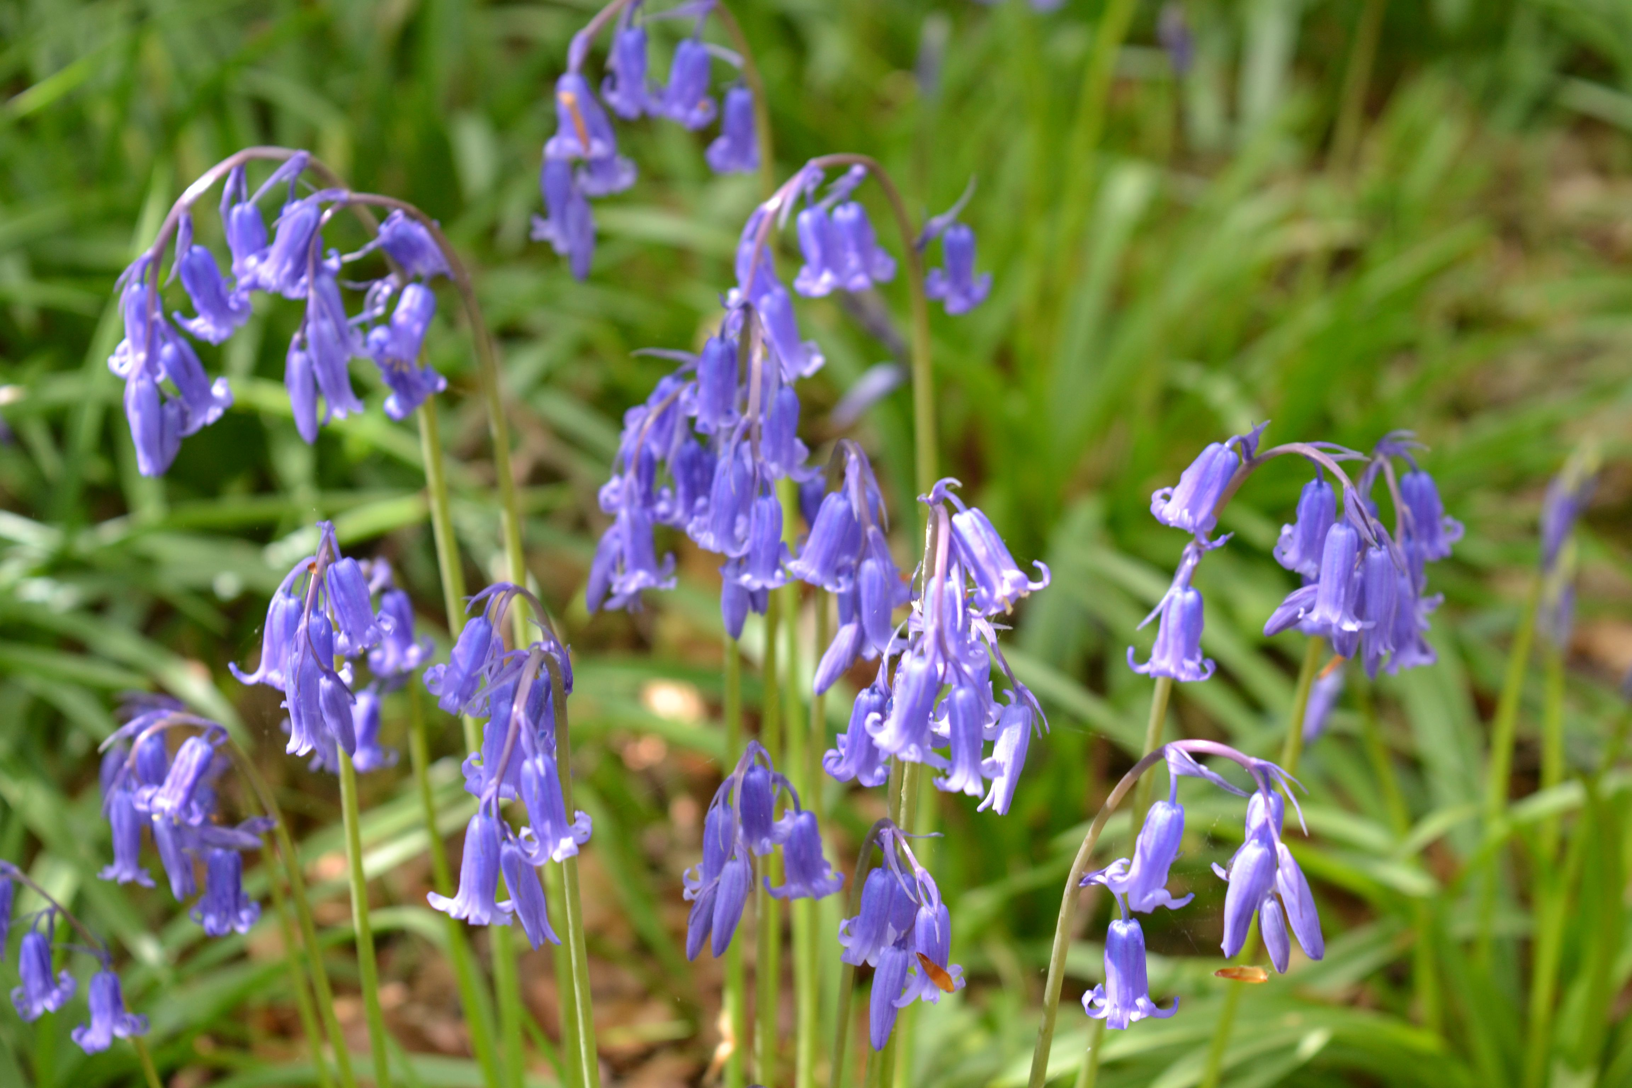
Copy and complete the wordfill below
die
Some plants such as poppies _______ completely in the winter. Their ________ grow into new plants in the spring. In other plants, such as bluebells, only the parts above the ground die. They leave ________ underground that will grow again in the spring
seeds
bulbs
seeds
die
bulbs

Slide 16
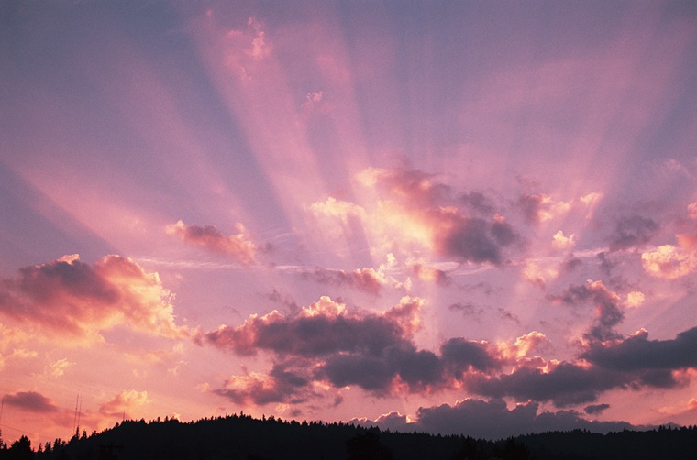
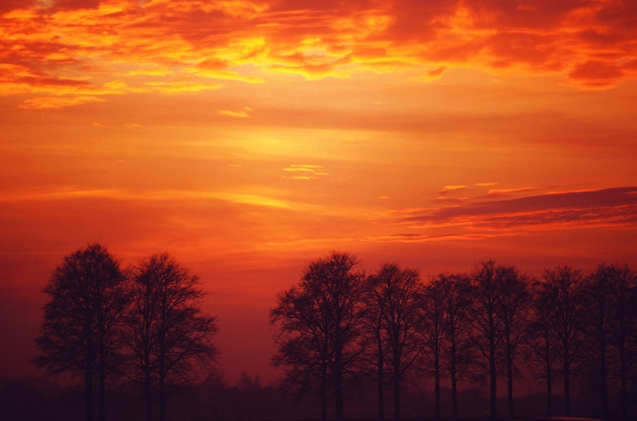
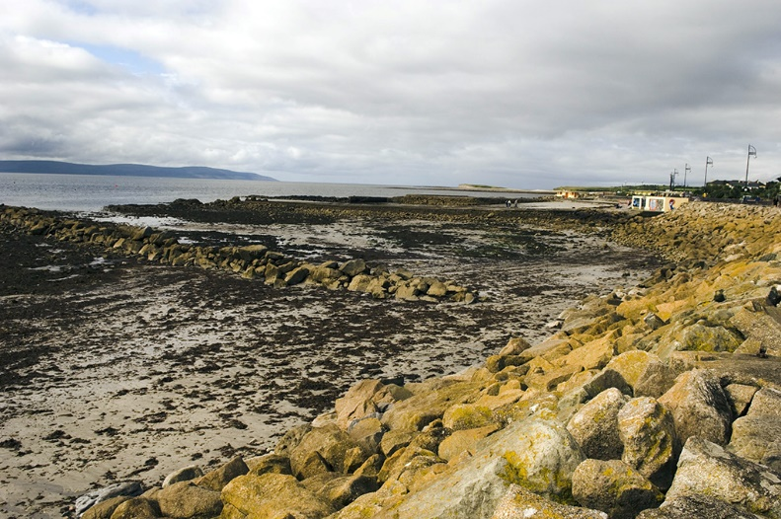
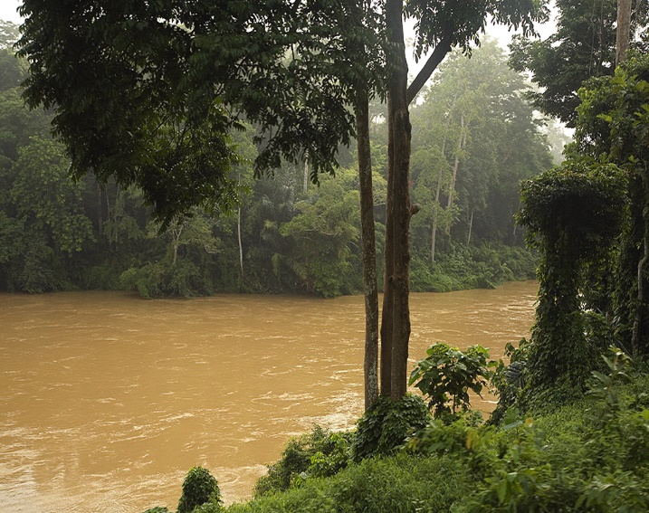
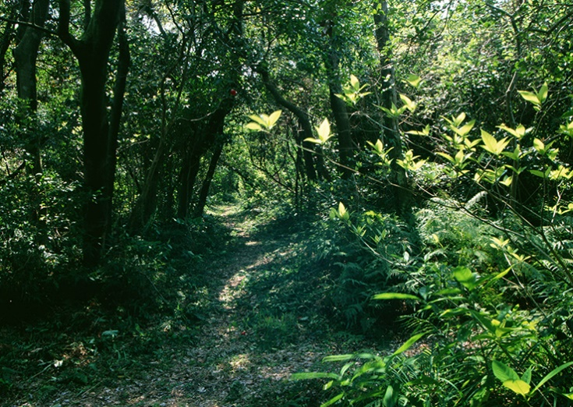
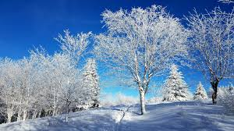
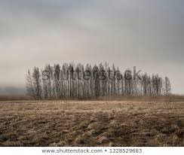
The coast also changes daily with the tides coming in and out twice a day.
At high tide the water reaches the rocks
As the Sun rises each day:
it gets lighter
it gets warmer.
As the Sun sets:
it gets darker
it gets cooler.
In the winter, the temperatures can be very low
In Malaysia, rain falls in large amounts during the monsoon seasons (June to September, and December to March).
This greatly changes the water levels in rivers.
In summer, the leaves on the trees limits the amount of light that reaches the ground.
In the winter, there are fewer hours of daylight and less sun

Slide 17
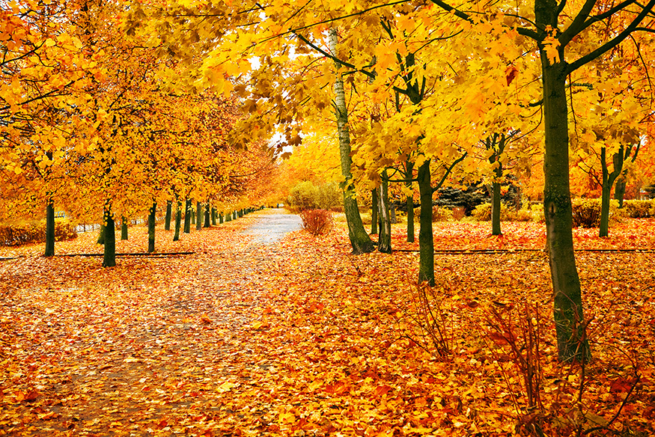
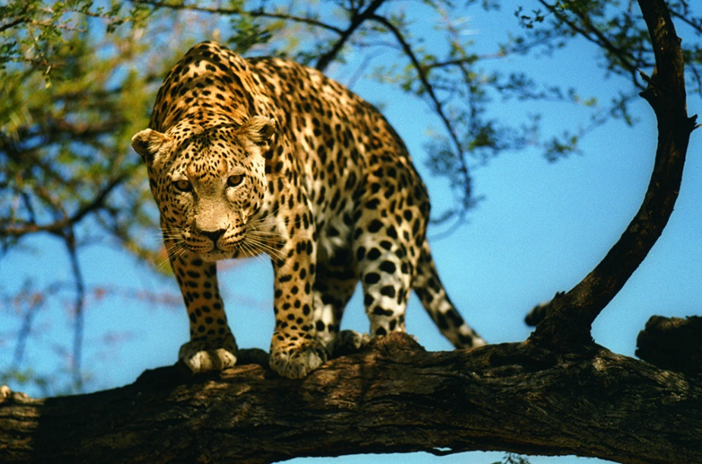
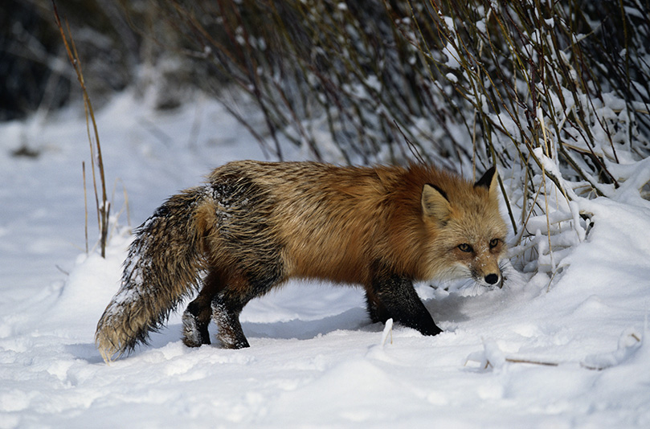
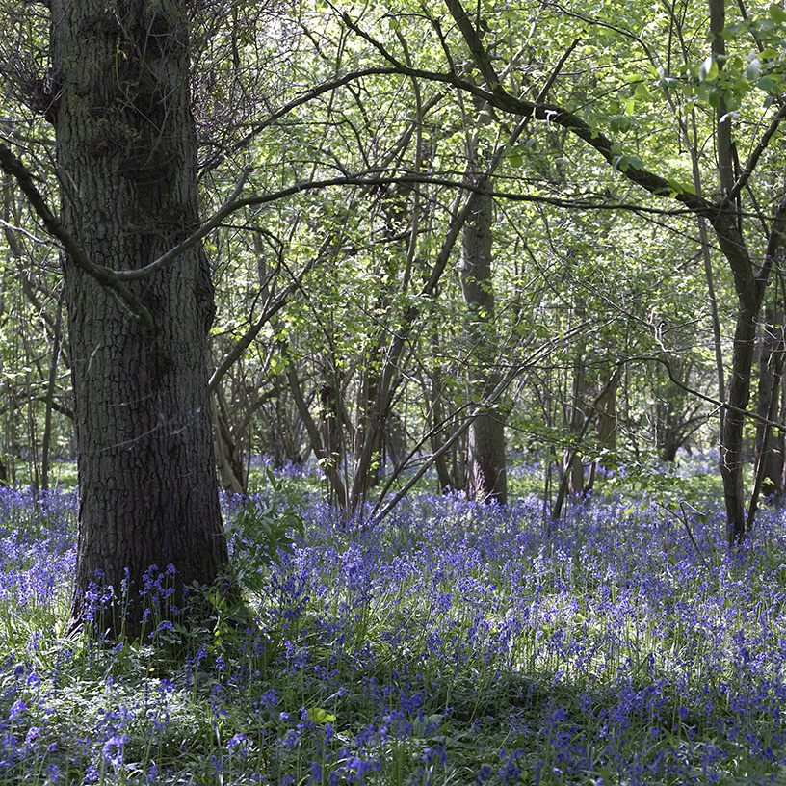
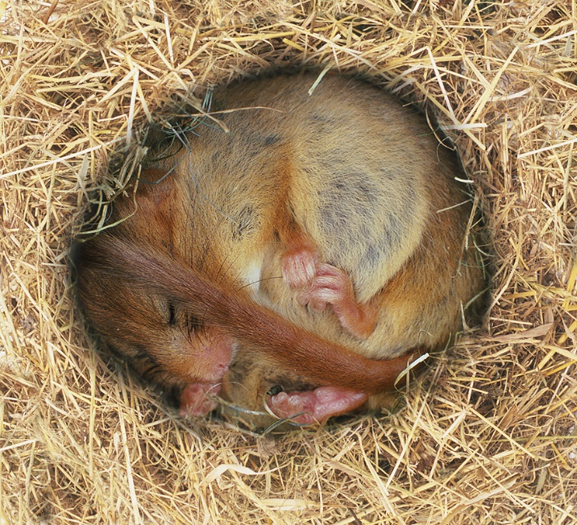
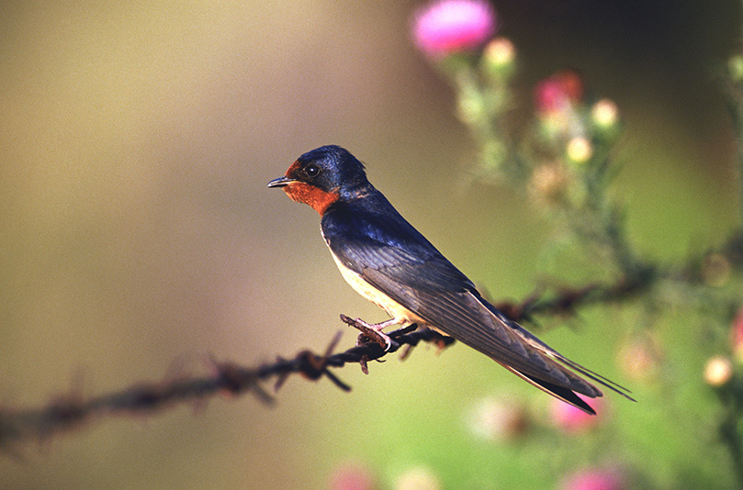
In Britain many trees lose their leaves in autumn.
Many ground cover plants die back.
Most animals look for food during the day as they need light to see their prey.
Some animals (like this fox) grow thicker coats to keep warm.
Swallows and other birds migrate (move away) to where it is warmer and there is more food.
Some animals like this dormouse hibernate (a kind of deep sleep) when it is cold.
In spring, woodlands may be full of flowers that die back when the leaves on the trees open.

Slide 18
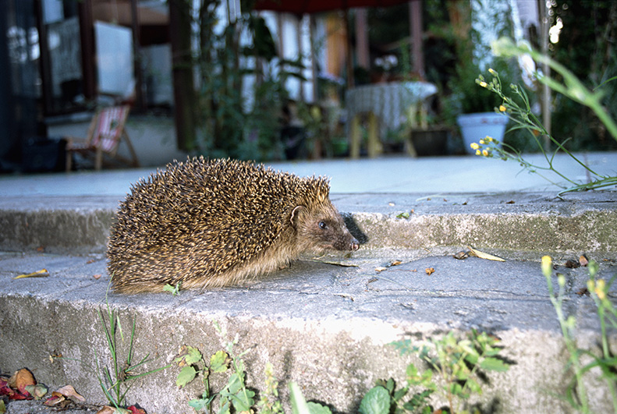
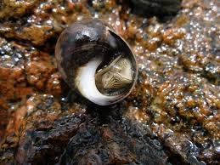
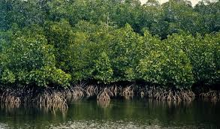
Some animals only come out at night.
They are nocturnal. Hedgehogs come out at night to feed on earthworms that only come to the surface when it is cool and damp.
When the tide is out, periwinkle sea snails cluster in crevices, secrete a glue-like mucus to stick to the rocks surface and withdraw into the shells to avoid drying out
On tropical deltas and along ocean edges and river estuaries, trees have adapted to living in wet, marshy conditions. These trees, called mangroves, have wide-spreading stilt roots that support the trees in the tidal mud and trap nutritious organic matter.

