Slide 1
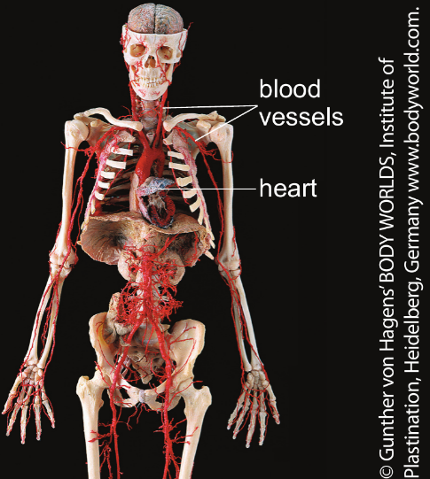
CW
7Ca Muscles and breathing
What do muscles do?
Why do we breath?
@hpscience

Slide 2
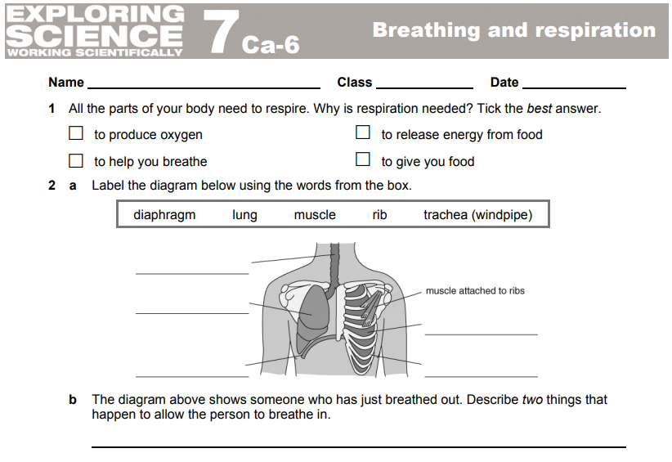
Use this worksheet in the lesson
https://www.activeteachonline.com/default/player/document/id/277700/external/0

Slide 3
This unit covers three important organ systems;
the gas exchange system
the circulatory system
the locomotor system
The various effects of drugs on these systems are also considered, together with their effects on the nervous system.

Slide 4
Note to teacher – the next lesson is on the circulatory system. You may want to do heart dissections at some point during this unit.

Slide 5
Copy this contents list into your books.
7Ca Muscles and breathing
7Cb Muscles and blood
7Cb Scientific questions (WS)
7Cc The skeleton
7Cc Sentences (L&C)
7Cd Muscles and bones
7Ce Drugs

Slide 6
Introduction
All cells require energy to survive.
This energy comes from a process called respiration.
This chemical reaction requires oxygen and produces carbon dioxide as a waste product.
Introduction
All cells require energy to survive.
This energy comes from a process called r________.
This chemical reaction requires o_____ and produces c_____ d_____ as a waste product.

Slide 7
Oxygen and carbon dioxide are g____ and are exchanged (swapped) between our blood and the air by the gas exchange system.
This system is sometimes called the respiratory or breathing system.
gases
Extension - Can you name any of the organs of the gas exchange system?

Slide 8
Complete questions 1 and 2 on the worksheet

Slide 9
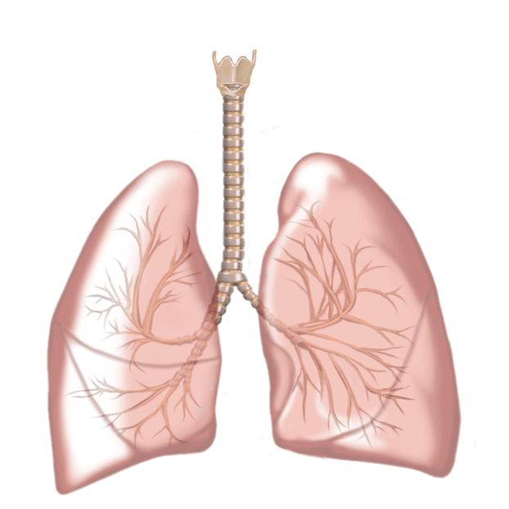
Breathing
Breathing in and breathing out are separate processes in the body:
Breathing in - inhalation.
Breathing out - exhalation.
https://www.activeteachonline.com/default/player/interactive/id/312546/external/0
Active learn video

Slide 10
Inhalation and exhalation

Slide 11
The pathway taken by air into the lung.
As we breath in where does the air go?
Make a list and put these in the correct order.
trachea
nose
air sac (alveoli)
bronchus
bronchiole
larynx

Slide 12
Gas exchange

Slide 13
Inhalation
Intercostal (rib) muscles contract.
The ribcage moves up and out.
The diaphragm flattens.
This increases the volume inside the chest.
Pressure decreases and air is taken in from the outside.
Exhalation is the reverse.

Slide 14
The differences between inhaled and exhaled air
Inhaled Air
Exhaled Air
Oxygen: 21%
Oxygen: 16%
Carbon dioxide: 0.04%
Carbon dioxide: 4%
Water vapour: small amount
Water vapour: large amount

Slide 15
Gas exchange
In the lungs oxygen is taken from the air and diffuses into the blood to be transported.
Carbon dioxide moves from the blood into the air.

Slide 16
This gas exchange takes place between the alveoli and capillaries.
Alveoli increase the surface area of the lungs to increase gas exchange.

Slide 17
The walls of the alveoli and capillaries are only one cell thick.
This speeds up the rate of diffusion (movement of gases).

Slide 18
Muscles
specialised cells
Muscles are made of s________ c___ called muscles cells.
Muscle cells contain a protein that is able to get shorter (contract).
When lots of muscle cells
contract together, the muscle
contracts and causes movement.
The opposite to contract is r____.
relax

Slide 19
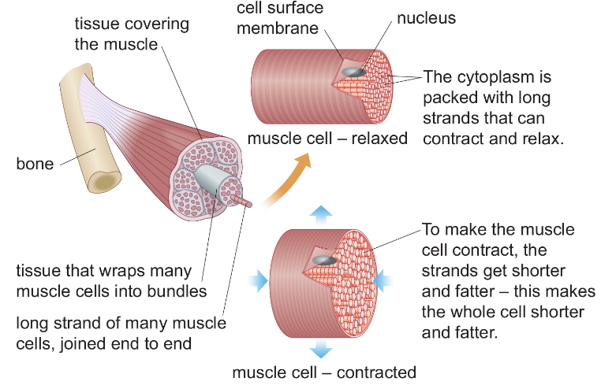

Slide 20
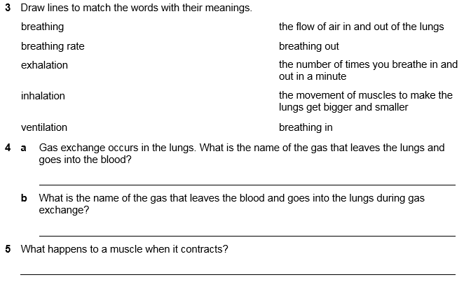
Complete the rest of the worksheet and check the answers

