Slide 1
Objectives
Identify adjectives, comparatives and superlatives in sentences.
Use adjectives, comparatives and superlatives to measure and compare.

Slide 2
Making comparisons
We make comparisons in science when making observations and measurements.

Slide 3
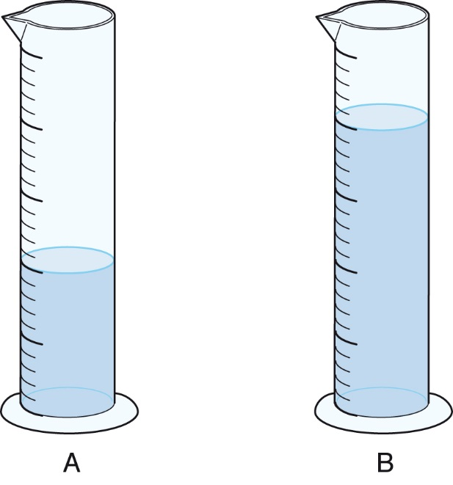
We use a comparative adjective when we have two observations or measurements.
The liquid in B has a larger volume than the liquid in A.
Or,
The liquid in A has a smaller volume than the liquid in B.
© Pearson Education Ltd 2014. Copying permitted for purchasing institution only. This material is not copyright free.
Notes:
3

Slide 4
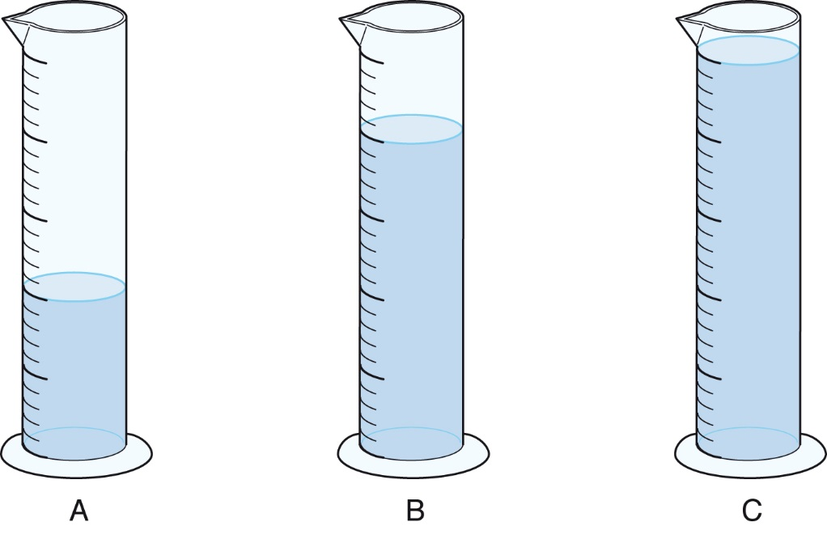
We use a superlative adjective when we have three or more observations or measurements.
The liquid in C has the largest volume.
Or,
The liquid in A has a smallest volume.
© Pearson Education Ltd 2014. Copying permitted for purchasing institution only. This material is not copyright free.
Notes:
4

Slide 5
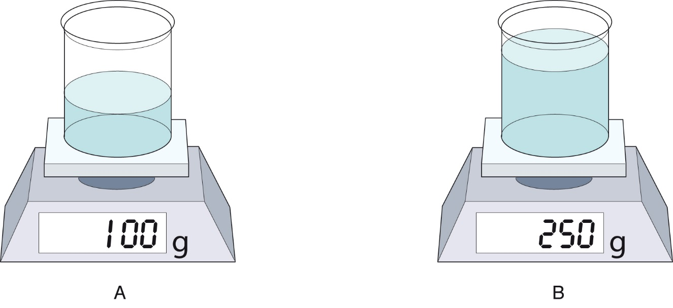
Use a suitable comparative or superlative adjective to describe the following diagrams:
larger
Beaker B has a ___________ mass than the beaker A.
Or,
Beaker A has a ___________ mass than the beaker B.
smaller
© Pearson Education Ltd 2014. Copying permitted for purchasing institution only. This material is not copyright free.
Notes:
5

Slide 6
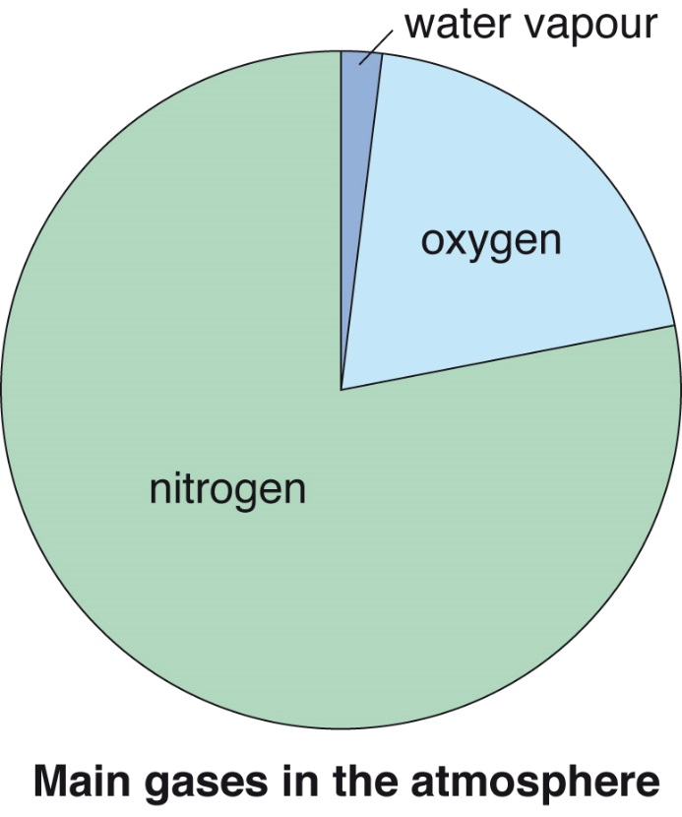
greatest
Nitrogen makes up the ___________ volume in the atmosphere.
Oxygen has a ___________ volume than water vapour in the atmosphere.
greater
© Pearson Education Ltd 2014. Copying permitted for purchasing institution only. This material is not copyright free.
Notes:
6

Slide 7
farthest
Trolley A has travelled the ___________ distance.
Or,
Trolley C has travelled the ___________ distance.
shortest
© Pearson Education Ltd 2014. Copying permitted for purchasing institution only. This material is not copyright free.
Notes:
7

