Slide 1
H
Write Down
Copy & Complete
Answers
Hands up for true
Check your work
Stick In

Slide 2
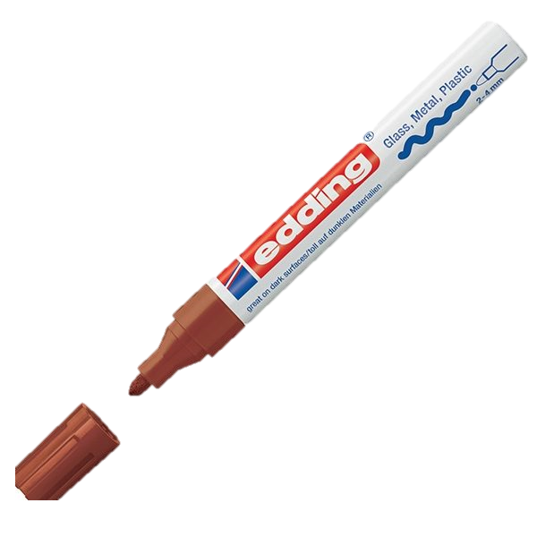
Ed: Chromatography
CW
Do Now: What colours make up the colour brown in a felt tip pen?

Slide 3
Requisitions
Equipment | Worksheets
Chromatography Practical

Slide 4
1 What E happens when a liquid turns to gas only at its surface?
2 What DS is left behind when a solution is heated?
3 Which SC is a substance found in rock salt?
4 What B means salty water?
5 What SS is made by evaporating sea water?
6 What B is when all parts of a liquid are turning into a gas at once?
7 Which BP is the temperature at which a liquid boils?

Slide 5
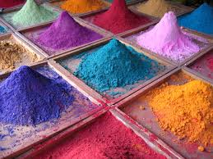
Ink and Dye
Write Down
A solid coloured pigment is dissolved into a liquid; making a coloured solutions

Slide 6
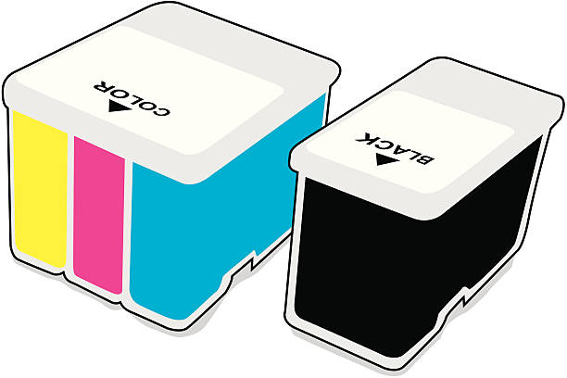
Think about this…
How many ink cartridges does a printer use?
How many colours does it produce?

Slide 7
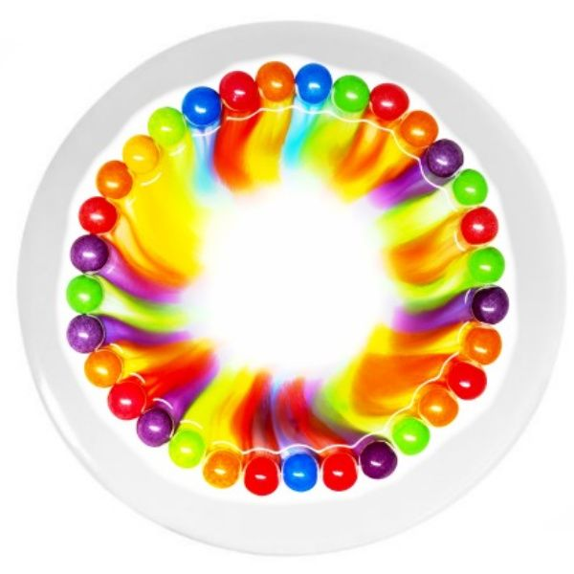
Watch and Complete (video)
Copy & Complete
Chromatography separates substances _________ in a mixture in order to identify each substance.
It can be used to find out which colours are ________ together in different paints, dyes and inks.
The substances are carried at different ________, which separates them out
dissolved
mixed
speeds

Slide 8
Copy and Label

Slide 9
Copy and Label

Slide 10
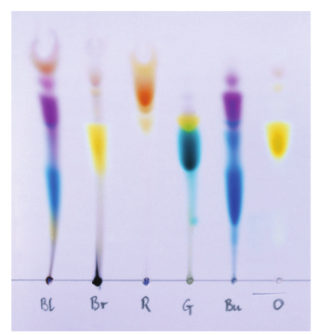

Slide 11
Experiment
Check that your paper hangs close to the bottom of the empty beaker without touching it
Draw a pencil line on the paper, about 2cm from the bottom
Put a small spot of ink from each pen on your pencil line
Label underneath each spot with a pencil
Pour some water into the beaker to a depth of about 1 cm.
Lower the chromatography paper into the beaker so that the bottom of the paper is in the water, but the water level is below the spots.
Leave the paper in the beaker until the water reaches near the top of the paper.

Slide 12
Uses of Chromatography
Write Down
Water analysis – clean water must be tested before it can be used for drinking water.
Testing for banned drugs
Forensic analysis
Food analysis

Slide 15
Analysing your Results
Stick your chromatogram into your book.
Write the colour marker you used and label each of the dyes that separated out.

Slide 16
Analysing a Chromatogram
Extension task

Slide 17
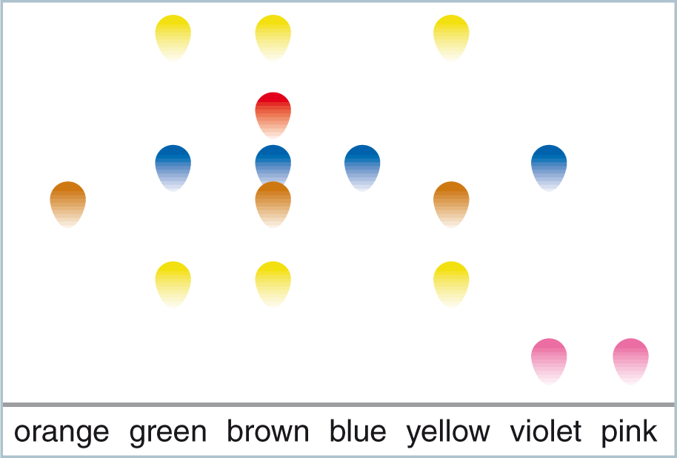
Analysing a chromatogram
The chromatogram below shows the colourings found in various coloured sweets.

Slide 18
From the chromatogram what can you tell about the colourings in the different sweets?
Which sweets have lots of different colours in them?
Which sweets have only a few?
© Pearson Education Ltd 2014. Copying permitted for purchasing institution only. This material is not copyright free.
Notes:
18

Slide 19
The orange, blue and pink sweets just contain one colouring because there is only one dot above these colours.
The violet sweets contain two colourings as there are two dots.
© Pearson Education Ltd 2014. Copying permitted for purchasing institution only. This material is not copyright free.
Notes:
19

Slide 20
How many colourings are in the brown sweets?
Answer =
5
© Pearson Education Ltd 2014. Copying permitted for purchasing institution only. This material is not copyright free.
Notes:
20

Slide 21
The brown and yellow sweets both contain the colouring substance used in the orange sweets.
They all have a dot of the same colour that moved the same distance above the start line.
© Pearson Education Ltd 2014. Copying permitted for purchasing institution only. This material is not copyright free.
Notes:
21

Slide 22
Which sweets contained the same colouring as the blue sweets?
Answer =
green, brown and violet.
© Pearson Education Ltd 2014. Copying permitted for purchasing institution only. This material is not copyright free.
Notes:
22

Slide 23
Which sweets have the colourings from the blue and pink sweets mixed together?
Answer =
violet.
© Pearson Education Ltd 2014. Copying permitted for purchasing institution only. This material is not copyright free.
Notes:
23

Slide 24
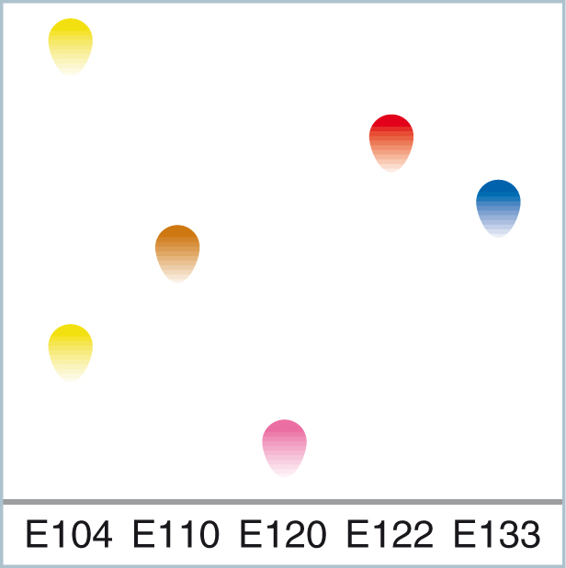
All food additives (including food colourings) are classified and given an ‘E number’.
The colourings in the sweets all have E numbers.
Some people can suffer allergic reactions with food additives.
© Pearson Education Ltd 2014. Copying permitted for purchasing institution only. This material is not copyright free.
Notes:
24

Slide 25
Therefore, it is important to know which E numbers are in which foods.
If you were allergic to E104 which sweets would it not be safe for you to eat?
Answer =
green, brown and yellow.
© Pearson Education Ltd 2014. Copying permitted for purchasing institution only. This material is not copyright free.
Notes:
25

