Slide 1
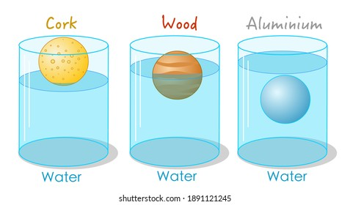
8Ia2 Density
CW
Do Now:
Where is the density of something important?

Slide 2
Requisitions
Equipment | Worksheets
Density blocks (including some irregular shaped objects). Mass balances. Rulers. Large beakers/tubs to test floating or sinking. Displacement cans. Measuring cylinders. Bosses & Clamps. DEMO: Cartesian Diver

Slide 3
Write Down
Density is a way of saying how much mass there is in a certain volume
m
$$ρ= \frac{m}{v}$$
$$density= \frac{mass}{volume}$$
ρ
V
Units for density: kg/m³ or g/cm³.

Slide 4
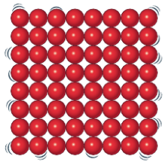
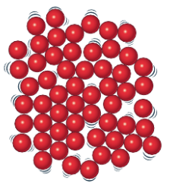
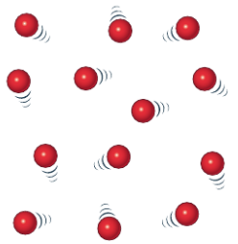
Which has the higher density, and why?
solid
liquid
gas
If I heat a solid what happens to it’s density?

Slide 5
My Learning Journey……
Completed
Developing | Securing | Working Scientifically
Describe how to measure the mass and volume of regular and irregular objects.
Explain how density depends on mass and volume.
State what is meant by density and recall is units and the factors affecting it.
Using the particle model describe how the density of a substance changes with temperature
Change the subject of a formula.

Slide 6
Write Down
Density Investigation
Aim
To investigate how to calculate the density of an object.
Method
In pairs, discuss what apparatus would you need?

Slide 7
Write out your method in a numbered list. Include what measurements you will take and the calculations you will do with them to find the volume and density.
How do we calculate volume?
How do we set out calculations in physics?
How do we calculate density?

Slide 8
Q
E
R
N
C
U
UANTITIES
Write Down inside front cover
QUATION
EARRANGE
UMBERS
ALCULATE
NITS

Slide 9
Choose a material
Use a balance to find its mass
Measure the length, height and width of your material
Multiply the measurements to find your volume
Divide by the mass by volume. This is the density
Now see if your material floats or sinks and record results
Repeat using other materials.
Correct your method as needed and carry it out for 3 materials.
Show all your working using QE(R)NCU.

Slide 10
Q
E
(R)
N
C
U

Slide 11
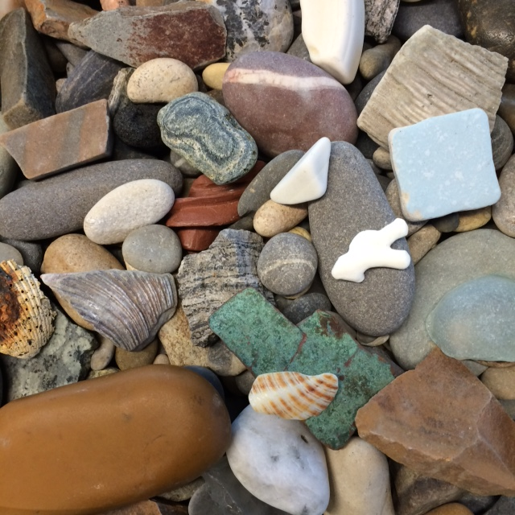
How do we calculate density for an irregular shaped object?

Slide 12
Collect your apparatus for method 2.
Write down the mass of the object and and the volume of water displaced.
Calculate the density of the object and whether it floats or sinks

Slide 13
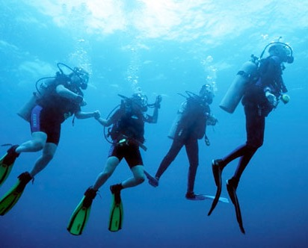
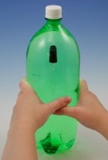
Why do some things float & others sink?
How does a cartesian diver work?
How can we get back up to the surface?

Slide 15
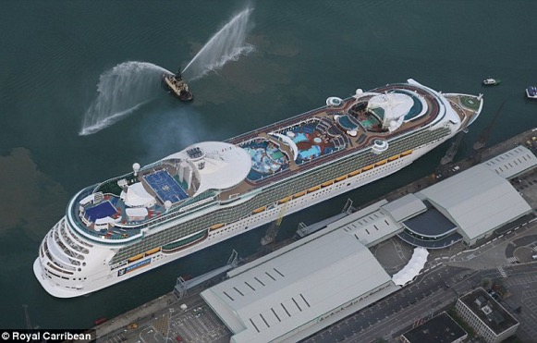
high
Materials with a ____ density sink and materials with a low density ____ in water.
Water has a density of 1 g/cm³. If a material has a density ____ than water it will float.
float
less
Density of steel = 7.7 g/cm³
How can this 160 000 tonne steel ship stay afloat?!

Slide 16
Q
E
R
N
C
U

Slide 17
Example

Slide 18
Self assess.

Slide 19
My Learning Journey……
Completed
Developing | Securing | Working Scientifically
Describe how to measure the mass and volume of regular and irregular objects.
Explain how density depends on mass and volume.
State what is meant by density and recall is units and the factors affecting it.
Using the particle model describe how the density of a substance changes with temperature
Change the subject of a formula.

Slide 20
 Give a clue or definition for these keywords.
Hot Seat

Slide 21
Hot seat
 Give a clue or definition for these keywords.
Volume

Slide 22
Hot seat
 Give a clue or definition for these keywords.
Density

Slide 23
Hot seat
 Give a clue or definition for these keywords.
g/cm³

Slide 24
Hot seat
 Give a clue or definition for these keywords.
Mass

Slide 25
Hot seat
 Give a clue or definition for these keywords.
Method

Slide 26
Hot seat
 Give a clue or definition for these keywords.
Displacement

