Slide 1
8Hc Weathering and Erosion
CW
Do Now:
Why are there gaps in the limestone?
How has this happened?

Slide 2
Requisitions
Period | Set | Room | SoW Ref | Equipment | Worksheets
 |  |  |  |  | Freeze Thaw Worksheet 8Hc5

Slide 3
Objectives
Recall some examples of physical changes and of chemical changes.
Describe the effect of physical and biological weathering on rocks.
Explain why rainwater is slightly acidic.
Describe the effect of chemical weathering on rocks.
Recall how weathered rocks are eroded and explain how fragments get worn down during transport.
Describe the link between the size of rock fragments carried and the water speed.
Describe how weathering can break up rocks.
Compare the fragment sizes that can be transported by wind, water and ice.

Slide 4
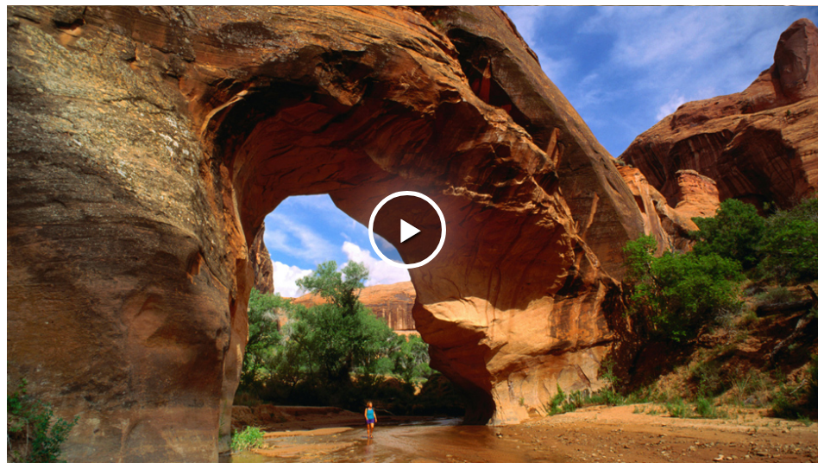

Slide 5
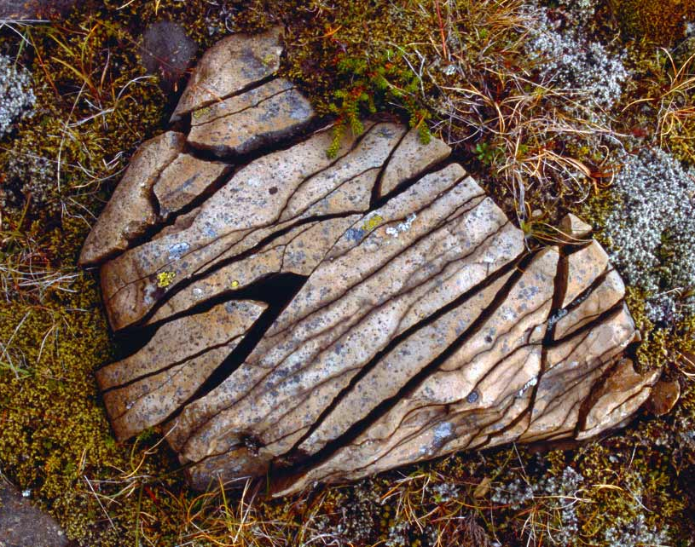
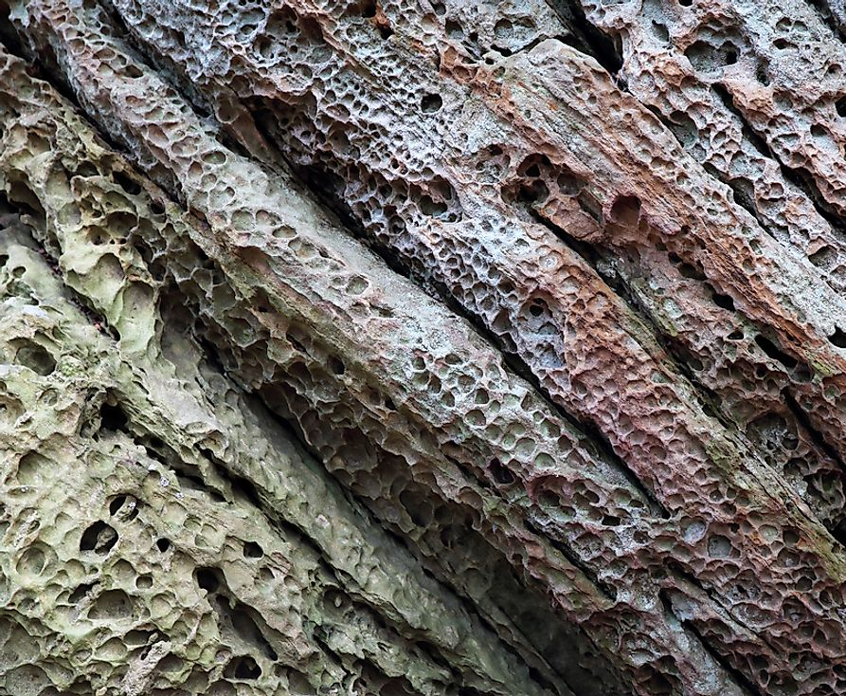
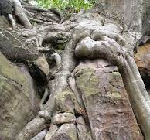
Types of Weathering
Write Down
Physical Chemical Biological

Slide 6
Use the text below to complete the worksheet
Physical Weathering
Freeze-thaw action
Freeze-thaw weathering starts with a tiny dip or crack in a rock.
Rain gets into the crack and when the temperature drops below 0 °C the water freezes.
The expanding ice pushes on the sides of the crack.

Slide 7
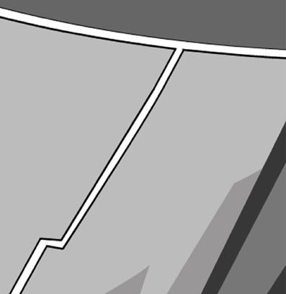
The force from the expanding ice makes the crack wider and longer.
After many cycles of freezing and thawing, the crack may get so big that the rock breaks up completely.

Slide 8
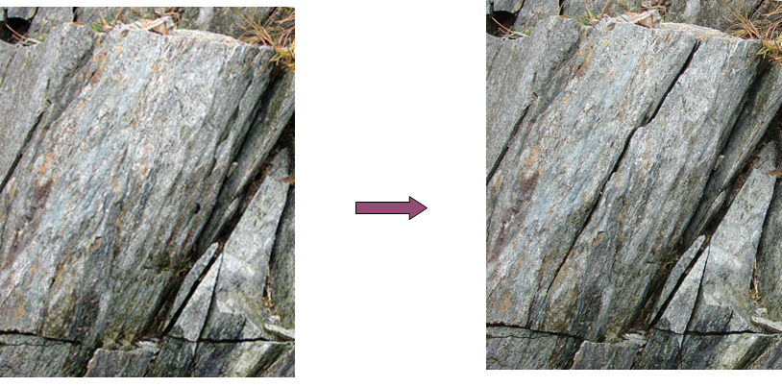

Slide 9
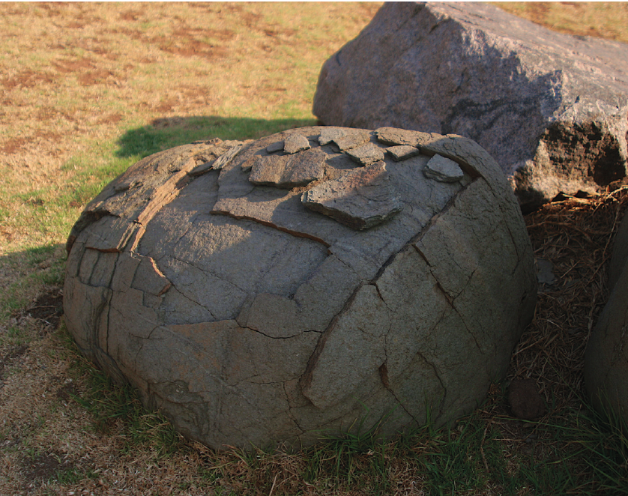
Write Down
Onion-Skin Weathering
The Sun heats up the outer layers of the rock which expand slightly compared to the cooler inner layers. This can cause the outer layer to crack.
At night, the outer layers of the rock contract as they cool down, causing further cracks to appear
The outer layers may crack so much that they fall away.

Slide 10
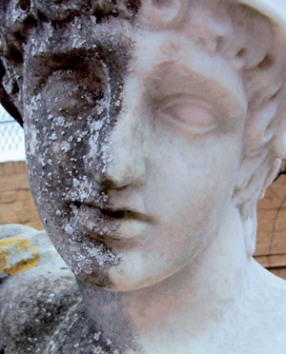
Write Down
Chemical Weathering
Rain contains dissolved gases which make it slightly acidic.
When this rain falls onto rocks it can react with minerals to cause chemical weathering.
The reaction with these minerals creates new minerals which are often weaker or more soluble.
This means that they will wear away easily.

Slide 11
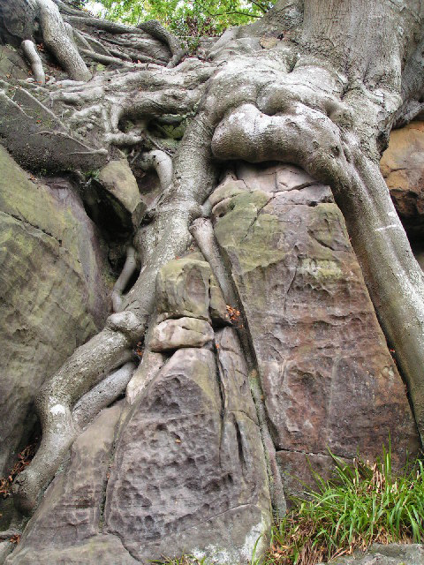
Write Down
Biological Weathering
Weathering can be caused by animals and plants.
Plants roots can grow into cracks within rocks. As these plants grow, the roots become larger and fracture the rock further.

Slide 12
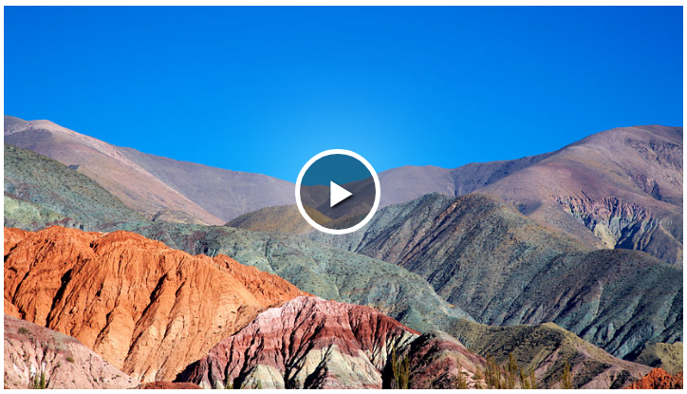

Slide 13
Copy & Complete
Erosion
aste
The wearing away of rock and the removal of w______ debris and soil. Erosion typically occurs by the action of rivers, g_______ , waves, wind and even animals.
Not to be confused with w__________ , which is the breaking down of rock by c________ and p__________ processes.
laciers
eathering
hemical
hysical

Slide 14
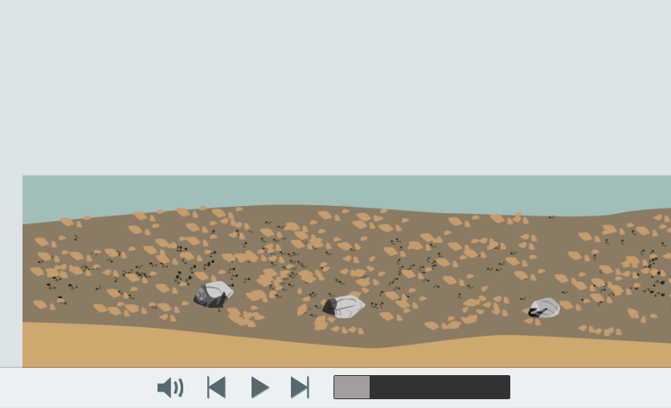

Slide 15
Transport
Copy & Complete
Rivers and wind can transport rocks and sediment long distances. The ______ the water or wind moves, the _______ the bits of rock and sediment it can transport.
During transport, rocks can collide into each other, breaking apart. This is called ________.
The longer a rock of bit of sediment is transported, the smaller and rounder it becomes.
faster
larger
abrasion
Notes:
https://www.activeteachonline.com/product/view/id/335/page/124/mode/dps?modal=/player/animation/id/390823

Slide 16
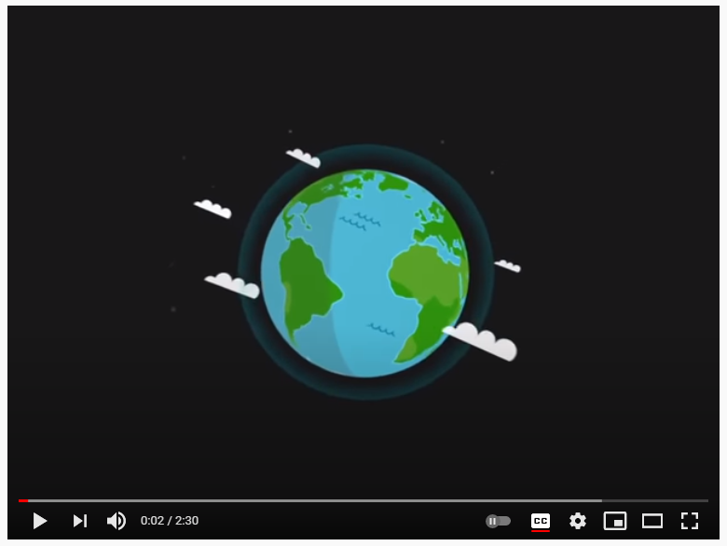

Slide 17
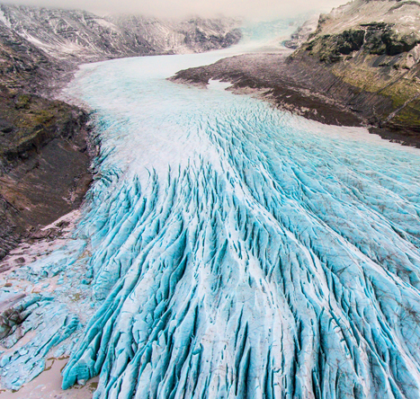
Glaciers
Write Down
Glaciers are large rivers of ice that move slowly and can transport large sediment and rocks.
These rocks can scrape away at the land they move over and abrade them until they become small particles.
Notes:
https://www.youtube.com/watch?v=loI584OFVpE

Slide 18
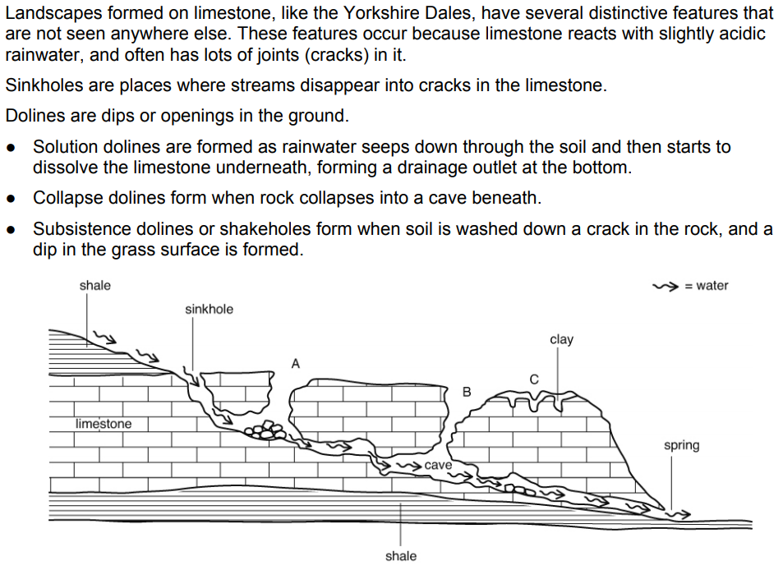

Slide 20
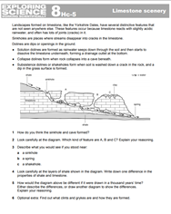
Extension/ H/W
Complete W/S 8Hc-5

Slide 21
 Give a clue or definition for these keywords.
Hot Seat

Slide 22
Hot seat
 Give a clue or definition for these keywords.
Chemical weathering

Slide 23
Hot seat
 Give a clue or definition for these keywords.
Freeze Thaw

Slide 24
Hot seat
 Give a clue or definition for these keywords.
Biological weathering

Slide 25
Hot seat
 Give a clue or definition for these keywords.
Abrasion

Slide 26
Hot seat
 Give a clue or definition for these keywords.
Onion skin weathering

Slide 27
Hot seat
 Give a clue or definition for these keywords.
Acid rain

