Slide 1
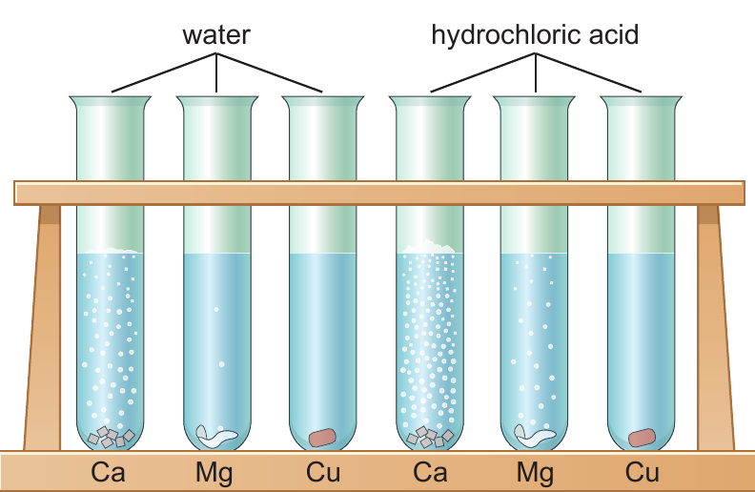
8Gd Metals and Acids

Slide 2
Collect five test tubes and put about 3 cm depth of dilute hydrochloric acid in each of them.
Put small samples of calcium, iron, copper, zinc and magnesium in each of them. Collect the calcium from your teacher.
Observe then put the petals in order of reactivity, the most reactive at the top and the least at the bottom.
Repeat the experiment with dilute sulphuric acid

Slide 3
Hydrochloric acid
Calcium
Magnesium
Zinc
Iron
Copper
Sulphuric acid
Calcium
Magnesium
Zinc
Iron
Copper
Increasing reactivity

Slide 4
This list is called a reactivity series

Slide 5
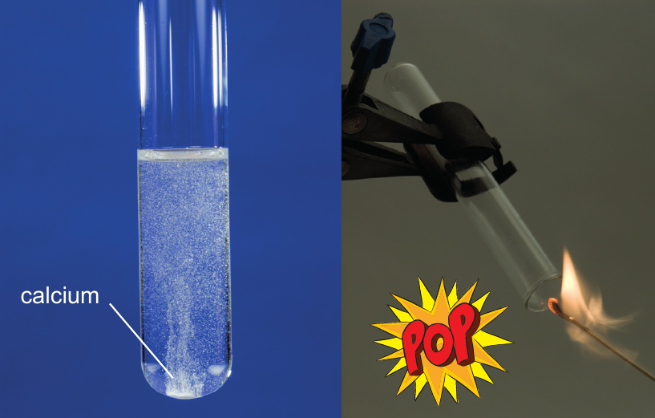
Put some magnesium in a test tube with acid and test with a burning splint.
magnesium

Slide 6
True or false
All metals react with dilute acid.
The order of reactivity depends on the acid.
Metals react faster with acids than they do water.
Hydrogen is produced when metals react with acids.
Copper is a very reactive metal.
False
False
True
True
False

Slide 7
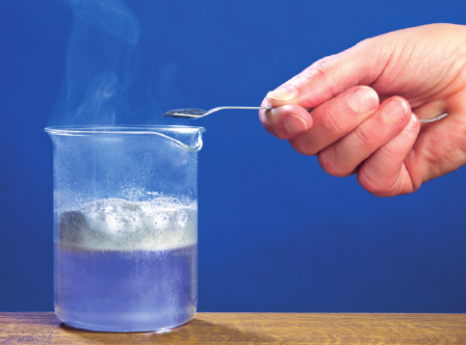
General equation.
metal + acid → salt + hydrogen

Slide 8
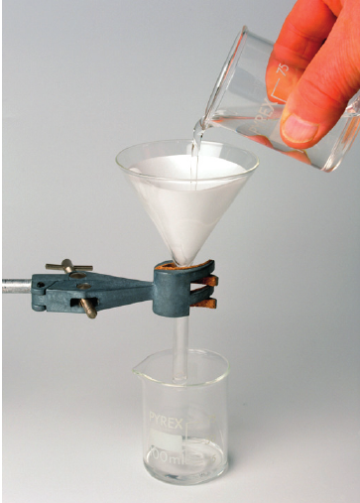
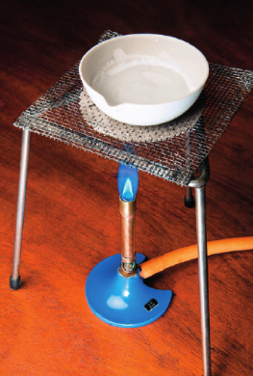
Obtaining a solid sample of the salt
React excess metal with the acid
Filter the mixture to remove solid metal
Evaporate the water until crystals of salt start to form.

Slide 9
Match the name of the acid with the formula
Hydrochloric acid
Nitric acid
Sulphuric acid
HNO₃
H₂SO₄
HCl
All acids contain the element…
hydrogen

Slide 10
Naming Salts

Slide 11
The rules
Hydrochloric acids make chlorides, sulfuric acid makes sulfates, nitric acid makes nitrates.
The name of the salt comes from the metal and the acid.
+
hydrochloric acid
+
magnesium
chloride
hydrogen
magnesium
→
The acid
The metal
The salt
+
magnesium
sulfate
+
hydrogen
Sulfuric
acid
magnesium
→

Slide 12
Word equations
iron + hydrochloric acid→
magnesium + sulfuric acid →
zinc + nitric acid →
Iron chloride + hydrogen
magnesium sulfate + hydrogen
zinc nitrate + hydrogen

Slide 13
Balanced symbol equations
Magnesium (Mg) reacts with hydrochloric acid (HCl) to form magnesium chloride (MgCl₂) and hydrogen (H₂)
Step 1 Write down the correct formulae. The reactants are on the left and the products are on the right.
Mg + HCl → MgCl₂ + H₂

Slide 14
Step 2 Balance the equation.
2
Mg + HCl → MgCl₂ + H₂
Mg
1
1
H
X
1
2
2
Cl
X
2
2
1

