Slide 1
Requisitions
Demo:
worksheets:
8Ed-1
8Ed-4
© Pearson Education Ltd 2014. Copying permitted for purchasing institution only. This material is not copyright free.

Slide 2
Objectives
Recall examples of non-metal oxide pollutants caused by burning fossil fuels and their impurities.
Describe the reactions of non-metals with oxygen.
Explain the products formed by the complete and incomplete combustion of hydrocarbons.
Explain the problems caused by incomplete combustion.
Explain how sulfur dioxide and nitrogen oxides are produced in some combustion reactions.
Explain how sulfur dioxide and nitrogen oxides help to cause acid rain.
Explain how neutralisation can be used to reduce pollution from fossil fuel combustion.
Explain how vehicle catalytic converters work (to reduce pollution from fossil fuel combustion).
Explain the effects of acid rain on organisms, bodies of water.
Evaluate ways in which pollution from non-metal oxides can be reduced.

Slide 3
Learning Objectives
Developing | Securing | Exceeding
Must… | Should… | Could…
Recall examples of non-metal oxide pollutants caused by burning fossil fuels and their impurities. Describe the reactions of non-metals with oxygen. | Explain the products formed by the complete and incomplete combustion of hydrocarbons. Explain the problems caused by incomplete combustion. Explain how sulfur dioxide and nitrogen oxides are produced in some combustion reactions. Explain how sulfur dioxide and nitrogen oxides help to cause acid rain. Explain how neutralisation can be used to reduce pollution from fossil fuel combustion. Explain how vehicle catalytic converters work (to reduce pollution from fossil fuel combustion). Explain the effects of acid rain on organisms, bodies of water. | Evaluate ways in which pollution from non-metal oxides can be reduced.

Slide 4
CW
8Ed Air Pollution
Copy and complete the following word equations table
 | SOURCE
Carbon + Oxygen →
Carbon + Oxygen →
Hydrogen + Oxygen →
Carbon
Sulphur + Oxygen →
Nitrogen + Oxygen →
Carbon dioxide
These reactions can occur when fuels are burnt.
Carbon monoxide
Hydrogen oxide (water vapour)
Sulphur dioxide
Nitrogen oxide

Slide 5
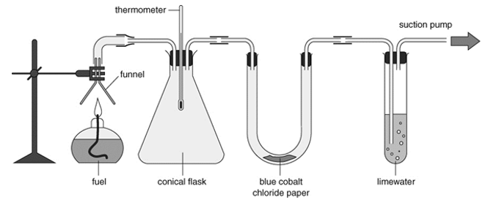
What oxides are produced in COMPLETE combustion of hydrocarbon fuels? Hint: think back to 8Ea lesson
Carbon dioxide
Hydrogen oxide (water vapour)

Slide 6
Add the source to your table
 | SOURCE
Carbon + Oxygen →
Carbon + Oxygen →
Hydrogen + Oxygen →
Carbon
Sulphur + Oxygen →
Nitrogen + Oxygen →
Carbon dioxide
Complete combustion
Carbon monoxide
Hydrogen oxide (water vapour)
Complete combustion
Sulphur dioxide
Nitrogen oxide

Slide 7
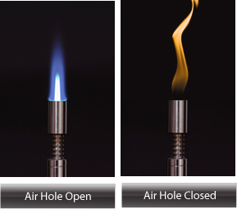
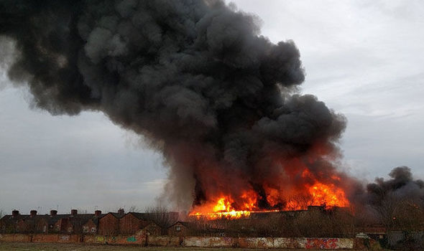
What happens when there is not enough oxygen?
INCOMPLETE combustion of hydrocarbon fuels
What causes the smoke to be black?

Slide 8
Add the source to your table
 | SOURCE
Carbon + Oxygen →
Carbon + Oxygen →
Hydrogen + Oxygen →
Carbon
Sulphur + Oxygen →
Nitrogen + Oxygen →
Carbon dioxide
Complete combustion
Carbon monoxide
Incomplete combustion
Hydrogen oxide (water vapour)
Complete combustion
Incomplete combustion
Sulphur dioxide
Nitrogen oxide

Slide 9
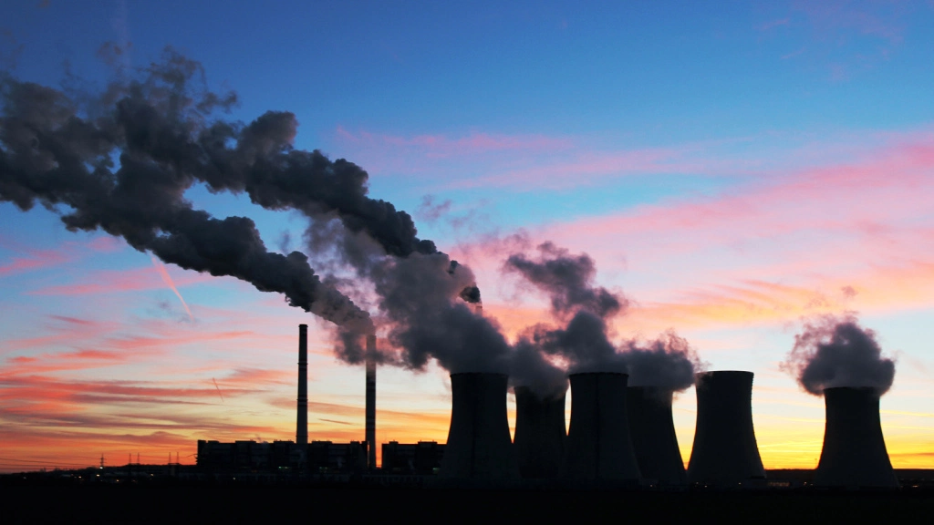
Some fuel contain impurities

Slide 10
Add the source to your table
 | SOURCE
Carbon + Oxygen →
Carbon + Oxygen →
Hydrogen + Oxygen →
Carbon
Sulphur + Oxygen →
Nitrogen + Oxygen →
Carbon dioxide
Complete combustion
Carbon monoxide
Incomplete combustion
Hydrogen oxide (water vapour)
Complete combustion
Incomplete combustion
Impurities in hydrocarbon fuels
Sulphur dioxide
Nitrogen oxide

Slide 11
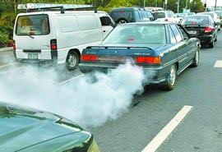
Nitrogen oxides are produces in the high temperatures of an engine
Where does the nitrogen and oxygen come from?

Slide 12
Add the source to your table
 | SOURCE
Carbon + Oxygen →
Carbon + Oxygen →
Hydrogen + Oxygen →
Carbon
Sulphur + Oxygen →
Nitrogen + Oxygen →
Carbon dioxide
Complete combustion
Carbon monoxide
Incomplete combustion
Hydrogen oxide (water vapour)
Complete combustion
Incomplete combustion
Impurities in hydrocarbon fuels
Sulphur dioxide
Nitrogen oxide
Air in engines

Slide 13
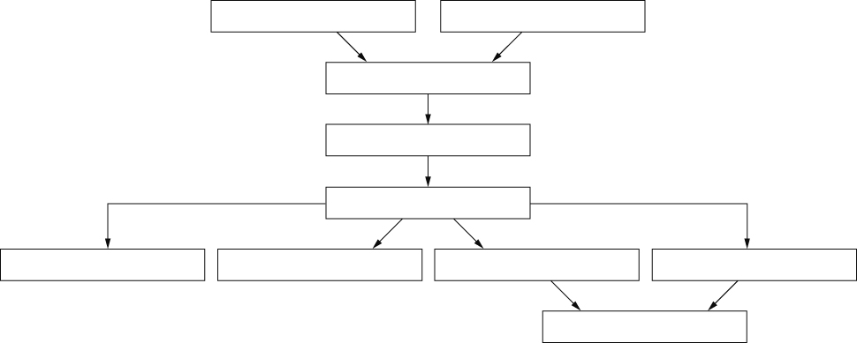
What problems do these pollutants cause?
Use Acid Rain presentation and video on P 79 Yr8 active book
Complete w/s 8Ed-4
D Nitrogen oxides are produced by car engines.
I Burning fossil fuels, such as petrol and diesel, produces carbon dioxide, sulfur dioxide and nitrogen oxides.
B Acidic gases dissolve in moisture in the air
E The dissolved gases make rain more acidic.
F Acid rain falls onto the land and runs into lakes and rivers.
C Acid rain reacts with chemicals in the soil to release poisonous compounds
A Fish die in acidic lakes.
H Acid rain speeds up the weathering (breaking down) of rocks.
J Acid rain washes some mineral salts out of the soil.
G Plants become unhealthy.

Slide 14
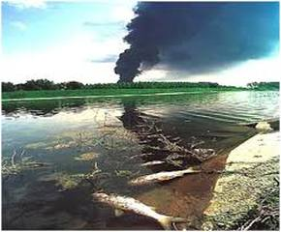
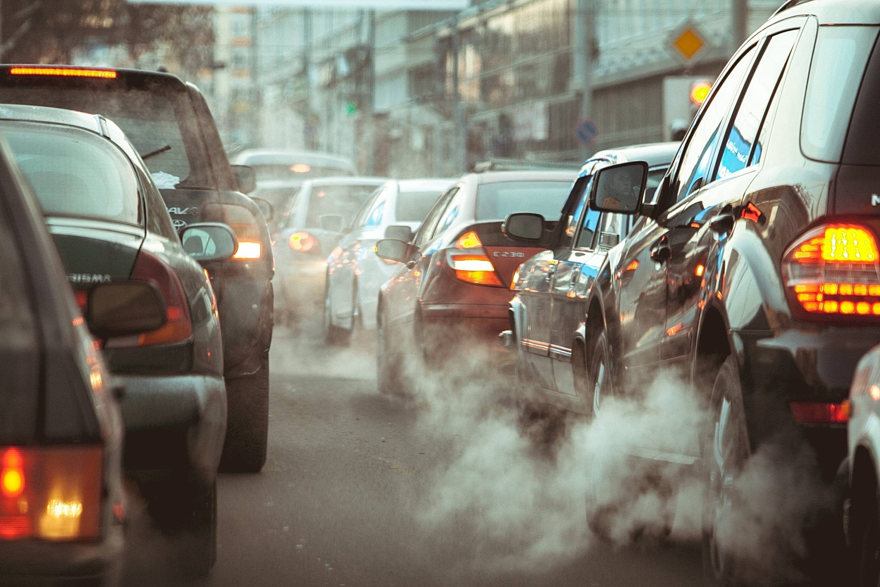
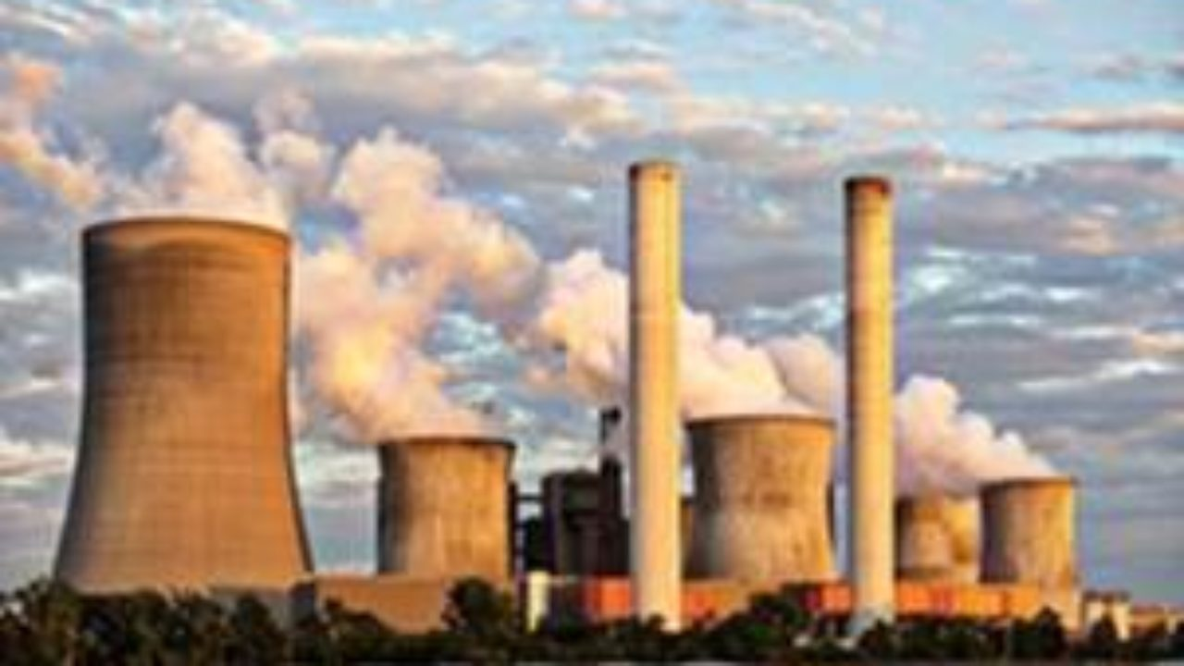
How are pollutants reduced?

Slide 15
Modern car have a catalytic converter to change polluting gas and a filter to remove carbon particles (soot).

Slide 16
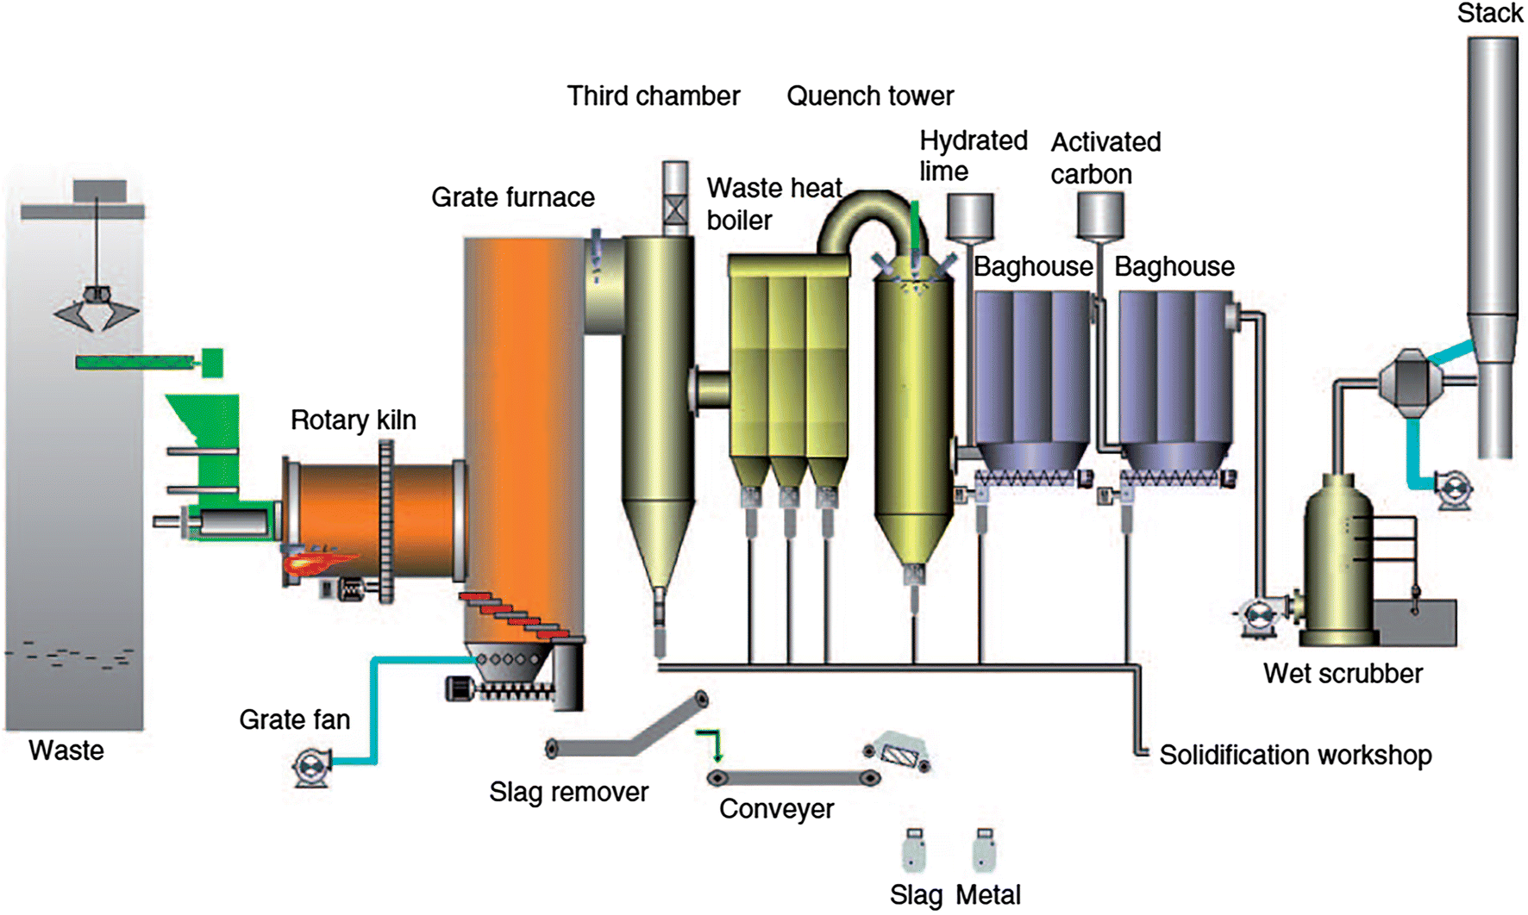
Neutralisation reactions are used to remove the acidic gases from chimney smoke.

Slide 17
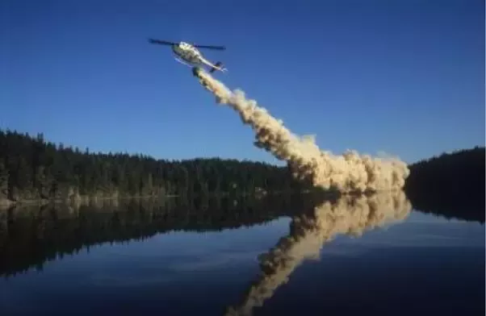
Alkali substances such as calcium carbonate are used to neutralise acidic soil and waterways.

Slide 18
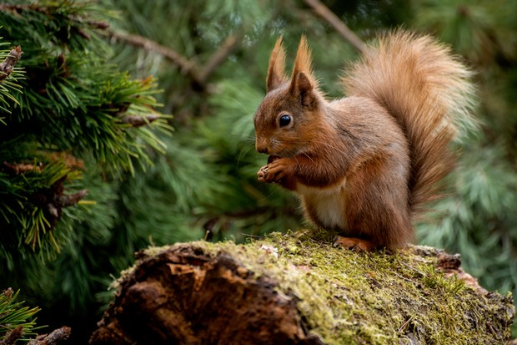
Homework:
w/s 8Ed-1, 8 or 9
Active learn: Exercises 8Ed developing, secure & exceeding
Date due:

Slide 19
Thinking skills
Air pollution

Slide 20
Consider all the possible answers to this statement:
The concentration of nitrogen oxides at a monitoring station changes during the day.
Possible answers
Next question

Slide 21
Consider all the possible answers to this statement:
The concentration of nitrogen oxides at a monitoring station changes during the day.
The monitoring station is near a busy road where the amount of traffic changes at different times of day.
The monitoring station is near factories where more fossil fuels are burnt at some times of day than at others.
Wind blows with different strengths during the day.
Possible answers
Next question
© Pearson Education Ltd 2014. Copying permitted for purchasing institution only. This material is not copyright free.

Slide 22
Consider all the possible answers to this statement:
The concentrations of sulfur dioxide in the air have fallen.
Possible answers
Next question
© Pearson Education Ltd 2014. Copying permitted for purchasing institution only. This material is not copyright free.

Slide 23
Consider all the possible answers to this statement:
The concentrations of sulfur dioxide in the air have fallen.
Vehicles are using low-sulfur fuels in their engines.
Power stations and industries are removing sulfur from their emissions before they are released into the air.
Power stations and industries have changed to burning fuels that contain less sulfur, e.g. natural gas.
The wind is blowing more strongly.
It has been raining and more of the sulfur dioxide has dissolved in the rain.
Possible answers
Next question
© Pearson Education Ltd 2014. Copying permitted for purchasing institution only. This material is not copyright free.

Slide 24
Think of a Plus, a Minus and an Interesting point about this statement:
All road vehicles should be fitted with a soot filter and a catalytic converter.
Possible answers
Next question
© Pearson Education Ltd 2014. Copying permitted for purchasing institution only. This material is not copyright free.

Slide 25
Think of a Plus, a Minus and an Interesting point about this statement:
All road vehicles should be fitted with a soot filter and a catalytic converter.
Plus: This would reduce air pollution by particles, carbon monoxide and nitrogen oxides.
Minus: This will make the vehicles more expensive to buy.
Interesting: Vehicles that use hydrogen don’t produce particulates or gases that a catalytic converter clears from exhaust gases. Could all vehicles, even very old ones, be fitted with these attachments?
Possible answers
Next question
© Pearson Education Ltd 2014. Copying permitted for purchasing institution only. This material is not copyright free.

Slide 26
Which is the odd one out in this list?
Carbon dioxide Carbon monoxide Carbon
Possible answers
End show
© Pearson Education Ltd 2014. Copying permitted for purchasing institution only. This material is not copyright free.

Slide 27
Which is the odd one out in this list?
Carbon dioxide Carbon monoxide Carbon
Carbon, because it hasn’t reacted with oxygen.
Carbon monoxide because it is the only one that is poisonous.
Carbon because it is a solid and the others are gases.
Possible answers
Back to start
End show
© Pearson Education Ltd 2014. Copying permitted for purchasing institution only. This material is not copyright free.

