Slide 1
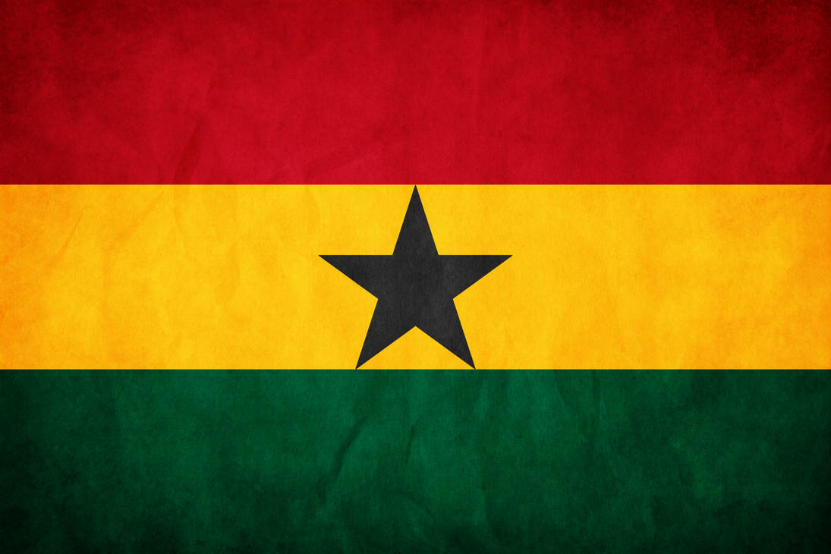
Facts about Ghana
By Bobbi-Jo Abraham 8P1

Slide 2
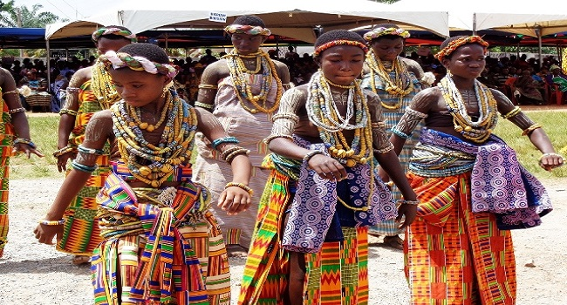
culture and tradition
Traditionally, Ghana as a nation was divided into three different castes namely, royals, commoners, and slaves. Up to date, the traditional class stratification is still recognized although slavery is not prominent in today’s Ghana.
Ghana uses English as their official language which however has a distinctive West African Accent.

Slide 3
Ghana’s interesting history
Ghana was the first country to gain independence in West Africa from the British people.
The country was named after the medieval empire of West Africa which initially was Wagadugu.
Ghana before 1957 was commonly known as the Gold Coast due to the availability of gold along the rivers Ankobra and Volta.

Slide 4
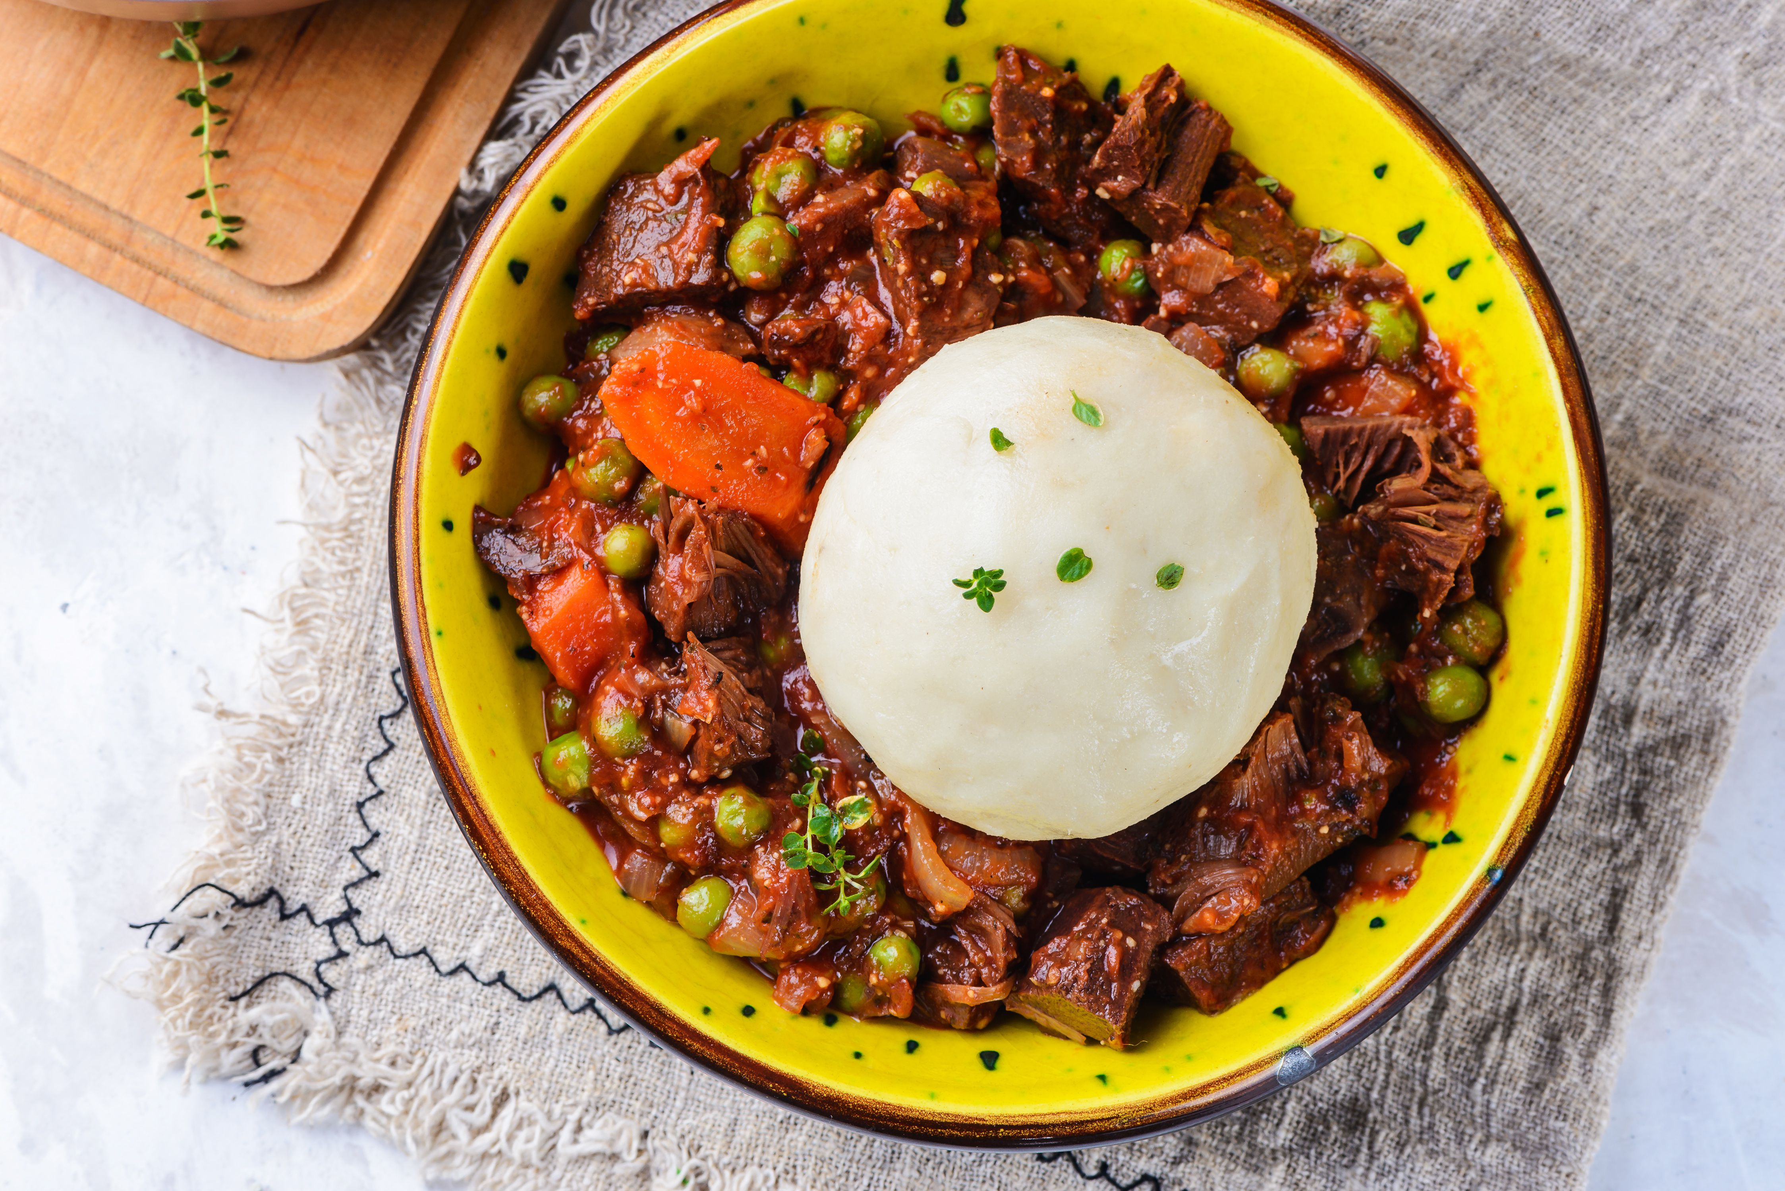
Ghana's delicious food
Most of the Ghanaian foods are traditional reflective of the country’s history as well as agriculture.
The delicacy for most people is boiled cassava, plantains, and yams which are rolled into balls commonly known as fufu.
Most, if not all dishes in Ghana are spiced up mainly with chilies and red peppers.
Ghanaians celebrate a dancing festival held annually and most of their celebrities are known globally as not allowing their wealth or even statuses affect their daily living.

Slide 6
The End
Thanks for listening to me about my culture.
-By Bobbi-Jo Abraham 8P1.
This Photo by Unknown author is licensed under CC BY-NC-ND.

