Slide 1
8Ec1: Fair Testing
Do Now:
Write the conservation of mass in your own words

Slide 2
Requisitions
Equipment | Worksheets
Different size beakers Tea lights Matches ? Stop watches | Safety Symbols Fire Triangles

Slide 3
Objectives
Identify variables that need to be controlled in a given experiment.
Plan ways in which to control a simple control variable.
Explain the need for a fair test.
Plan ways in which to control more than one variable.
Justify the choice of control variables.
Name the three sides of the fire triangle and describe how to stay safe in familiar situations.
Recognise hazard symbols.
Use the idea of the ‘fire triangle’ to explain how to extinguish a fire.
Justify methods of risk reduction.
Evaluate data on burning fuels to deduce the best energy per gram of fuel.

Slide 4
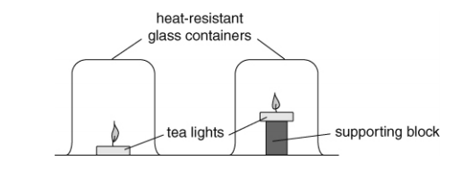
Demonstration 8Ec.2
Aim: to investigate the effect of candle flame height on the length of time it takes to go out

Slide 5
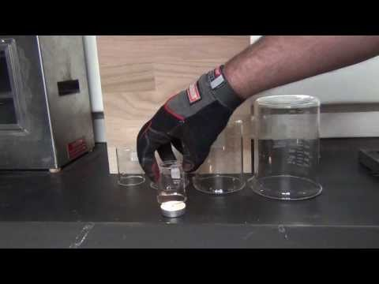

Slide 6
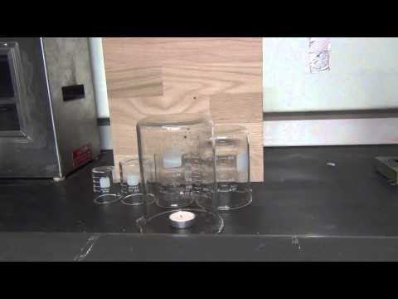

Slide 7
Aim:
To investigate the effect of candle flame height on the length of time it takes to go out
What causes the flame to extinguish?
What are the variables in this experiment?

Slide 8
Variables
A variable is a quantity or characteristic that can take different values. Every investigation involves three types of variable:
Independent Variable - The thing you change
Dependant Variable - The thing you measure
Control Variable - The things you keep the same

Slide 9
Which variables, apart from the height of the block, could vary in a way that affects the time that the candle flame burns for?
What could be done to control these variables, so that they don’t affect time?

Slide 10
Which variables, apart from the height of the block, could vary in a way that affects the time that the candle flame burns for? size of container, type of fuel used to make tea light, size of tea light, length of time tea light has already been burning (affects size of pool of liquid fuel at base of wick), length of wick.
What could be done to control these variables, so that they don’t affect time? In all cases, make sure identical apparatus used, and that the tea lights have the same size pool of melted fuel at the base of the wick

Slide 11
Think about…
3. What do your results show about the effect of height of candle on the time taken for the flame to go out?
4. Suggest a reason why height had this effect.
5. Why can you be sure that this effect was caused by the height and not something else?

