Slide 1
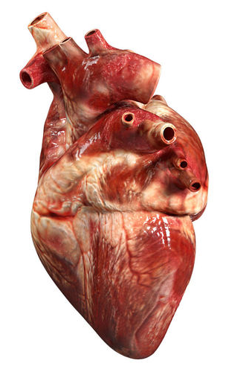
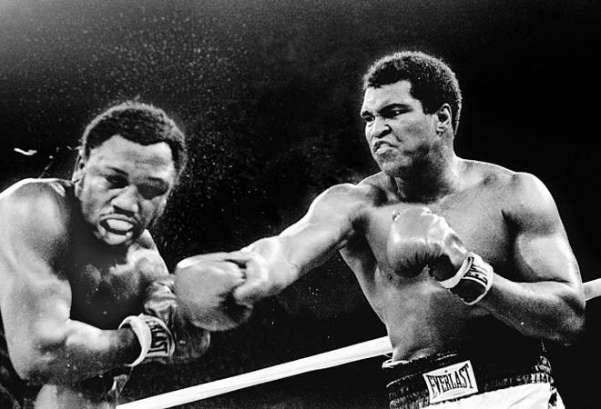
CW
7Cb Muscles and blood
What is function (job) of the heart?
Why does your heart rate increase when you exercise?
@hpscience

Slide 2
Warning!
this powerpoint contains images of blood

Slide 3
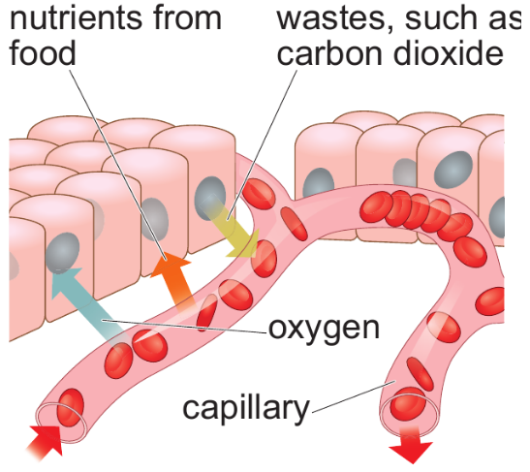
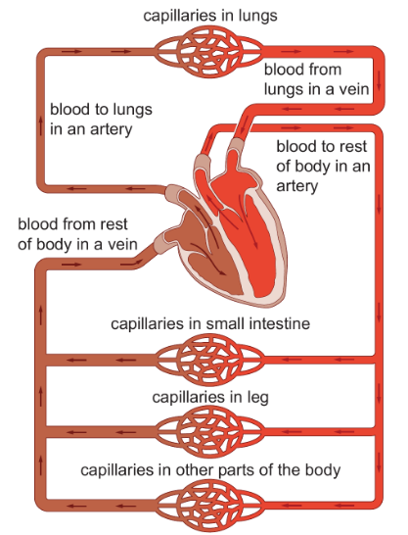
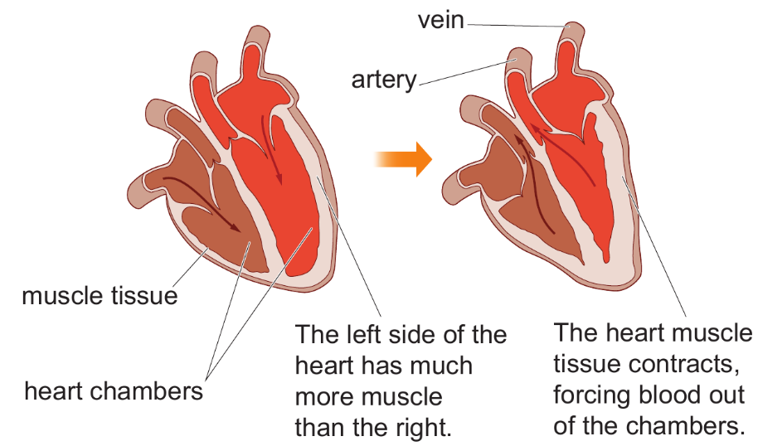
Diagrams for printing

Slide 4
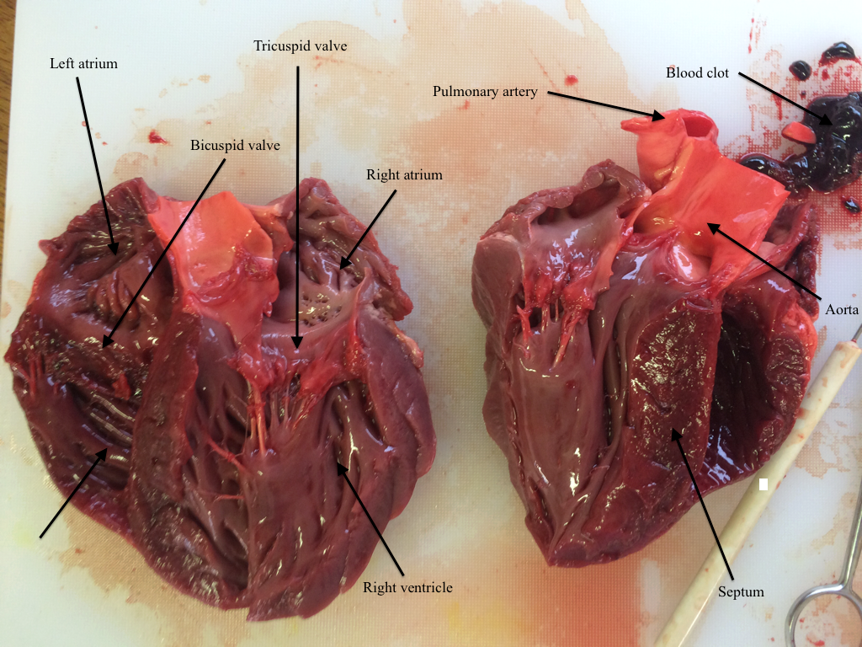
Teacher note - You may want to do a heart dissection for this lesson.
https://www.youtube.com/watch?v=_8IaqzNh3D0

Slide 5
The heart
The heart is mostly made of muscle.
The function of the heart is to pump blood around the body.
The human heart has 4 chambers. Two receive blood returning to the heart. The other two pump blood out of the heart.

Slide 6
When the muscles in the heart contract, blood is forced out of the heart and travels to the lungs and the rest of body through blood vessels.
Try to find your pulse in your neck or your wrist. The pulse is caused by the heart contracting.
If you count the pulses you can work out your heart rate.

Slide 7
Measure your heart rate.
Count the number of pulses in your wrist or neck for 15 seconds.
Multiply by 4.
This is your heart rate.
Heart rate is measured in beats per minute (BPM).

Slide 8
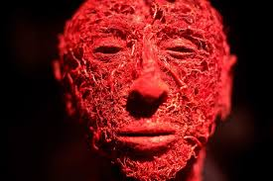
There are three types of blood vessels;
Arteries – transport blood away from the heart
Capillaries – transport blood from the arteries to the veins
Veins – transport blood back to the heart

Slide 9
Capillaries
Function – delivers nutrients and oxygen to the tissues and removes the waste products.
Structure – very thin walls to allow substances to move from the blood and tissues easily.

Slide 10
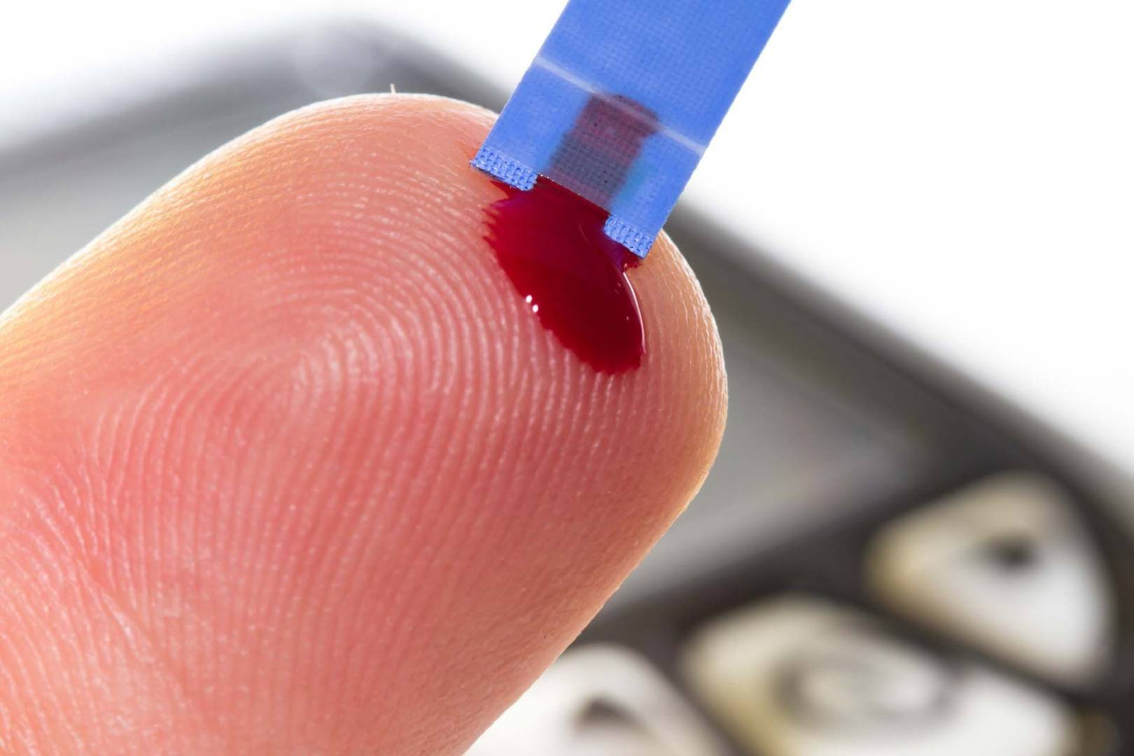
Blood
Blood is made of several components;
Plasma – the liquid part that carries nutrients (e.g. glucose and amino acids) and wastes products (e.g. CO₂)
Red blood cells – transports oxygen
White blood cells – fight infection

Slide 11
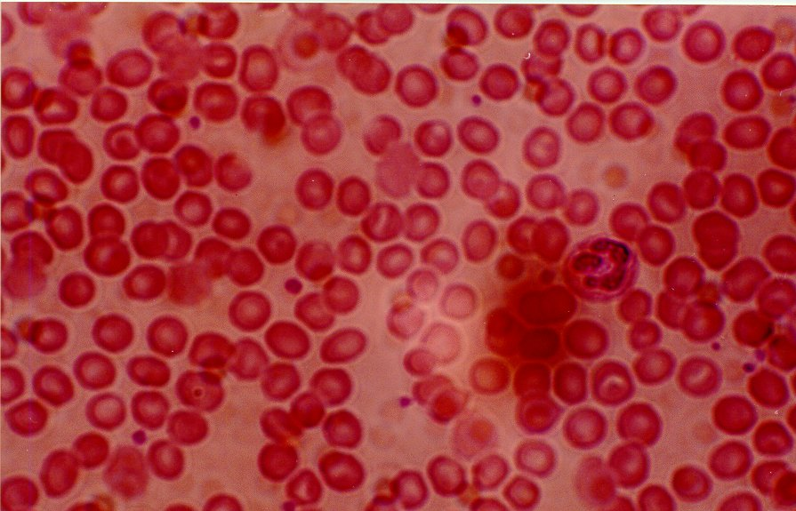
Red blood cells
Function – transport oxygen
Adaptations
Contains haemoglobin* to carry oxygen
No nucleus – more room for haemoglobin
Biconcave shape – more surface area to get more oxygen in and out quickly
*Haemoglobin is a red pigment made of protein.

Slide 12
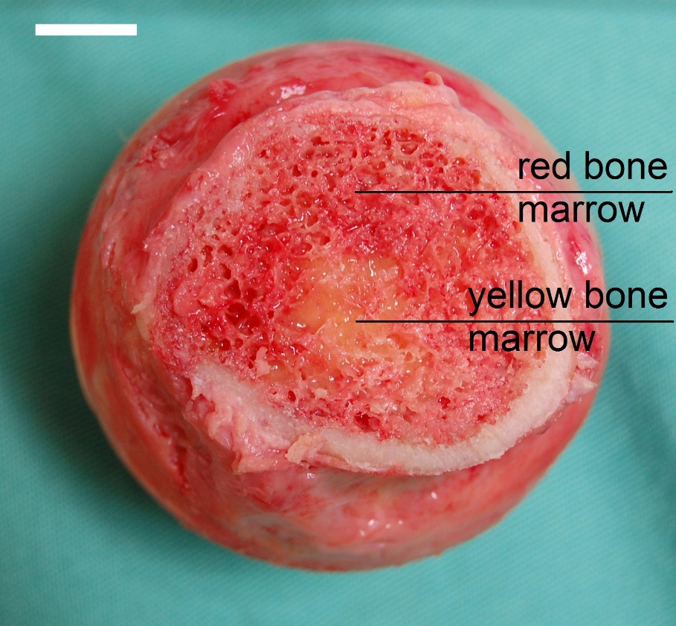
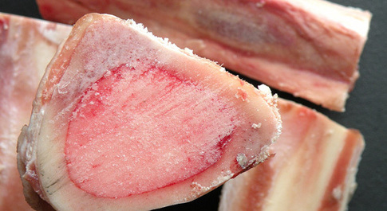
Where is blood made?
Blood is made in bone marrow.
Bone marrow is found inside larger bones.

