Slide 1
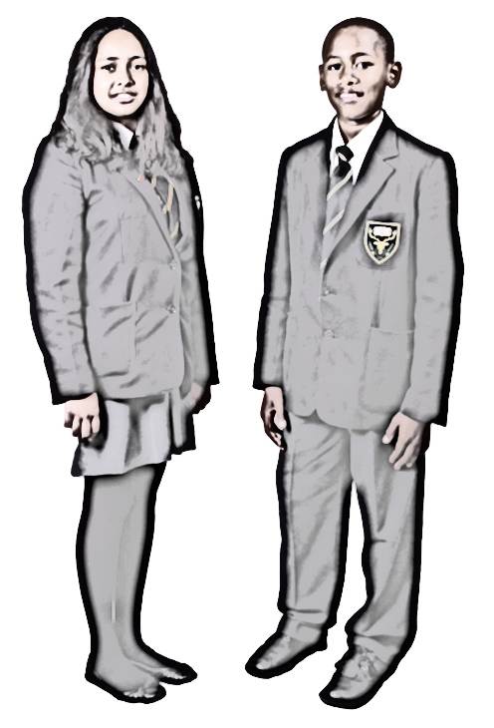

Slide 2
Highams Park school will support @youngmindsuk #helloyellow campaign on:
Monday 12- Wednesday14 October 2020

Slide 3
Why do we need to promote kindness in school?
Encouraging kind behaviour in schools can make a big difference and is so much more than just a ‘nice to have’. Evidence shows that promoting kindness among young people directly reduces disruptive behaviour and helps to increase social and emotional wellbeing.
Promoting kindness has also been shown to help reduce bullying in schools. Bullying obviously has a serious impact on children’s wellbeing and bullies are often suffering themselves too. Running a kindness project provides a positive and inclusive way forward.

Slide 4
Do kindness!
Every kindness project starts with doing: using creative activities to explore, promote and experience caring and compassionate behaviour.
It’s important that you learn by doing not just by talking or thinking about kindness this helps your ideas become real and with repetition it helps it helps them to start forming new habits.

Slide 5
Notice kindness
It is also important to notice acts of kindness done by others around you. This teaches you to look for the good things that others do and helps to create a culture which rewards caring behaviour.
Research also shows the kindness is contagious nice and kind acts not only makes us feel that we are living in a kinder world but encourages us to be kind to others.

Slide 6
How talking to your “inner child” can help you deal with negative thoughts

Slide 7
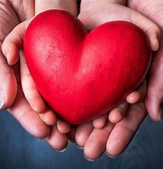
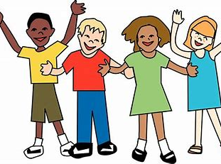
Kindness messages from Our Year 13’s to year 7’s
“Dear year 7’s…….
Stay strong
Know that everyone has bad days and they will get better
Choose your friends wisely – quality is better than quantity…. Surround yourself with positive people
Try not to overly stress
If you are feeling stressed out, talk to someone as its not good to keep it all to yourself.
Don’t be scared of us older students – we really are very friendly!
Be confident in your abilities
Don’t put too much pressure on yourself
Enjoy school and try your best – that really is good enough
best wishes, From year 13”

Slide 8
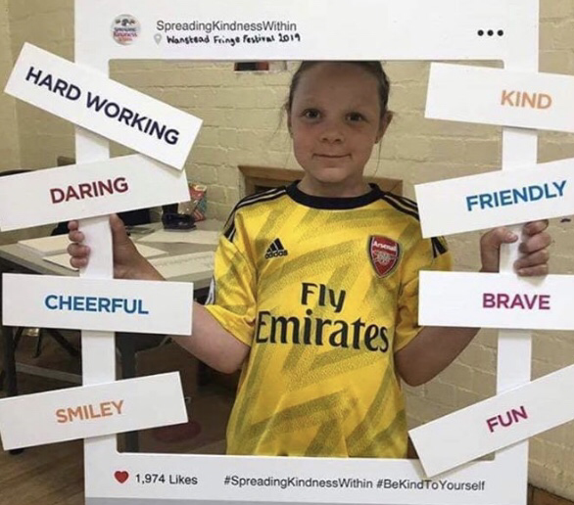
Actively Participate in our visual kindness picture frame display
“I am…”

Slide 9
Creating a respectful classroom

Slide 10
Highams park staff intend to
our

Slide 11
What is your kindness commitment? What can you do to support each other’s wellbeing?
Discuss this in forms next week
I/we pledge to……

Slide 12
A Big Thanks goes to:
@YOUNGMINDSuk
@aCTIONFORHAPPINESS

