Slide 1
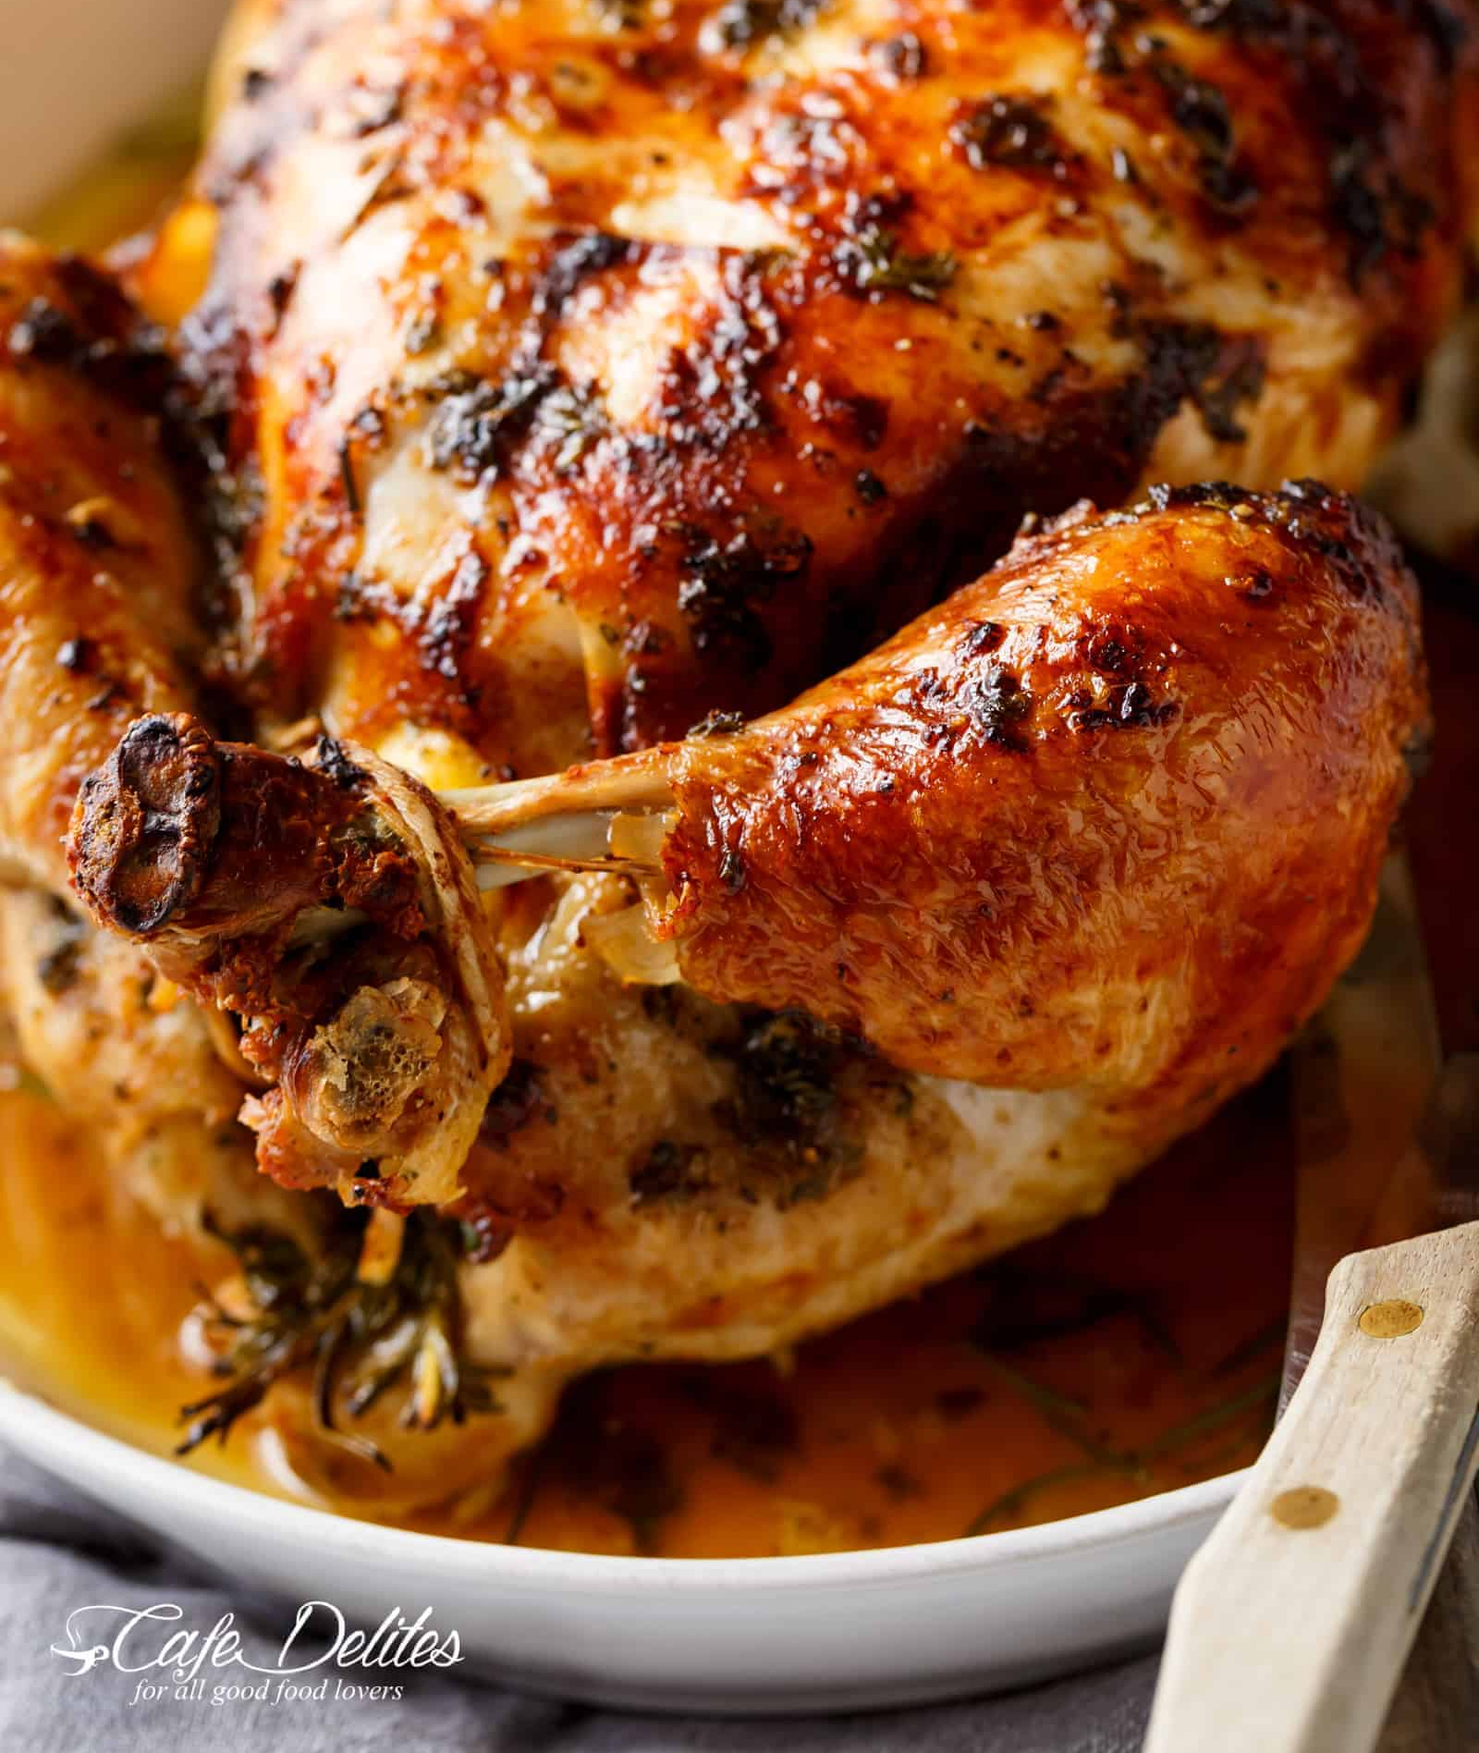
8Kd Power and Efficiency
CW
Do Now:
Can you cook a chicken with a lightbulb?

Slide 2
Requisitions
Equipment | Worksheets
 | 8Kd1 Power & Efficency

Slide 3
https://www.youtube.com/watch?v=-zvCUmeoHpw

Slide 4
Copy & Complete
We can use many electrical appliances in the home eg an electric heater for heating or an oven for _______.
The amount of energy transferred per second is the power of the appliance, measured in the units watts (W) or ____watts (kW).
1 watt = 1 joule transferred every second
_____ W = 1 kW
cooking
kilo
1000

Slide 5
Appliance | Power rating | Transfers energy by…
Kettle Toaster Drill Phone / tablet Standard filament bulb Energy saving bulb Electric shower
Options: heating, sound, light, forces
W or kW?

Slide 6
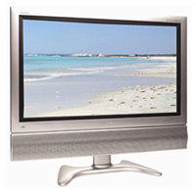
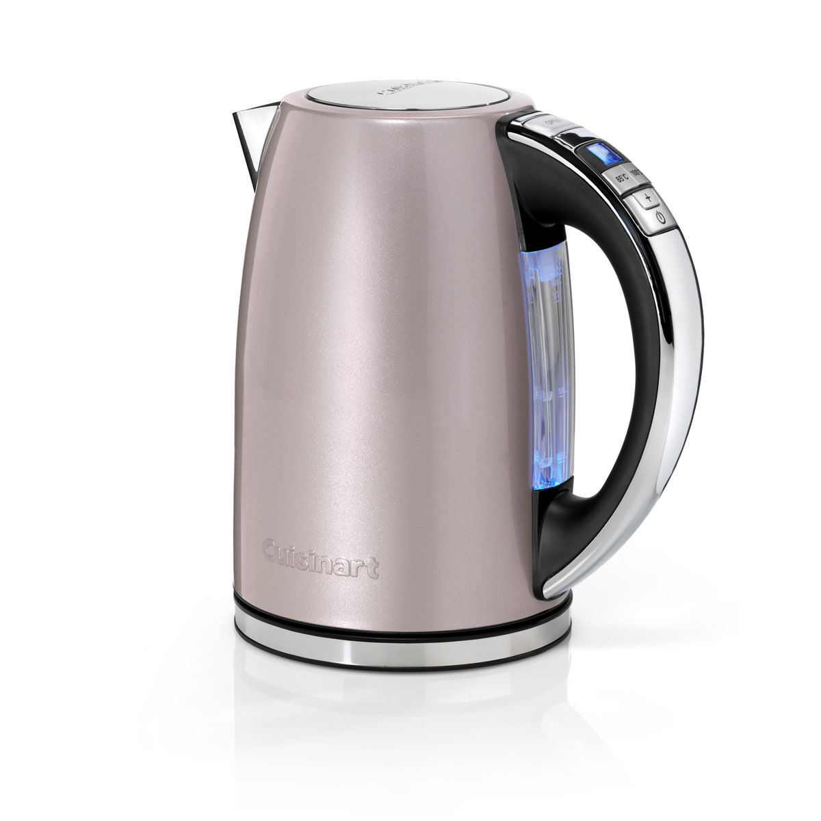
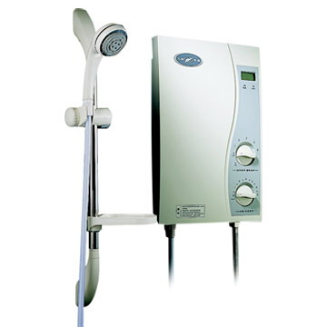
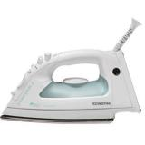
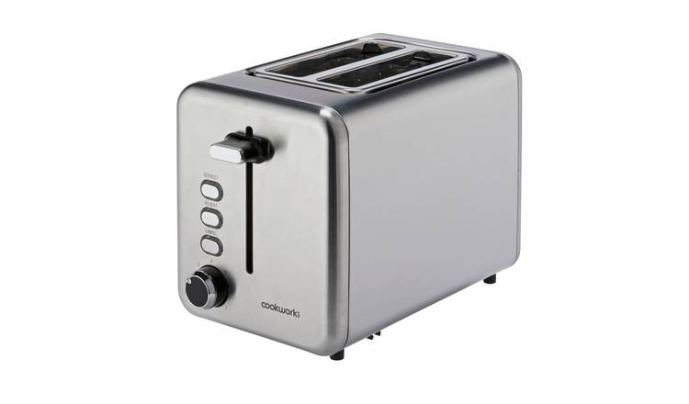
Write down these appliances down your page in order of power rating.
Add the energy transfer.
11 W
How are the lightbulbs different?
200 W
400 W
1000 W
60 W
900 W
8000 W
1000 W
10 W

Slide 7
Appliance | Power rating | Transfers energy by…
Kettle Toaster Drill Phone / tablet Standard filament bulb Energy saving bulb Electric shower
1000
900
400
10
Options: heating, sound, light, forces
60
11
8000
W or kW?

Slide 8
 Add the power shower to your table.

Slide 9
a) Which appliance transfers the most energy per second?
b) Why do you think this is?
2. What do you notice about the appliances with the highest power ratings?
The electric shower.
It has to heat a lot of water very quicker.
They all transfer energy by heating.

Slide 10
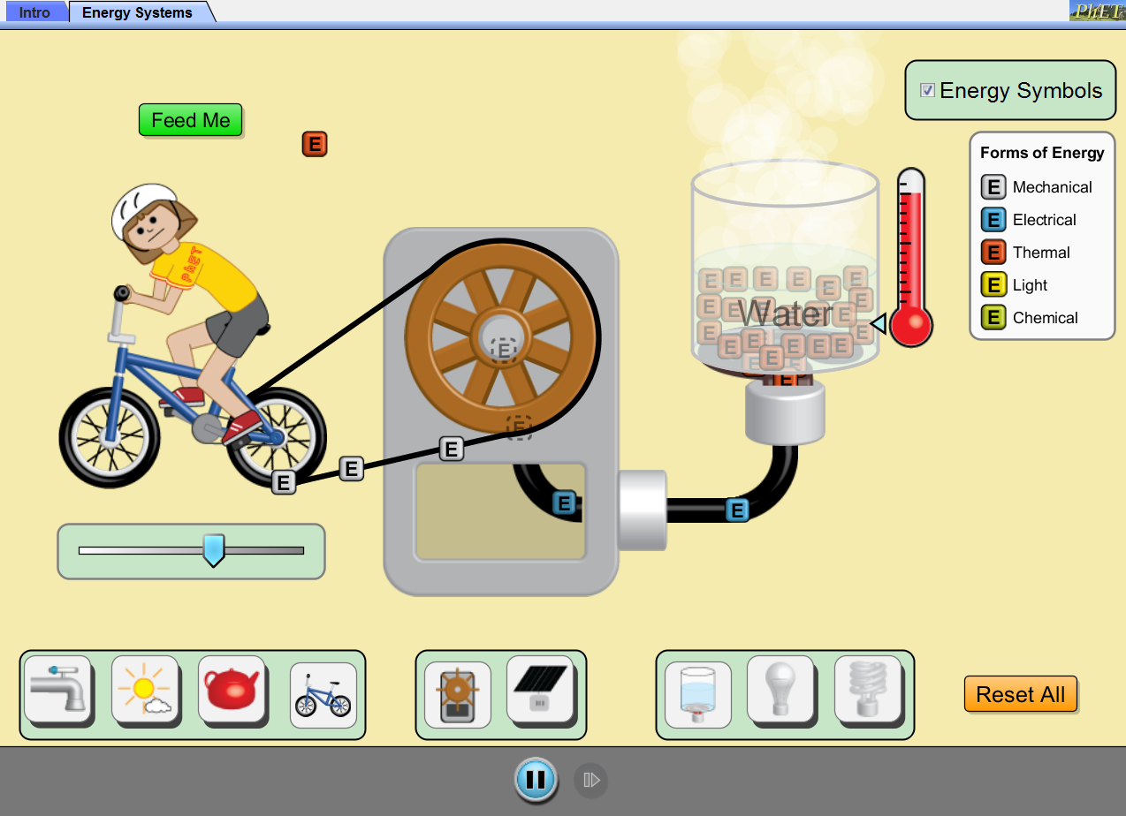
Is all the energy transferred usefully?

Slide 11
https://www.youtube.com/watch?v=-zvCUmeoHpw

Slide 12
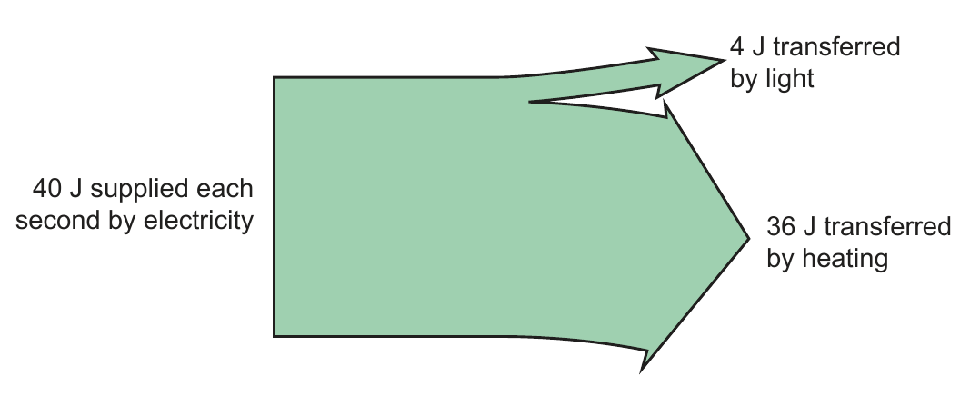
Write Down
Efficiency is a way of comparing the amount of useful energy transferred with the total amount of energy supplied.
We can show this on a Sankey diagram, with the width of each arrow representing the proportion of the energy. eg for a standard filament light bulb:
What is the efficiency of this bulb?

Slide 13
Write Down & Sketch
$$efficiency= \frac{useful energy transferred }{total energy supplied }×100$$
Calculate the efficiency of this light bulb.

Slide 14
$$efficiency= \frac{useful energy tranferred }{total energy supplied }×100$$
Efficiency = ? Total energy supplied = J
Useful energy transferred = J

Slide 15
Stick in and complete your worksheet.

Slide 16
Check your work

Slide 17
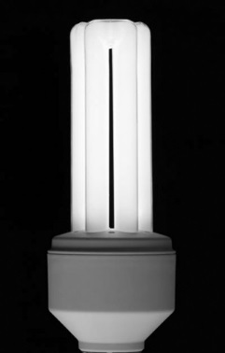
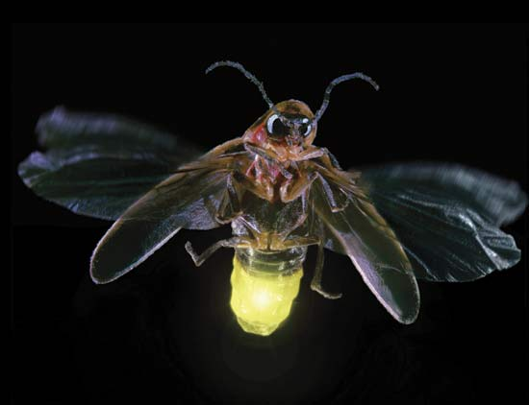
So why do lightbulbs make better cookers than lights?

Slide 18
https://www.youtube.com/watch?v=-zvCUmeoHpw

Slide 19
 Give a clue or definition for these keywords.
Hot seat
power

Slide 20
 Give a clue or definition for these keywords.
Hot seat
efficiency

Slide 21
 Give a clue or definition for these keywords.
Hot seat
wasted

Slide 22
 Give a clue or definition for these keywords.
Hot seat
kilowatts

Slide 23
 Give a clue or definition for these keywords.
Hot seat
useful

Slide 24
 Give a clue or definition for these keywords.
Hot seat
energy

Slide 25
 Give a clue or definition for these keywords.
Hot seat
Sankey diagram

Slide 26
 Give a clue or definition for these keywords.
Hot seat
watts

Slide 27
 Give a clue or definition for these keywords.
Hot seat
energy transfer

