Slide 1
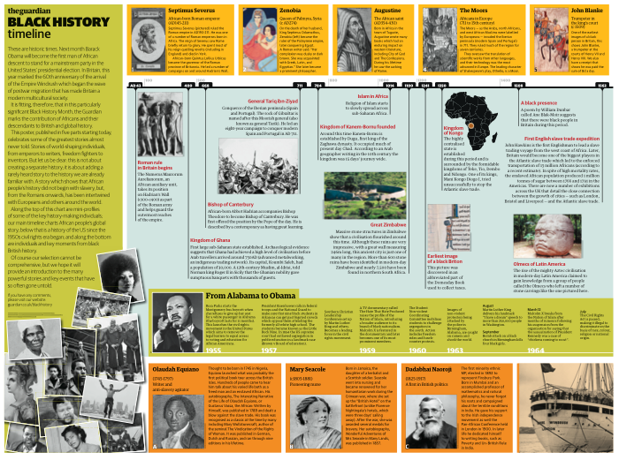
Today we are going to look at a timeline of Black History from the Romans to the present day.
DO NOW:
Write down 3 things you would expect to find on this timeline.
What do you expect to see?
What do you expect to find out?

Slide 2
Black History Timeline: What can we learn?
Outcomes:
To analyse the Black History Timelines
Make judgements on significance
Create presentation
21/10/2020

Slide 3
Task: In groups of 4 you will move around the room looking at the different timelines
What you need to do:
Each member of the group will have to find one feature on each timeline that they think is important to share with the rest of the class.
You can make notes on what you find,
Draw a sketch
What makes something important?

Slide 4
You will get 5 minutes to look at each timeline
You will walk around the room looking at each timeline
You need to give each other enough space to look at the timelines
Try not to touch them or move them – every group will be looking at them

Slide 5
Now you have investigated all of the timelines.
In your groups – Make a decision
What is the most important feature to share from each timeline.
Each of you will feedback one point.

Slide 6
Over to you: You now need to create something for our school Black History Month Exhibition
Decide what you think is important to include:
You can include more than one idea
You need to make your presentation very clear because many people will be looking at it – Why is the feature you have chosen so important to share?

