Slide 2
HISTORY OF HIP HOP
Mr Tobias

Slide 3
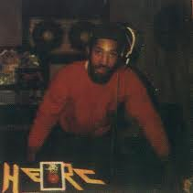
1520 Sedgwick Avenue
Clive Campbell, better known as Kool Herc was born in Kingston, Jamaica in 1955.
Kool Herc had his first DJ gig at his sister’s birthday party.
His home address, 1520 Sedgwick Avenue, is the birthplace of hip hop.

Slide 4
The Beginnings…
During the late 1960s, Herc was interested in keeping the break section of songs longer.
He would buy two copies of the song and “repeat” the break section.
During this break, he would introduce himself and call out the names of his friends who were in the crowd.
These shout outs began to get more and more elaborate.

Slide 5
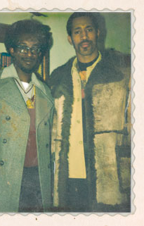
As Herc’s career rose, he focused his energies on the complexities of deejaying.
He asked his friends Coke La Rock and Clark Kent to handle the microphone duties, known as emceeing.
Kool Herc and the Herculoids was rap music’s first emcee team.

Slide 6
Others to name
Other MC teams arose after the Herculoids.
Many of these teams were collaborations between former gang members.
Solo rapping wasn’t introduced until much later.
Kool Herc coined the name “B-boy” (beat-boy) to describe the people who waited for the break section of the song to dance and “rap.”

Slide 7
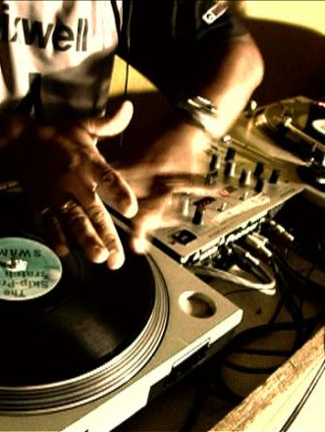
Rap catches on
Rap was limitless:
Anyone could do it.
No money was needed.
Free expression.
Only rules:
Be original .
Rhyme on time of beat.
Greatest reward:
Being deemed as “Def”.

Slide 8
Recording
“Rapper’s Delight” vs. “King Tim III (Personality Jock)”
Both are regarded as the first hip hop recording by different circles.
By the early 1980s, the major elements and techniques of hip hop were in place.
New York City was by far the birthplace of Hip Hop/Rap.
Philadelphia was next.

Slide 9
Sugar Hill Gang – Rapper’s Delight

Slide 10
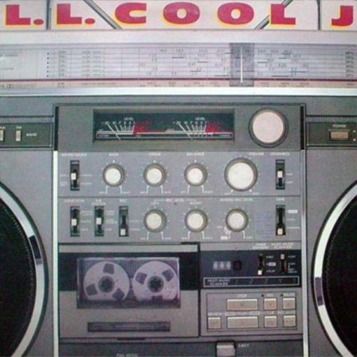
The 1980s
The 1980s marked the diversification of hip hop as the genre developed more complex styles.
The music and the equipment used both changed and were updated.
They lyrical content of hip hop evolved as well.

Slide 11
WORLD WIDE
Prior to the 1980s, hip hop was largely confined to the U.S. however, during this decade it began to spread worldwide.
Hip Hop has always kept a very close relationship with the Latino community in New York.
Dj Disco Wiz & the Rock Steady Crew, The Mean Machine, & Kid Frost were some of the Latino artists.
In 1988, Cypress Hill was formed.

Slide 12
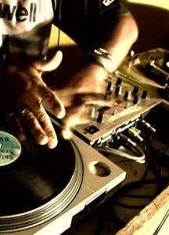
The New School of Hip Hop
Run D.M.C and L.L. Cool J were among those who brought about the new school of hip hop.
Artists projected a tough, cool, street b-boy attitude both in person & in the music.
Songs were shorter for radio play and hip hop became a fixed part of mainstream music.

Slide 13
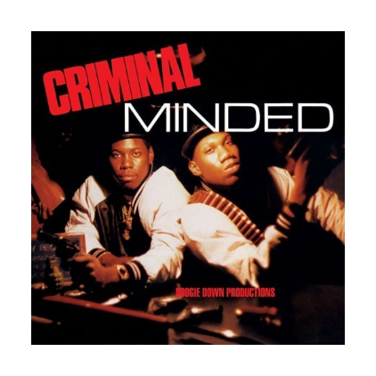
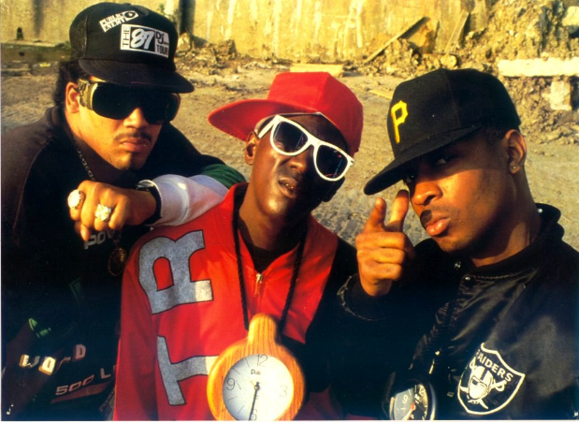
The Golden Age
Hip Hop’s golden age was between the mid-1980s and the mid 1990s.
Those most associated with this Golden Age are Public Enemy, Boogie Down Productions, Eric B. & Rakim, De La Soul, A Tribe Called Quest, Gang Starr, Big Daddy Kane and the Jungle Brothers.
It is characterized as the time when everything in Hip Hop was new, different, innovative, unforeseen, and undiscovered.

Slide 14
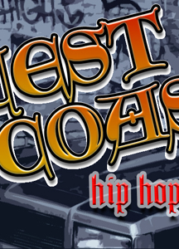
Gangsta Rap & West Coast Hip Hop
This subgenre of Hip Hop is characterized by it’s violent lifestyles of inner-city American black youth.
Schooly D, Ice T, and N.W.A. are most widely associated with gangsta rap.
Straight Outta Compton, released in 1988 established Los Angeles, and the West Coast hip hop, as a vital part of hip hop. (Important since New York and the East Coast are accredited as being the original home of hip hop.)

Slide 15
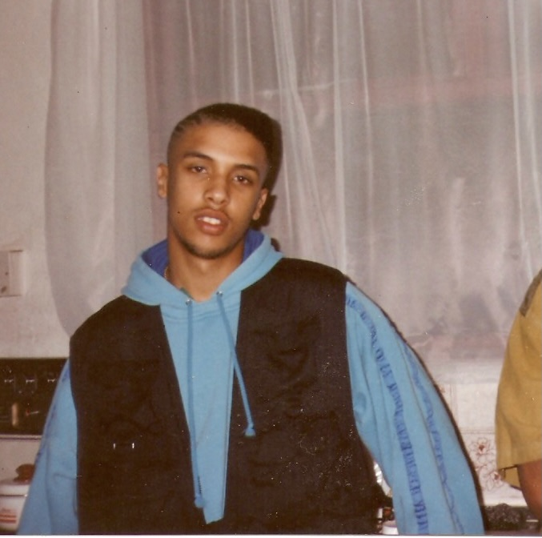
How hip influenced my life

Slide 16
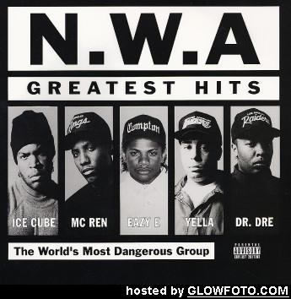
Controversy
The N.W.A. song “F*** the Police” earned the N.W.A a letter from the FBI expressing law enforcement’s resentment of the song.
Political figures of the left and right wings have both expressed concern for gangsta rap lyrics. However, artists defend themselves by saying they are rapping about the reality of inner-city life and they are merely adopting a character within their songs, which behave in ways they may not endorse.

Slide 17
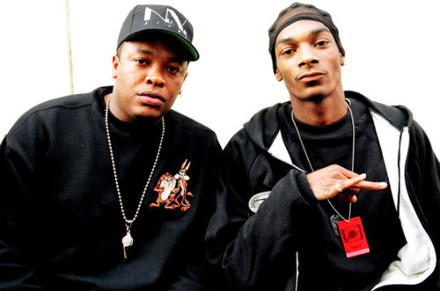
Dr Dre

Slide 18
1990s
In the 1990s, artists such as M.C. Hammer, Dr. Dre, the Wu-Tang Clan, the Beastie Boys and others emerged and pushed hip hop into mainstream pop music.l
The Wu-Tang Clan, Jay-Z, The Notorious B.I.G., and Nas were part of the so-called East Coast Renaissance.
Record labels in Atlanta, St. Louis, and New Orleans gained fame through artists like Bone Thugs-n-Harmony, Tech N9ne, and Twista.

Slide 19
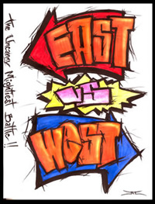
East Coast-West Coast
We all know about the troubles between the East Coast and West Coast music scenes. Both claim to be homes to rap and hip hop across various subgenres. These tensions were evident with the music the artists produced.
Main/Most Known West Coast Artists:
Dr. Dre & N.W.A.
Tupac Shakur
Snoop Dogg
Main/Most Known East Coast Artists:
Public Enemy
Wu-Tang Clan
Nas
Jay-Z
The Notorious B.I.G.

Slide 20
2000s
The new millennium brought with it new hip hop artists.
Eminem, Nelly, 50 Cent, Kanye West, Outkast, and others entered the mainstream music scene in the 2000s.
It is reported that hip hop/rap music sales have declined by more than 44% since 2005. Many say this is due to fans having various resources and access to the music they love.

Slide 21
2012-2022
Drill rap originated in Chicago through artists like Chief Kief
Known for its storytelling of street life
The drill scene spread and became big in the UK and then spreading to countries across Europe and the rest of the world through artists like Harlem Spartans, Headie One, Central Cee, Lowski and Digga D.

Slide 22
The “Firsts” List
1st hip hop recording: “Rapper’s Delight”
1st hip hop record released by a female: “Funk You Up”
1st female solo hip hop artist: DJ Lady B
1st hip hop musician to represent a major product: Kurtis Blow (Sprite) (Also 1st rap artist to perform on national television)
1st rap album to hit #1 on Billboard charts: Beastie Boys’ 1986 album Licensed to Ill
1st rap/rock collaboration: Walk this Way, Aerosmith & Run DMC
1st Grammy award for best rap performance: DJ Jazzy Jeff & Fresh Prince for Parents Just Don’t Understand

