Slide 1
Gas Exchange System
23/11/2018
Which two gas are exchanged in the lungs?
2. Write down some facts about breathing.
What do you know already?
5 mins
Keywords: Trachea, Bronchi, Bronchioles, Lungs, Alveoli, Surface Area .

Slide 2
Objectives
• Describe the functions of the organs in the human gaseous exchange system and what happens during gas exchange.
Explain how diffusion occurs in terms of movement of particles). Explain how and why a concentration gradient is maintained for oxygen and carbon dioxide between the blood and lungs.
Explain how specialised cells keep the lungs clean (mucus production and ciliated epithelial cells).
Describe how muscles attached to ribs and the diaphragm produce breathing movements and use a model to explain how lungs expand and contract.
Use a pressure model to explain ventilation.

Slide 3
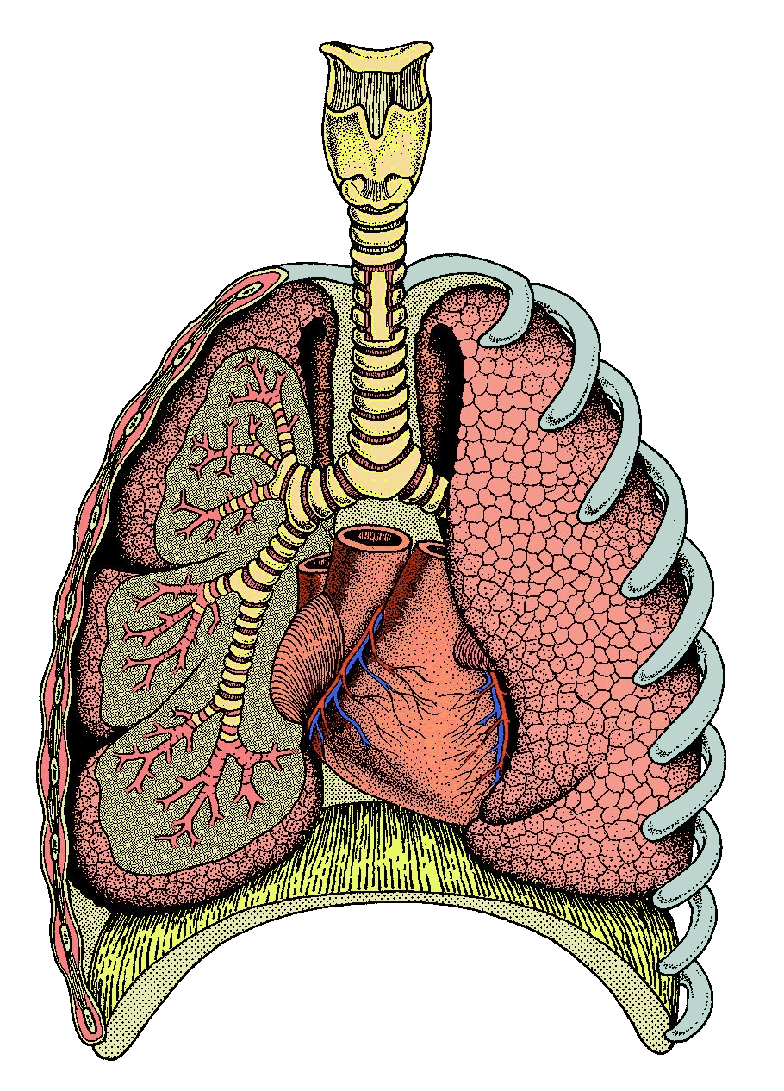
Watch the video and label the parts of the breathing system on the worksheet (7 marks).
Trachea
Alveoli
Ribs
Bronchi
Lung
Diaphragm
10 mins
Bronchioles
http://www.tes.co.uk/teaching-resource/Anatomy-and-Physiology-of-the-Lungs-6175106/
https://www.youtube.com/watch?v=0cqZGxwXZzk

Slide 4
worksheet
Trachea
Alveoli
Ribs
Bronchi
Lung
Diaphragm
Bronchioles

Slide 5
Trachea
Ribs
Alveoli
Bronchi
Bronchioles
Lung
Diaphragm

Slide 7
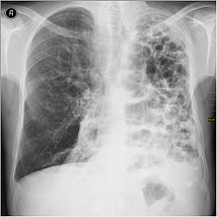
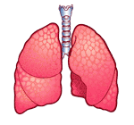
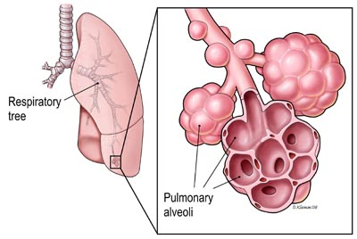
Alveoli
Bronchiole
Alveoli

Slide 8
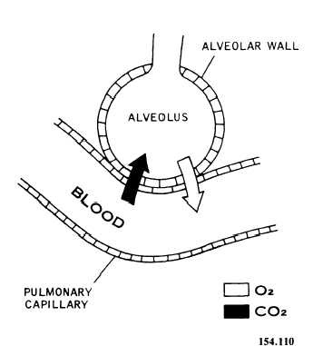
How are the alveoli specially adapted for gas exchange?
Thin walls

Slide 9
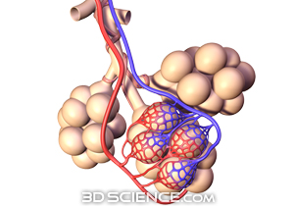
How are the alveoli specially adapted for gas exchange?
Large close contact blood supply

Slide 10
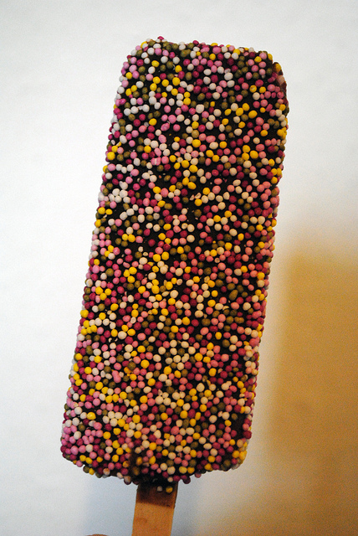
How are the alveoli specially adapted for gas exchange?
Vs
Large Surface Area

Slide 11
Tasks
Imagine you are oxygen explain your path from the nose to the red blood cell.
2) Explain how the alveoli is specially designed to carry out maximum gas exchange of oxygen and carbon dioxide. (5 marks)
5 mins
5 mins

Slide 12
Answer
1) I travel from the nose or mouth down the trachea, the bronchus, then the bronchiole and finally to the alveoli. At the alveoli I diffuse into the red blood cell.

Slide 13
Marking Criteria
2) The alveoli has a large surface area and a large blood supply to maximise gas exchange at a faster rate.
The blood vessels and the alveoli have thin walls and are in close contact which reduces the distance the gases have to travel, therefore increasing gas exchange.
Task 2:
3 marks: Forming
4 marks : Developing
5 marks : Secure
6 marks: Excelling

Slide 14
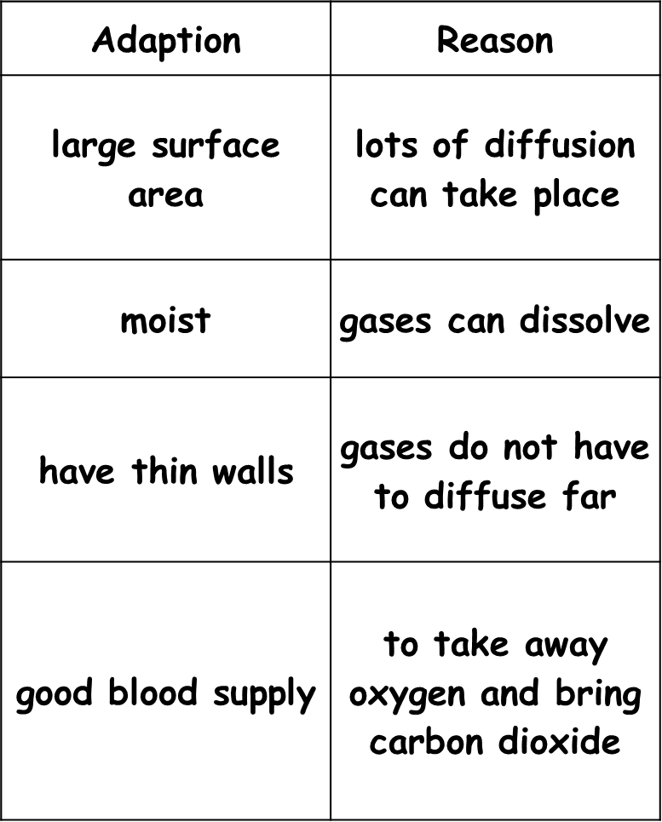

Slide 15
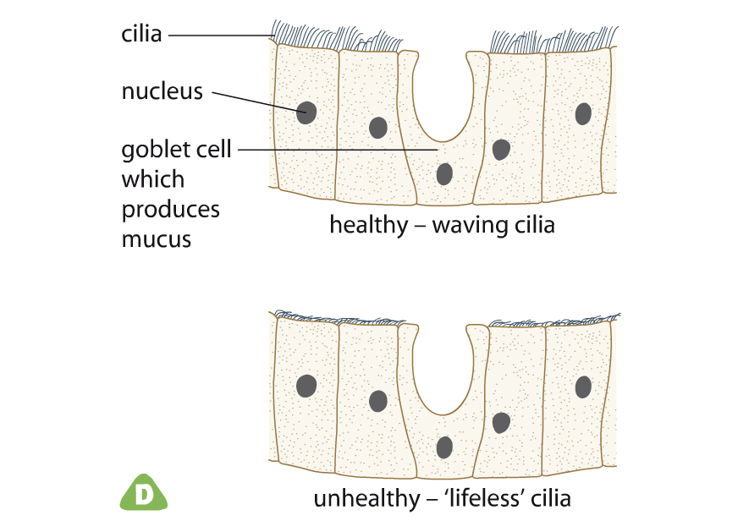
Reduced gas exchange
Chemicals in cigarette smoke stop cilia working. Mucus collects in the lungs and reduces surface area for gas exchange.

Slide 16
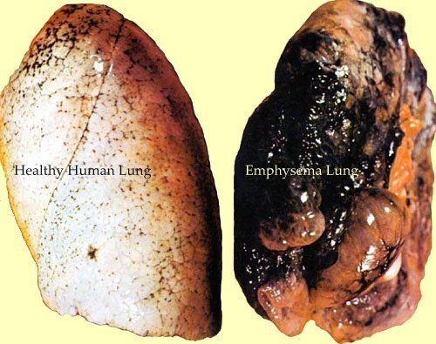
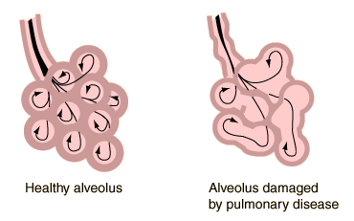
Emphysema
Smoke irritates alveoli. Over time this causes the alveoli to break down which again reduces surface area.
What’s Happening inside?
Clue: surface area

Slide 17
Ventilation
What happens to the lungs, rib cage and diaphragm when we inhale and exhale?
-Fill in the table using the next slides.
Inhalation | Exhalation

Slide 18
Inhalation and exhalation

Slide 19
If the opposite happens for exhalation (breathing out), work out how these descriptions would be different.
https://www.activeteachonline.com/product/view/id/335/page/40/mode/dps?modal=/player/animation/id/390816

Slide 20
Breathing in
Intercostal muscles _______ and the rib cage moves ___ and out. This _______ the diaphragm and the air rushes ___.
Breathing out
Intercostal muscles _______ and the rib cage moves ___ and in. This _______ the diaphragm and the air rushes ___.
Curves in contract out flattens up relax down

Slide 21
Breathing in
Intercostal muscles contract and the rib cage moves up and out. This flattens the diaphragm and the air rushes in.
Breathing out
Intercostal muscles relax and the rib cage moves down and in. This curves the diaphragm and the air rushes out.

Slide 22
Explain the similarities and differences between Inhaled and Exhaled air.

Slide 23
Comparing inhaled and exhaled air
What are the differences between inhaled and exhaled air?
inhaled air
exhaled air
nitrogen (78%)
oxygen (21%)
carbon dioxide (0.04%)
other
nitrogen (78%)
oxygen (17%)
carbon dioxide (4%)
other
How could you test for the differences between inhaled and exhaled air?

Slide 25
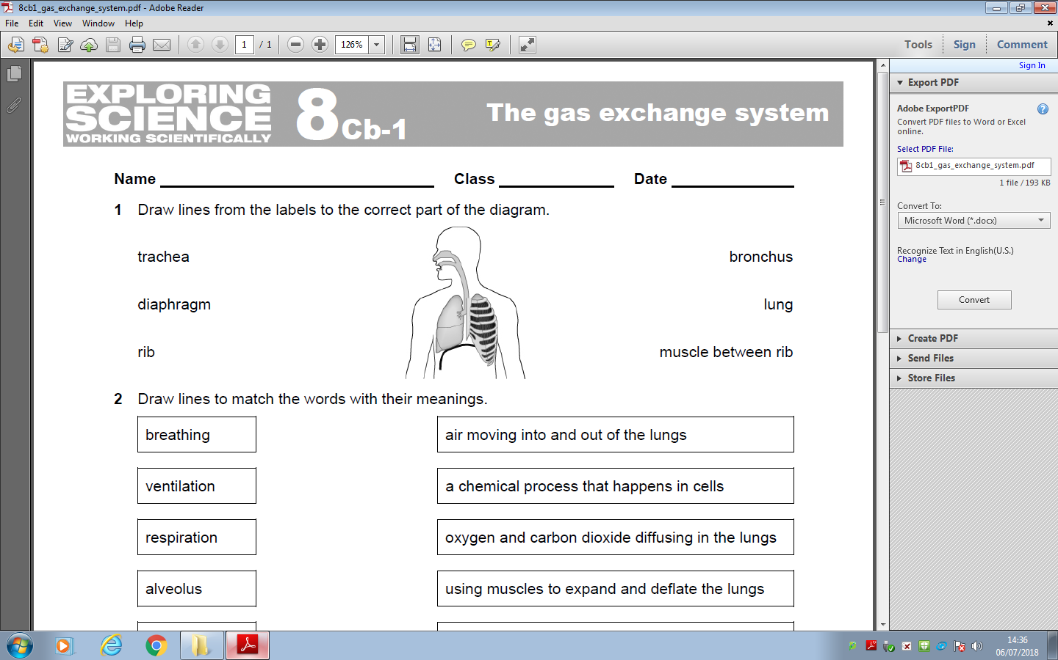
Worksheet

Slide 26
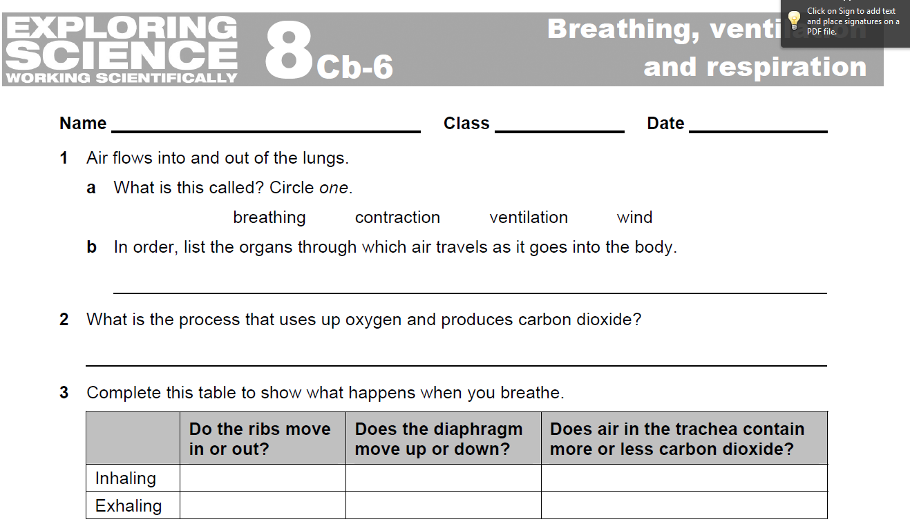
Worksheet

