Slide 1
c.W Voltage and resistance 7jd 20.11.18

Slide 2
For each of the following statements – write down whether they are True or false in the back of your books
A series circuit has only one loop
When an extra bulb is added in parallel to a circuit, the first bulb gets dimmer
In a series circuit, the bulbs get brighter when more are added
When one bulb is unscrewed from a series circuit, the other bulbs will go off
In a parallel circuit, the current in the main part of the circuit is greater than current in the branches added together
House lights are wired in parallel so that each light can be switched off independently

Slide 3
Give yourself a mark out of 6
A series circuit has only one loop T
When an extra bulb is added in parallel to a circuit, the first bulb gets dimmer F
In a series circuit, the bulbs get brighter when more are added F
When one bulb is unscrewed from a series circuit, the other bulbs will go off T
In a parallel circuit, the current in the main part of the circuit is greater than current in the branches added together F
House lights are wired in parallel so that each light can be switched off independently T

Slide 4
Learning objectives
State what is meant by voltage and resistance and what units are used for both
Describe how a voltmeter is used and why it is connected in parallel
Recall how the current changes when the voltage of the supply changes.
Describe how voltage varies in a parallel circuit and how it is divided between components in a series circuit
Describe the relationship between resistance and current.
Describe how the resistance of a wire varies with its length and thickness.
Explain how a variable resistor works.
Use a model to explain the idea of voltage.
Describe how voltage and energy are linked.

Slide 5
Read through the questions, watch the clip then answer the questions in full sentences in your book
Can you think of any other factors that may affect resistance?
https://www.twig-world.com/film/resistance-1556/
What is resistance?
If the voltage is constant – what happens to the current when the resistance increases?
What is resistance measured in
Complete the sentence: “ the longer the powerline…………”

Slide 6
Complete the word fill then swap books, mark in green pen, give a mark out of 4 and correct.
dimmer
If you add more bulbs to a series circuit the bulbs get __________. It is ___________ for the current to flow through the thin filament in a bulb than through connecting wires.
The more bulbs added, the __________ the current. This is because bulbs have high _________.
harder
smaller
resistance
harder
smaller
dimmer
resistance

Slide 7
Look carefully at the picture below. What is the difference between the 2 booths?

Slide 8
Consider the picture in the previous slide, discuss in pairs and and jot down answers in the back of your book
Can you think of another analogy/ model?

Slide 9
Complete the wordfill. There is no multiple choice so you will have to think hard
As you add more branches in a parallel circuit, the current flowing from the cell _________. The current flows more easily as there are more paths for it to take. The overall resistance of the circuit _________
Increases
Decreases
What will happen to the brightness of the bulbs?

Slide 10
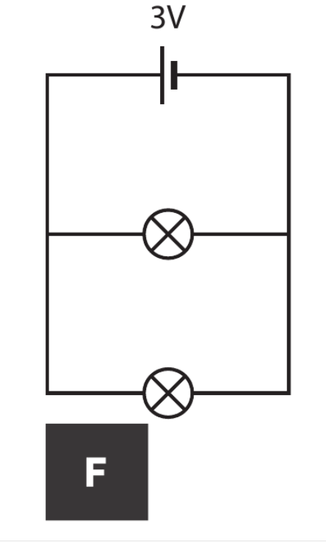
Look at the circuits and answer the questions

Slide 11
Why would you use a resistor in a circuit?
The current in a circuit can be made smaller by using a resistor. A resistor has high resistance and makes it harder for electricity to flow
copy

Slide 12
What do you think the two items/ symbols below are? What is the difference between the top one and the bottom one?

Slide 13
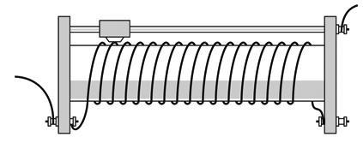
Copy the paragraph in red into your books
A variable resistor allows the amount of resistance in a series circuit to be changed.
It is made up of a coil of wire and a slider that touches the wire.
slider
connection to circuit
connection to circuit
coil of resistance wire
The resistance changes when the slider moves along the coil.
© Pearson Education Ltd 2014. Copying permitted for purchasing institution only. This material is not copyright free.
Notes:
13

Slide 14
Where does the current flow?
Current flows into the variable resistor from the circuit.
It travels through the coil of wire until it reaches the slider.
The current then travels along the slider bar and back out into the circuit.

Slide 15
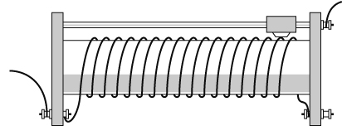
How does the position of the slider affect the resistance?
The wire in the coil is much thinner than the slider bar.
As the wire is wrapped around many times to make the coil, it is also much longer than the slider.
The current finds it much harder to flow through the wire.
Therefore, the wire has greater resistance than the slider.

Slide 16
Fill in the missing words:
slider
As the __________ moves to the left, the current travels only a __________ distance through the coil.
When the slider moves to the right, the __________ has to travel much __________ through the coil.
So, as the slider moves to the right, the __________ to the current goes ______ .
short
current
farther
resistance
up

Slide 17
Think about the questions below.
1. What else affects the size of the current besides resistance?
2. What does voltage do in a circuit?
3. What is voltage measured in? and what with?
Voltage provided by cell or power pack will also affect current
Voltage pushes the charges around a circuit
Voltages is measured in Volts using a Voltmeter

Slide 18
Draw the diagram and copy the text
How does this compare with where an ammeter is connected?
The Voltmeter is connected across a component and measures how much energy is being transferred by the charge

Slide 19
Look at the diagram and answer the questions below.
Is more energy being transferred to the bulb or the motor?
What can be said about the voltage across the cell compared to across the individual components?
If the cell was changed to 3V – what would happen to the current flowing? What would happen to the voltage across the 2 components?

Slide 20
Investigating voltage in parallel circuits
Https://phet.colorado.edu/en/simulation/circuit-construction-kit-dc
Voltage is the same across each component of a parallel circuit

Slide 21
Worksheet 7Jd1.
Pleases add your name and stick in your books.
Due in next week

