Slide 1
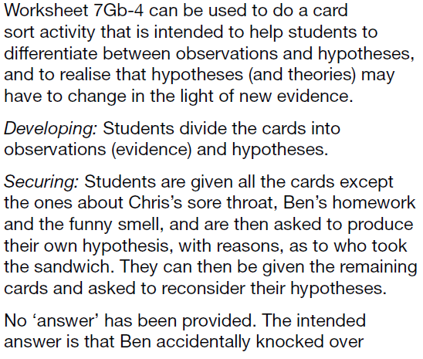
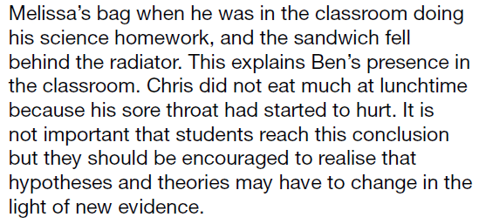
Resources
Worksheets
7Gb 4 the missing lunch box mystery – card sort
h/w
Active Learn exercises
7Gb 4 the missing lunch box mystery – card sort

Slide 2
Objectives
Describe different types of observations and data that can be used as evidence.
Identify scientific questions, hypotheses and predictions.
Describe how evidence and observations are used to develop a hypothesis into a theory.
Explain how evidence and observations support or do not support a certain theory.

Slide 3
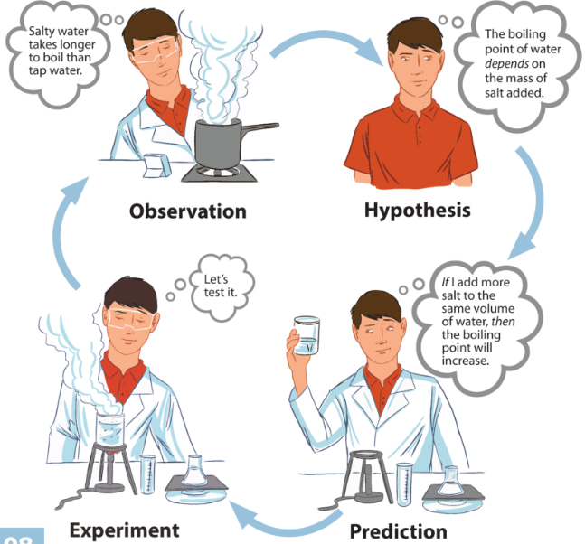
Scientific Method
A Theory
Definition
A hypothesis or set of hypothesis that explains how and why something happens. The predictions made using a theory should have been tested on several occasions and always found to work.
Write definitions for the following words
observation, hypothesis, prediction and experiment.

Slide 4
Observation:
Something that you see happening
Hypothesis:
An idea about how something works that can be tested using experiments. Plural = hypotheses
Prediction:
What you think will happen in an experiment
Experiment:
A scientific procedure

Slide 5
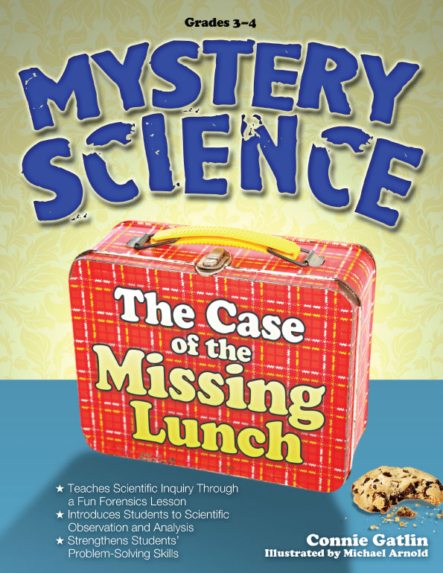
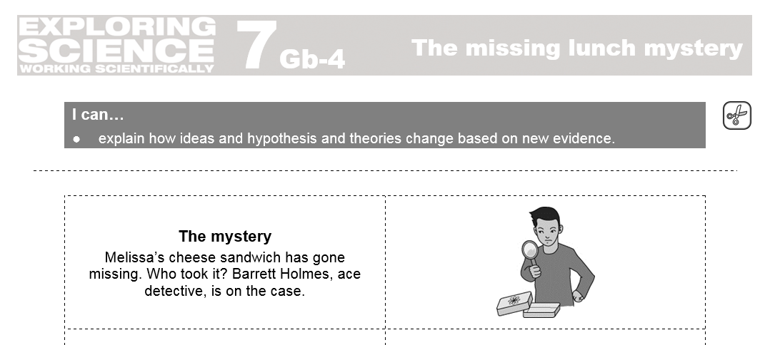
The Missing Lunch Box Mystery
See resources slide for instructions

Slide 6
Key words

Slide 7
Objectives
Describe different types of observations and data that can be used as evidence.
Identify scientific questions, hypotheses and predictions.
Describe how evidence and observations are used to develop a hypothesis into a theory.
Explain how evidence and observations support or do not support a certain theory.

