Slide 1
Resources
Worksheets
w/s 8Fc7 – The first periodic table
Practical
8Fb2 run as circus
Teacher Demos

Slide 2
Objectives
Use the periodic table to look up symbols.
Identify the alkali metals, halogens, (transition metals) and noble gases on the periodic table.
State what elements in the same group of the periodic table share.
Recall that the noble gases are chemically inert compared to other elements.
Recall the typical properties of alkali metals.
Recall the typical properties of halogens.
Explain how Mendeleev made predictions using his table.
Describe how the periodic table is arranged (in terms of elements in groups of similar properties).
Explain how Mendeleev originally arranged the periodic table by placing the elements in order of atomic weight.
© Pearson Education Ltd 2014. Copying permitted for purchasing institution only. This material is not copyright free.

Slide 4
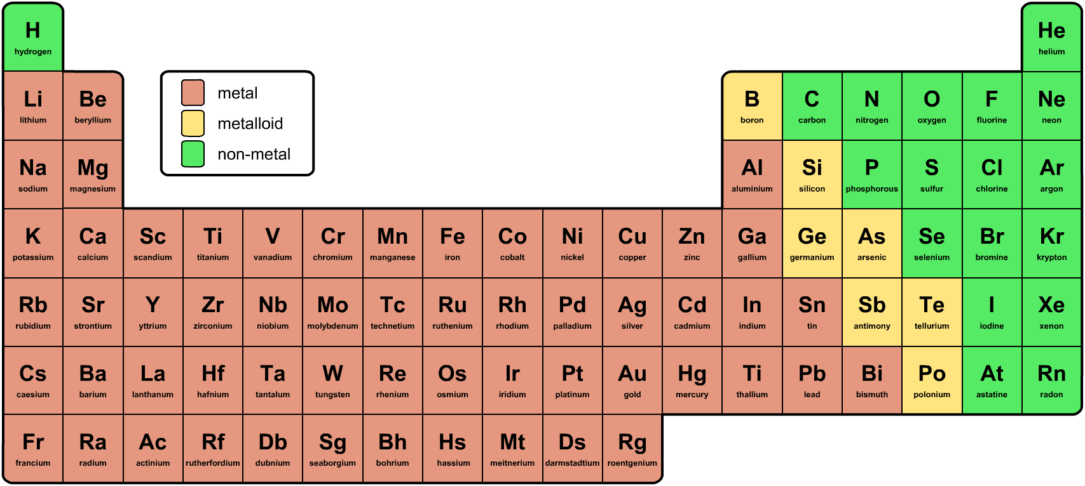
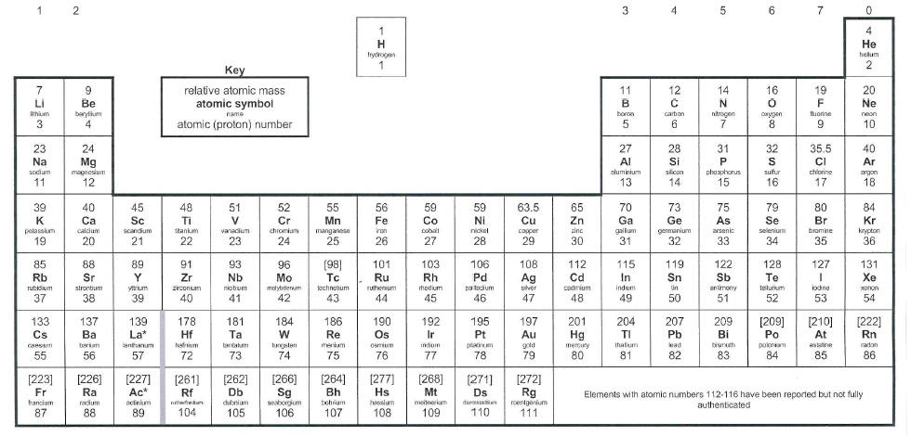
The modern Periodic Table
Stick in your periodic table
Can you spot any patterns in how the elements are arranged in the periodic table?
Outline these blocks in different colours and write a key
Notes:
Photo credit: © 2008 Jupiterimages Corporation

Slide 5
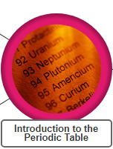
8Fc Mendeleev’s Table
Watch presentation and make note in your book ?
Use presentation on p92 of active book
and
twig videos: Introduction to periodic table
Now complete w/s 8Fc7 Q2– The first periodic table

Slide 6
The elements in the periodic table are arranged in families called groups and periods. A period is a horizontal row, increasing in atomic number from left to right
Annotate your table
1
2
3
4
5
6
7
Periods 1-7
Notes:
Photo credit: © 2008 Jupiterimages Corporation

Slide 7
A group is a vertical column in the periodic table.
Groups 1-7 & 0
Elements in the same group have similar properties
Annotate your table
Notes:
Photo credit: © 2008 Jupiterimages Corporation

Slide 8
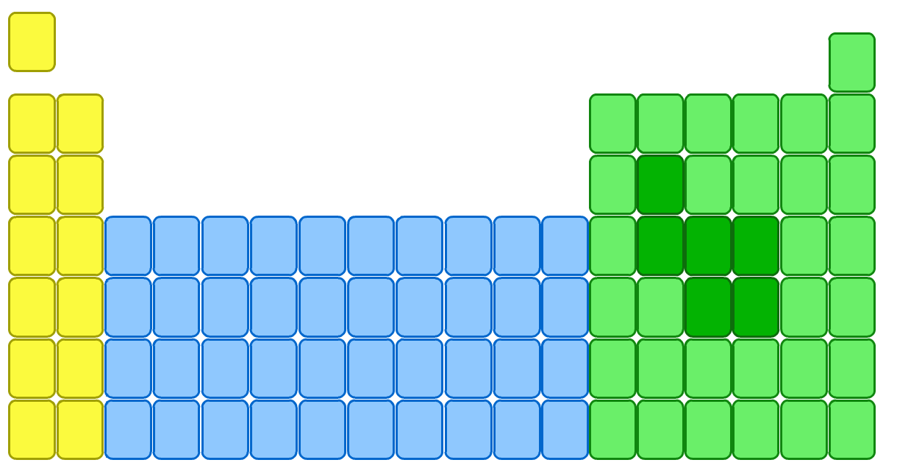
Group 1 – the alkali metals
lithium
Li
The elements in group 1, on the left of the periodic table, are called the alkali metals.
sodium
Na
potassium
K
rubidium
Rb
caesium
Cs
These metals are all very reactive and are rarely found in nature in their elemental form.
francium
Fr
Watch demo or
https://www.youtube.com/watch?v=uixxJtJPVXk
Make list of the alkali metals properties

Slide 9
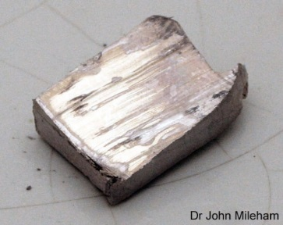
The characteristic properties of the alkali metals are:
They are soft and can be cut by a knife. Softness increases going down the group.
They have a low density.
Lithium, sodium and potassium float on water.
They have low melting and boiling points.
They are good conductors of heat and electricity.
They all react with oxygen. Reactivity increases going down the group.
alkali metal + oxygen → alkali metal oxide
They all react with water. Reactivity increases going down the group.
alkali metal + water → alkali metal hydroxide + hydrogen
Notes:
Photo credit: Dr John Mileham
Image is of sodium, freshly cut. Sodium tarnishes very quickly – within approximately 20 seconds. In this image, you can see how it is already tarnishing, starting from the right hand side.

Slide 10
Group 7 – the Halogens
The elements in group 7 of the periodic table, on the right, are called the halogens.
Watch twig video ‘The halogens’ – a little too much info but ok.
For reaction – too much but ok
https://www.youtube.com/watch?v=u2ogMUDBaf4
Make list of the halogen properties
F
fluorine
Cl
chlorine
Br
bromine
I
iodine
At
astatine

Slide 11
The characteristic properties of the halogens are:
non-metals and so do not conduct electricity
Halogen
Relative size
Melting point (°C)
Boiling point (°C)
State
brittle and crumbly when solid
-220
-118
gas
poisonous and smelly.
-101
-34
gas
They become darker in colour down the group.
-7
59
liquid
They have low melting and boiling points which increase down the group.
114
184
solid
They all react with alkali metals. Reactivity decreases going down the group.
alkali metal + halogen → alkali metal halide
Notes:
Photo credit: Dr John Mileham
Image is of sodium, freshly cut. Sodium tarnishes very quickly – within approximately 20 seconds. In this image, you can see how it is already tarnishing, starting from the right hand side.

Slide 12
Group 0 or 8 – the Noble gases
The elements in group 0, on the right of the periodic table, are called the noble gases.
He
helium
Watch
https://www.youtube.com/watch?v=QLrofyj6a2s
https://www.youtube.com/watch?v=pXAjFOz2kOM
Make list of the noble gases properties
Ne
neon
Ar
argon
Kr
krypton
Xe
xenon
Rn
radon

Slide 13
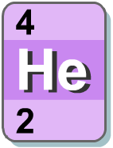
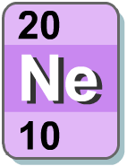
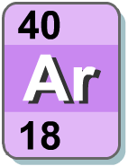
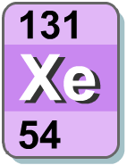
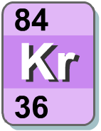
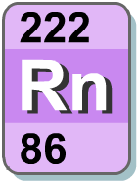
The characteristic properties of the noble gases are:
All noble gases are colourless, odourless and unreactive.
This makes them difficult to isolate and identify.
Because noble gases are so unreactive, there are few patterns, or trends, among the group.

Slide 14
Now complete w/s 8Fc7 Q2– The first periodic table

Slide 15
Homework: Date due:
w/s 8Fb1 – Mendeleev’s table (basic overview) Active learn:
Exercises 8Fc developing, secure & exceeding
w/s 8Fc8 - missing elements

Slide 16
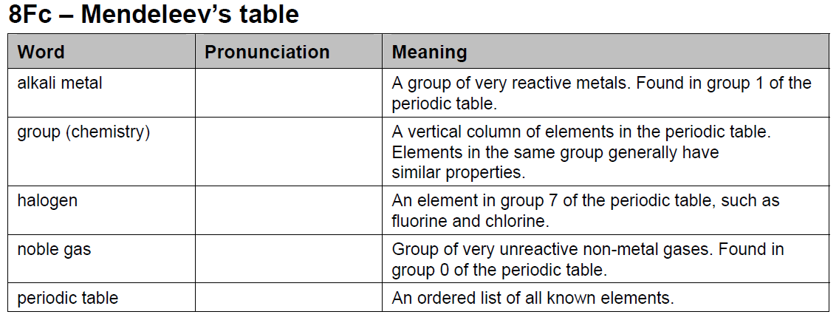
Key words

