Slide 1
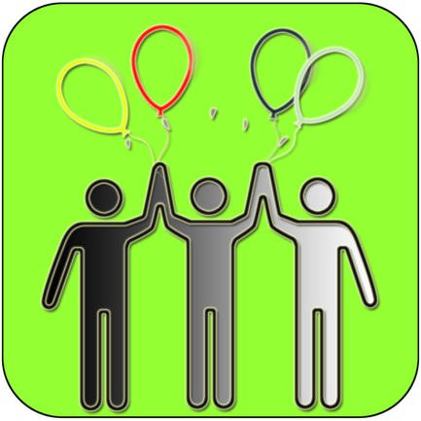
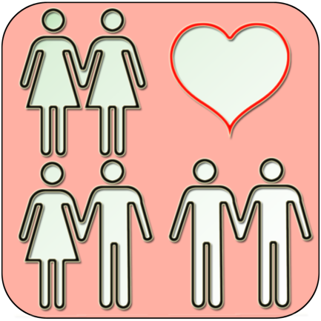
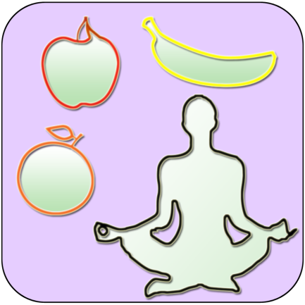
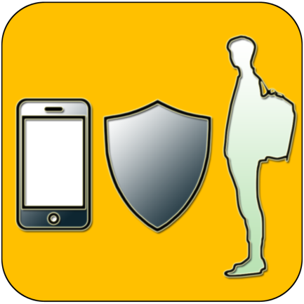
Health and Safety in the Home
The home is the most common place for young children to be injured. Before they begin school, children often spend the greater part of their day at home and they are curious, adventurous and do not have a full understanding of the consequences of their actions.
Most injuries are predictable and preventable. It’s important to make the home environment as safe as possible to minimise the likelihood, frequency and severity of injuries.
Task: Write a list of activities that you do or could do at home, that might potentially be dangerous or a health and safety risk.

Slide 2
To identify potential health and safety risks at home
To understand how to minimise those risks and what to do if they occur
How do we make sure we are always safe?

Slide 3
What did you come up with?
Brainstorm your lists together as a form so that you can see the risks that you may not have thought of yourself. (3 mins)
Then....
What can you do to minimise each risk?

Slide 4
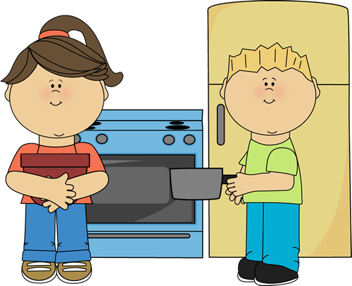
Cooking at home
Please remember the following:
Ask an adult's permission before cooking if possible.
Ask for help if you aren’t sure of what to do.
Keep it simple wherever possible, remember that a toaster and microwave are safer than a cooker/oven, so use them if you can.
Don’t cook too many things at once! It can be difficult to manage.
Remember hygiene! Wash your hands before cooking and after touching any raw meat. Wash up everything that you have used with hot water and washing up liquid.
If you burn yourself, tell an adult, run the burn under cold running water for 5 mins. If you are alone or it is very bad, call for an ambulance.
Cooking with family can be fun and something to do together. Think about baking or cooking with parents and siblings if possible.

Slide 5
Home alone?
If you have periods of time where you are home without an adult, it’s good to keep these things in mind:
Think about it before you answer a knock at the door – ask who it is and if you don’t know them, don’t open it!
Know who you would contact if there was an emergency or you were worried – do you have parents numbers saved in your phone or written down? Who else could you call? (Another family member, family friend, neighbour etc) Ask your parents about this so that you are agreed on who you should contact.
If there was an emergency (i.e. a fire or an accident) – What would you need to do?

Slide 6
Calling emergency services
Turn and talk with your partner: (2 mins)
What are the 3 emergency services?
How do you contact them?
What kind of thing might you need to tell them?
Feedback as a class (2 mins)
Always remember the following when calling 999:
Calling 999 is free from any phone, you do not need credit
Speak as clearly as you can and try to stay calm and explain the issue
Tell them your address and if there is an adult at home or not
Never muck around or prank call, it could risk someone else’s life

Slide 7
What if someone at home becomes ill or injured?
Write down the first 3 things you would do if someone in your home become suddenly very ill or injured themselves.
If it’s the adult in charge and you are the only/eldest child you might need to:
Call 999 and explain what has happened
Call another family member/emergency contact
Make sure younger children are safe and out of the way
If there is an adult at home that isn’t the ill/injured one you should:
Make sure that the adult knows what has happened immediately
Follow their instructions sensibly
Help to look after younger children and keep them out of the way

Slide 8
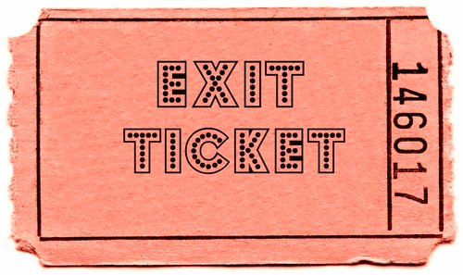
Finally....
Tell your partner the most important thing
that you have learnt today and listen to theirs.
The key words for
this lesson are…
I always knew ... but now
I can see how it connects to…
The most important thing I
have learnt today is…
Before I only knew ...
now I also know ...
I’m really proud of the
way I have…
I used to feel ...
but I now feel ..
I would like to learn…
A question I
would like to
ask is…
One assumption of
mine that was
challenged was…
One thing I didn’t
realise was…
now I know that…
Before I thought that ...
but now I realise..
Today I have tried to…
Next lesson I would like to..
Before I would have done…
Now I will …
I supported others by…

