Slide 1
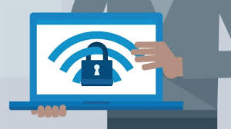
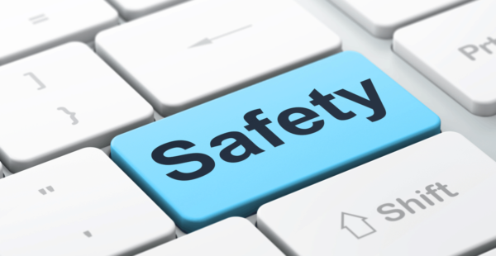
STAYING SAFE ONLINE
By Melanie
Tenzin
Penny

Slide 2
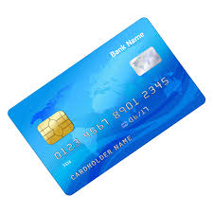
.Keep Personal Information Limited
People don't need to know what school you attend or what your school uniform looks like. You wouldn't hand purely personal information out to strangers individually—don't hand it out to millions of people online. Things like your home address and bank details don’t need to be online, freely accessible.

Slide 3
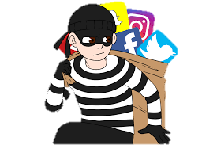
.Keep Your Privacy Settings On
I’m sure all your friends love to know all about you and what your doing, but so do predators and hackers. So take charge of your information. Many social media apps have settings available to protect your privacy online. Major apps like Instagram and snapchat also have privacy-enhancing settings available. Make sure you have enabled these privacy safeguards, and keep them enabled.

Slide 4
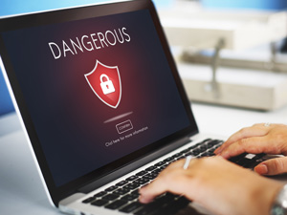
.Practice Safe Browsing
You wouldn't choose to walk through a dangerous neighbourhood— similarly don't visit dangerous websites online. Cybercriminals use lurid content as bait. They know people are sometimes tempted by dubious content and may let their guard down when searching for it. The Internet is filled with a lot of unsafe content, where one careless click could expose personal data or infect your device with malware. By resisting the urge, you don't even give the bad guys a chance.

Slide 5
.Be Careful What You Download
Don't download apps that look suspicious or come from a site you don't trust. That new game that everyone’s playing on their phones could actually be gathering up enough information on you to leave your privacy vulnerable. Do a little research before you download that next widget or game to make sure the app developer has a good reputation.

Slide 6
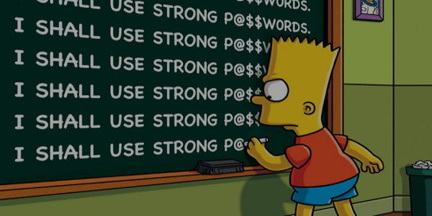
.Choose Strong Passwords
Passwords are one of the biggest weak spots in the whole Internet security structure, but there's currently no way around them. And the problem with passwords is that people tend to choose easy ones to remember(such as their name or 123456), which are also easy for cyber thieves to guess. Select strong passwords that are harder for cybercriminals to discover. A strong password is one that is unique and complex—at least 15 characters long, mixing letters, numbers and special characters. And don’t give out your password.

Slide 7
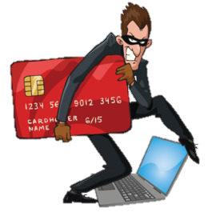
.Make Online Purchases From Secure Sites
Any time you make a purchase online, you need to provide credit card or bank account information—just what cybercriminals are most eager to get their hands on. Only supply this information to sites that provide secure, encrypted connections. Check credit card and bank statements carefully after shopping to ensure that the correct amount has been debited, and also that no fraud has taken place as a result of the transaction.

Slide 8
.Be Careful What You Post
The Internet does not have a delete key, any comment or image you post online may stay online forever because removing the original (say, from Twitter) does not remove any copies that other people made. There is no way for you to "take back" a remark you wish you hadn't made, or get rid of that embarrassing selfie you took at a party. Don't put anything online that you wouldn't want your mom or a prospective employer to see.

Slide 9
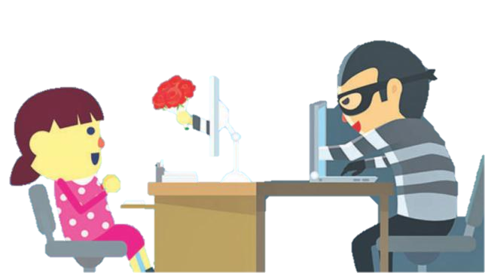
.Be Careful Who You Meet Online
People you meet online are not always who they claim to be. Indeed, they may not even be real. Fake social media profiles are a popular way for hackers to cosy up to unwary Web users and pick their cyber pockets. Be as cautious and sensible in your online social life as you are in your in-person social life.

Slide 10
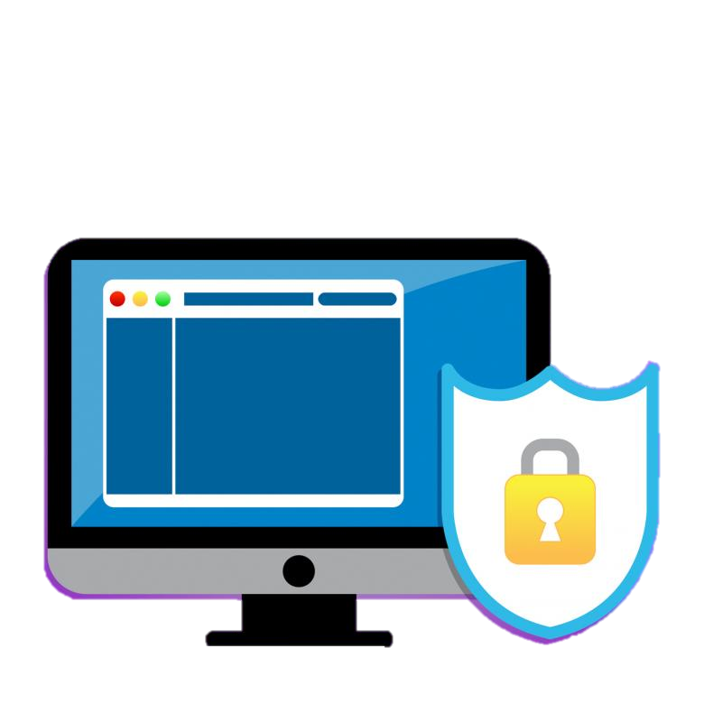
.Keep Your Antivirus Program Up To Date
Internet security software cannot protect against every threat, but it will detect and remove most malware—though you should make sure it's to date. Be sure to stay current with your operating system's updates and updates to applications you use. They provide a vital layer of security.

Slide 11
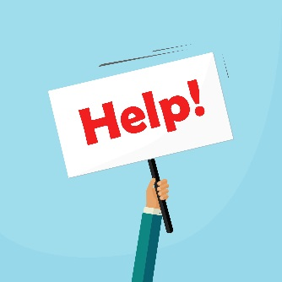
.What to do if your concerned about your online safety
Five ways to get support if things go wrong
Talk to someone you trust like an adult, or you can always talk to a Child line counsellor
Report bullying and abuse directly to the website.
Delete things you’ve shared that you’re worried about, or find ways to hide them
Tell the police by making a report if someone is threatening or blackmailing you
Plan for the future and change your privacy settings so it doesn’t happen again
If your concerned about your online safety, please contact the authorities or someone you trust.

Slide 12
THANK YOU!
Make sure you think before you click

