Slide 1
Year 7 Module Revision lesson 2
Quelle est la date aujourd’hui?

Slide 5
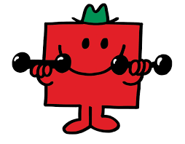
Petit
Grand
Amusant
Intelligent
Bavard
Fort
Timide
Méchant
patient

Slide 6
Grammaire- Stand up for feminine words and sit down for masculine words, raise your hand if both
Patient
Intelligente
Forte
Timide
Méchant
Grande
Bavard
Amusante
Petit
Sympa

Slide 8
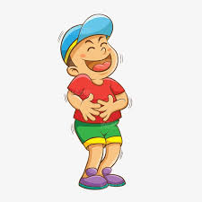
Pour moi, la rentrée, c’est…

Slide 10
La liste de revisión…
The speaking sheet with 7 questions on
Avoir and etre – homework sheet from yesterday
Vocabulary – things that we have written down so far this term
Masculine and feminine articles and adjective rules
Key phrases:
Sur la photo il y a …
Pour moi la rentrée, c’est …

Slide 11
Revision – p.23

Slide 14
In pairs, reply to the following questions…

