Slide 1
Activities Week 2015 July 11th – July 15th ^{Year 7 Residential Trip}

Slide 2
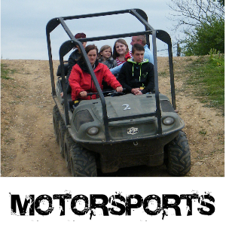
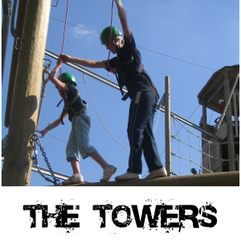

Slide 3
Stubbers Adventure Centre
Set in 130 acres
Widest range of activities in the South East

Slide 4
Accomodation - Maple Lodge
Rooms sleep 6 with 3 bunk beds
kitchen, dining, toilet & shower facilities

Slide 5
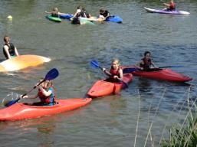
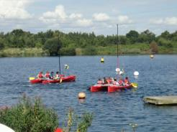
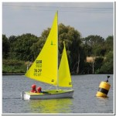
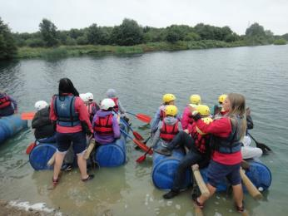
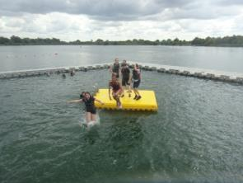
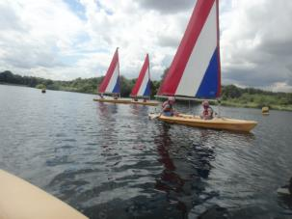
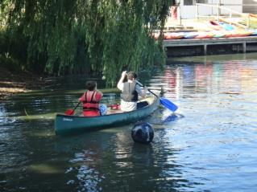
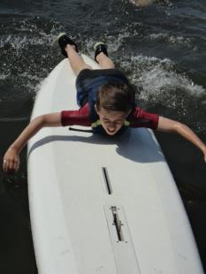
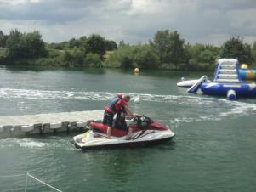
Activities Available
WATERSPORTS
Kayaking
Kata Kanu
Wobbly boarding
Jet Ski Rides
Open Canoeing
Sailing
Raft Building
Banana Boat Rides
Paddle Boarding

Slide 6
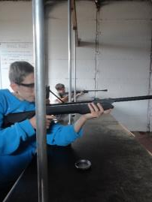
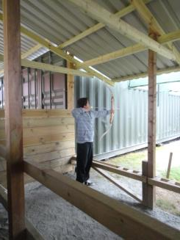
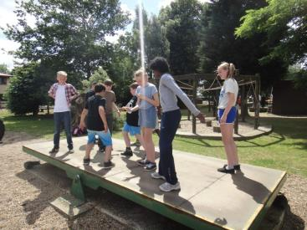
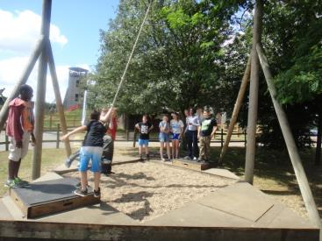
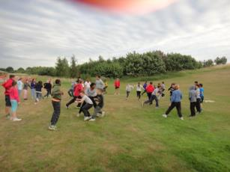
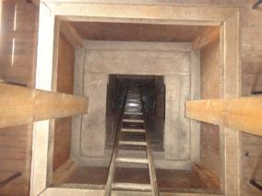
Activities Available
LAND-BASED
Archery
Fencing
Grass Sledging
Team Challenge
Orienteering
Rifle Shooting
All Terrain Boarding
Team Games
Tunnelling
Pond Cross
Bushcraft
Laser Tag

Slide 7
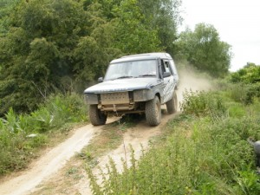
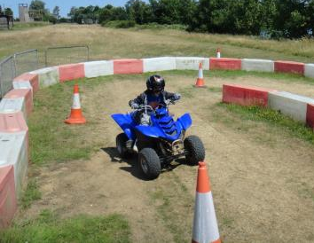
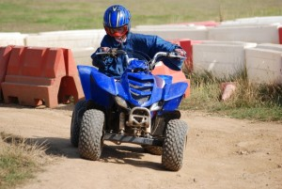
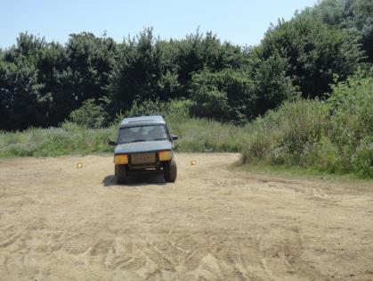
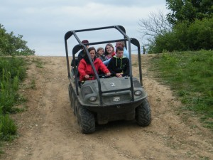
Activities Available
MOTORSPORTS
Quad Bikes
4x4 Driving
Argocat

Slide 8
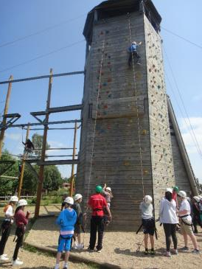
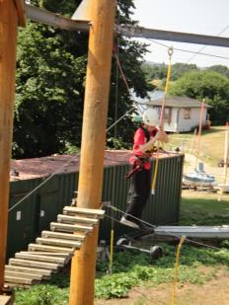
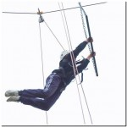
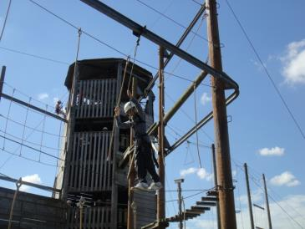
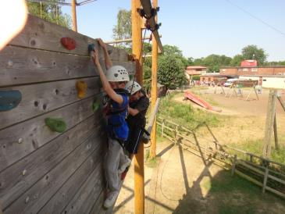
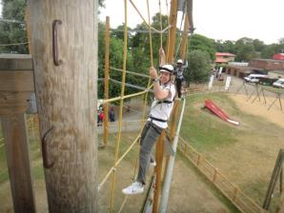
Activities Available
THE TOWERS
Climbing
Abseiling
High Ropes Aerial Walkway
Crate Stack
Jacob’s Ladder
Pamper Pole
Zip Wire

Slide 9
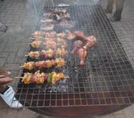
Monday-Friday
All food included
BBQ on the last night
4 Activities every day organised by qualified and experienced instructors
Evening activities
£410
There are a limited number of places available

