Slide 1
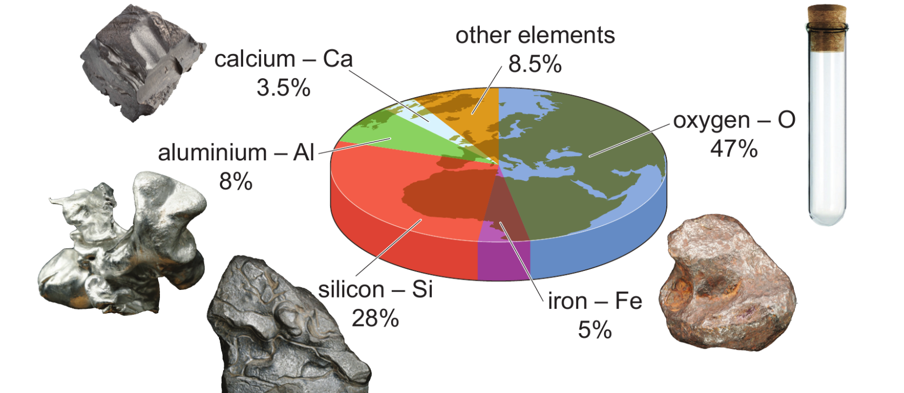
7Hb Earth’s Elements
CW
Do Now:
Which two elements make up 75% of the earths crust?
Which three named elements are metals?
Oxygen and silicon
Iron, aluminium and calcium

Slide 2
Requisitions
Equipment | Worksheets
 | Periodic Table (small)

Slide 3
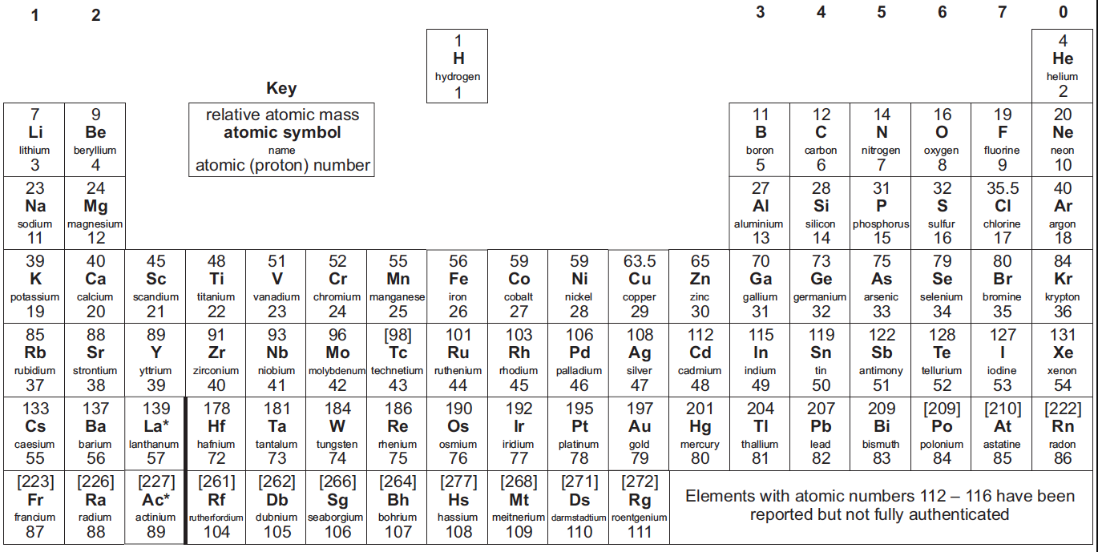
You will need your periodic table for the next task.

Slide 4
Symbols for elements
Identify the element shown in each photo.
Give the symbol for the element.

Slide 5
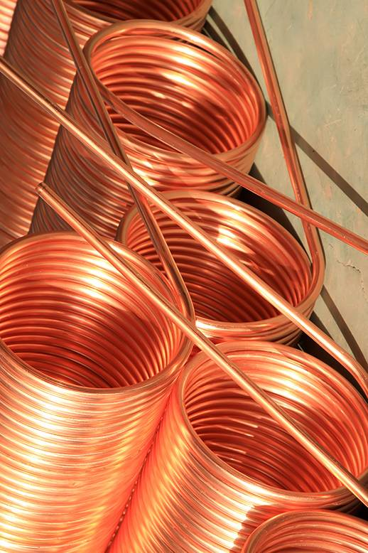
Symbols for elements
What element is this?
Answer:
What is its symbol?
Answer:
Copper
Cu

Slide 6
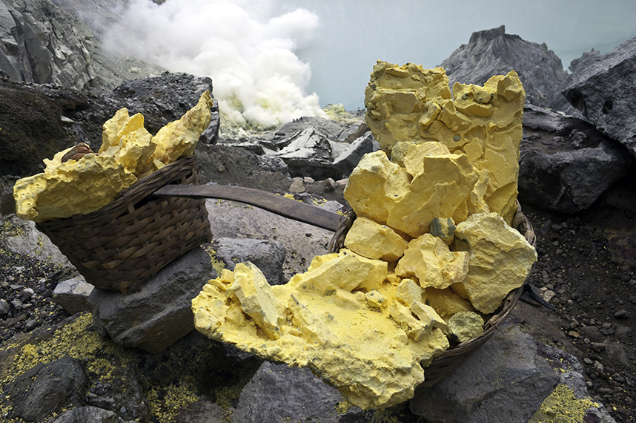
What element is this? Answer:
What is its symbol? Answer:
Sulfur
S
© Pearson Education Ltd 2014. Copying permitted for purchasing institution only. This material is not copyright free.
Notes:
6

Slide 7
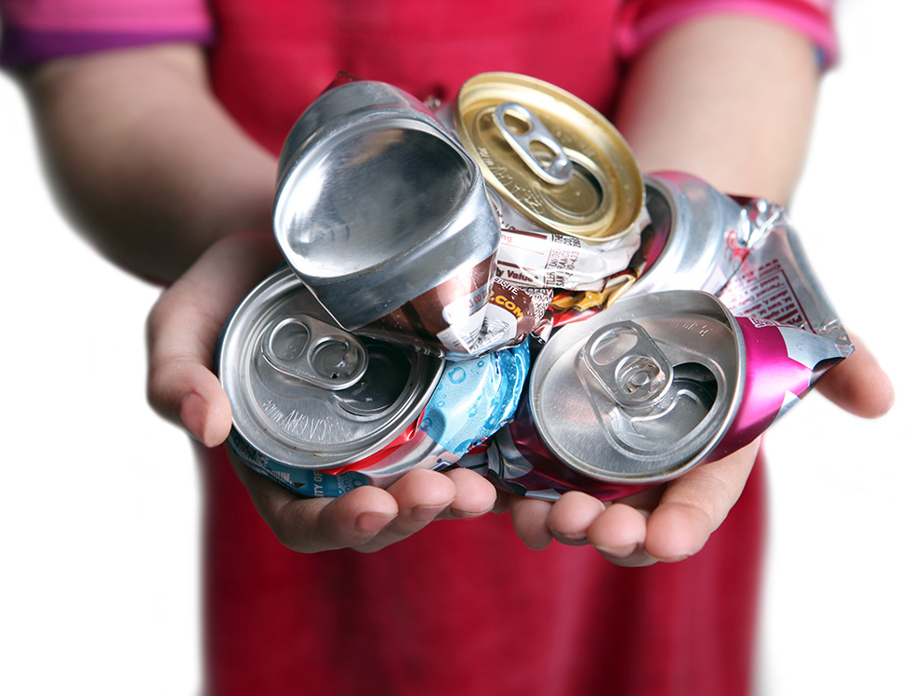
What element is this? Answer:
What is its symbol? Answer:
Aluminium
Al
© Pearson Education Ltd 2014. Copying permitted for purchasing institution only. This material is not copyright free.
Notes:
7

Slide 8
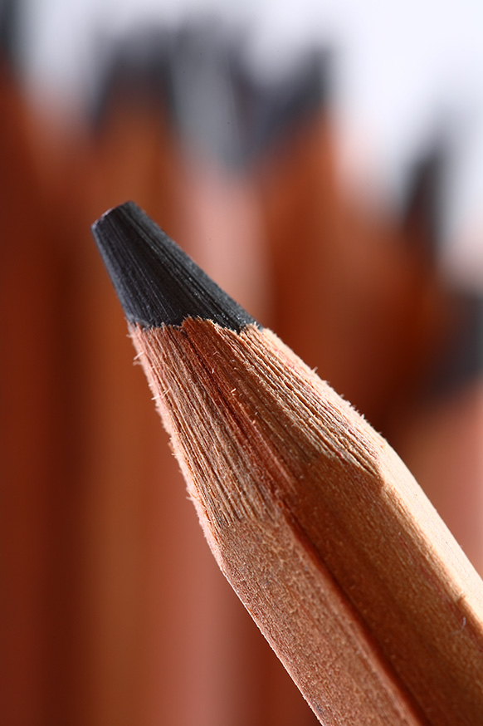
What element is this?
Answer:
What is its symbol?
Answer:
Carbon (graphite)
C
© Pearson Education Ltd 2014. Copying permitted for purchasing institution only. This material is not copyright free.
Notes:
8

Slide 9
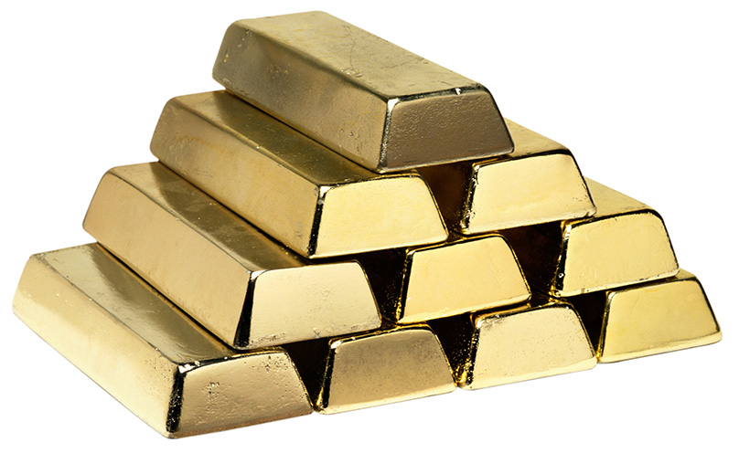
What element is this? Answer:
What is its symbol? Answer:
Gold
Au
© Pearson Education Ltd 2014. Copying permitted for purchasing institution only. This material is not copyright free.
Notes:
9

Slide 10
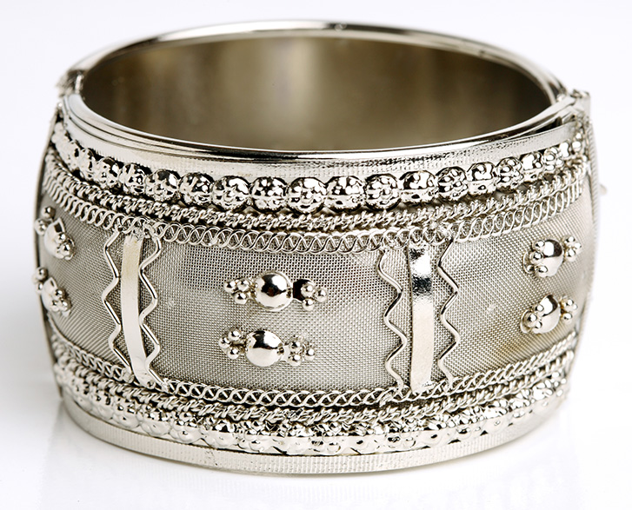
What element is this? Answer:
What is its symbol? Answer:
Silver
Ag
© Pearson Education Ltd 2014. Copying permitted for purchasing institution only. This material is not copyright free.
Notes:
10

Slide 11
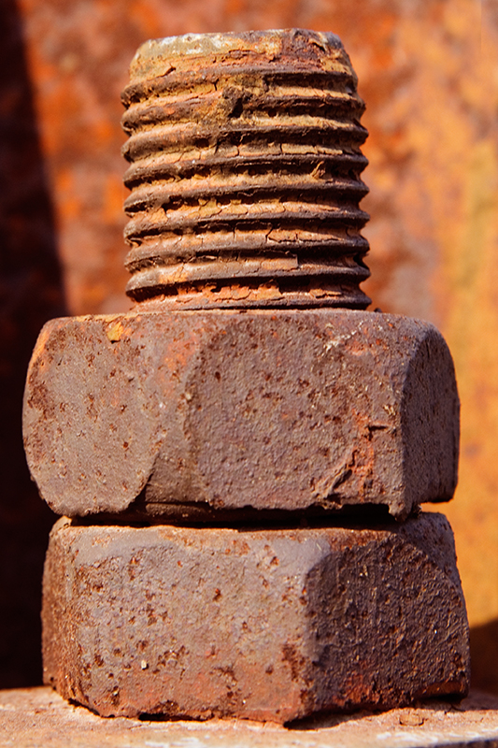
What element is this?
Answer:
What is its symbol?
Answer:
Iron
Fe
© Pearson Education Ltd 2014. Copying permitted for purchasing institution only. This material is not copyright free.
Notes:
11

Slide 12
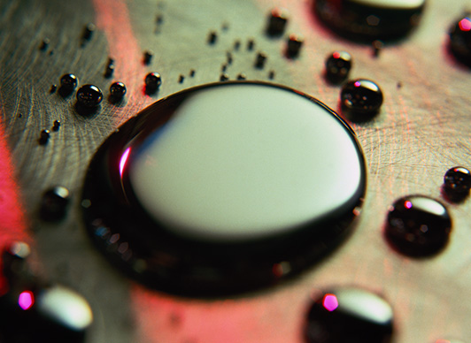
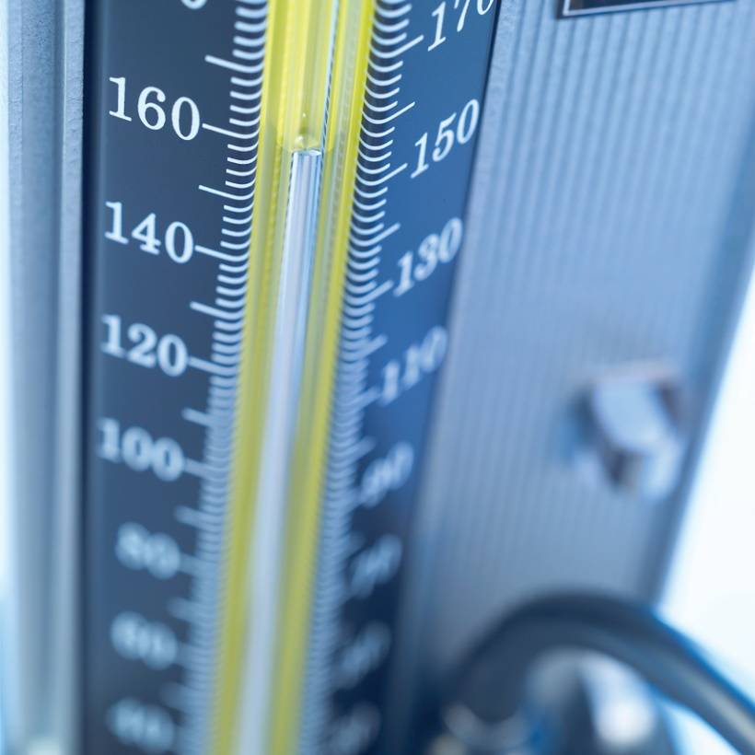
What element is this? Answer:
What is its symbol? Answer:
Mercury
Hg
© Pearson Education Ltd 2014. Copying permitted for purchasing institution only. This material is not copyright free.
Notes:
12

Slide 13
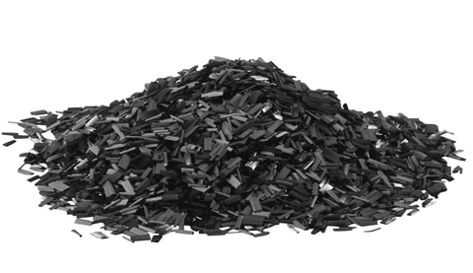
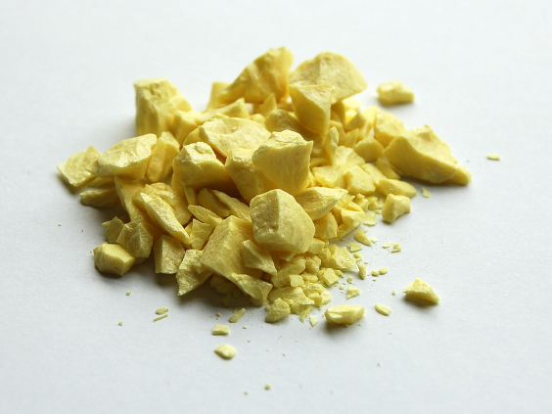
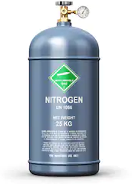
Name | Symbol
Oxygen
Carbon
Sulfur
Nitrogen
O
C
S
N

Slide 14
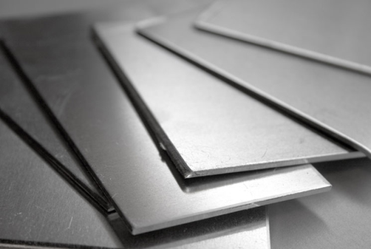
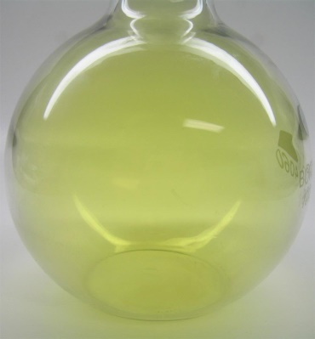
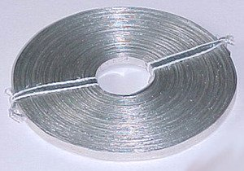
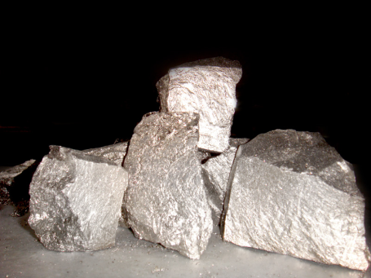
Name | Symbol
Aluminium
Chlorine
Magnesium
Calcium
Al
Cl
Mg
Ca

Slide 15
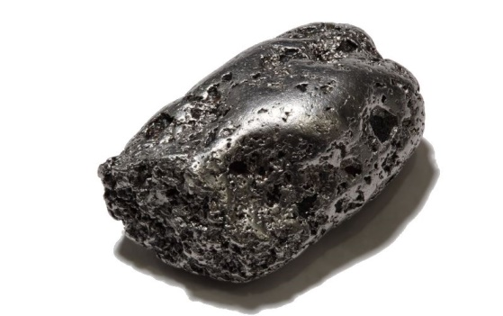
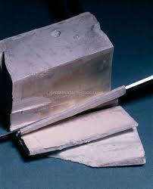
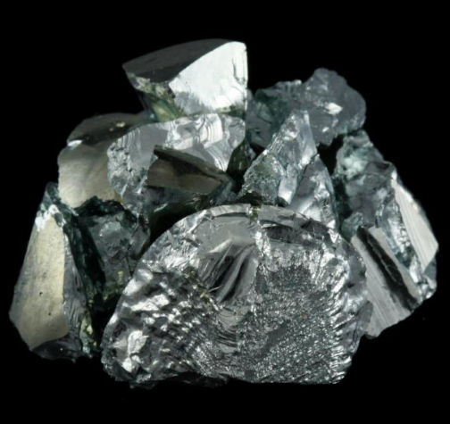
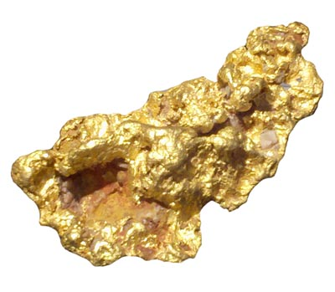
Name | Symbol
Iron
Sodium
Gold
Lead
Fe
Na
Au
Pb

Slide 16
Copy & Complete
All the elements have a symbol. If the symbol is just one letter, it is a __________. If the symbol has two letters, the second letter is __________.
Some elements have symbols based on their old _______ names. The old Latin name for iron is ferrum and its symbol is ______.
capital
lower case
Latin
Fe
lower case Fe capital Latin

Slide 17
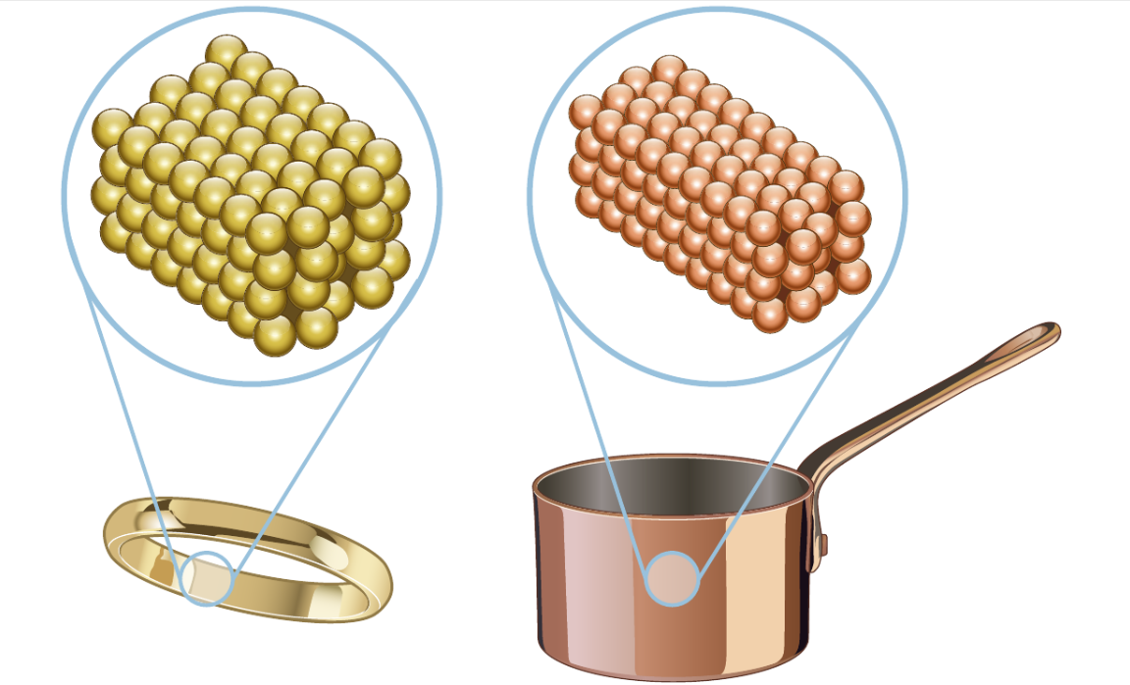
Copy & Complete
Properties and uses
Gold is used in jewellery because….
Copper is used for saucepans because….
Copper saucepan
Gold ring

Slide 18
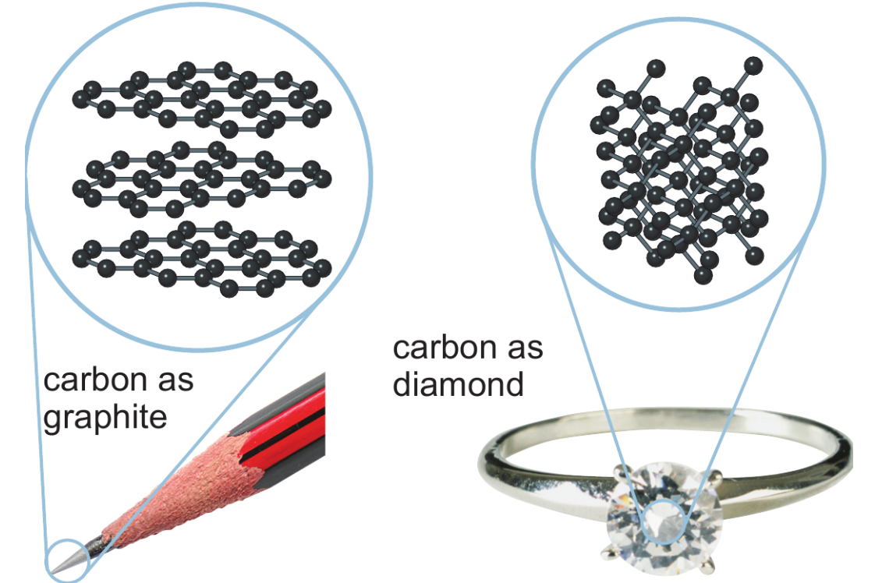
Copy & Complete
Carbon comes in different forms, for example, __________ and ________.
Diamond is very _____ and graphite is a lot ______.
The property depends on the ___________ of carbon atoms
graphite
diamond
hard
softer
arrangement
arrangement hard graphite diamond softer

Slide 19
Your old phone is full off untapped precious metals
WHAT EXACTLY IS IN MY SMARTPHONE?
Smartphones are pocket-sized vaults of precious metals and rare earths. A typical iPhone is estimated to house around 0.034 g of gold, 0.34g of silver, 0.015g of palladium and less than one-thousandth of a gram of platinum. It also contains the less valuable but still significant aluminium (25g) and copper (around 15g).
These are all present in relatively small amounts. But more than two billion people currently have a smartphone, and that number is projected to increase. What’s more, the concentration of some of these elements, such as gold and silver in a mobile phone is actually much higher than their concentration in an equivalent weight of ore. One tonne of iPhones would deliver 300 times more gold than a tonne of gold ore and 6.5 times more silver than a tonne of silver ore.
WHY IS THIS A PROBLEM?

Slide 20
Find the names of five elements in a mobile phone.
Why is it a good idea to recycle mobile phones.
Name five elements with symbols based on old Latin names.

Slide 21
Your old phone is full off untapped precious metals
Your old phone is full off untapped precious metals
WHAT EXACTLY IS IN MY SMARTPHONE?
Smartphones are pocket-sized vaults of precious metals and rare earths. A typical iPhone is estimated to house around 0.034 g of gold, 0.34g of silver, 0.015g of palladium and less than one-thousandth of a gram of platinum. It also contains the less valuable but still significant aluminium (25g) and copper (around 15g).
WHAT EXACTLY IS IN MY SMARTPHONE?
Smartphones are pocket-sized vaults of precious metals and rare earths. A typical iPhone is estimated to house around 0.034 g of gold, 0.34g of silver, 0.015g of palladium and less than one-thousandth of a gram of platinum. It also contains the less valuable but still significant aluminium (25g) and copper (around 15g).
These are all present in relatively small amounts. But more than two billion people currently have a smartphone, and that number is projected to increase. What’s more, the concentration of some of these elements, such as gold and silver in a mobile phone is actually much higher than their concentration in an equivalent weight of ore. One tonne of iPhones would deliver 300 times more gold than a tonne of gold ore and 6.5 times more silver than a tonne of silver ore.
WHY IS THIS A PROBLEM?
These are all present in relatively small amounts. But more than two billion people currently have a smartphone, and that number is projected to increase. What’s more, the concentration of some of these elements, such as gold and silver in a mobile phone is actually much higher than their concentration in an equivalent weight of ore. One tonne of iPhones would deliver 300 times more gold than a tonne of gold ore and 6.5 times more silver than a tonne of silver ore.
WHY IS THIS A PROBLEM?

