Slide 1
2021 Events
Ella,Tiana,Attiya
This Photo by Unknown author is licensed under CC BY-NC.

Slide 2
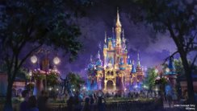
The 50th anniversary of Walt Disney World.
The Walt Disney World 50th Anniversary will be one of the biggest celebrations Disney has ever had . October 1, 2021, will be the 50th anniversary of Disney's Magic Kingdom

Slide 3
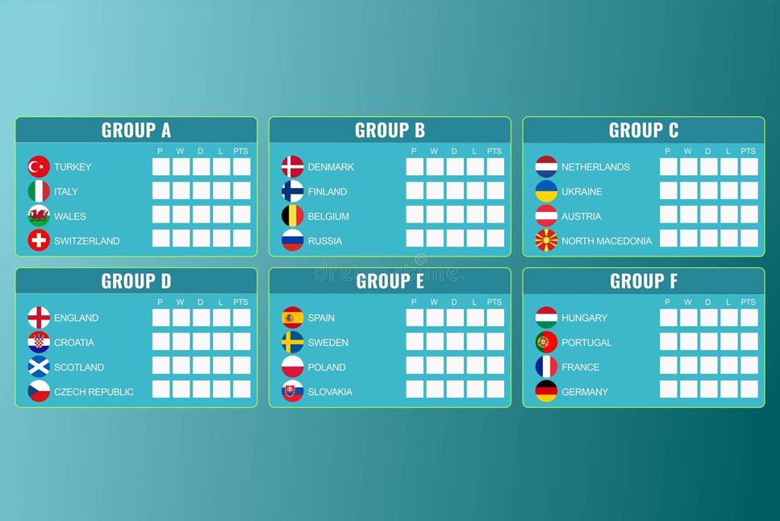
Euro 2021
Last year June 2020 the euros were postponed because of a global pandemic (coronavirus).
The euros happen all around the Europe .no country hosts the euros
All together they are 24 teams qualified for the euros

Slide 4
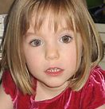
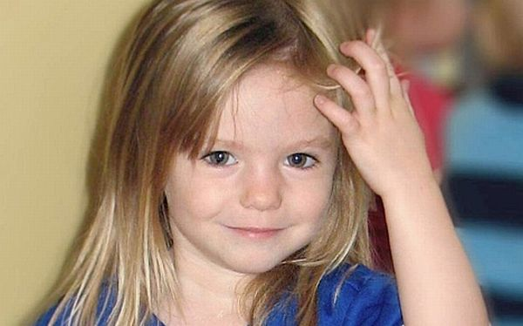
New lead to madeline mcann case
In June 2020 a man was accused of the Madeline Mcann kidnapping case after 13 years. Coincedentally he did commit a crime in the same resort a year and half before Madeline went missing. Recently in June a clairvoyant has claimed Madeline was buried in the woods, Unfortunately to this day Madeline has never been found
Original idea
This Photo by Unknown author is licensed under CC BY-SA-NC.

