Slide 1
7Bb Reproductive organs
Name the parts of the male and female reproductive systems and their jobs
Explain how the sperm and egg cells are adapted to their functions
State what happens at the menopause
Starter: In the back of your books, write down everything you remember about gametes from last lesson.

Slide 2
Recap from last lesson: Gametes
Gametes (sex cells) are specialised cells.
They carry genetic information
Egg cells (ovum) are female gametes.
Sperm cells are male gamete.
Sperm and ovum fuse together during fertilisation to form a specialised egg (zygote), which develops into a foetus.
Notes:
Answer:

Slide 3
Sperm cell

Slide 4
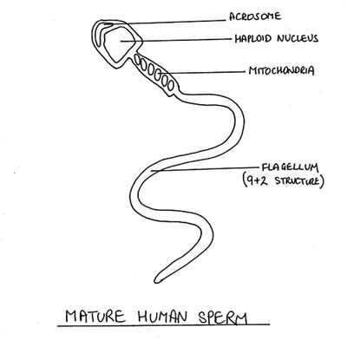
Diagram of sperm cell
Copy the diagram
Top of head
Tail

Slide 5
Adaptations of a sperm cell
Copy the text
Top of head (acrosome) contains enzymes to help the sperm burrow through an egg cell.
Long tail moves from side to side so the whole sperm cell swims forward towards the egg.
Lots of mitochondria (spiral shaped) to provide the sperm with energy
Streamlined shape
Nucleus contains the genes (genetic information)

Slide 6
Ovum (egg cell)

Slide 7
Copy the diagram
Diagram of an ovum (egg cell)
Jelly coat
Nucleus
Cell membrane
Cytoplasm

Slide 8
Adaptations of an egg cell
Copy the text
Jelly coat hardens after it has been fertilised by sperm to prevent a second sperm fertilising the egg cell
Large store of nutrients in the cytoplasm to provide a source of energy for cell division and growth after fertilisation
Nucleus contains the genes (genetic information)

Slide 9
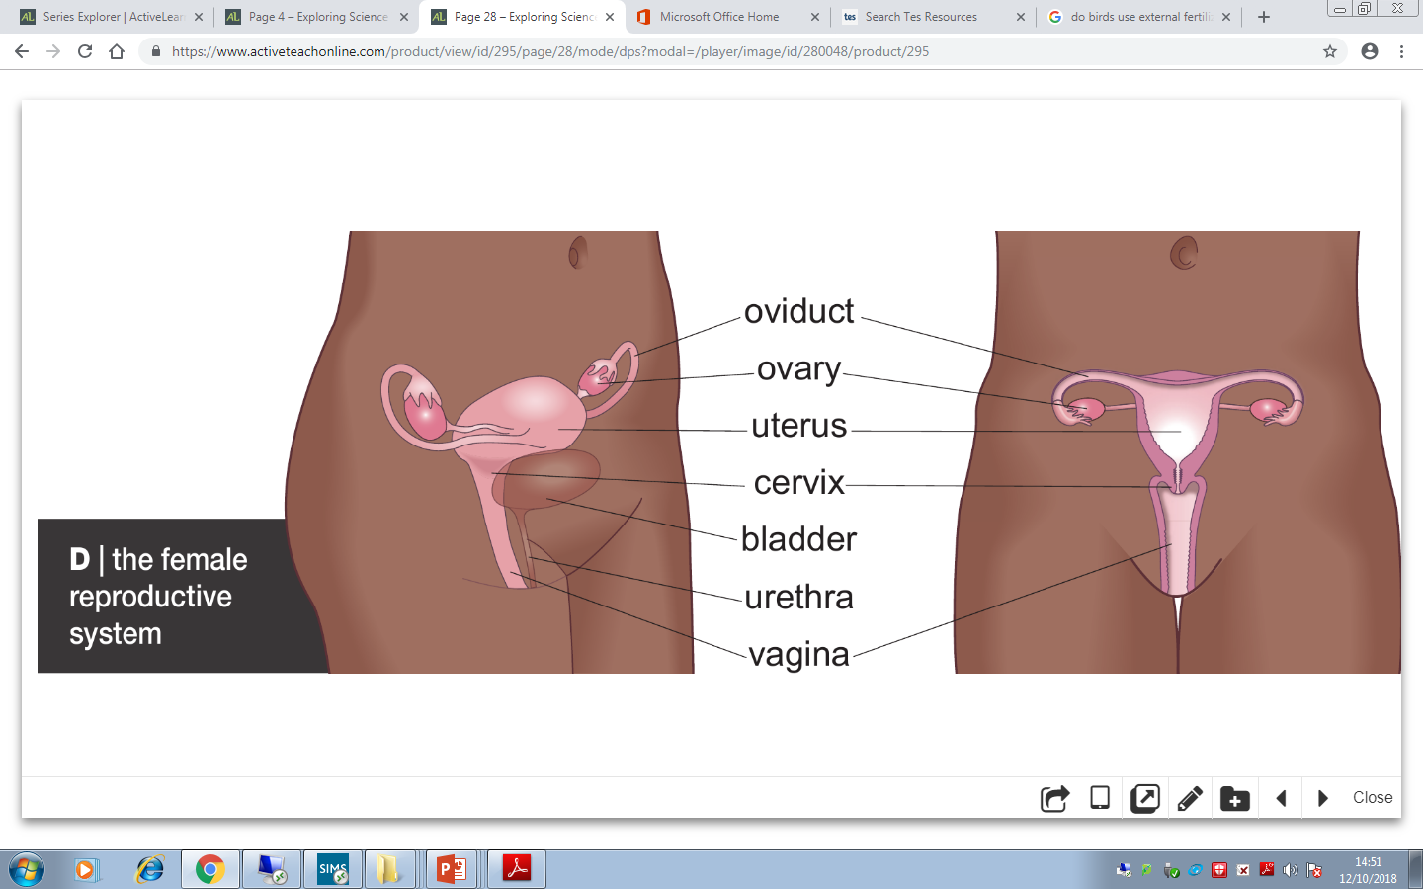
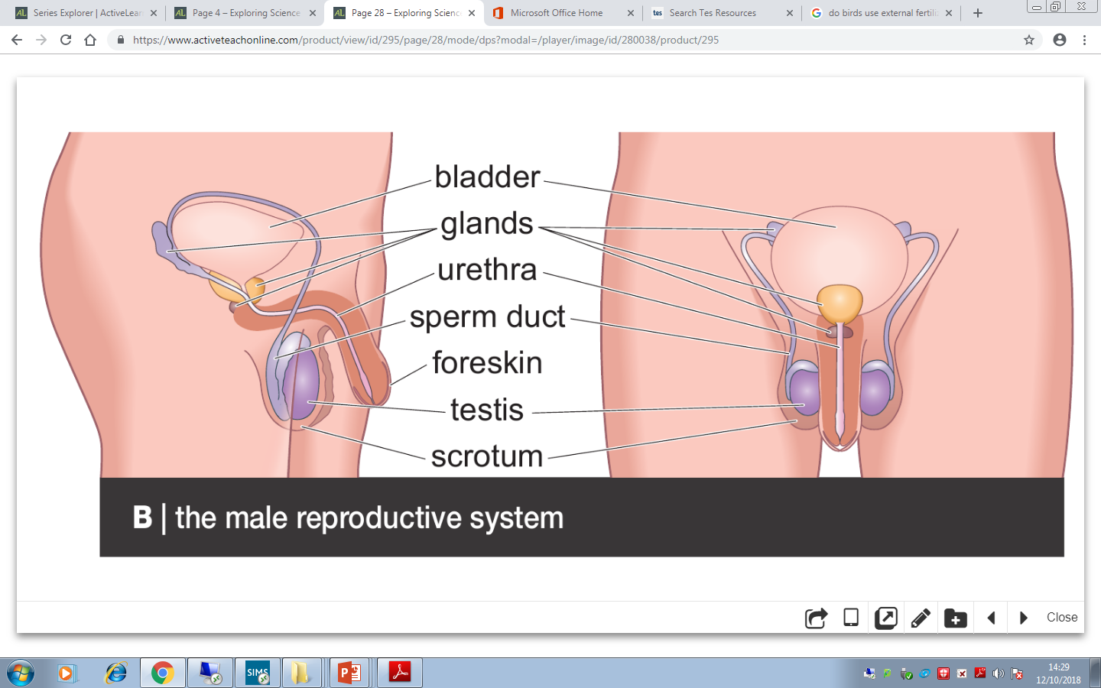
Reproductive system

Slide 10
Reproductive system
Copy and complete the text below
The r___________ organs produce gametes and are part of the organ system called the r_____________ system.
The t_____ are the male reproductive organ and produce s____ cells.
The o______ are the female reproductive organ and produce the o___ (egg cells) .

Slide 11
Reproductive system
Correct your work using green pens
reproductive
The r___________ organs produce gametes and are part of the organ system called the r__________ system.
The t_____ are the male reproductive organ and produce s____ cells.
The o______ are the female reproductive organ and produce the o___ (egg cells) .
reproductive
testis
sperm
ovaries
ovum

Slide 12
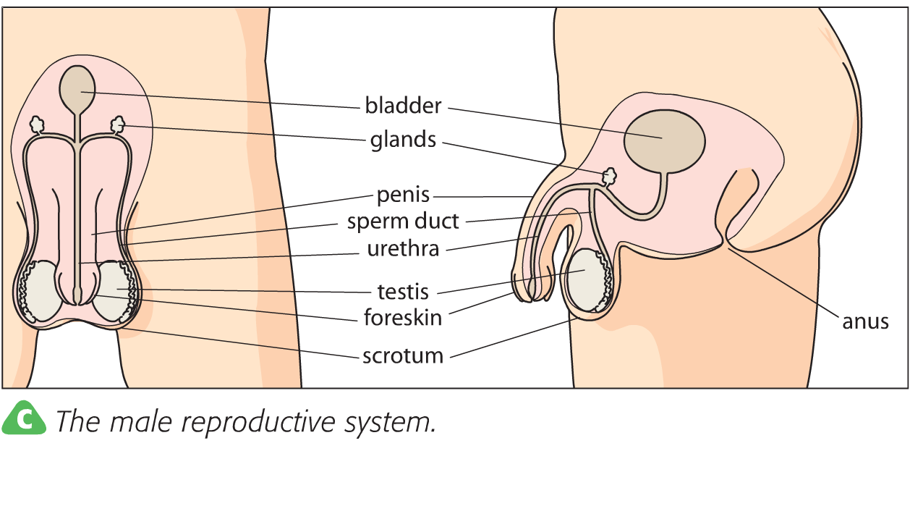
Male reproductive system

Slide 13
Male reproductive system
Watch the video
https://www.activeteachonline.com/product/view/id/295/page/28/mode/dps?modal=/player/video/id/270269

Slide 14
Male reproductive system

Slide 15
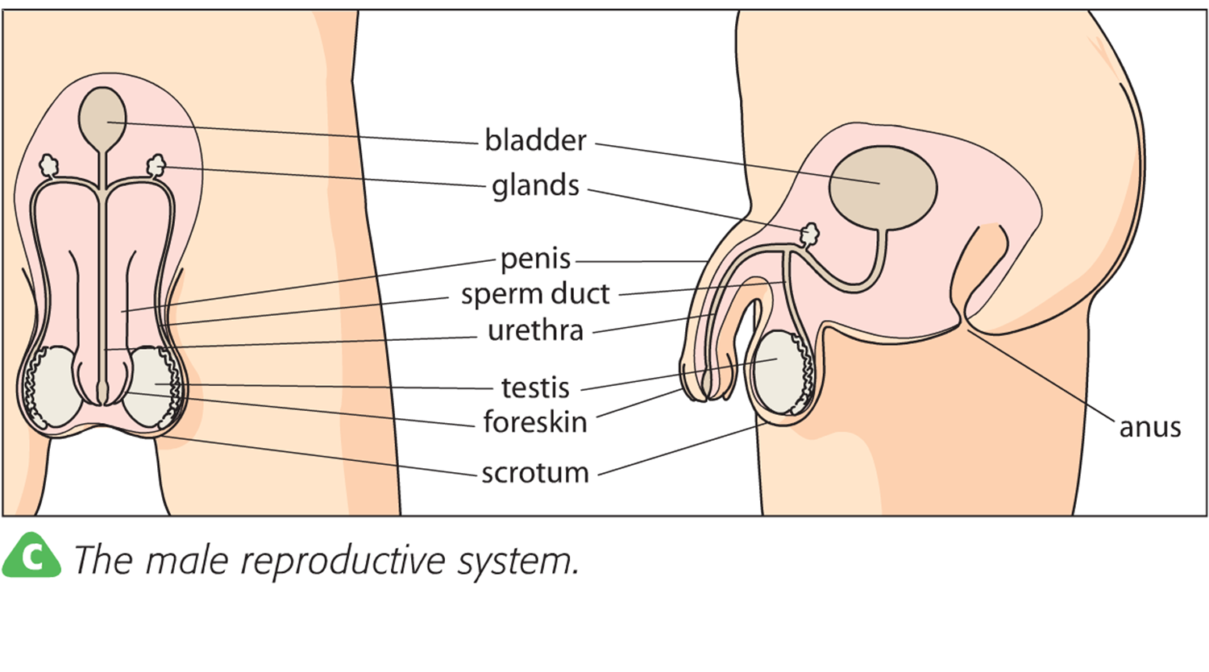
Male reproductive system
Copy the text below
Testis release sperm cells.
Sperm cells travel through the sperm ducts, where fluids are added from glands.
The fluids give the sperm cells energy.
Together the sperm cells and fluids are called semen.
The semen leaves the body through the urethra.
The urethra also carries urine from the bladder but never at the same time as semen.

Slide 16
Male reproductive system
Copy the text below
Testis are held outside the body in a sack called the scrotum. This keeps the sperm cells at the correct temperature so that they develop properly.
After males go through puberty, they produce sperm for the rest of their lives.

Slide 17
Task: Complete the worksheet on the male reproductive system.
Challenge: Answer the questions below in full sentences.
Where are sperm cells made?
Explain whether sperm cells need to be warmer or colder than the body to develop?
What is semen?
Notes:
See firefly for worksheet
Answers to challenge questions:
Testis
Colder so the sperm can develop properly
A mixture of fluid and sperm

Slide 18
Bladder
Glands
Mark your work using a green
Sperm duct
Penis
Urethra
Testis
Foreskin
Scrotum
Bladder
Glands
Sperm duct
Penis
Urethra
Testis
Foreskin
Scrotum

Slide 19
Mark your work using a green

Slide 20
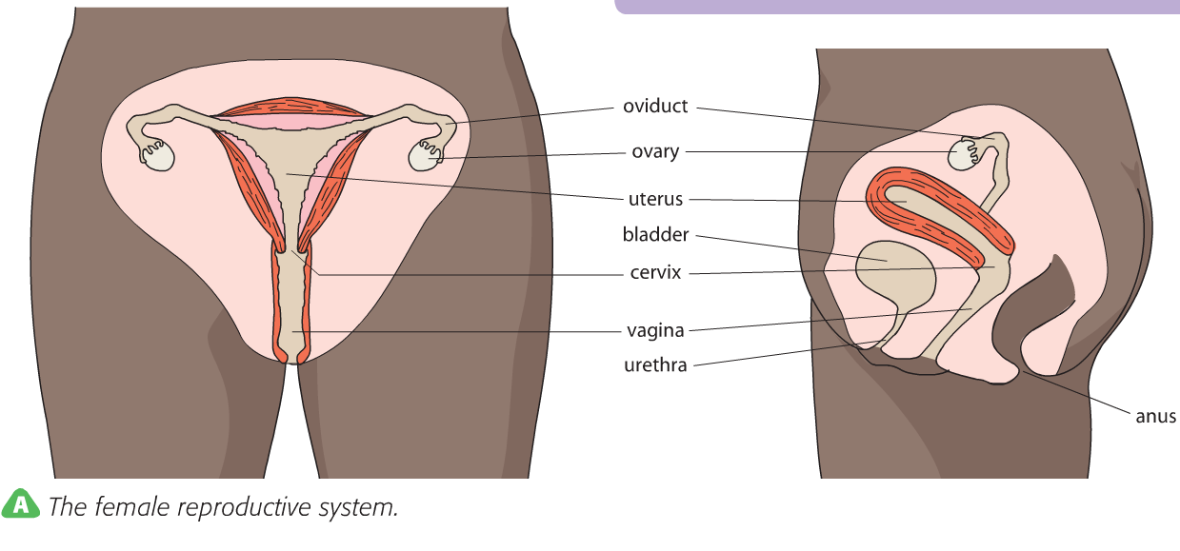
Female reproductive system

Slide 21
Female reproductive system
Watch the video
https://www.activeteachonline.com/product/view/id/295/page/28/mode/dps?modal=/player/video/id/270270

Slide 22
Female reproductive system

Slide 23
Female reproductive system

Slide 24
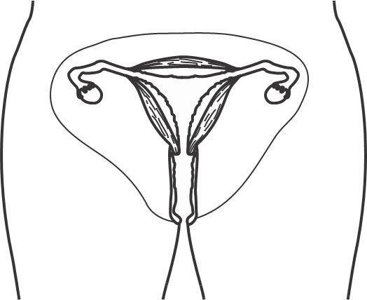
Female reproductive system
Copy the text below
After puberty, egg cells develop.
Usually one egg cell is released from the ovary every 28-32 days. This is called the menstrual cycle.
The egg cell is released, into the oviducts.
The oviduct is lined with cilia that sweep the egg cell towards the uterus (where baby devlops).
The uterus has strong, muscular walls and a soft lining.
The cervix is the lower part of the uterus. This is a ring of muscle that hold the baby in place.

Slide 25
Female reproductive system
Copy the text below
The ovaries stop releasing eggs at around the age 45-55. This is called the menopause.

Slide 26
Task: Complete the worksheet on female reproductive parts.
Challenge: Answer the questions below in full sentences.
What are female sex cells called?
How does an egg get to a uterus?
What is the cervix?
A woman releases an egg cell every 28 days for 35 years. How many egg cells does she release in total? Show your working out.
Where does a fertilised egg get its energy from?
Notes:
See firefly for worksheet
Answer to challenge questions:
Egg cells/ ovum
Cilia in the oviducts sweep it to the uterus
365/ 28 = 13 eggs released each year
13 x 35 = 456 eggs released in 35 years

Slide 27
Mark your work using a green
Oviduct
Ovary
Uterus
Cervix
Vagina
Oviduct
Ovary
Uterus
Bladder
Cervix
Vagina
Urethra

Slide 28
Mark your work using a green

Slide 29
Thinking skills
Reproductive organs

Slide 30
Think of a Plus, a Minus and an Interesting point about this statement:
The testes should be inside the body rather than being in the scrotum.
Possible answers
Next question
© Pearson Education Ltd 2014. Copying permitted for purchasing institution only. This material is not copyright free.

Slide 31
Think of a Plus, a Minus and an Interesting point about this statement:
The testes should be inside the body rather than being in the scrotum.
Plus: The testes would be better protected inside the body.
Minus: Sperm cells need to be at a lower temperature than the rest of the body.
Interesting: How many sperm cells are made in the testes each day? Adult men produce up to 100 million sperm cells every day.
Possible answers
Next question
© Pearson Education Ltd 2014. Copying permitted for purchasing institution only. This material is not copyright free.

Slide 32
Think of a Plus, a Minus and an Interesting point about this statement:
The menopause should occur at 70 years of age.
Possible answers
Next question
© Pearson Education Ltd 2014. Copying permitted for purchasing institution only. This material is not copyright free.

Slide 33
Think of a Plus, a Minus and an Interesting point about this statement:
The menopause should occur at 70 years of age.
Plus: Each woman could produce more offspring in her lifetime.
Minus: Women might have babies when their bodies are too old to maintain pregnancy and look after a new baby.
Interesting: Do some women have the menopause very late in life or very early? Some animals, like African wild dogs, do not have the menopause.
Possible answers
Next question
© Pearson Education Ltd 2014. Copying permitted for purchasing institution only. This material is not copyright free.

Slide 34
Which is the odd one out in this list?
Sperm duct Urethra Bladder
Possible answers
Back to start
End show
© Pearson Education Ltd 2014. Copying permitted for purchasing institution only. This material is not copyright free.

Slide 35
Which is the odd one out in this list?
Sperm duct Urethra Bladder
Bladder, as it is the only part not involved with producing or transferring sperm.
Sperm duct, as the other two are both involved in the urinary system.
Possible answers
Back to start
End show
© Pearson Education Ltd 2014. Copying permitted for purchasing institution only. This material is not copyright free.

