Slide 1
Reqs
Rock Samples (Basalt and Gabbro)
Structure of the earth diagram (unlabeled)
Extension/Homework
W/S 8Hb7

Slide 2
Objectives
Recall that the Earth consists of a core, mantle and crust.
Describe how magma can be erupted to form volcanoes.
Describe how igneous rocks are formed.
Describe how metamorphic rocks are formed.
Recall the names of some igneous and metamorphic rocks.
Describe the textures and properties of igneous and metamorphic rocks.
Explain how the size of crystals in igneous rocks is evidence for the speed of cooling and describe some factors that affect this.
Use crystal size to classify igneous rocks as intrusive and extrusive.

Slide 3
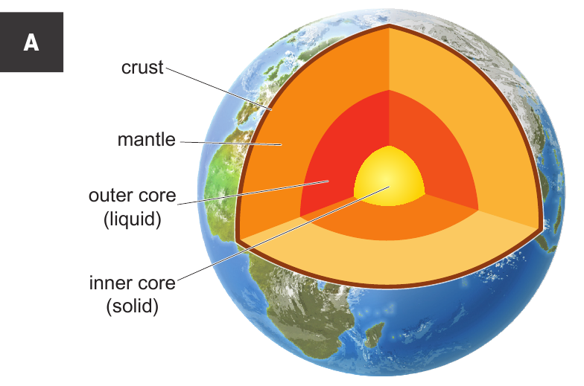
C/W
04/02/2019
8Hb – Igneous and Metamorphic
Starter
Using the lines on the diagram, draw in labels to name each layer of the earth.
As you watch the video, add in a fact about each layer on your diagram

Slide 4
Igneous rocks
What is the difference between magma and lava?
Watch the video and complete the word fill
Rocks that form by the c_______ and s____________ of molten rock (magma and lava). I________ rocks are the most common of the three types of rock on Earth.
S____________ and m___________ rocks make up only about one-twentieth of the crust.
E__________ igneous rocks are formed when lava cools at the surface, while I___________ igneous rocks are those that cool and form underground

Slide 5
Cooling Speed and crystal size
Copy the text below
If molten rock cools down fast, it forms rocks containing small crystals; such as basalt. This tends to happen above the ground.
If molten rock cools down slowly, if forms rocks containing large crystals; such as gabbro or granite. This tends to happen deep below the ground.

Slide 6
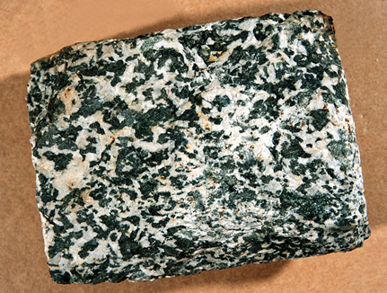
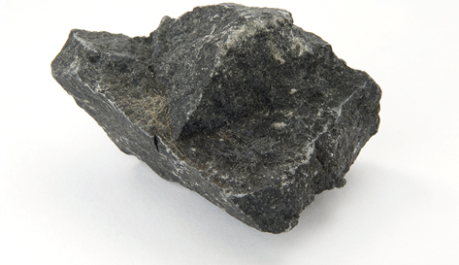
Basalt and Gabbro
Would these rocks have interlocking or rounded grains?
Which rock is Gabbro? Which rock is Basalt?
Explain your choice using crystal/grain size.
Gabbro
Basalt

Slide 7
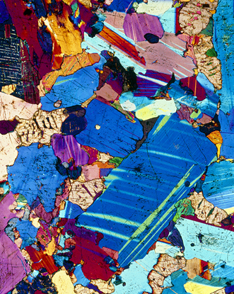
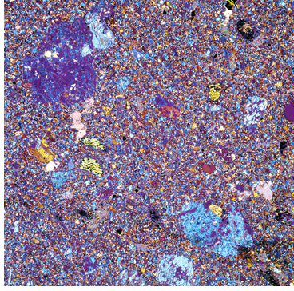
Basalt and Gabbro
This photograph shows a thin section of basalt through a microscope. There are many small grains and crystals showing that the liquid rock has cooled quickly on or near the surface of the Earth.
This photograph shows a thin section of gabbro through a microscope. The large crystals can clearly be seen.

Slide 8
As a class, complete the activity to investigate how crystal cooling happens in volcanoes.
https://www.activeteachonline.com/default/player/interactive/id/388822/external/0
PARTICLE MODEL
Another way to explain this is using the particle model. While a liquid (molten rock), the particles have room to move around. As they cool down (solidify), the particles form a grid pattern and become unable to move.
The slower the cooling, the larger the grid/crystals as here is more time for the particles to become ordered. If cooling happens fast, there is less time for particles to become ordered, so you get a smaller grid/smaller crystals.
Notes:
Explaining crystal size in terms of particles is in the assessment so you need to ensure they understand how these two concepts could be linked.

Slide 9
Metamorphic rocks
Watch the video and complete the word fill
Naturally occurring rock that has been transformed by h___ and p_______ in the Earth's crust.
The rocks transformed in this way may start the process as s_________ or i_______. Typical metamorphic rocks include sl____ , which is formed from sh____ , and m_____ which is formed from l__________.
Metamorphic rocks always contain interlocking grains and usually have different properties from the original rock.

Slide 10
Turning a rock into a Metamorphic Rock

Slide 11
Quick Questions

Slide 12
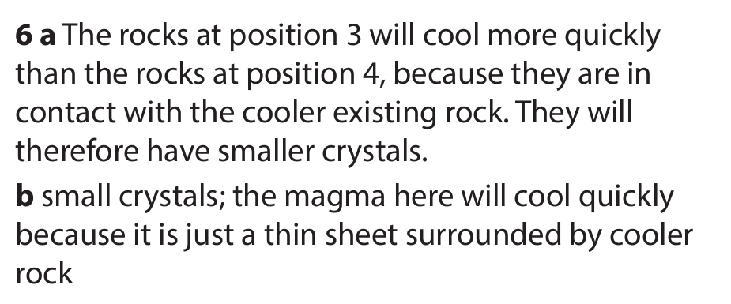
Quick Questions

Slide 13
Extension/ H/W
Complete W/S 8Hb7

Slide 15
 Give a clue or definition for these keywords.
Hot Seat

Slide 16
Hot seat
 Give a clue or definition for these keywords.
Magma

Slide 17
Hot seat
 Give a clue or definition for these keywords.
Extrusive

Slide 18
Hot seat
 Give a clue or definition for these keywords.
Intrusive

Slide 19
Hot seat
 Give a clue or definition for these keywords.
Metamorphic

Slide 20
Hot seat
 Give a clue or definition for these keywords.
Igneous

Slide 21
Hot seat
 Give a clue or definition for these keywords.
Lava

