Slide 1
7Je Using Electricity
In your book answer these questions:

Slide 2
Requisitions
Equipment | Worksheets
 | Plug Diagram

Slide 4
Learning Objectives
Recall some dangers of electricity.
Recall some safety precautions to be followed when using electricity.
Describe the job that fuses do and recall how the different wires are connected in a plug.
Explain why electricity is more convenient than other sources of energy, and classify some of its uses.
Explain how a domestic ring main is a form of parallel circuit.
Identify errors in the wiring of a plug.
Apply knowledge of voltage, current and electrical safety to novel situations.

Slide 5
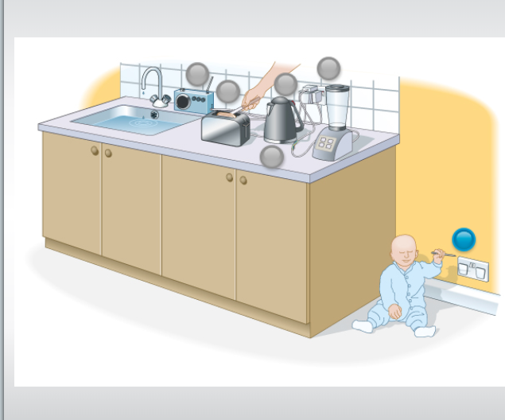
Write down what each number is labelling, then work in pairs and decide if you think each spot is safe or unsafe
5
1
3
2
4
6

Slide 6
Self Assess

Slide 7
Avoiding the hazards of electricity

Slide 8
Dangers of Electricity Identify the dangers of electricity in each of the following situations. Add the blue text to your diagram

Slide 9
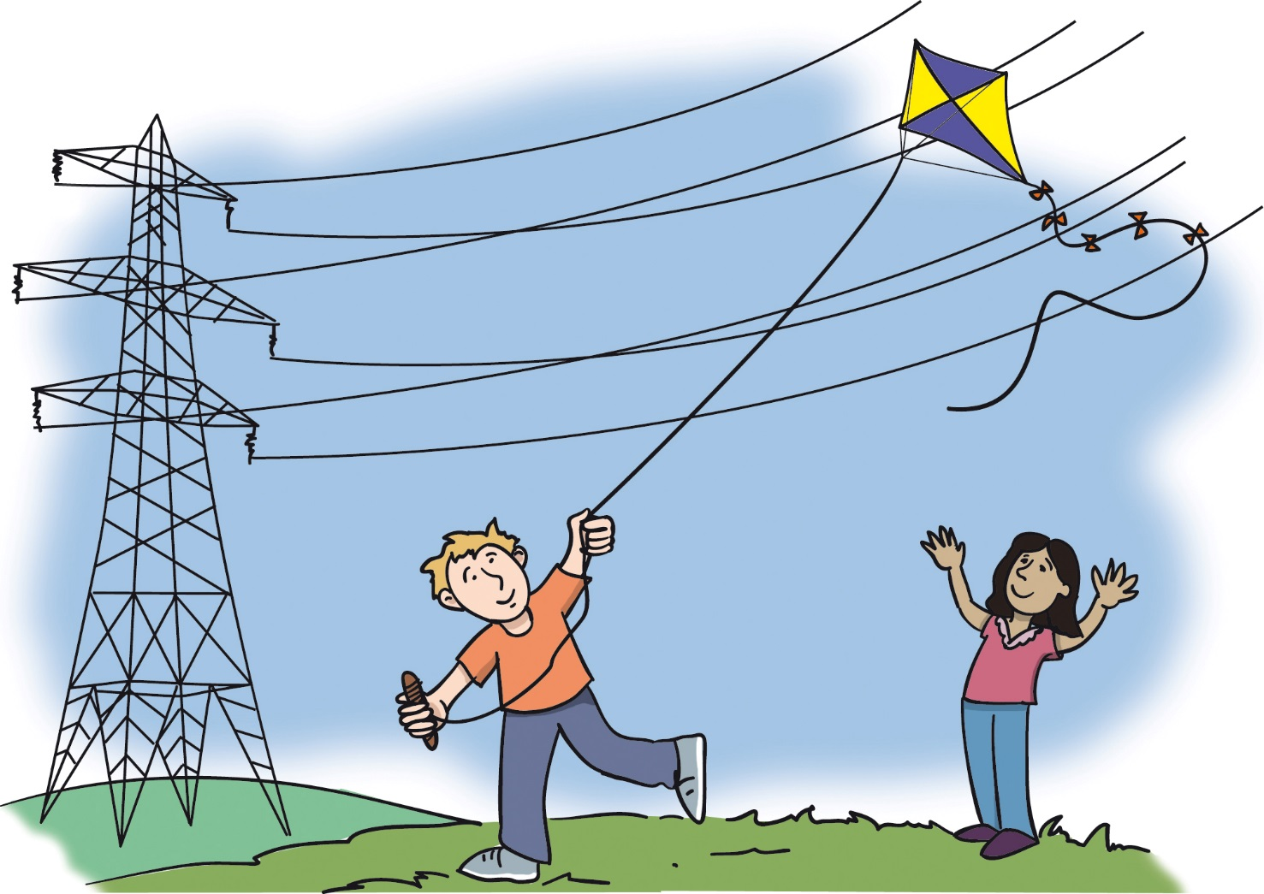
If the kite touches the pylon wires, current will flow down the string and electrocute the boy.
Never fly kites near high voltage power lines.

Slide 10
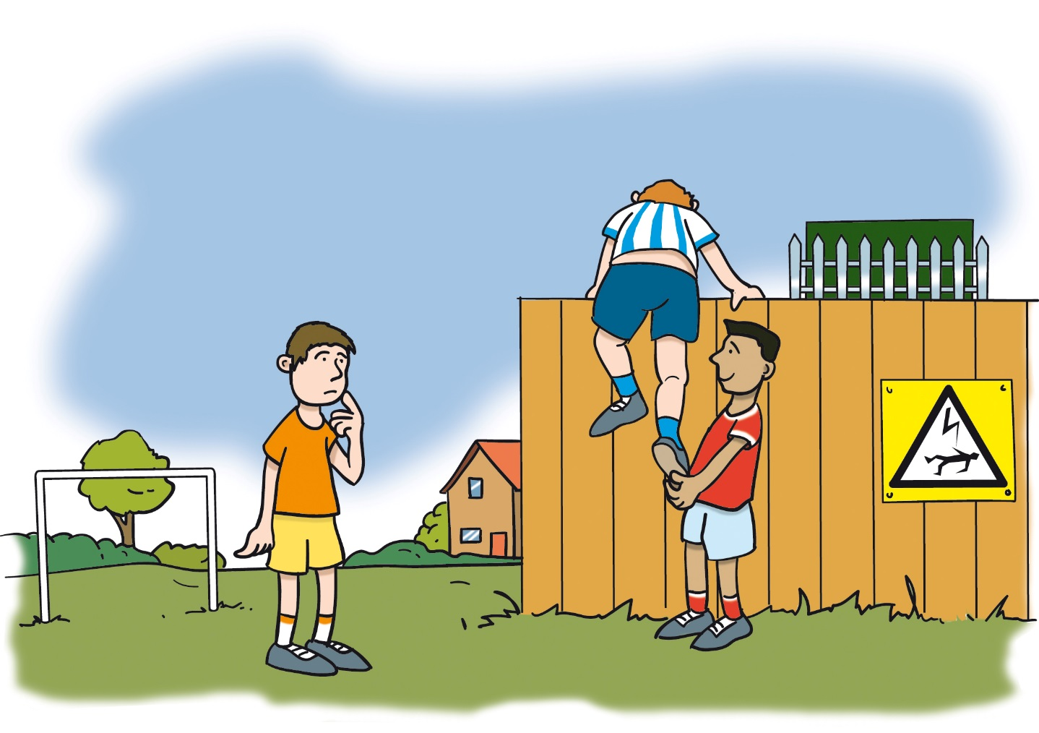
If the boy touches the high voltage transformers, he will be electrocuted.
Do not enter electricity sub-stations.

Slide 11
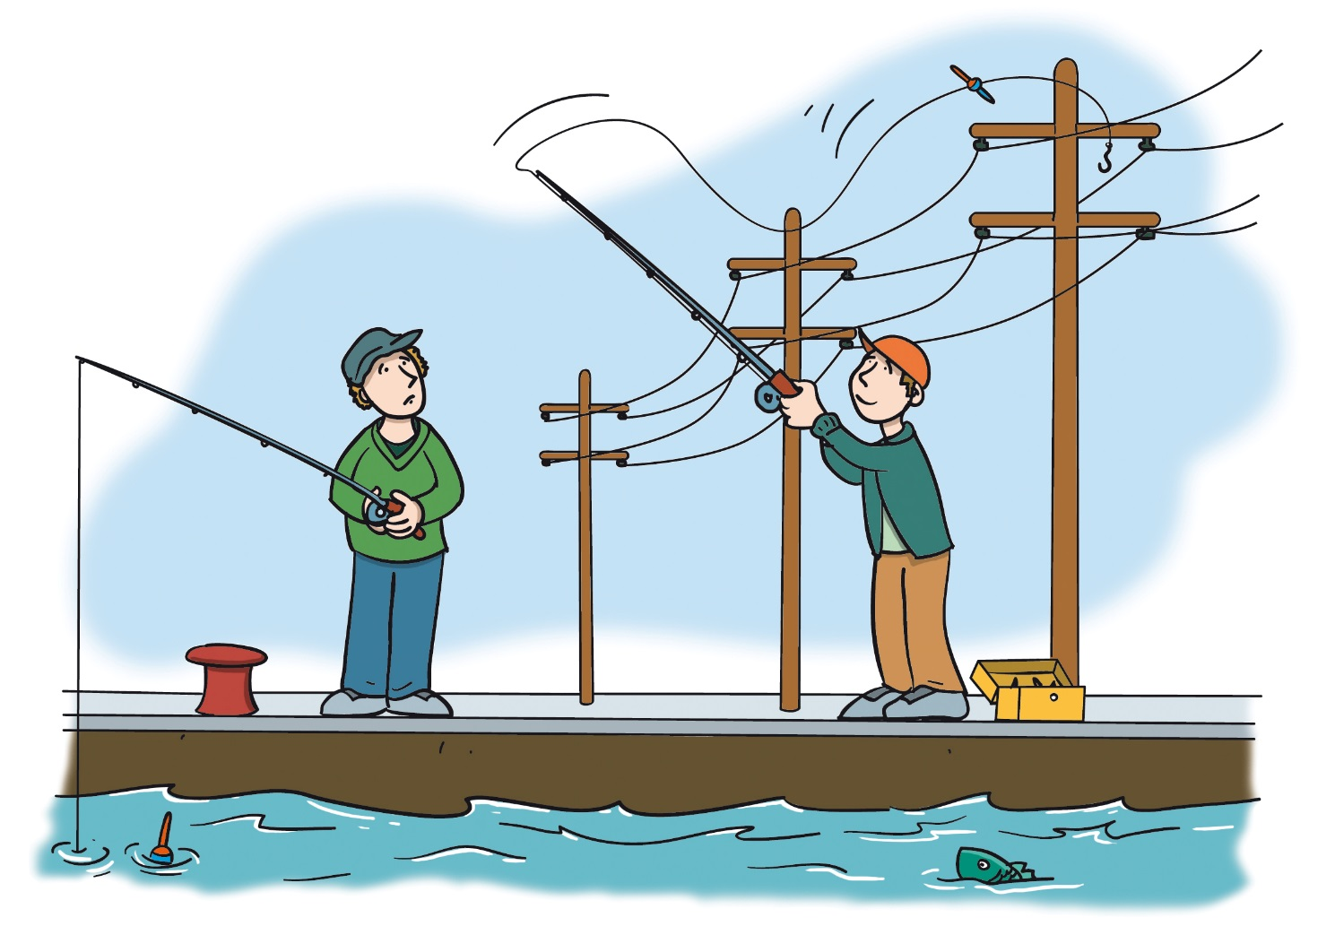
If the fishing line gets tangled in the overhead wires, current will flow down the line and give him an electric shock.
Check for overhead lines before you start fishing.

Slide 12
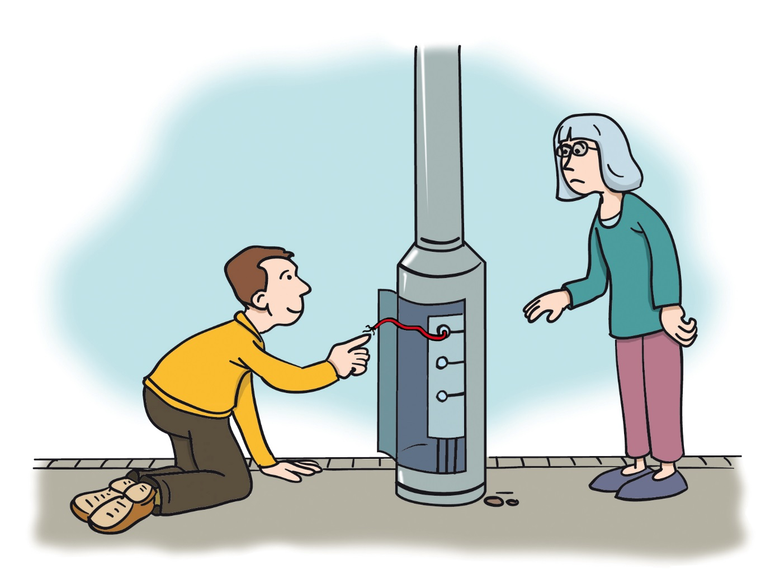
If he touches the wires and they are live, then he will get an electric shock.
Never touch or interfere with electrical circuits.

Slide 13
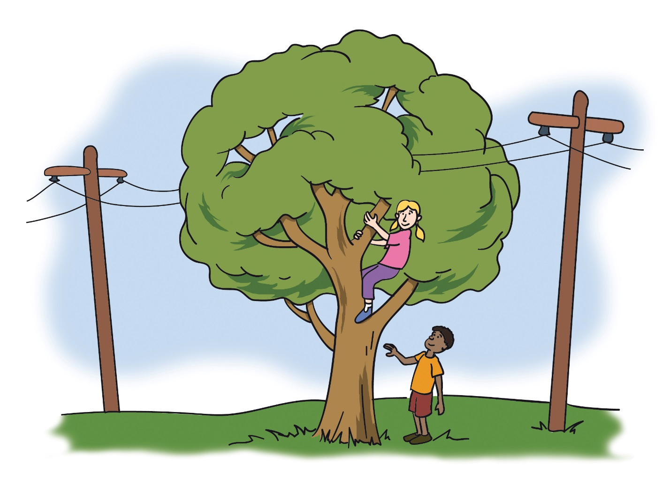
When climbing the tree, she may accidentally touch the power lines and be electrocuted. Or, she could push a branch onto the power lines, receive an electric shock and fall from the tree.
Beware of overhead lines when climbing.

Slide 14
Watch (video) and complete:
If too large a current flows, wires can heat up too much and cause fires.
A ____is a piece of wire that is designed to melt if the current gets too _____.
This breaks the _______ and stops the large current from flowing.
Fuses have different ratings depending on how much current they are designed to carry without melting

Slide 15
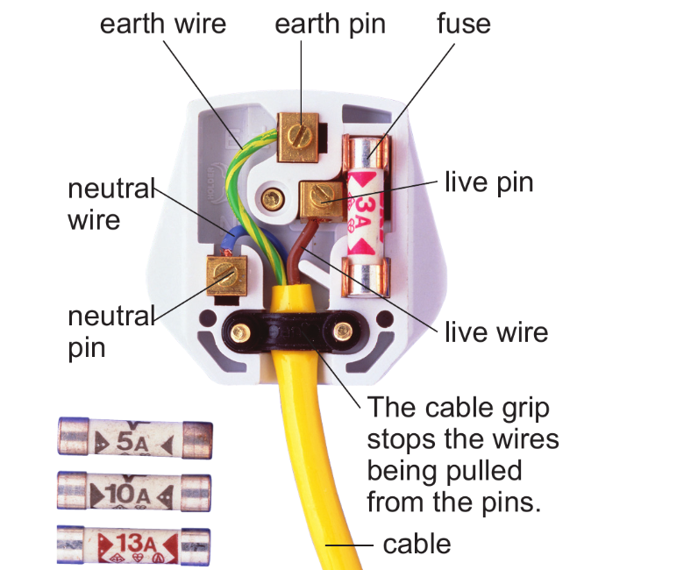

Slide 16
Wire | Colour | Function
Neutral | Blue | Carries current round the circuit
Live | Brown | Carries current round the circuit
Earth | Green and Yellow | Connects the case of the appliance to the earth (safety)

Slide 17
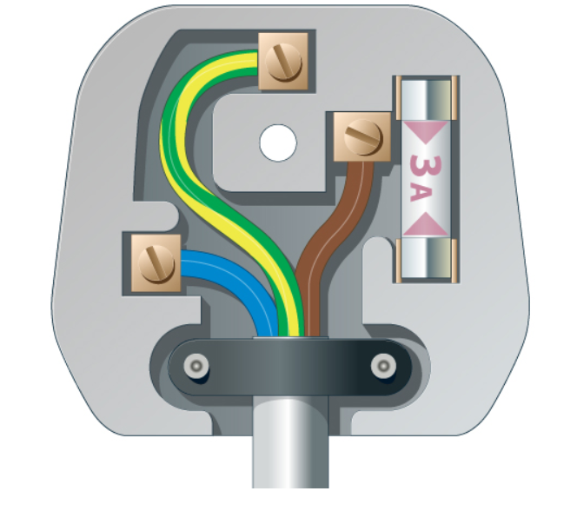
Which description matches the diagram?
Earth and live wire swapped over
Correctly wired
Fuse is missing
The earth wire is not connected properly to the earth pin

Slide 18
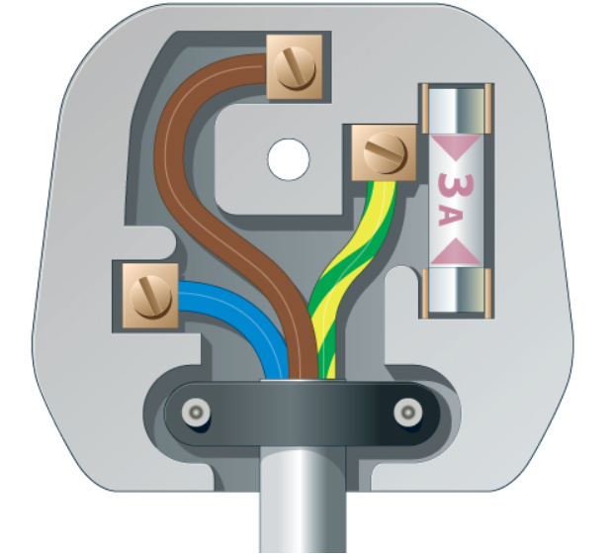
Earth and live wire swapped over
Correctly wired
Fuse is missing
The earth wire is not connected properly to the earth pin

Slide 19
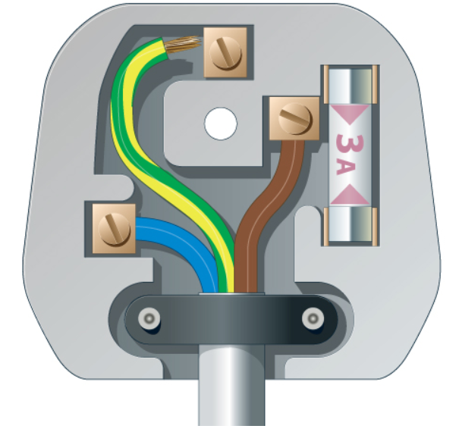
Earth and live wire swapped over
Correctly wired
Fuse is missing
The earth wire is not connected properly to the earth pin

Slide 20
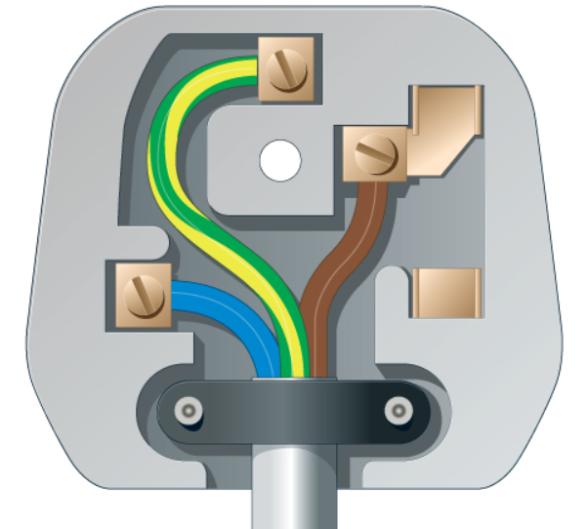
Earth and live wire swapped over
Correctly wired
Fuse is missing
The earth wire is not connected properly to the earth pin

