Slide 1
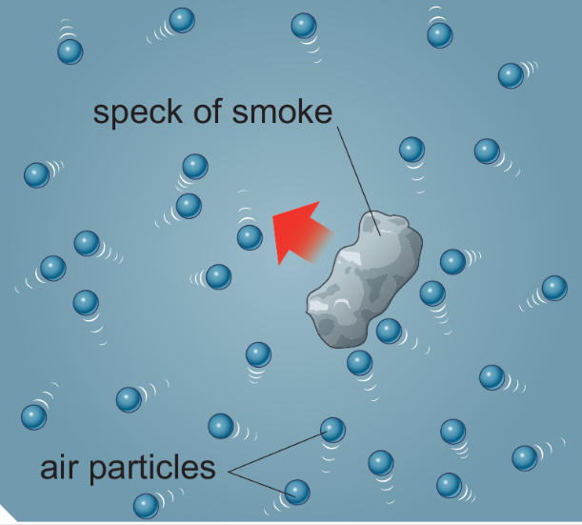
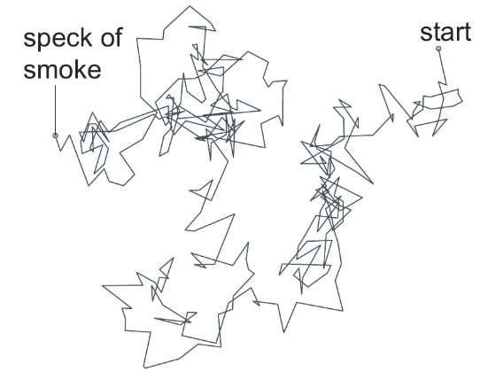
7Gc Brownian Motion
CW
Do Now:
Describe the movement of the speck of smoke

Slide 2
Requisitions
Equipment | Worksheets
 | 7Gc2

Slide 3
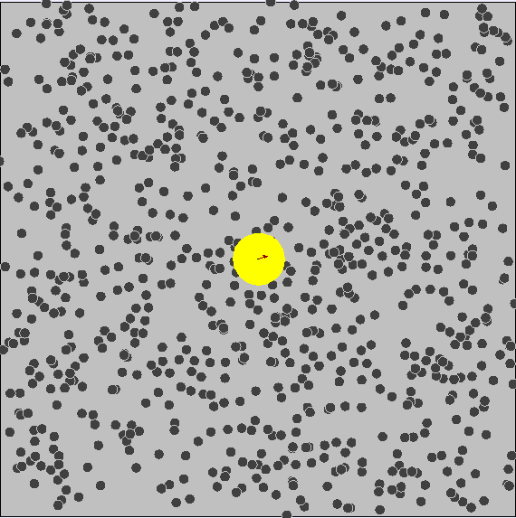
Brownian Motion
Write Down
Brownian Motion is the erratic (random) movement of matter caused by being hit by moving particles that make up liquids or gases

Slide 4
Notes:
Other opitons https://www.stem.org.uk/resources/elibrary/resource/28836/brownian-motion

Slide 5
7Gc 2 Explaining Brownian Motion
How did Robert Brown describe the movement of the pollen grains in water?
What was Brown’s first hypothesis?
How did he test his hypothesis?
What theory about matter did Einstein use to explain Brownian motion?
He said they moved in a random, jerky way as if they were ‘dancing on the water’
At first Brown thought the pollen was alive
He used 100 year old pollen and this showed the same movements.
The particle theory of matter

Slide 6
5. Explain the importance of Brownian motion to the development of particle theory?
Einstein and others used the ideas of matter being made up of tiny moving particles to explain Brownian motion in detail. This was the conclusive proof of the idea and so the particle theory was confirmed
6. Explain how Brownian motion occurs in your own words.
Brownian motion is produced by the tiny water particles hitting the pollen unevenly, so if many water particles hit one side of the pollen it is moved in the opposite direction. As the water particles’ movements are random the movement of the pollen is random

Slide 7
Comparing Sizes
What size are the particles in solids, liquids and gases?
Could you use metres to describe the size of a particle?

Slide 9
The particles that make up solids, liquids and gases are very small. The best way to imagine them is to start from 1 metre and divide by 10 time after time.
You have to go down this scale quite far before you cannot see features with your eyes. Below this, microscopes allow you to see the details.
However, even the most powerful microscopes (electron microscopes) cannot see particles of matter.

Slide 10
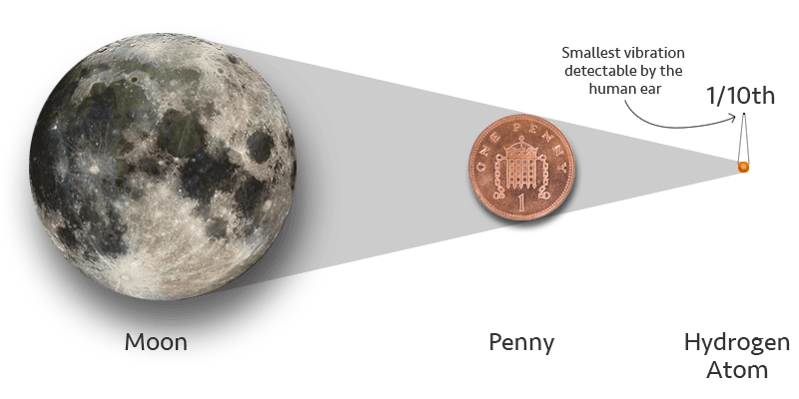

Slide 11
Nano-Scale
The particles that make up matter are far too small to see, even with the most powerful microscope.
They are so tiny that they are measured in nanometres (nm).
One nanometre is one billionth of a metre, that is 0.000 000 001 metres.
To change metres into nanometres multiply by 1 billion (1 000 000 000).
To change nanometres into metres divide by 1 billion (1 000 000 000).
Other common scale measurements used include: micrometres (µm) (1 µm = 0.000 001 m) millimetres (mm) (1 mm = 0.001 m) The word nano- is used as a prefix for other words.
Nanoparticles are particles that are smaller than 100 nm in length. Nanotechnology is the science of building and controlling particles whose sizes range from 10 to 100 nanometres.

Slide 12
