Slide 1
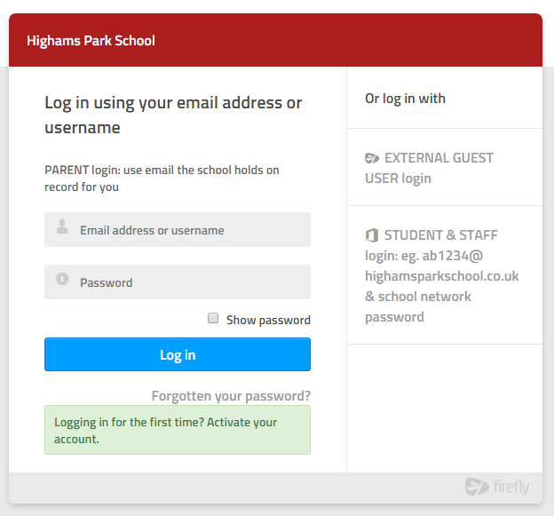
Learning resources available 24-7 in and out of school.
highamspark.fireflycloud.net
Log in via Office365 with your school email address (eg ab1234@highamsparkschool.co.uk) & your normal school network password
Any issues email firefly@highamsparkschool.co.uk or see ICT support in school.
For Firefly & wider Digital Learning updates follow
@HPdigitalLearn

