Slide 1
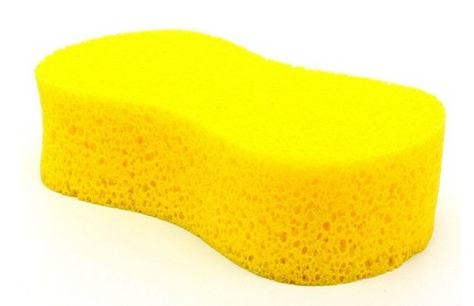
CW
8Ae Absorption
This sponge is absorbent.
What does absorbent mean?
Write your answer in the back of your books.
You can’t use the word absorb to define the word absorbent.
@hpscience

Slide 2
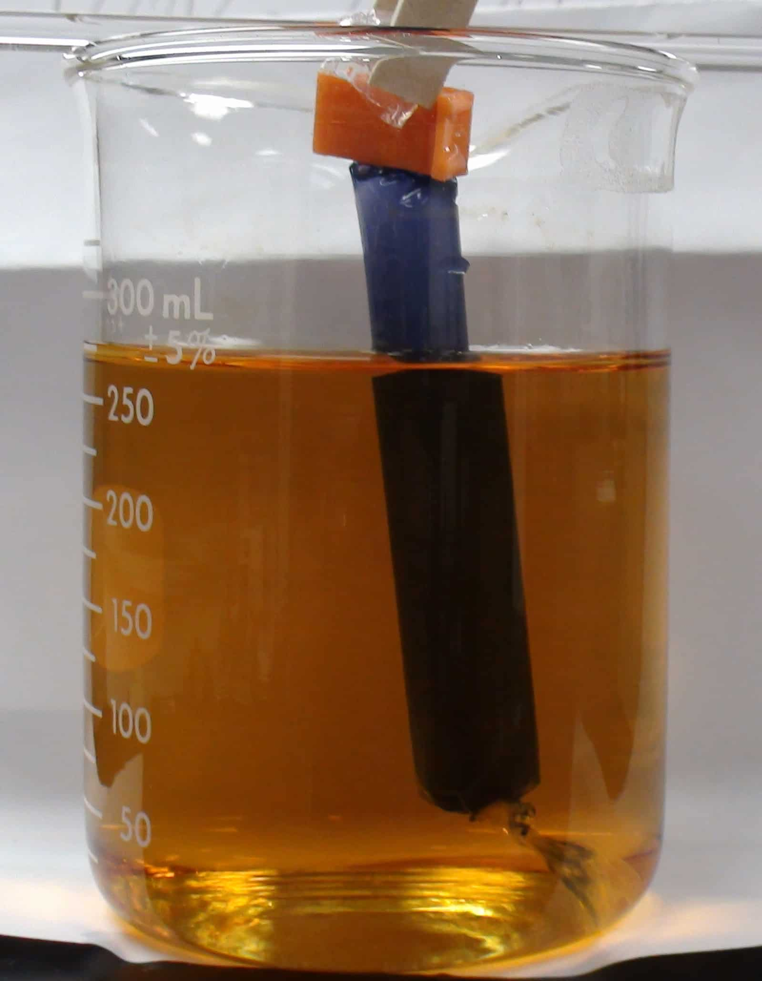
Order Demo
Visking tubing
Starch solution in tubing
Iodine solution in beaker
I suggest:
Starch solution inside the visking tubing. (too big to get out)
Iodine solution on the outside. (small enough to get in
Outcome:
Iodine moves in and starch turns blue-black
Starch can’t get out, no colour change
There are other variations of this demo.
Watch video if you’re not sure.
https://www.youtube.com/watch?v=hxZFU2LBfgA

Slide 3
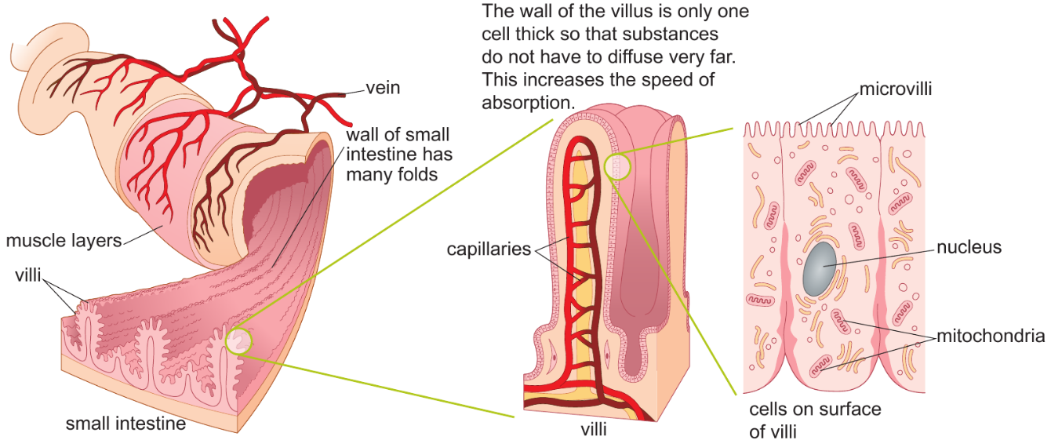

Slide 5
So far in this unit we have learnt that;
food contains nutrients that our bodies need.
the names of these nutrients and what they are needed for
what happens if we have too much or too little of a nutrient
how we breakdown our food (digestion)
Today we will learn what happens to our food once it has been broken down (digested), how in gets into our blood (absorption) and where it goes next.

Slide 6
Visking tubing demonstration
Think about these 3 questions
Describe and explain what happens to the starch.
Describe and explain what happens to the iodine.
By what process does the iodine move?
Visking tubing is a material with very small holes.
Only very small molecules are able to pass through it.
https://www.youtube.com/watch?v=hxZFU2LBfgA

Slide 7
Key words
Copy these key words into your book.
Absorption - the process by which one thing absorbs or is absorbed by another
Absorb – to take in or “soak up” a liquid or other substance
Absorbent – a material that is able to take in or “soak up” a liquid
Watch your spellings - absorption not absorbtion?

Slide 8
https://www.twig-world.com/film/glossary/absorption-629/
https://www.youtube.com/watch?v=5VW5-VXlWic GCSE video

Slide 9
Once the food is broken down into small, soluble substances by e______ (digestion), it is absorbed by the s____ i_______.
It is then and transferred in to the b____ where it can be transported around the body.
These substances are then delivered to the body’s cells where they are used.
For example, the chemical energy stored in glucose is used by cells during r________.
enzymes
small intestine
blood
respiration

Slide 10
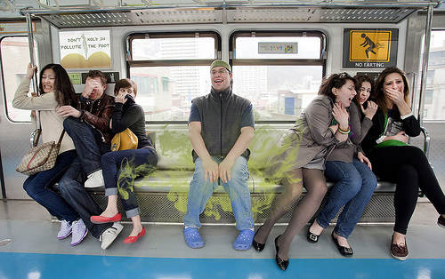
If you release a smell on one side of the room what happens to that smell and why does that happen?

Slide 11
Describe what this diagram shows.
Discuss in pairs and write it in the back of your books.

Slide 12
Glucose does not stay in the blood for long. It is taken up by cells and used for respiration or stored.
Because of this glucose concentration is lower in the blood than in the small intestine.
Therefore, glucose moves from the higher concentration in the small intestine to the lower concentrations in the blood by diffusion.

Slide 13
Diffusion
After you have eaten the concentration of digested food molecules is higher in the small intestine than in the blood.
These molecules move around randomly in all directions.
Overall the molecules move from high concentration in the small intestine to low concentration in the blood as they spread out.
These substances are now in the blood and ready to be transported around the body.

Slide 14
What is the function of the small intestine?
How is the small intestine adapted to its function?
How is the small intestine adapted to speed up the rate of diffusion?

Slide 15
https://www.twig-world.com/film/small-intestine-1017/ watch this video.

Slide 16
Adaptations of the small intestine
Function – absorption of digested food
The small intestine has a large s_____ a___, this speeds up the rate of d______.
The wall of the small intestine is folded.
This folded wall is covered in villi, finger-like extension
The villi are made of villi cells which have a folded top called microvilli
These three adaptations greatly increase surface area and the rate of diffusion.
surface area
diffusion

Slide 17
These soluble substances are carried in the liquid part of the blood.
Do you know what the liquid part of the blood is called?
The liquid part of the blood is called the plasma.
https://www.activeteachonline.com/default/player/interactive/id/350143/external/0

Slide 18
Homework – complete this doddle task for revision – test next
https://www.doddlelearn.co.uk/app/teacher/launch-content/6357174c-7315-4cd1-9288-886150ebc185
Or set one of the active learn exercises for 8Ae absorption. There are three levels; Forming, Securing, Exceeding

