Slide 1
Objectives
Describe what happens during evaporating.
State what happens at a material’s boiling point.
Use a knowledge of dissolving to decide how mixtures should be separated.
Justify the decision to separate a solution in a certain way.

Slide 2
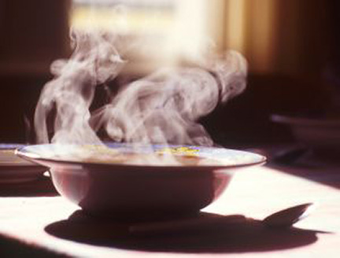
7Ec evaporation
CW
Starter:
What’s happening in this picture? How do you know?
@hpscience

Slide 3
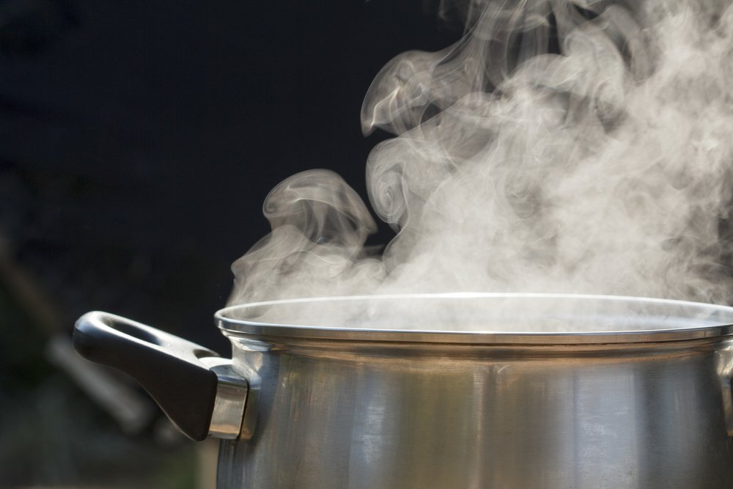
During evaporation of a solution, the liquid turns into a ____ which escapes into the air. This leaves behind the solid what was ________in it.
gas
dissolved
Notes:
Video : https://www.twig-world.com/film/solutions-1475/

Slide 4
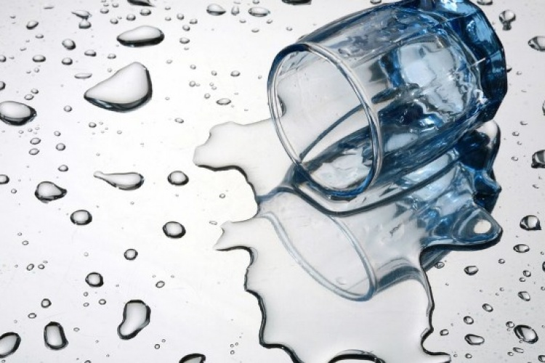
At what temperature does water evaporate?
Evaporation can happen at any temperature. Think of water that’s been spilt, if its left, all the water will disappear
What is the boiling point of water?
The boiling point of water is 100°C. Boiling is when liquid is turning to gas throughout all the liquid.
Notes:
Video : https://www.twig-world.com/film/solutions-1475/

Slide 5
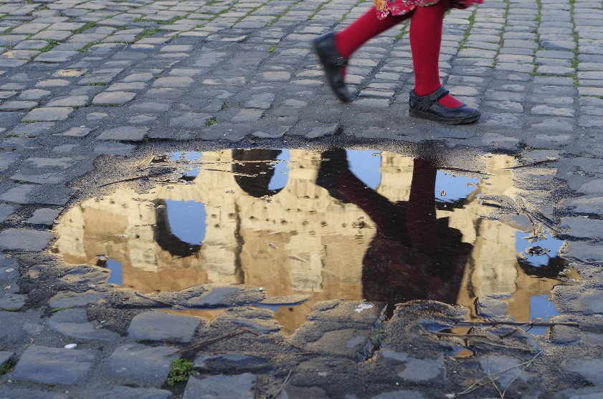
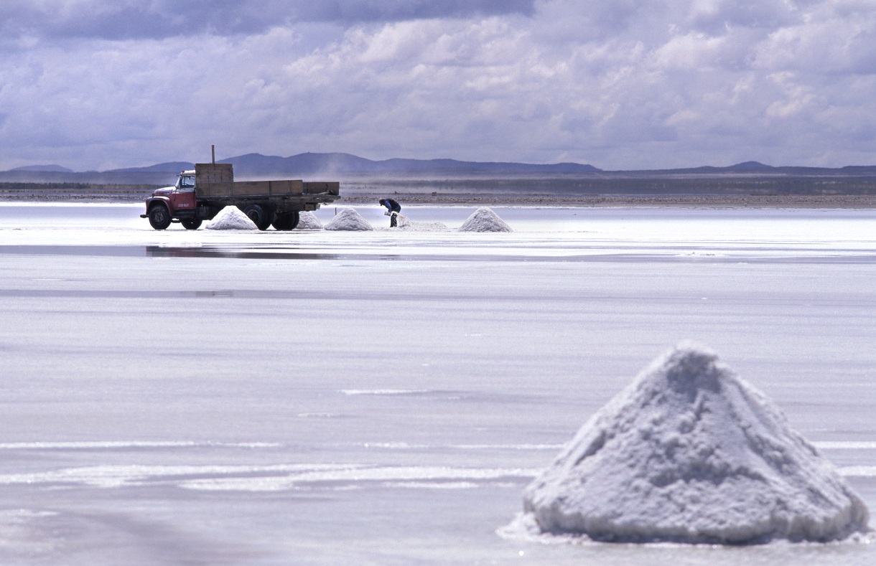
Evaporation
The rate of evaporation increases as the temperature increases – think of puddles drying on warm days.
During summer months, whole lakes can evaporate.
Salt crystals form as water evaporates from this lake.
© Pearson Education Ltd 2014. Copying permitted for purchasing institution only. This material is not copyright free.
Notes:
5

Slide 6
Producing salt – watch the video and answer the following questions
What is the chemical formula for salt?
Uses of salt
How do we obtain rock salt?
Notes:
https://www.activeteachonline.com/product/view/id/295/page/80/mode/dps?modal=/player/video/id/270287

Slide 7
Answers
Sodium chloride
Food, to keep roads ice free
Mined/ dug out of ground,
water pumped underground to dissolve rock salt and evaporate water
Evaporate seawater to leave sea salt

Slide 8
Rock salt is a mixture of salt and rock that is put on icy roads.
How can you separate the salt from the rock salt?
Come up with a step by step set of instructions for a method to separate salt from rock.
Apparatus:
Beaker
Stirring rod
Bunsen burner
Bench mat
Tripod
Gauze
Funnel
Filter paper

Slide 9
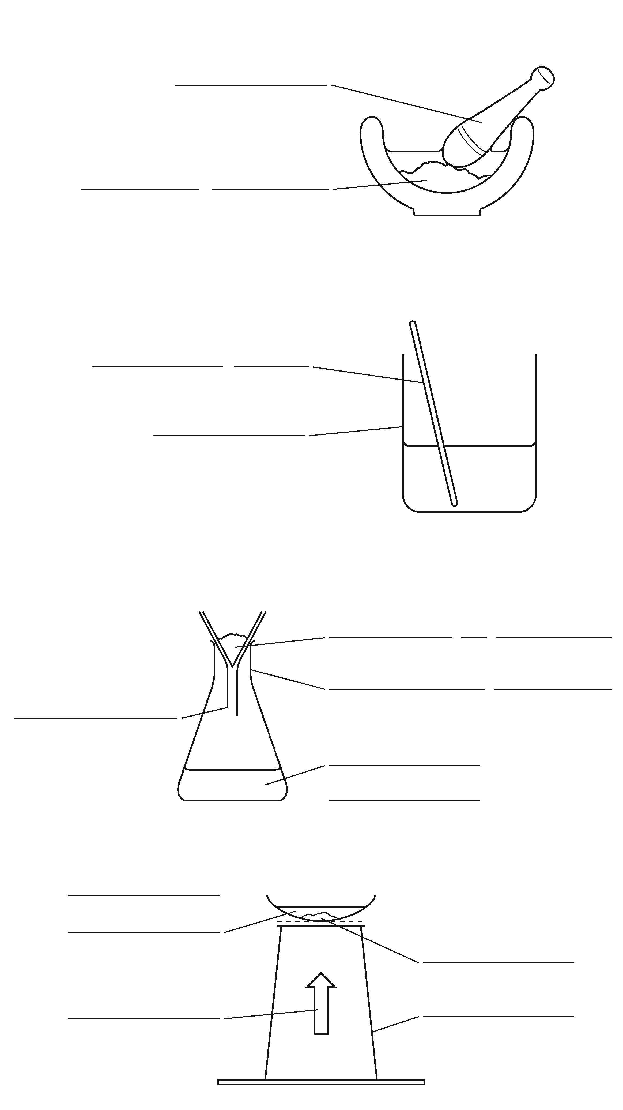
Ws 7Ec6
mortar
B Crush up the rock salt using a mortar and pestle.
F This makes sure that there is no salt trapped inside bits of rock.
rock salt
E Put the crushed-up rock salt into a beaker and add water.
stirring rod
G The salt is soluble and will dissolve. The bits of rock are insoluble and will not dissolve.
beaker
J Stir the mixture to help the salt to dissolve
A Filter the mixture.
bits of rock
C The insoluble bits of rock will be trapped in the filter paper. Salty water will go through the filter paper.
funnel
conical flask
salty water
I The filter paper does not trap the salt because the salt is dissolved in the water.
evaporating basin
pure salt
D You can get the salt from the salty water by evaporating the mixture.
heat
tripod
H The water evaporates and leaves the salt behind

Slide 10
Before you try out your method, make sure you have filled in your risk assessment form.
Hazard | Why is it a risk? | How can I reduce the risk?

Slide 11
Do not let the beaker boil dry because it will start to spit very hot salt out.

