Slide 1
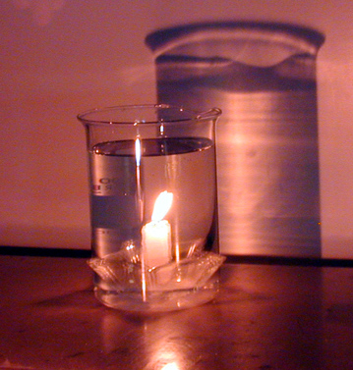
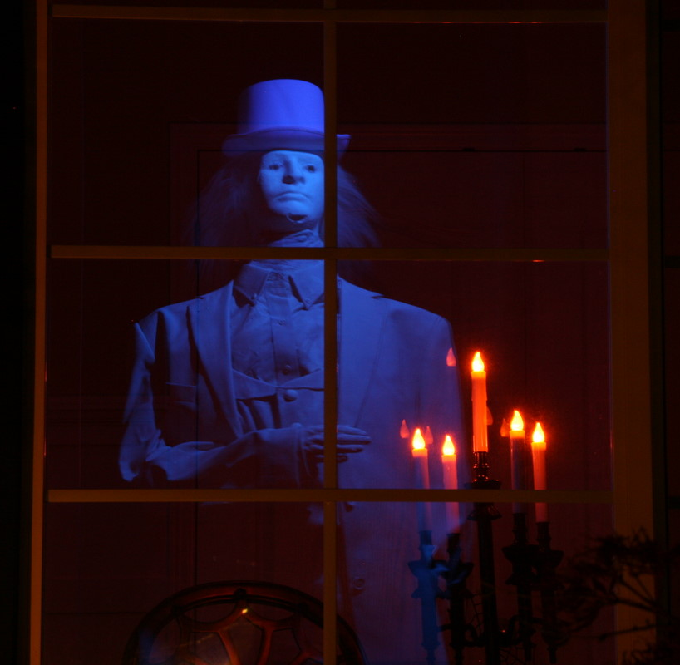
8Jb2 Images in Mirrors
CW
Is this candle really burning underwater?!
Is there a ghost outside?!
How is the eye fooled?

Slide 2
Objectives
Describe some uses of plane mirrors.
Use the ray model of light to explain how a periscope works.
Describe the characteristics of the image formed by a plane mirror and use ray diagrams to explain its formation.
State the meaning of: convex mirror, concave mirror.
Use ray diagrams to explain some of the features of images in periscopes.

Slide 3
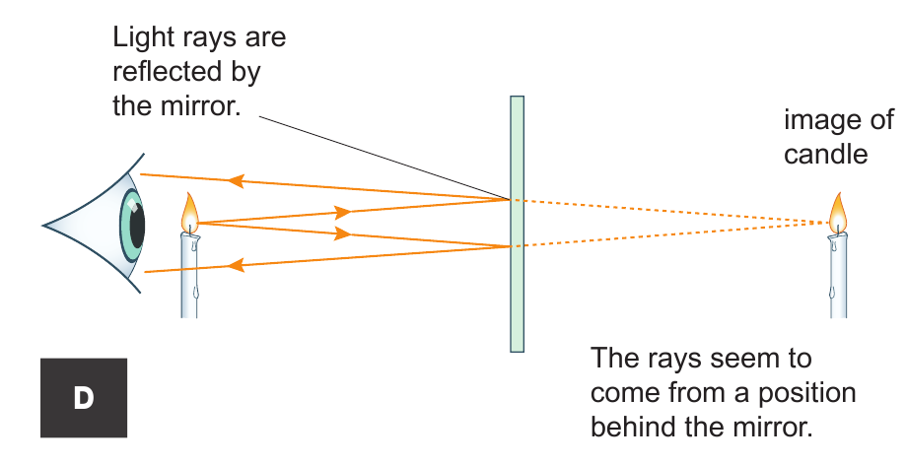
Stick in your diagram & continue the rays entering the eye backwards with dashed pencil lines.
Where does the image of the candle seem to be?
How big is it?

Slide 4
Measure how far behind the mirror the image is.
the same
The image is ___ _____ distance behind the mirror as the object is in front.
Can we show this in practice?
How big should you draw the candle?

Slide 5
 Prop up your mirror & try out the following:
Place a ruler under the mirror. Look where eg. 5 cm mark seems to be behind the mirror.
Hold your ruler upright with a toy soldier and look at the image of both in the mirror.
Draw between the lines of the star ONLY looking in the mirror (place hand in way of sheet).
How far behind a mirror is the image?
Why is it difficult to draw the star?
How big is the image compared to the object?

Slide 6
Copy & Complete
same size as object
the same
The image is ___ _____ distance behind the mirror as the object is in front.

Slide 7
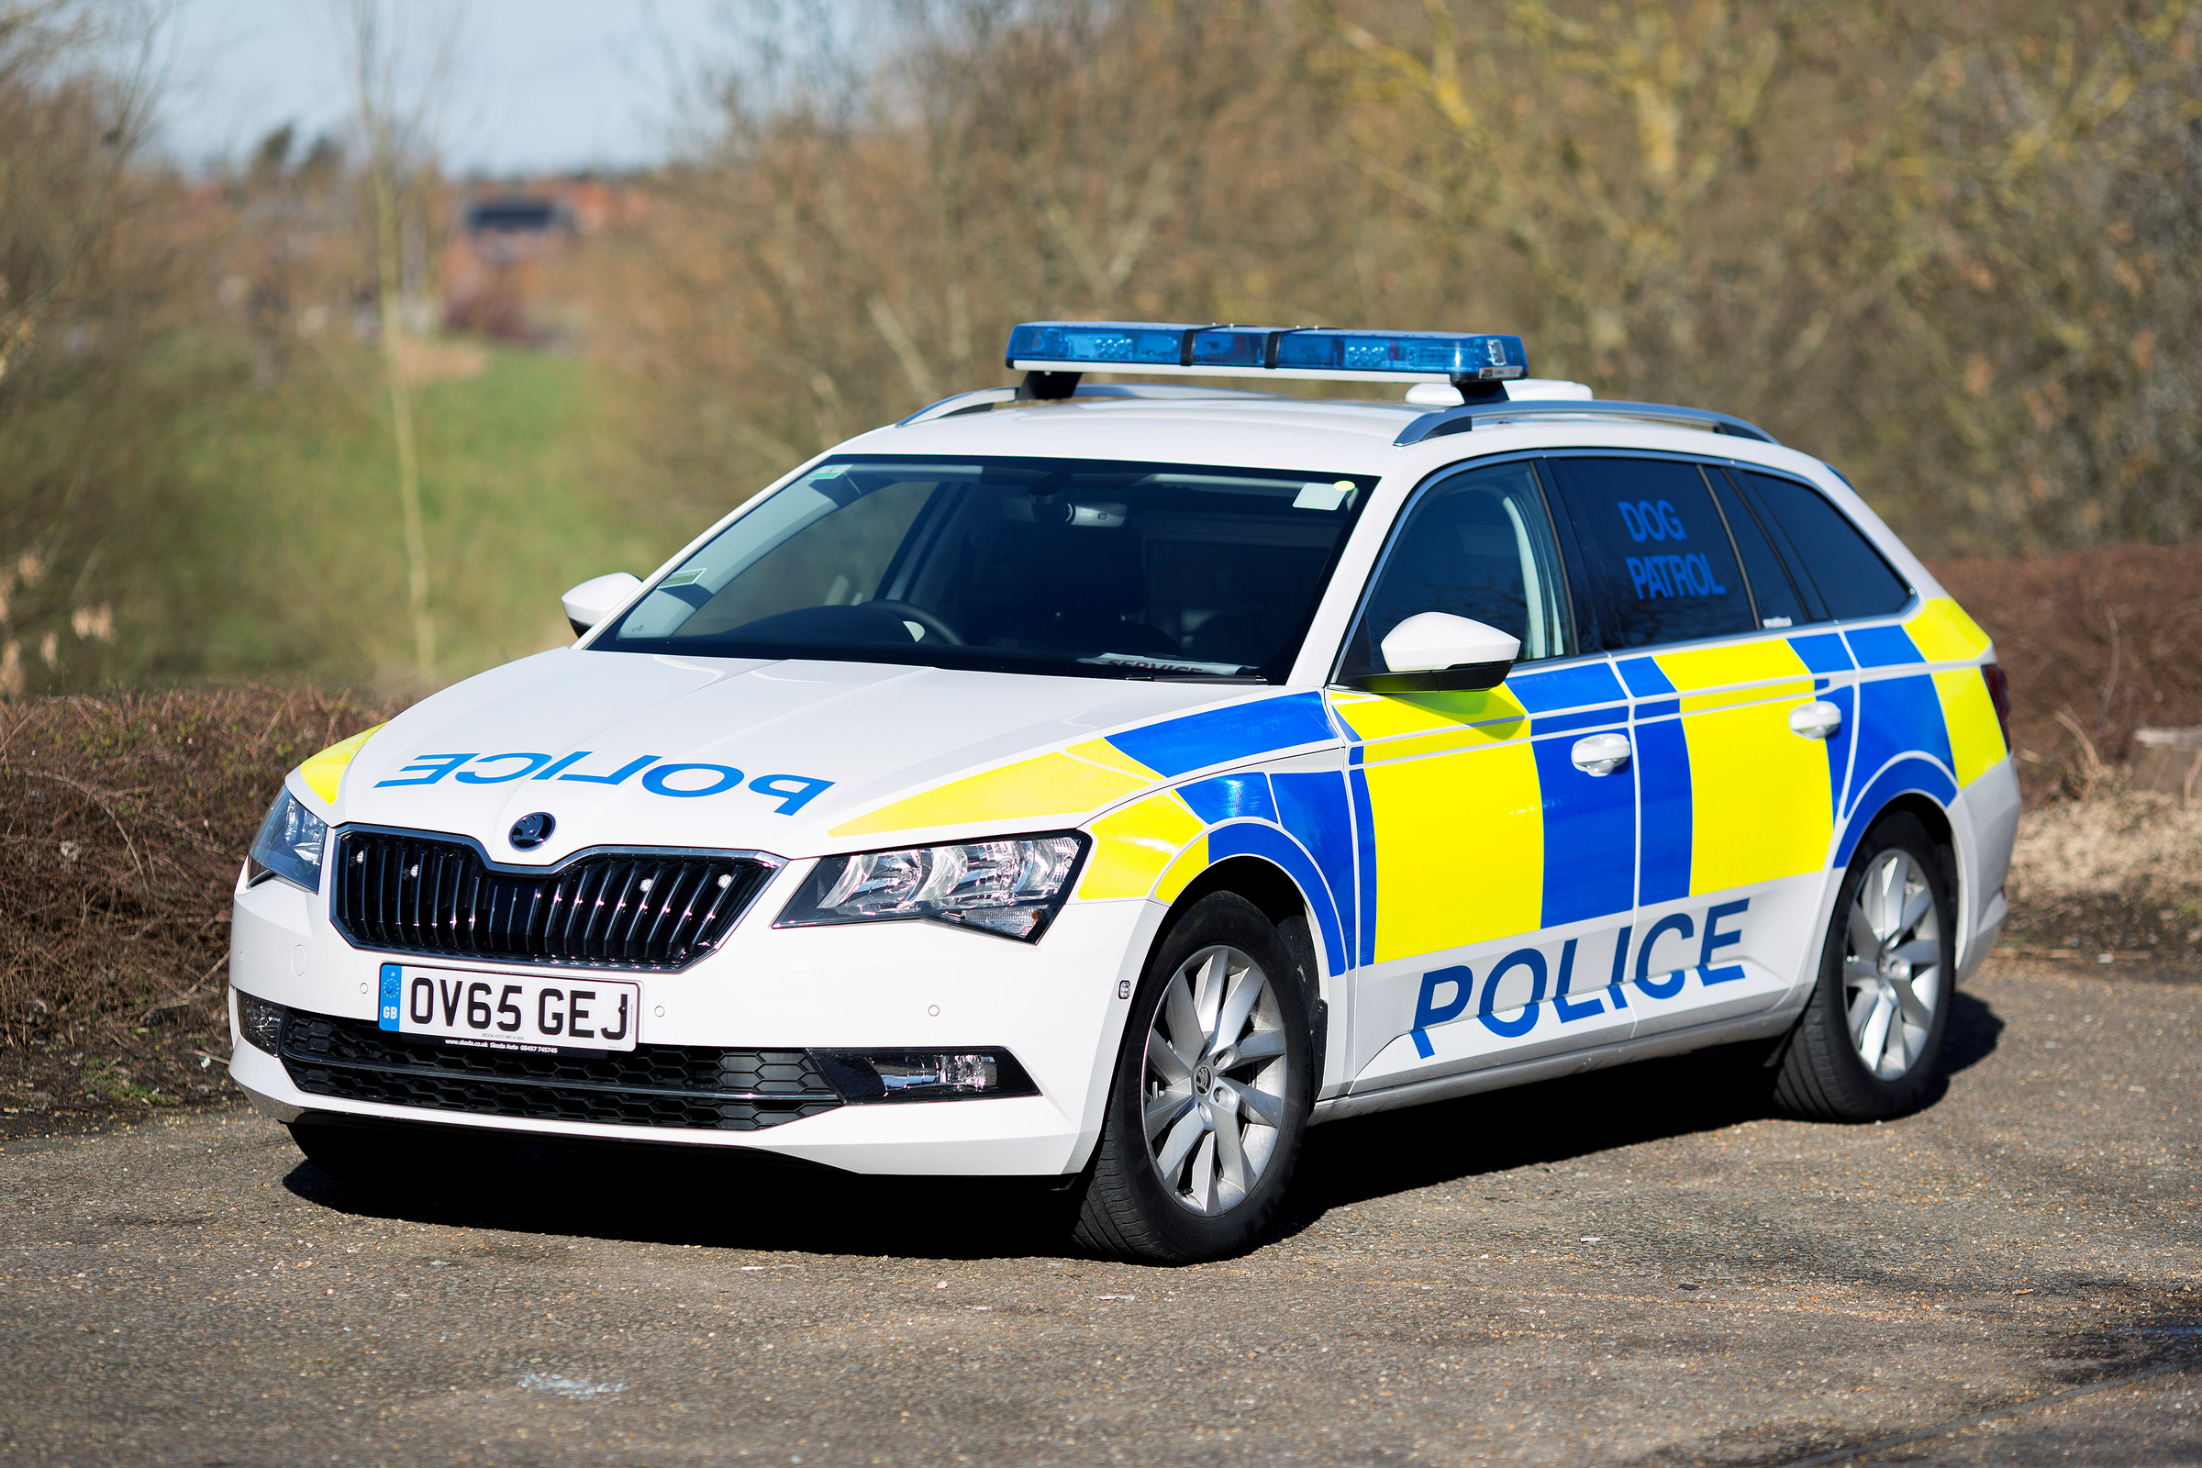
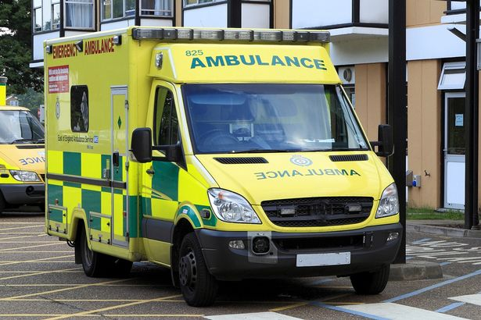
The image also has left and right swapped over.
Explain why POLICE & AMBULANCE is often written backwards. Include how it should look.

Slide 8
The image also has left and right swapped over.
POLICE and AMBULANCE is often written backwards so it looks the correct way round and drivers can read it in their mirrors:
Does everything look back to front in a periscope?

Slide 9
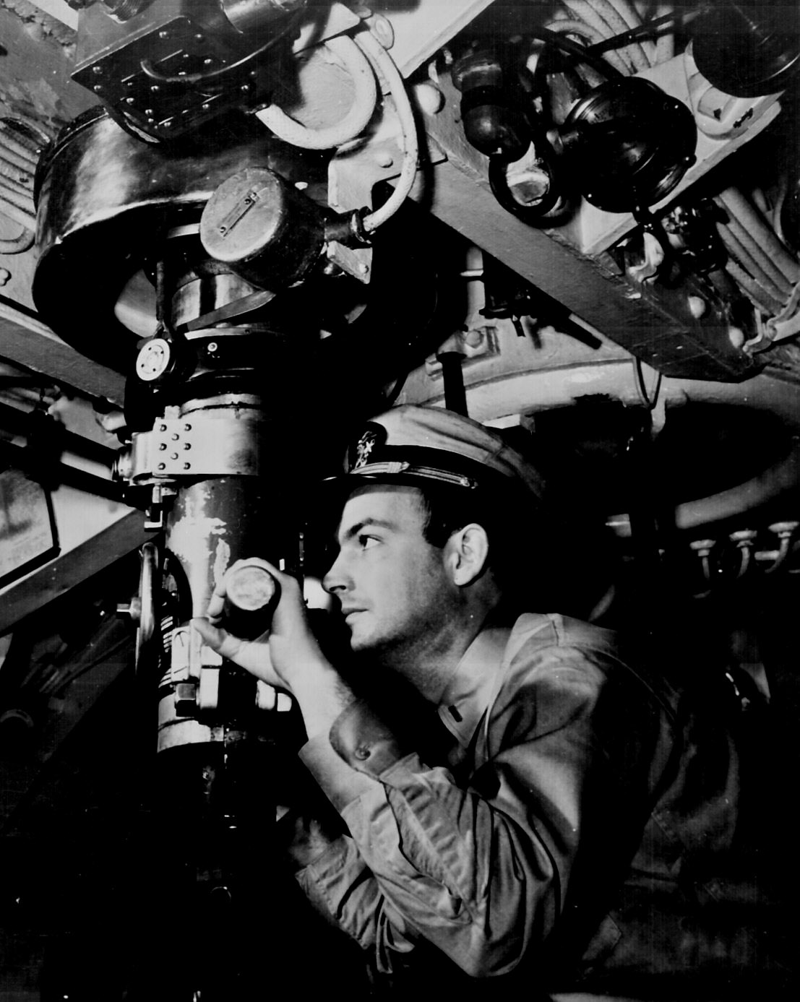
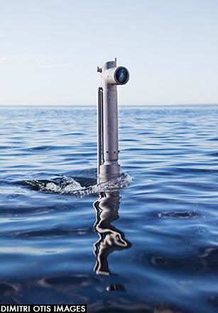
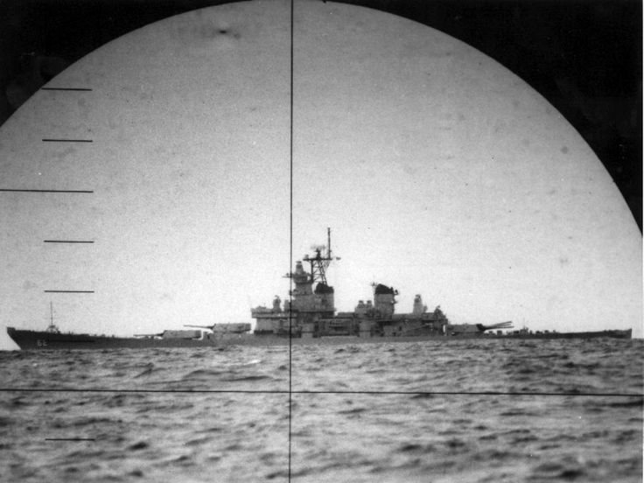
Is the ship moving left or right?!

Slide 10
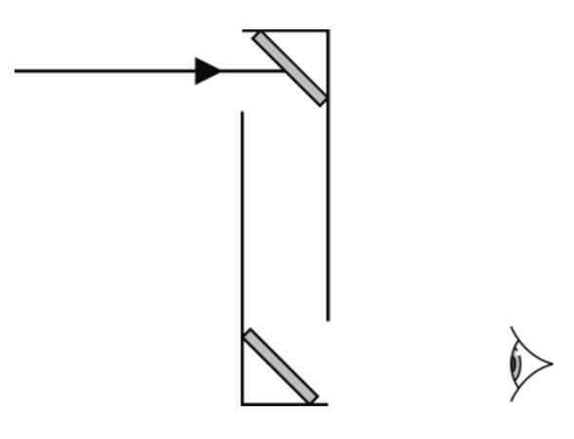
Periscopes
Stick in (or copy) this diagram and continue the ray.
 Look through the periscope and also try holding two mirrors as shown to “make” one.
Explain whether the image has left and right swapped over.
Is a mirror really doing anything that strange?
If you sit facing someone holding up their right hand, where do you see it?

Slide 11
Look at your reflection in a convex & concave mirror (or sides of a spoon).
Curved mirrors
Does it seem bigger or smaller?
Is it the right way up?
Does it change if you move the mirror closer or further away?

Slide 12
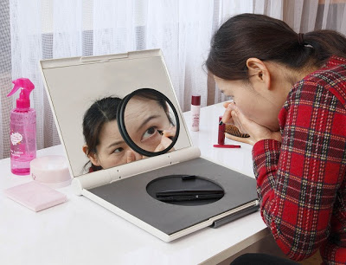
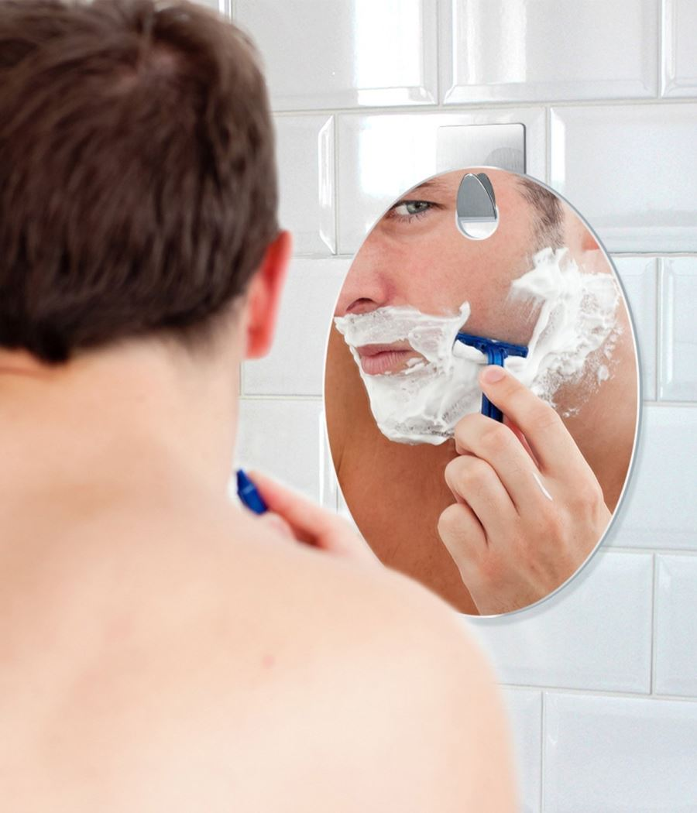
concave mirror

Slide 13
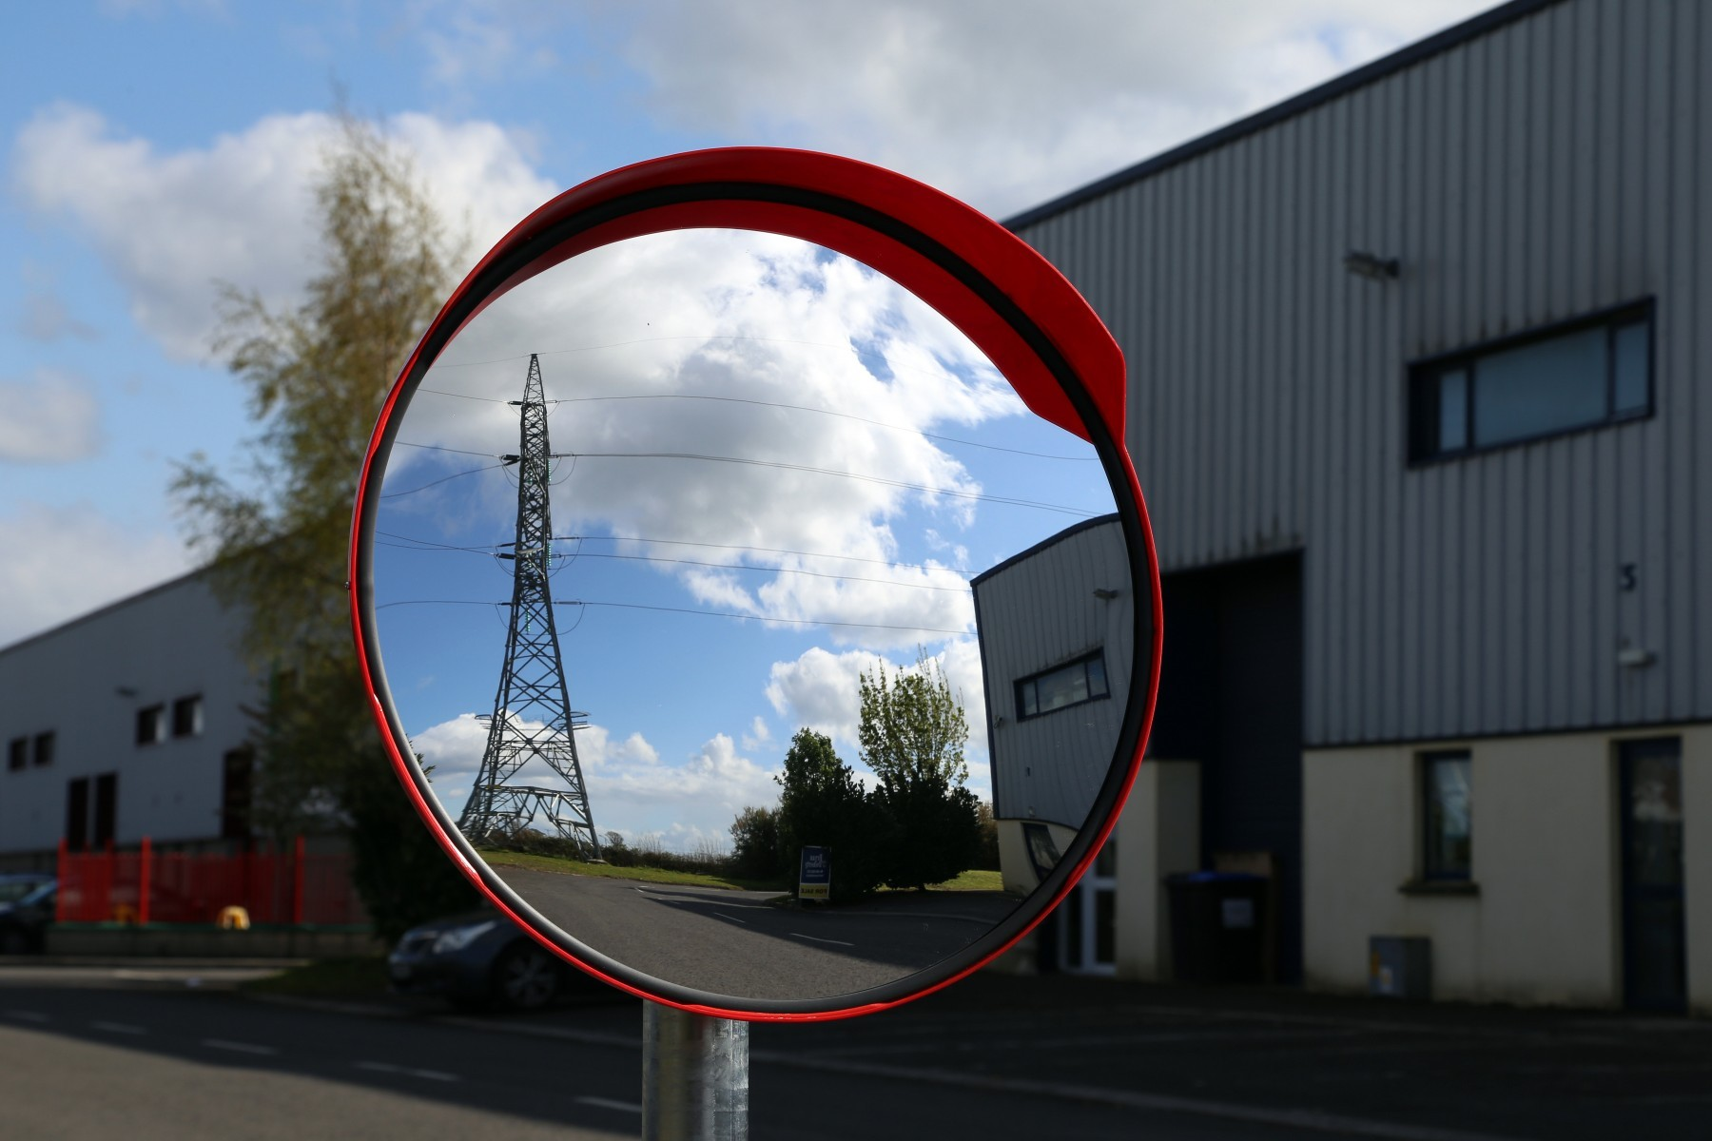
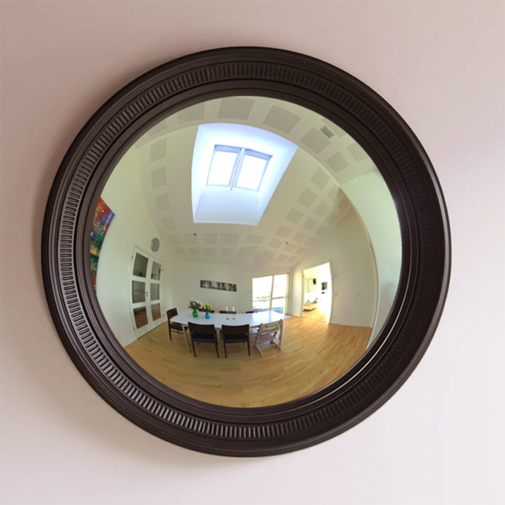
convex mirror

Slide 14
Draw & label the shape of each mirror.
Add the rays.

Slide 15
Is the law of reflection still obeyed?

Slide 17
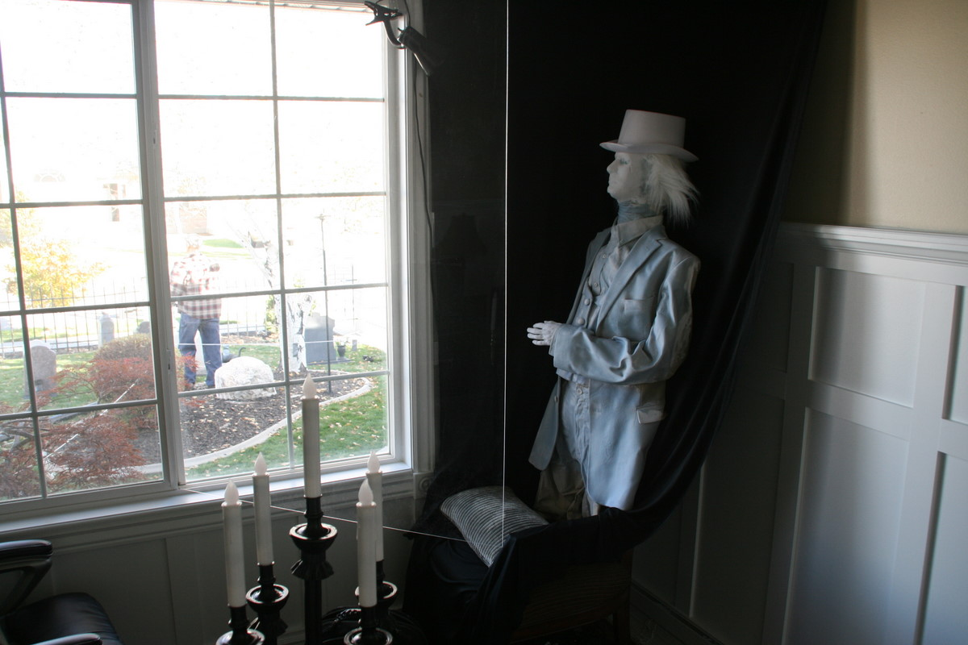

Slide 18
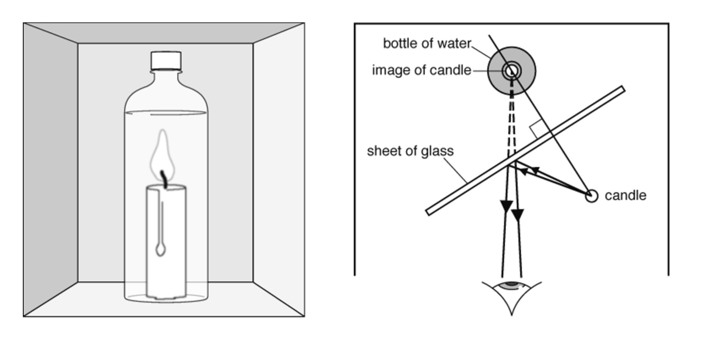
Try the Pepper’s Ghost illusion with a tea light & beaker OR
Use the hologram videos on the HP science 8J Light YouTube playlist (or 8Jb Firefly page) to try Pepper’s Ghost with your phone.

Slide 19
https://youtu.be/Q8ZdYe2blXU?t=1m38s

