Slide 1
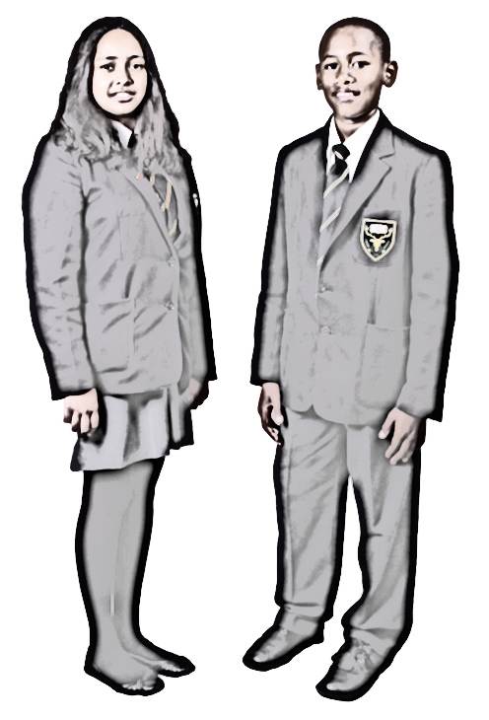

Slide 2
Highams Park school supports @youngmindsuk #helloyellow campaign
10 October 2019

Slide 3
Why do we need to promote kindness in school?
Encouraging kind behaviour in schools can make a big difference and is so much more than just a ‘nice to have’. Evidence shows that promoting kindness among young people directly reduces disruptive behaviour and helps to increase social and emotional wellbeing.
Promoting kindness has also been shown to help reduce bullying in schools. Bullying obviously has a serious impact on children’s wellbeing and bullies are often suffering themselves too. Running a kindness project provides a positive and inclusive way forward.

Slide 4
Do kindness!
Every kindness project starts with doing: using creative activities to explore, promote and experience caring and compassionate behaviour.
It’s important that you learn by doing not just by talking or thinking about kindness this helps your ideas become real and with repetition it helps it helps them to start forming new habits.

Slide 5
Notice kindness
It is also important to notice acts of kindness done by others around you. This teaches you to look for the good things that others do and helps to create a culture which rewards caring behaviour.
Research also shows the kindness is contagious nice and kind acts not only makes us feel that we are living in a kinder world but encourages us to be kind to others.

Slide 6
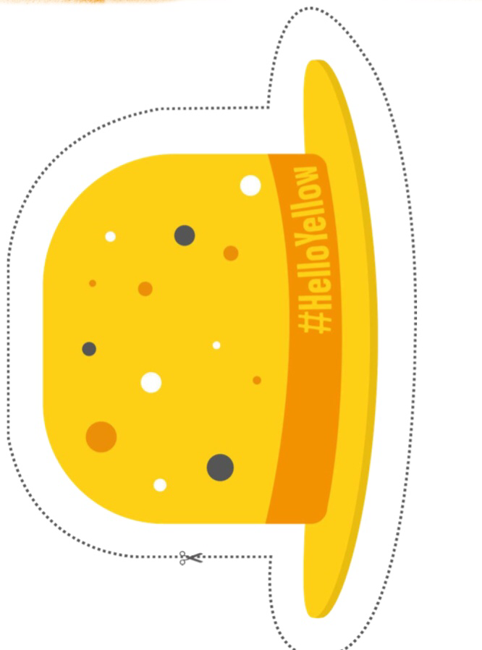
How can you help?
We need: 4 year 7 kindness ambassadors per form (up to 32 students in total) who will work on behalf of your tutor group to create, discuss and present kindness related activities and projects for hello yellow day 10.10.2019
Each form will be assigned a sixth form ambassador who will meet and support you to complete your kindness mission.

Slide 7
a well great way to encourage this is to set up a kindness wall In your classroom a place where people can set up a messages, stories photos drawings or thank you notes about kind things people have done for them or kind things they’ve seen done for others. The wall is a great way to celebrate the activities

Slide 8
Kindness checklist
Create an individual kindness checklist to encourage yourselves to complete several daily acts of kindness. Possible activities could include: picking up litter, smiling and saying thank you to the bus driver, helping a friend or anything else that is kind.

Slide 9
Publishing kindness stories
Gather a collection of kindness stories from fellow students, teachers, family and staff. Publish and distribute in a book, posters or on templates such as kind hands which can be made into a heart shape collage or whatever you would like to use.

Slide 10
Creating a respectful classroom
Discuss with your classmates that we are means to show respect to others, For example, listening respectfully to others, treating others as you would like to be treated etc. Then:
… Collect ways to create a respectful classroom. You could develop a respecting others motto or plan activities for the month that would show respect for others in form time or even all around the school.

Slide 11
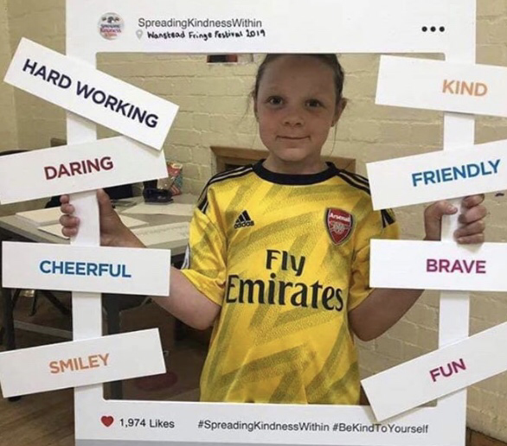
Actively Participate in our visual kindness picture frame display

Slide 12
Please speak to Mrs Taylor or Mrs Piggin for more information! And, Inform your tutor if you would like to get involved.

Slide 13
A Big Thanks goes to:
@YOUNGMINDSuk
@aCTIONFORHAPPINESS

