Slide 1
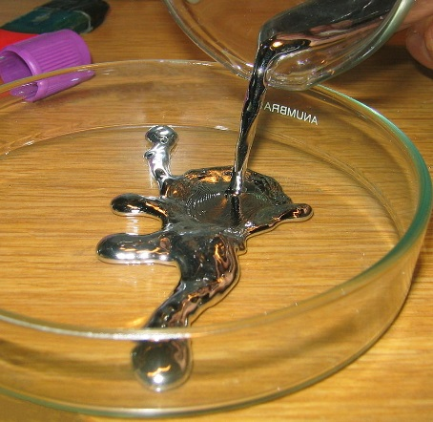
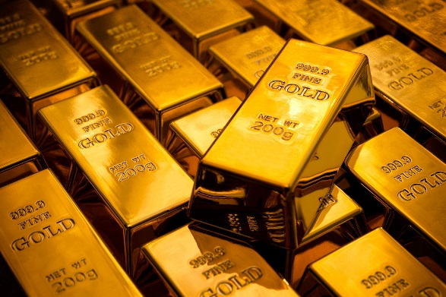
8Fa: Dalton’s Atomic Model
Do Now:
Draw particle diagrams for the following substances

Slide 2
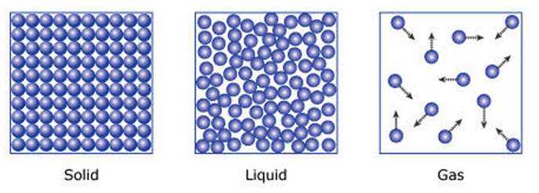
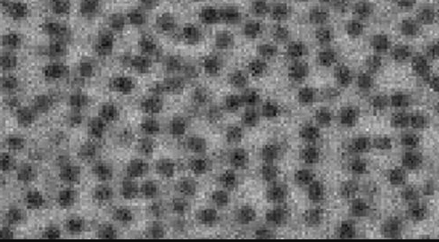
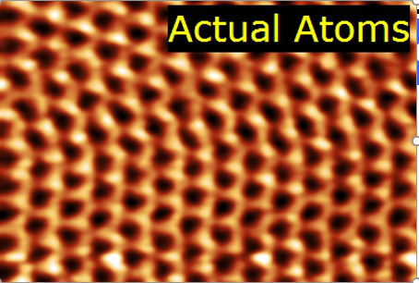

Slide 3
Which one do you think students often get wrong & why?

Slide 4
Objectives
Use a simple (Dalton’s) atomic model to describe an element.
Use a simple (Dalton’s) atomic model to describe a compound.
Describe Dalton’s ideas about atoms.
Recall that different elements have different physical properties.
Identify the chemical symbols for some common elements and vice versa.
Record two letter symbols correctly.

Slide 5
What’s the difference between these particles?

Slide 6
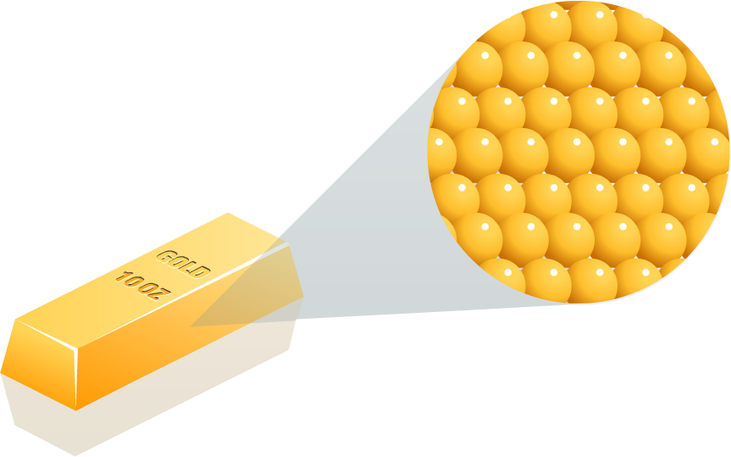
Copy & Complete
All matter is made up of tiny ______ called ____.
The atoms in an ______ are all identical (but each element has its own type of atom).
atoms element
particles

Slide 7
Answers
All matter is made up of tiny particles called atoms.
The atoms in an element are all identical (but each element has its own type of atom).
atoms element
particles

Slide 8
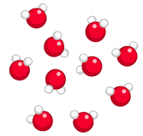
Copy & Complete
A compound is made of two or more ____ _______ joined together.
In ________, each atom of an element always joins to a ____ number of atoms of other ________.
atoms chemically compounds fixed elements

Slide 9
Answers
A compound is made of two or more atoms chemically joined together.
In compounds, each atom of an element always joins to a fixed number of atoms of other elements.
atoms chemically compounds fixed elements

Slide 10
What's the difference between a pure substance and a mixture?

Slide 11
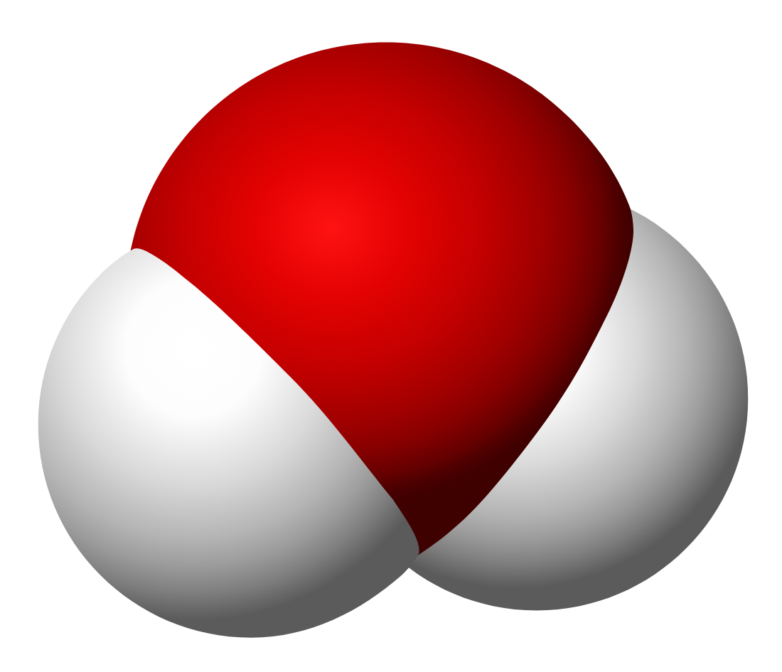
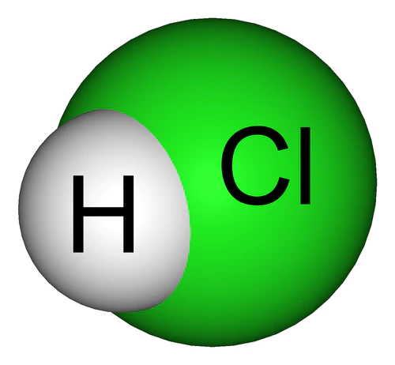
A | M | C | M
A particle of an element | The single unit of a compound e.g. $H_{2}O$ | Made of two or more atoms chemically combined. e.g Water | A mix of different molecules or atoms that are not chemically combined

Slide 13
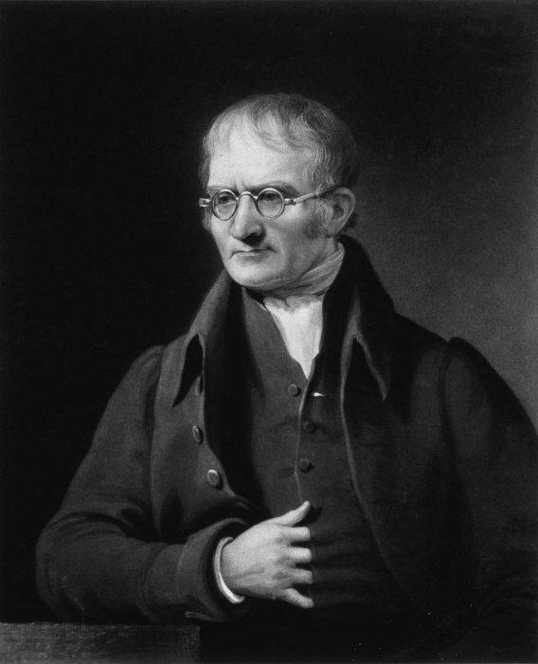
John Dalton's Theories
All matter is made up of tiny particles called atoms
Atoms of an element are identical
Atoms are indestructible and cannot be created or destroyed

Slide 14
Copy & Complete
D_____ thought that atoms of an element are i________, and that a_____ c______ be broken down any s_____.
Although Dalton’s ideas a__ ___ completely wrong, we have a much more d______ understanding of the a____ today.
smaller detailed identical atoms
atom cannot are not Dalton

Slide 15
Answers
Dalton thought that atoms of an element are identical, and that atoms cannot be broken down any smaller.
Although Dalton’s ideas are not completely wrong, we have a much more detailed understanding of the atom today.
smaller detailed identical atoms
atom cannot are not Dalton

Slide 16
Key Words
An atom is a particle of an element
A compound is made of two or more elements chemically joined together, e.g Water
A molecule is the single unit of a compound e.g $H_{2}O$

