Slide 1
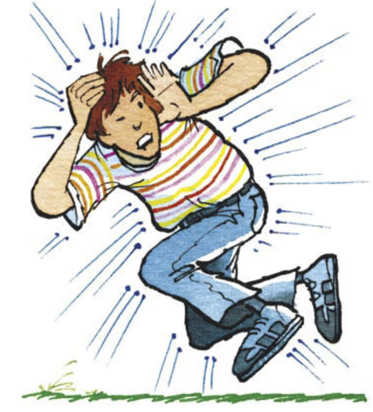
8Ic1 Pressure in Fluids
CW
Do Now:
What do you think causes pressure in gases and liquids?
What direction(s) does it act in?

Slide 2
Objective
State what is meant by gas pressure and recall some of its effects.
Recall that pressure in a fluid changes with depth.
Describe how pressure in a fluid increases with depth.
Use the particle model of matter to describe the causes of pressure in fluids.
Explain some effects caused by air or water pressure using ideas about forces.
Use the particle model of matter to explain atmospheric pressure in different situations.
Explain why pressure in a fluid increases with depth.
Use the particle model of matter to explain why gas pressure changes with temperature, number of particles and volume.

Slide 3
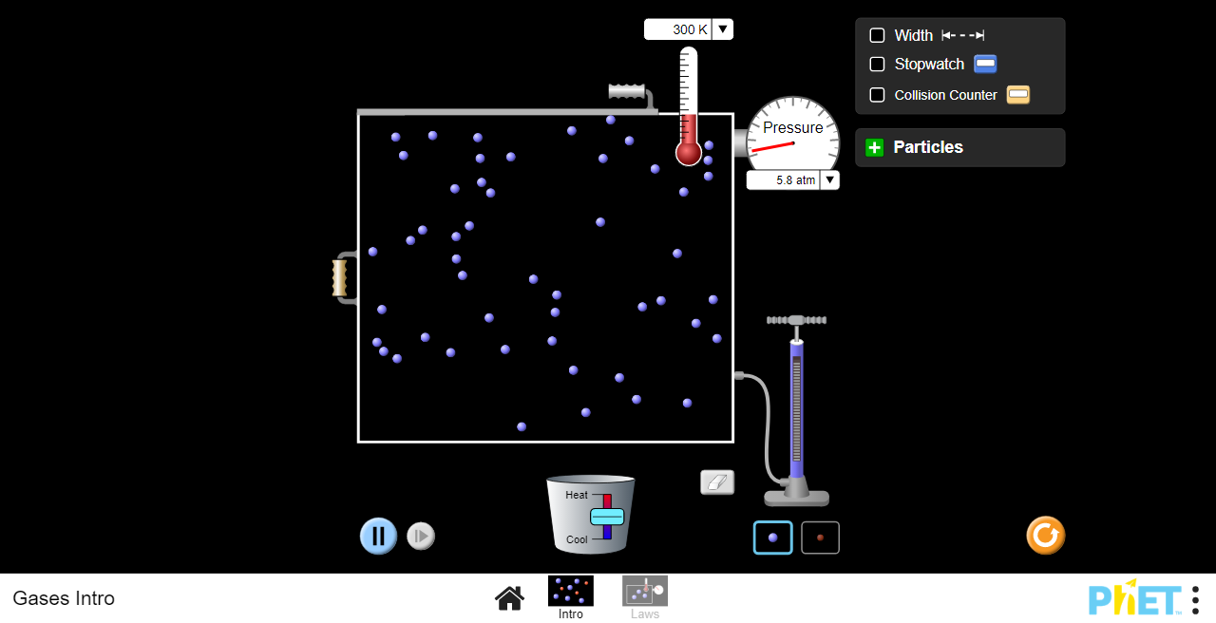

Slide 4
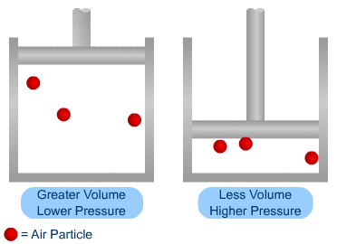
Write Down
Pressure in gases and liquids is caused by the force of lots of tiny particles colliding with your body or other surfaces. It acts in all directions.

Slide 5
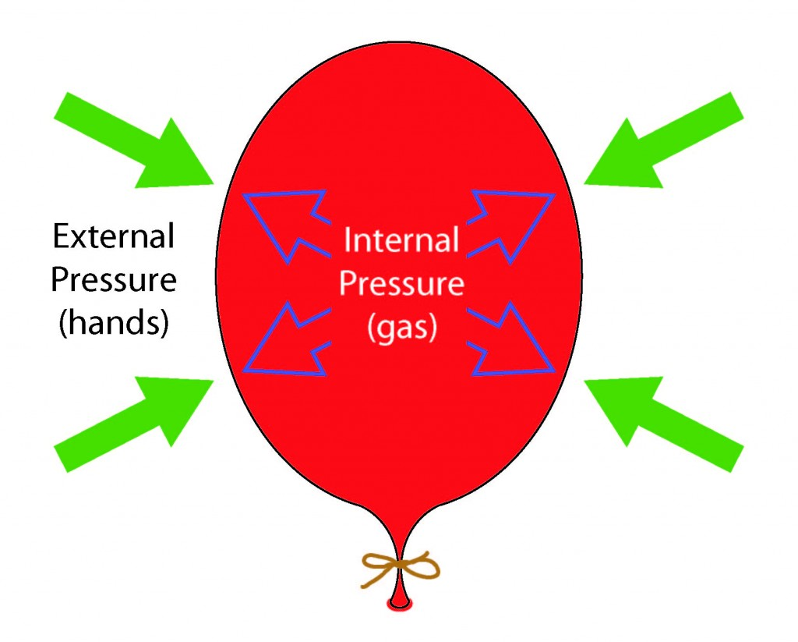
Atmospheric pressure
Atmospheric pressure

Slide 6
Copy & Complete
Atmospheric pressure is the pressure of the air around us, which is about 100 000 Pa. We do not notice this because…
the fluids inside our body are at a similar pressure.

Slide 8
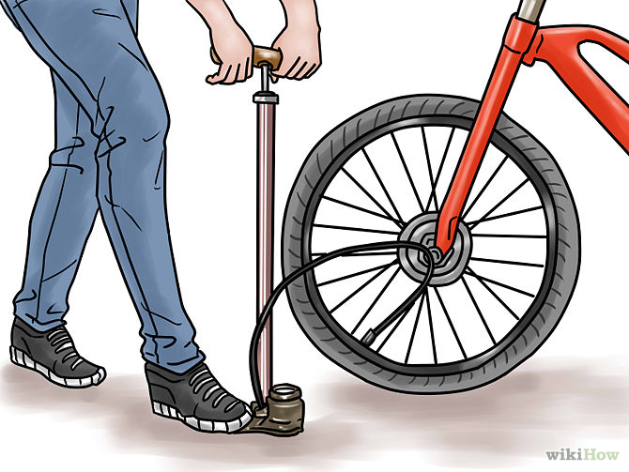
What happens to the pressure if you pump more air in?
What would happen to the pressure if you heated the tyre?

Slide 10
Check your work
add more particles
heat the fluid
reduce volume of container
(All these increase the number of collisions, heating increases the force of each collision too)

Slide 11
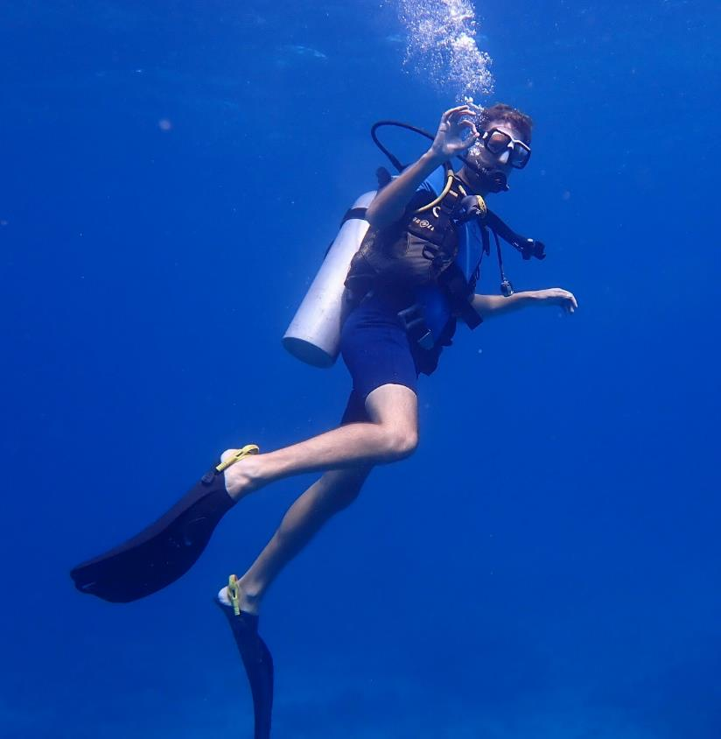
How does pressure vary with depth?
What do you feel if you dive down underwater?
How can you safely scuba dive to a depth of 20 m?

Slide 12
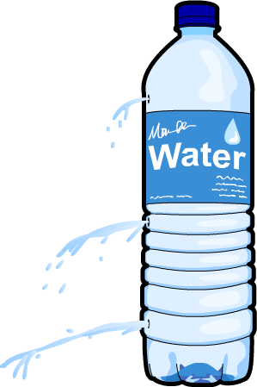
How does pressure vary with depth?
Copy & Complete
Pressure depends on the weight of fluid above you.
As you go deeper in water, the pressure _________ because the weight of water above you is________.
low pressure
increases
high pressure
greater

Slide 13
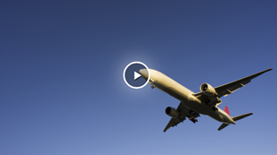

Slide 14
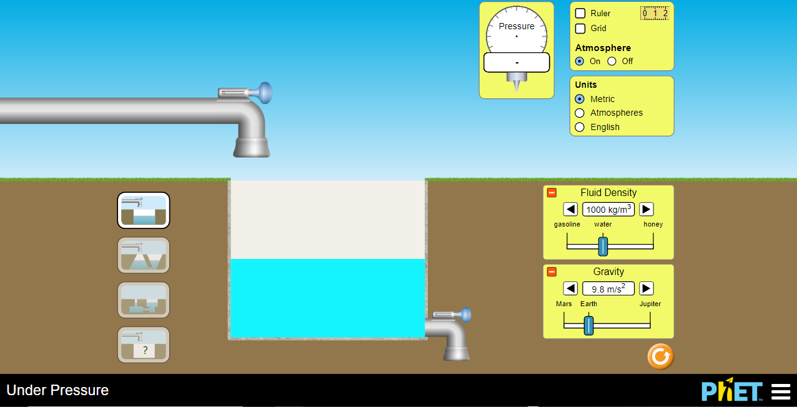

Slide 15
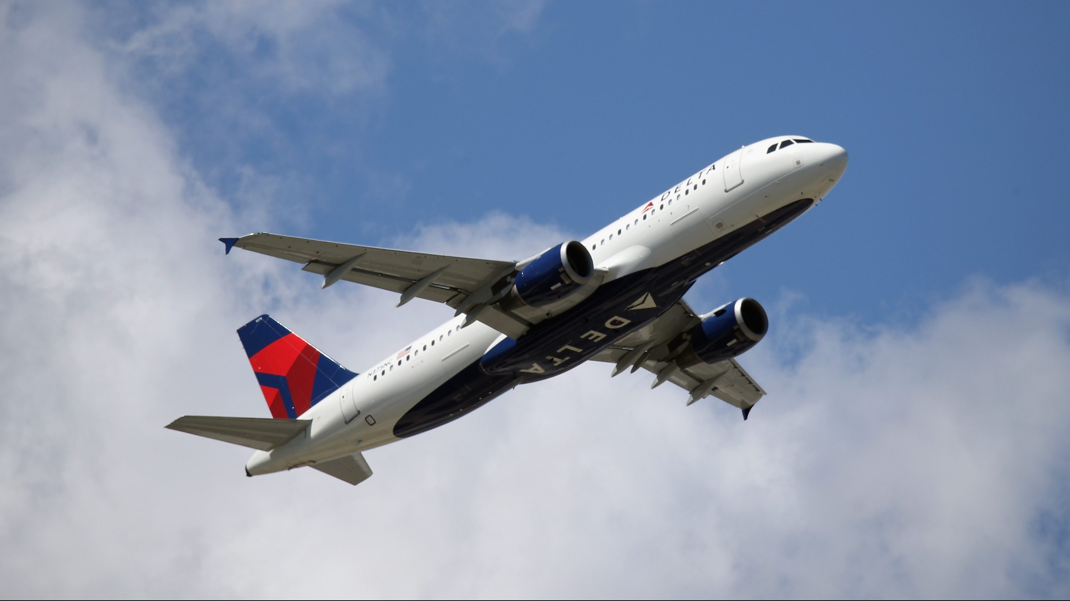
Copy & Complete
As you go higher in the air, the pressure __________ because the weight of air above you is_______.
decreases
lower

Slide 16
What is compressed air? Compare its pressure to normal air.
Explain what happened to the bubbles in the divers blood as she went upwards.
Why did the helicopter have to stay low?
Explain how the recompression chamber helped the diver recover from “the bends”.

Slide 17
https://www.youtube.com/watch?v=-zvCUmeoHpw

Slide 18
https://www.youtube.com/watch?v=-zvCUmeoHpw

Slide 19
What is compressed air? Compare its pressure to normal air.
Explain what happened to the bubbles in the divers blood as she went upwards.
Air that has been squashed into a smaller volume. It has a higher pressure than normal air.
The bubbles got bigger because the air pressure outside the bubble decreased. (The pressure inside the bubble stayed the same as before, so the overall force is outwards and the bubble expanded.)

Slide 20
Why did the helicopter have to stay low?
Explain how the recompression chamber helped the diver recover from “the bends”.
So that air pressure was a large as possible, to keep the bubbles in her blood small.
The pressure is very large in the chamber (like when deep underwater), so this reduces the size of the bubbles in her blood. The pressure can then be reduced to atmospheric pressure slowly.

Slide 21
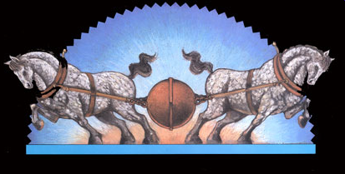
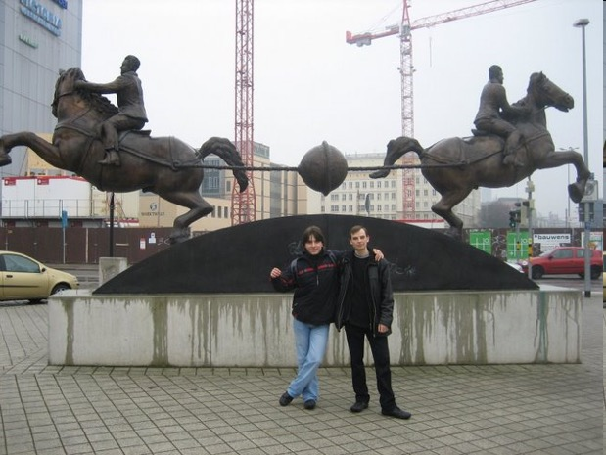
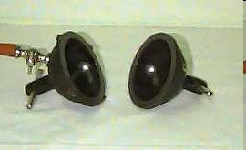
Magdeburg Hemispheres
Why couldn’t the horses pull apart the 2 hemispheres?

Slide 22
https://www.youtube.com/watch?v=-zvCUmeoHpw

Slide 23
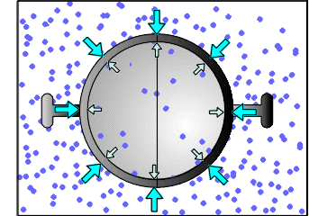
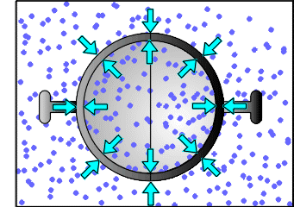
Which hemispheres would you be able to pull apart & why?

Slide 24
Magdeburg Hemispheres
Copy & Complete
When the air is pumped out from between the 2 hemispheres, they cannot be pulled apart, because:
there are ____ collisions inside than outside
so the _____ is less inside than outside
so there is an overall force acting _______, stopping you pulling them apart.
less
force
inwards

Slide 25
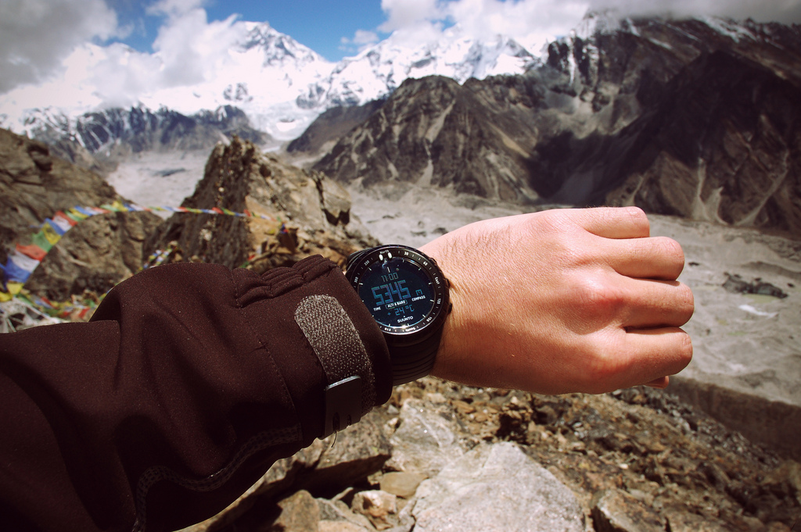
How do mountaineers know how high they are?

