Slide 1
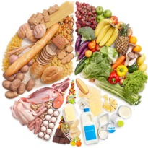
CW
8Aa Nutrients
Define the word diet?
Where do nutrients come from?
Name some nutrients?
@hpscience

Slide 2
Possible practical – Testing food. Will take a whole lesson to do properly.
Iodine
Biurets
Filter paper
Different food
This is a triple award practical in year 10

Slide 3
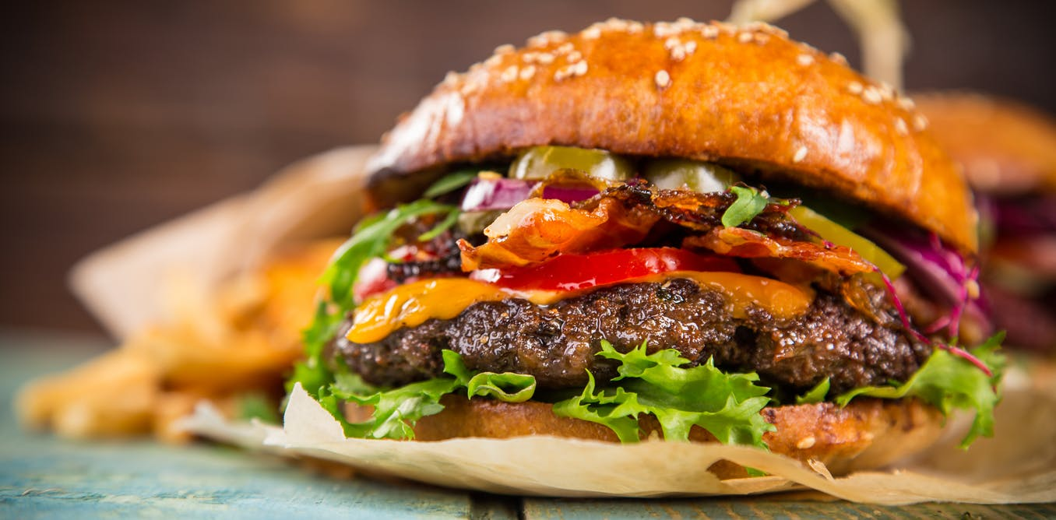
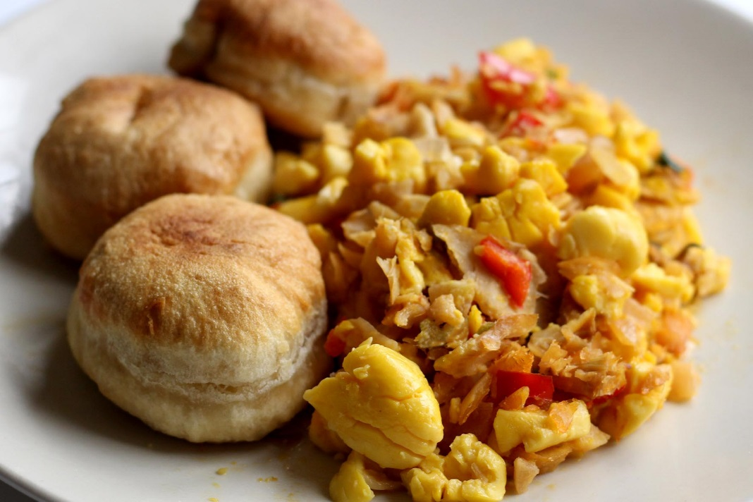
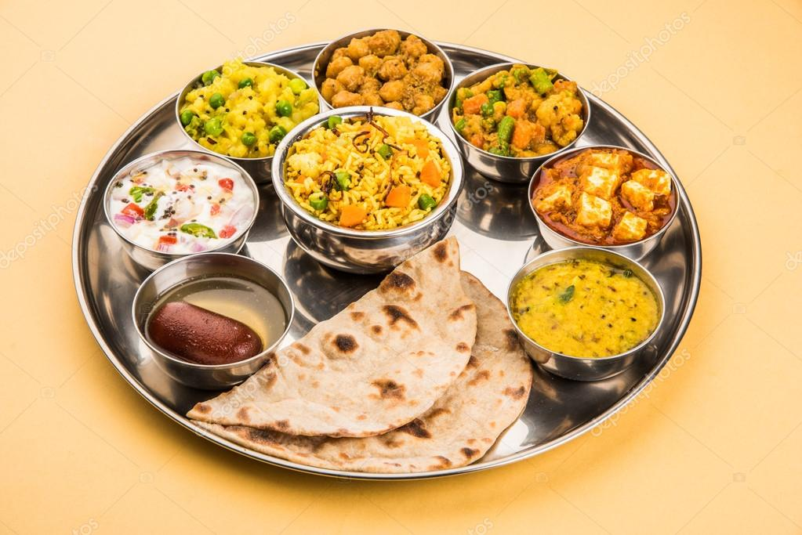
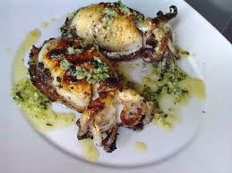
Diet - the food you eat
Your food provides the raw materials which are needed to keep you healthy, give you energy, make you grow and help you repair your bodies.

Slide 4
Name the nutrients.
These raw materials are known as nutrients.
Carbohydrates
Fats
Protein
Vitamins
Minerals
C
F
P
V
M
We learn what these nutrients do and where they come from in the next lesson

Slide 5
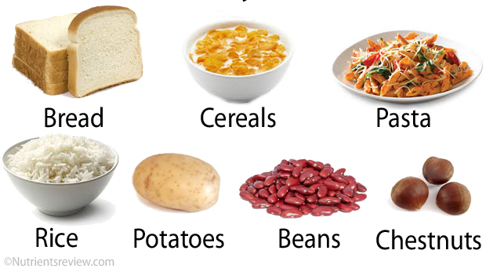
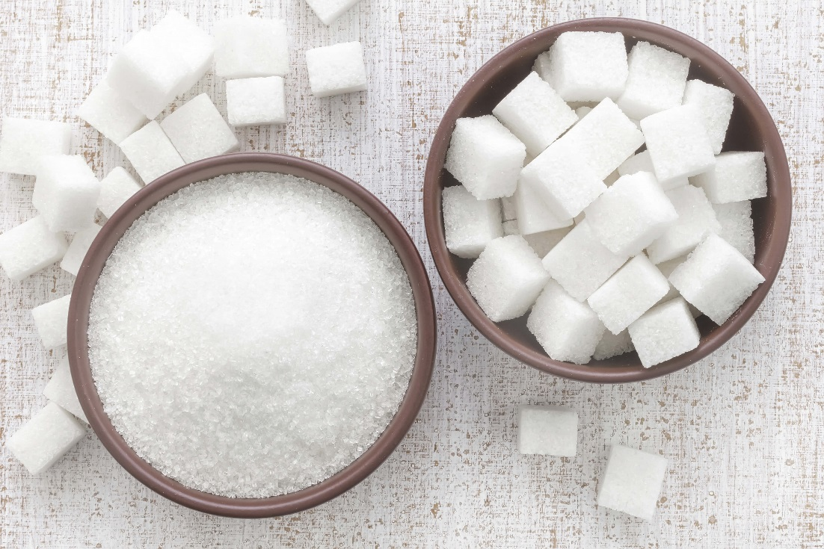
There are two main types of carbohydrates; starch and sugar.
There are two main types of carbohydrates; s____ and s____

Slide 6
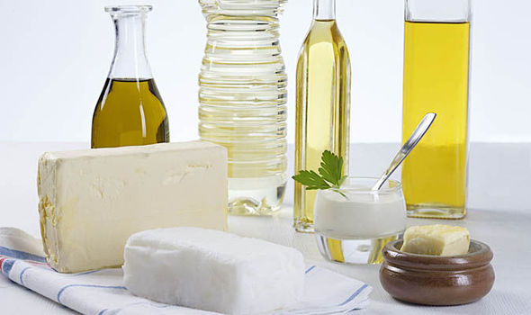
At room temperature fats can be either solid, e.g. butter, or liquid, e.g. olive oil.
Fat is essential in our diet but too much can be unhealthy.

Slide 7
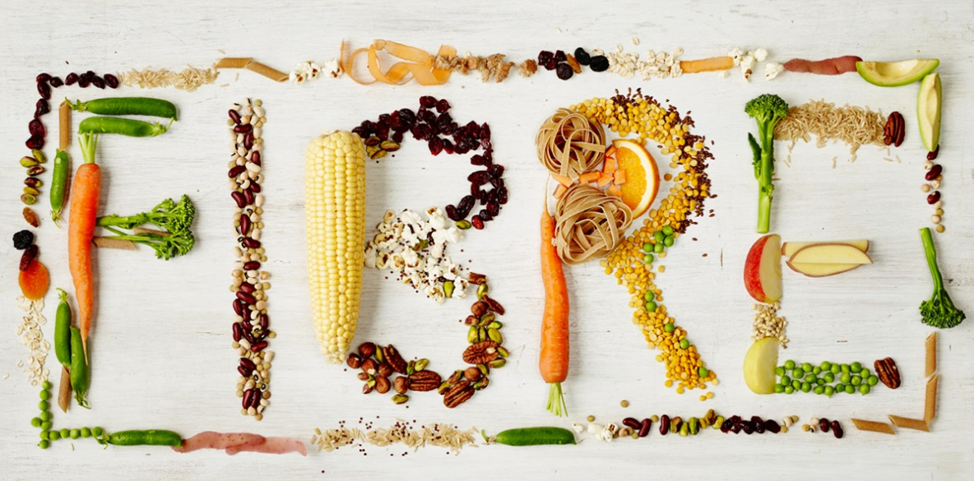
We also need water and fibre in our diet. However, these are not classed as nutrients.
Fibre is made of plant cell walls. We do not digest or absorb fibre.
Fibre keeps us healthy by moving food through the intestine and stops constipation.

Slide 8
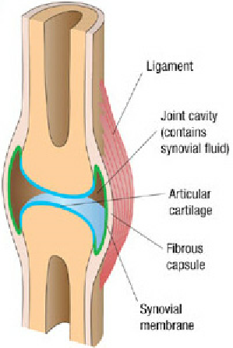
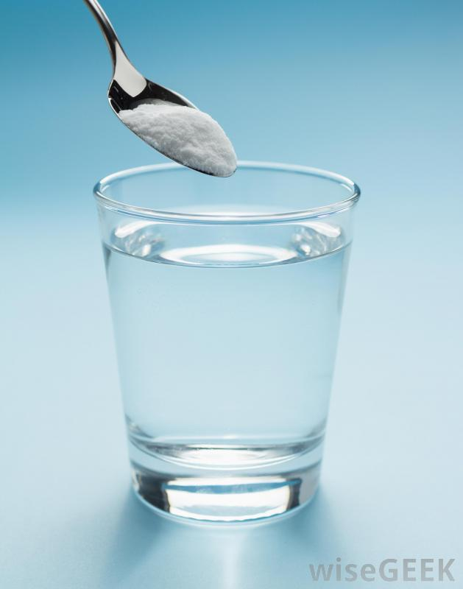
Water is essential. It is needed for;
Lubrication (in joints)
Dissolving substances (e.g. blood)
Cytoplasm
Cooling the body (s______ )
weating

Slide 10
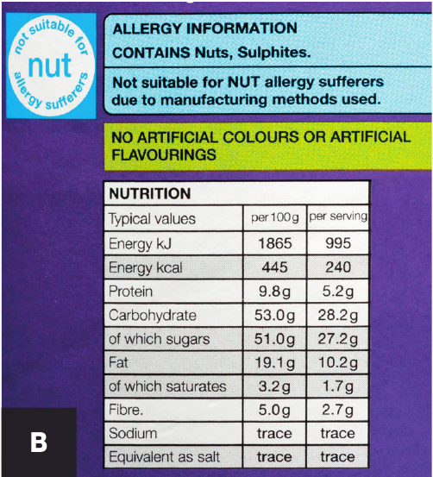
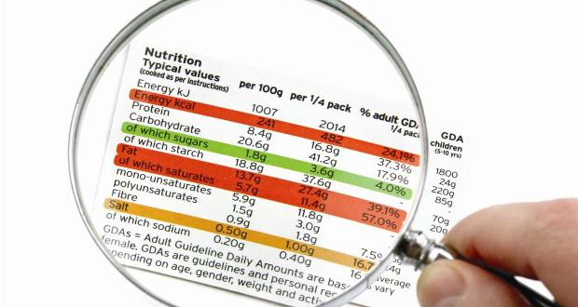
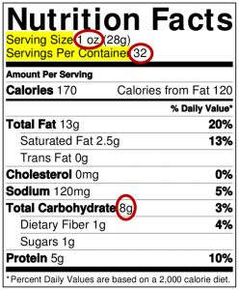
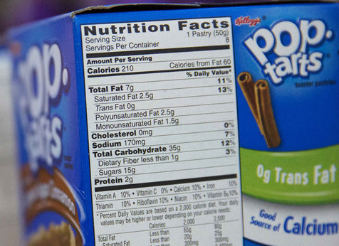
What are these and what are they for?
You may have some on the food in your bag.

Slide 11
Food labelling
Some of the food we eat has a label on it that tells us nutritional information.
We can see the amounts of the different nutrients it contains.
You can compare different foods by comparing the ‘per 100g’ values. Serving size varies and so is not a good comparison.

Slide 12
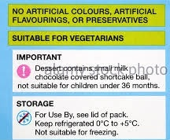
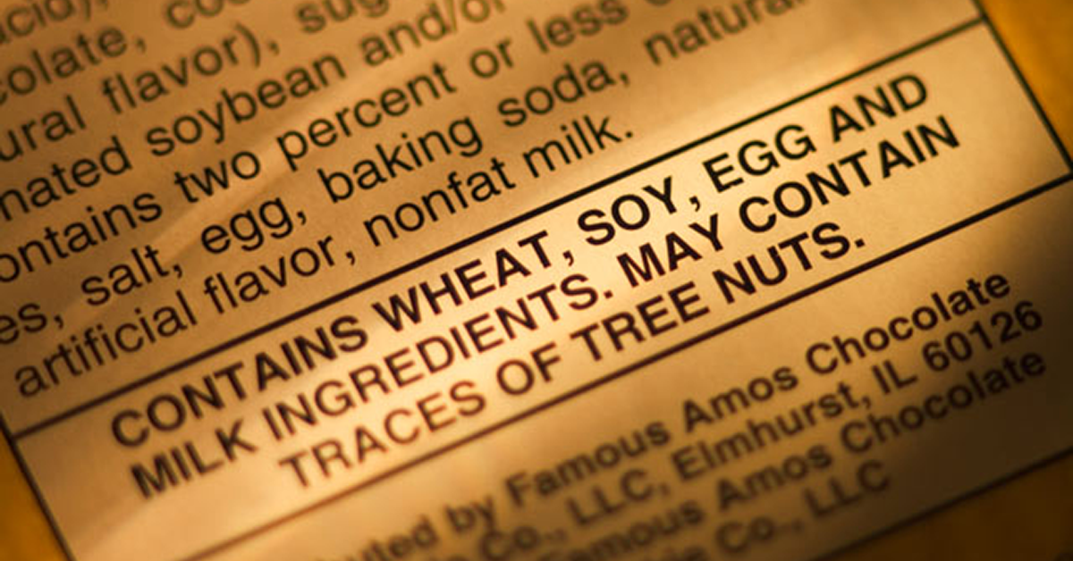
Food labels also show;
the amount of fibre and energy the food contains
ingredients that might cause allergies or not be suitable for some people

Slide 13
Possible practical – Testing food. Will take a whole lesson to do properly.
Iodine
Biurets
Filter paper
Different food
This is a triple award practical in year 10

Slide 14
There are a series of worksheets for the food tests.
I would not print all of these worksheets.
8aa4 – testing foods is a good work sheet the rest just give intructions.

Slide 16
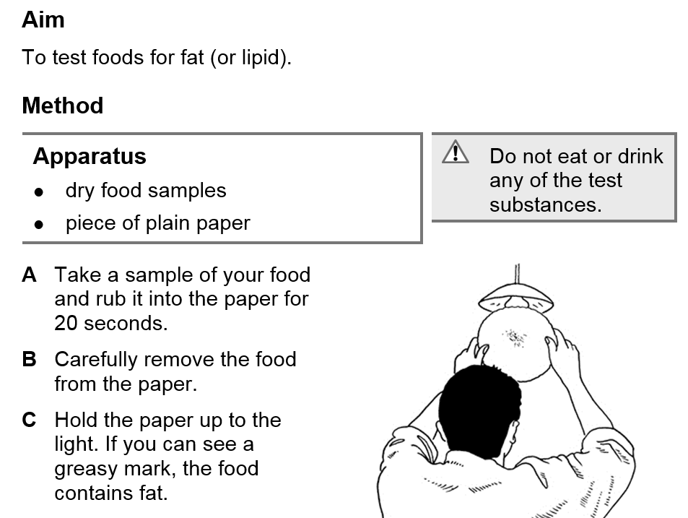

Slide 19
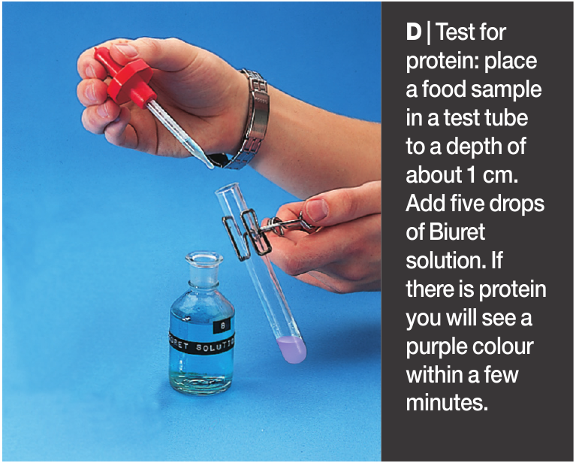

Slide 20
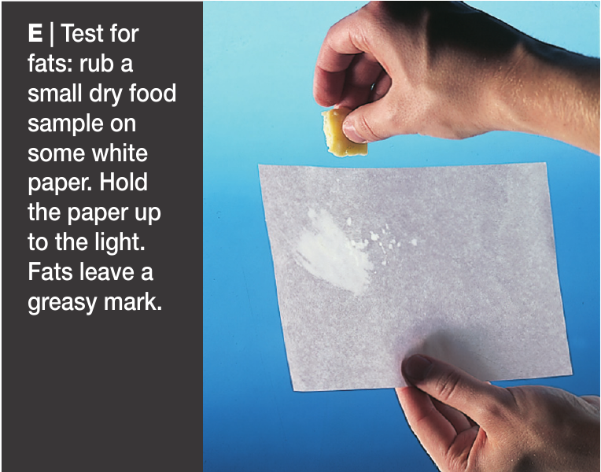

Slide 26
https://www.activeteachonline.com/default/player/interactive/id/350152/external/0
Do this task on ALDS

Slide 28
Objectives
Correctly use the term: diet.
Recall why we need food (energy, growth and repair, health).
State what is shown on food labelling.
Recall the names of the nutrients in food.
Interpret nutrition information labels.
Use nutrition information labels to perform calculations.

Slide 29
Objectives
Describe the uses of fibre and water by the body.
Describe tests for fat and starch.
Interpret results from simple food tests (e.g. fat, starch, protein, vitamin C).

Slide 30
Objectives
Interpret results from food tests for reducing and non-reducing sugars (glucose and sucrose).

