Slide 1
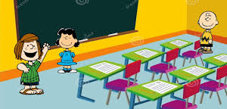
Module 2 – En classe
Quelle est la date aujourd’hui?

Slide 2
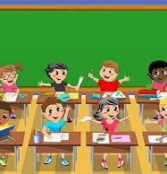
Objectives
To learn about some important French historical figures
To use our knowledge of cognates to work out the school subjects in French
To learn about some of the differences between French and British schools

Slide 4
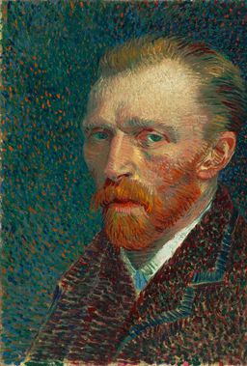
Vincent Van Gogh
Vincent Willem van Gogh (30 March 1853–29 July 1890) was a Dutchpost-impressionist painter. His work had a great influence on modern artbecause of its striking colours and emotional power. He suffered from anxiety and fits of mental illness. When he was 37, he died from shooting himself in the chest.
When he was a young man, Van Gogh worked for a company of art dealers. He traveled between The Hague, London and Paris. After that, he taught in England. He then wanted to become a pastor and spread the Gospel, and from 1879 he worked as a missionary in a mining place in Belgium. He began drawing the people there, and in 1885, he painted his first important work, The Potato Eaters. He usually painted in dark colors at this time. In March 1886, he moved to Paris and found out about the French impressionists. Later, he moved to the south of France, and the colors in his art became brighter. His special style of art was developed and later fully grown during the time he stayed in Arles in 1888.

Slide 5
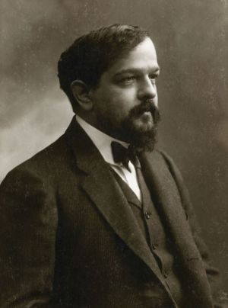
Charles Debussy
Achille-Claude Debussy (born St Germain-en-Laye, 22 August 1862; died Paris, 25 March, 1918) was a French composer. He was one of the most important composers of the early 20th century. Most of his compositions are for orchestra or for piano. He also wrote some songs, chamber music and one opera. He made his music very different from the Romantic style that other composers were using at the time. He is often called an Impressionisticcomposer because he was influenced by the group of painters called “Impressionists”. They were not so much interested in making their paintings look exactly like the real world, but preferred to paint things such as the effect of the sunlight shining on water. Debussy often did this in his music, which creates a special atmosphere.

Slide 6
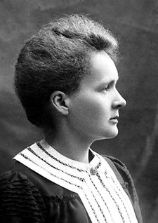
Marie Curie
Marie Curie (7 November 1867 – 4 July 1934) was a Polish and Frenchphysicist, chemist and feminist. She did research on radioactivity. She was also the first woman to win a Nobel Prize. She was the first woman professor at the University of Paris. She was the first person to win two Nobel Prizes. She received a Nobel Prize in physics for her research on uncontrolled radiation, which was discovered by Henri Becquerel.

Slide 7
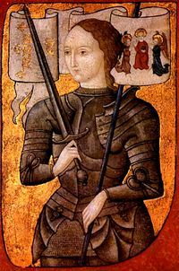
Jeanne D’Arc
Joan of Arc (6 January c. 1412 – 30 May 1431), nicknamed "The Maid of Orléans", is considered a heroine of France for her role during the Hundred Years' War, and was canonized as a Roman Catholic saint. She was born to Jacques d'Arc and Isabelle Romée, a peasant family, at Domrémy in north-east France.
Joan claimed to have received visions of the Archangel Michael, Saint Margaret, and Saint Catherine of Alexandria instructing her to support Charles VII and recover France from English domination late in the Hundred Years' War. The uncrowned King Charles VII sent Joan to the siege of Orléans as part of a relief mission. She gained prominence after the siege was lifted only nine days later. Several additional swift victories led to Charles VII's coronation at Reims. This long-awaited event boosted French morale and paved the way for the final French victory.
On 23 May 1430, she was captured at Compiègne by a group of French nobles allied with the English. She was later handed over to the English and put on trial on a variety of charges. After she was declared guilty she was burned at the stake on 30 May 1431, dying at about nineteen years of age.

Slide 8
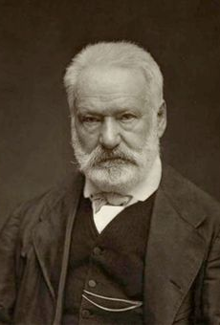
Victor Hugo
Victor Marie Hugo (26 February 1802 – 22 May 1885) was a French poet, playwright, novelist, statesman and human rights activist. He played an important part in the Romantic movement in France.
Hugo first became famous in France because of his poetry, as well as his novels and his plays. Les Contemplations and La Légende des siècles are his most famous poetry collections. Outside of France, his novels Les Misérables and Notre-Dame de Paris (known in English also as The Hunchback of Notre-Dame) are his most famous works.
When he was young, he was a conservative royalist. As he got older he became more liberal and supported republicanism. His work was about many of the political and social problems as well as the artistic trends of his time. He is buried in the Panthéon, in Paris.

Slide 9
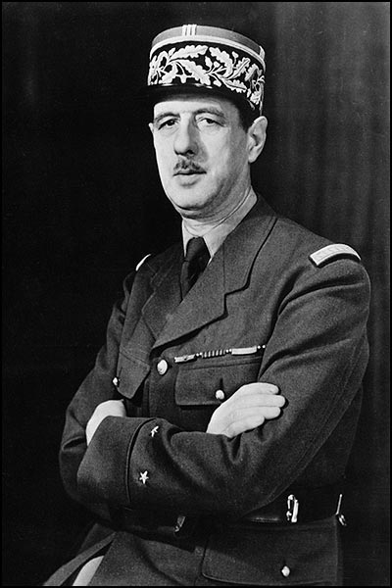
Charles De Gaulle
General Charles-André-Joseph-Marie de Gaulle (22 November 1890 - 9 November 1970) was a French military and political leader. Charles de Gaulle (1890-1970) was the dominant military and political leader of France, 1940-1969. Fleeing the victorious German invaders in 1940, he set up his base in London, proclaimed himself the incarnation of France, created the Free France movement, rallied the overseas colonies (especially in Africa), organized the French Resistance, and tried, but failed, to gain full recognition from the British and Americans. He retired from office in 1946, but returned in 1958 as France verged on civil war over the Algeria crisis. As president (1958-69) during the Fifth Republic, he revised the constitution to provide for presidential control of foreign and military policy, granted independence to Algeria and the African colonies, and restored the nation's economic health. Forging a close bond with Germany, he sought to dominate the European Common Market by vetoing British entry and holding the U.S. at arms length. Exhausted politically and emotionally, he finally left office in 1969. His reputation as the strongest and greatest of French leaders since Napoleon continues into the 21st century.

Slide 10
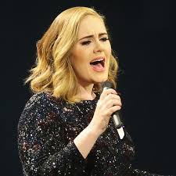
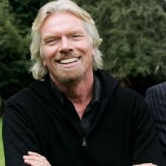
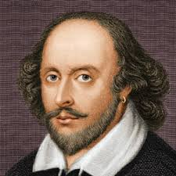
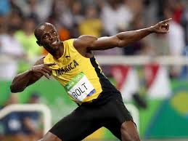
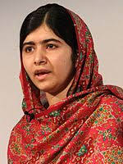
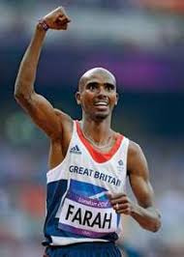
Who would you name your school after?

Slide 12
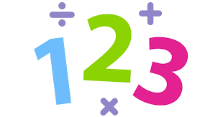
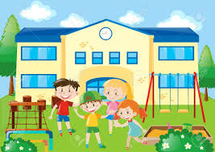
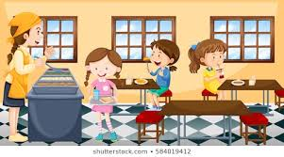

Slide 13
Tu aimes les maths?
Oui, j’aime les maths car c’est amusant
Non, je n’aime pas les maths car c’est ennuyeux.
Can you make your own sentences about other subjects?

Slide 15
Regarde le vidéo sur les écoles en France

Slide 16
Objectives
To learn about some important French historical figures
To use our knowledge of cognates to work out the school subjects in French
To learn about some of the differences between French and British schools

