Slide 1
Objectives
Correctly use the term: base.
Recall some applications of neutralisation (antacids, toothpastes, treating waste gases, rust removal).
Describe the reactions of acids with bases.
Explain how everyday examples of neutralisation are useful (antacids, toothpastes, treating waste gases, rust removal).
Describe how to produce a solution that is only a salt and water using the reaction between an acid and an alkali or insoluble base.

Slide 2
CW
7Fe neutralisation in daily life
Starter: complete the equation
Acid + base → ______ + _______
What is a base?
@hpscience

Slide 3
Neutralisation in daily life
18/07/2018
C/W
When an acid and an alkali are m_________, there is a chemical r________. This reaction is called n_________. If the right a________ of acid and alkali are mixed, the solution becomes n_________.
Examples:
Extension:
List some everyday examples of neutralisation.
7 acidic alkaline amounts antacids bodies cancel
constant diluting heartburn higher lower mixed
neutral neutralisation reaction weaker

Slide 4
Watch the video on neutralisation
Can you add to your list as you watch the videos?
Notes:
https://www.twig-world.com/film/acids-and-alkalis-part-2-1457/

Slide 5
Can you add to your list as you watch the videos?
Antacids used to treat indigestion or heartburn. They contain b_____ to help n__________ the acid.
The food you eat produces acids in your mouth which can decay teeth. Toothpastes contain b________ which r______ with acids in your mouth.

Slide 6
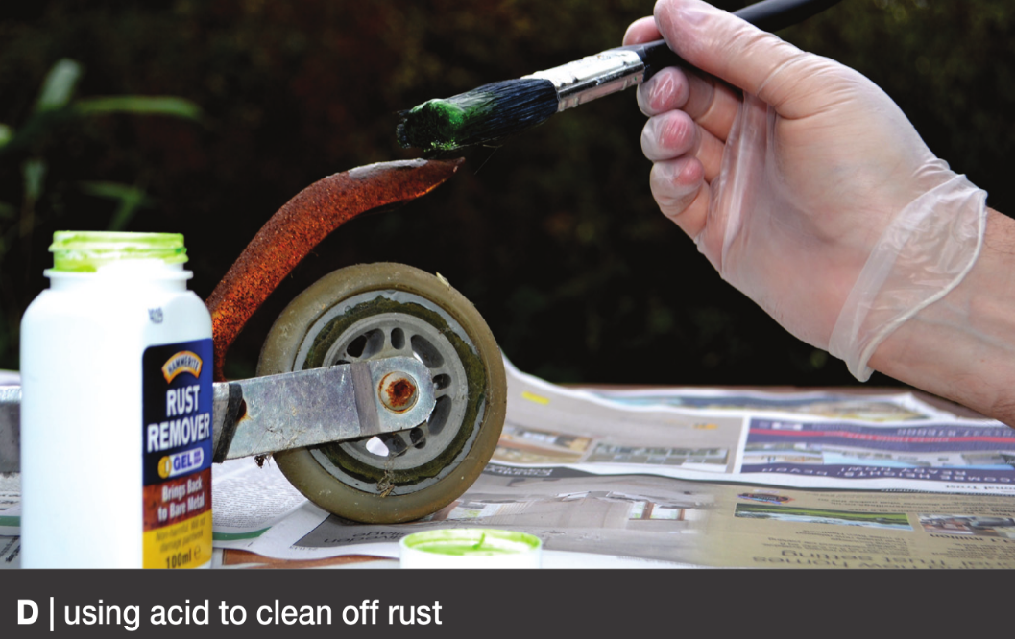
Can you add to your list as you watch the videos?
Acids can be used to clean metals which have rusted.
Acidic waste gases from industries are neutralised by alkali before being released into the atmosphere

Slide 7
Neutralizing stings
A bee sting
is acidic.
A wasp sting
is alkaline.
How can you treat a bee/wasp sting?

Slide 8
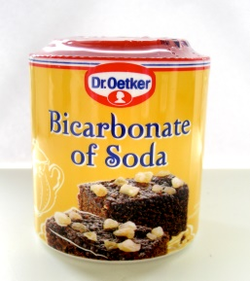
You get stung by a bee. A bee sting is acidic. What substance can you use to neutralise the sting?
You could use a weak alkali, to neutralise the bee sting.
An example would be bicarbonate of soda.

Slide 10
Practical – indigestion- finding the best indigestion remedy
Copy the table into your books.
Tables MUST be drawn neatly.
Table of Results

Slide 11
Practical – indigestion- finding the best indigestion remedy
Risk Assessment and Health and Safety
Must wear goggles.
Acids and Alkalis are corrosive therefore must be handled safely and sensibly.
You will be working in pairs.
Anyone seen misbehaving will be sent out and banned from doing practicals for this unit!!

Slide 12
Practical – Testing whether a substance is an acid or alkali?
Equipment
Apparatus
4 large test tubes
stirring rod
test tube rack
universal indicator paper
measuring cylinder
hydrochloric acid
4 samples of indigestion remedies

Slide 13
Practical – indigestion- finding the best indigestion remedy
method
A Measure out 10 cm3 of hydrochloric acid into each of the large test tubes. Stand the test tubes
in the test tube rack.
B One at a time, put the small amount of each antacid you have been given into a separate test
tube. After adding each amount, record the name of the remedy in the table.
C Stir the mixture in each test tube.
D After two minutes, dip a piece of pH paper in the first test tube and record the colour and pH
number. Record what the mixture looks like. Do the same with the other test tubes.alkali or neutral.

Slide 15
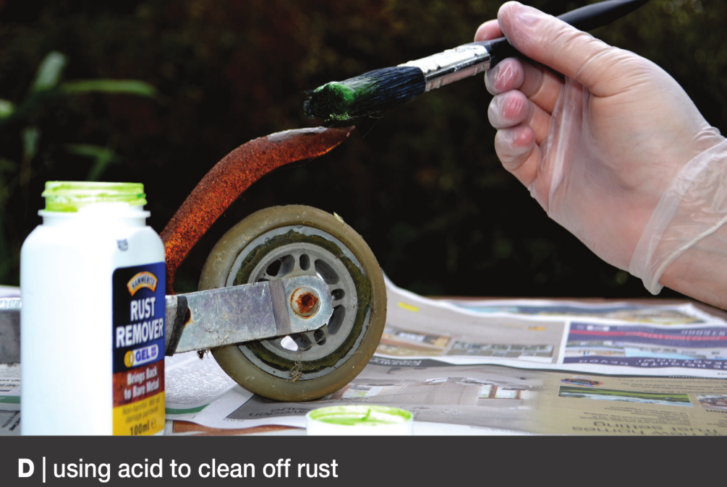

Slide 16
Answers

