Slide 1
CV writting

Slide 2
OBJECTIVES: - Understand how well written CV can escalate your career - Recognise the specific parts of well written CV - Tips on how to build great knowledge & skills to build up your CV - How to build up CV even with no experience

Slide 3
Vendula Novosadová
E-commerce, Vlogging equipment Social media content creation
Banking, Portfolio management
vendynovosadova@gmail.com

Slide 4
Write down:
- Are you clear on your dream job/business? - What area/activities/industry do you feel excited about? - Would you like to work in other city/country?

Slide 5
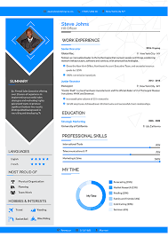
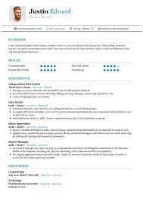
CV = LinkedIn
With 55 million companies listed there, 87% of companies use LinkedIn regularly to find new candidates
LinkedIn should reflect your CV + you have more space here to show off all your achievements/certificates/skills
CV styling
Is your role/industry in serious/creative area?
CV for local graphic design studio x large bank
Remember – big companies are using CV scanner software,
don’t use over-complicated fonts
Have 1 CV for each industry/role
Use free templates available online

Slide 6
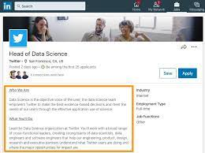
LinkedIn research for your CV
Find you ideal role, look at 10 different job postings of this job
Write down the keywords:
What the ideal candidate should know/have/experience
What is the role daily activity/daily tasks/expected tasks
Fit these keywords to your experience/courses/certificates - Don’t include extra information which doesn’t help you (don’t speak about Biology knowhow when you want to become graphic designer)
Why? Recruiters have job descriptions/use LinkedIn search bar to look for these keywords. Optimised CV & LinkedIn should give you attention. It takes 7 seconds for a recruiter to decide whether you are worth the interview

Slide 7
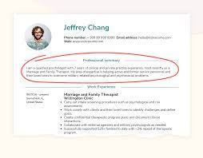
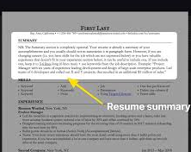
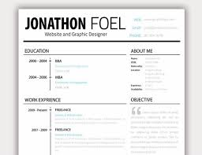
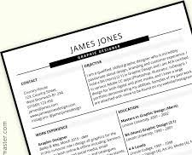
Header
First name + Surname City (current, or based on where you want to relocate) Phone number Personal email
Summary
Pick 3 top achievements
Ideally don’t repeat the same sentence, re-write the information
Use pattern: powerful verb + subject + purpose/extra info
#keywords

Slide 8
EXPERIENCE:
Job title, Company name, City 2021 – present
Interpreted xxx data and understood xxx
Created xxx and maintained xxx
Prepared xxx to do xxx
Completed 7/13/34 within xxx time (use messy number)
Use pattern: powerful verb + subject + purpose/extra info
#keywords

Slide 9
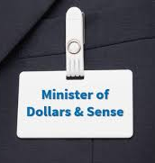
EXPERIENCE:
Always state the most recent experience on the top and go back to the past
Job title: be careful how to use them, use the real name, or justify
Trick:
X Analyst, XYZ UK Ltd, Milton Keynes 2015 – 2019
Alongside my X Analyst I was also fully covering a Y role and achieved:
• Reduced A by improving BCD
• Managed F to meet GHI, created JKL
• Raised a daily profit margin by 13% through MNO
#keywords

Slide 10
INTERNSHIPS:
XYZ Banking & GHI Internship (Forage) 2021
Analysed KLM, explained OPQ
Completed RST and calculated UVW
Free online/virtual internships which you can attend from your home:
Forage (internships: accounting, consulting, engineering, finance, human resources, public health, tech, etc) Bright Network (internship: banking, accounting, marketing, law, consulting, business) Research: X virtual internship / X certificate on Google
#keywords

Slide 11
EDUCATION:
A-Levels, High school of South London, 2019-2022 (Math – B, English – A, Biology – C)
High school of South London, 2019-2022 (Mathematics, Statistics, IT) - keywords
Online/virtual certifications/projects which you can complete from your home:
Bloomberg (certificate: only banking/trading/macroeconomics focused) Hubspot Academy (certificate: Marketing – all kinds) Coursera – courses and project (certificate and projects: all industries, monthly membership fee, check the discounts)
Research: X certification/ X project If you can’t find your exact dream job skills, do general skills which will always come handy (IT, Business, Accounting)

Slide 12
SKILLS:
Inbound Marketing Certification (Social media, Email marketing)
Python, SQL
Teaching
Presentation skills
Languages: French, Spanish
If you miss a certain skill, you can research/learn many things from Youtube/project & courses mentioned before
#keywords

Slide 13
Let´s stay in touch!
Thank you!

